Slide 1


Adversarial Prefetch: New Cross-Core Cache Side Channel Attacks
Yanan Guo¹, Andrew Zigerelli, Youtao Zhang¹, Jun Yang¹
¹University of Pittsburgh
S&P 2022

Slide 2
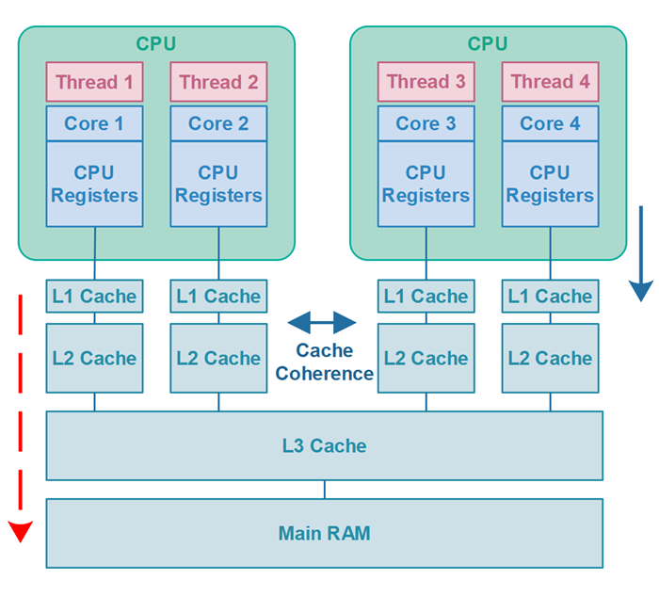
CPU Cache
CPU speed increases
Latency of DRAM is too high
Problem: DRAM is a bottleneck
Solution: Caches - fast/small memory buffers
On Intel desktop processors
Cache: less than 60 cycles.
DRAM: over 200 cycles.
http://tutorials.jenkov.com/java-concurrency/cache-coherence-in-java-concurrency.html

Slide 3
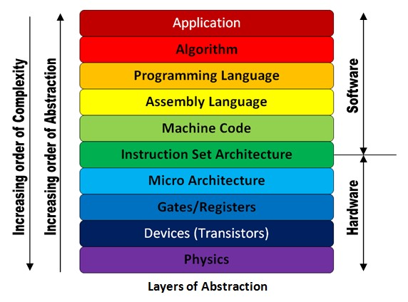
Memory accesses are cached
Every memory reference goes through the cache
Transparent to OS and programs
Cache is at microarchitecture level
https://electronics.stackexchange.com/questions/353915/what-is-the-role-of-isa-instruction-set-architecture-in-the-comp-arch-abstract

Slide 4
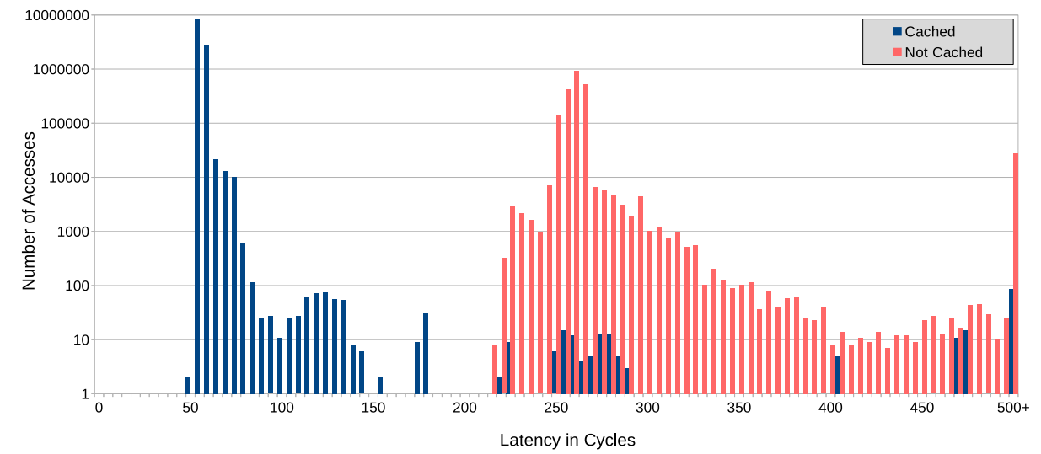
Memory Access Latency
However, timing leaks everything…

Slide 5
Unprivileged Cache Maintenance
User programs can optimize cache usage
E.g. CLFLUSH: throw out data from all caches
… based on virtual addresses

Slide 6
A little bit more about cache
Set-associative cache
Memory Addr
Tag
Set index
Block offset
Way 0
Way 1
Way 2
Way 3
n bits
b bits
Set 0
Set 1
Tag0
Tag1
Tag2
Tag3
0001
…
Cache hit: Tags match
Cache miss: Tags do not match
(If the set if full, one of the set is evicted)
Set 2^{n}
4-Way Associative Cache

Slide 7
A little bit more about cache
Cache hierarchy
Inclusive cache: early desktop CPUS
Non-inclusive cache: server CPUs and recent desktop CPUs
Core 0
Core 1
Private
caches
Last-level cache (LLC)

Slide 8
A little bit more about cache
Cache hierarchy
Inclusive cache: early desktop CPUS
Non-inclusive cache: server CPUs and recent desktop CPUs
Core 0
Core 1
Core 0
Core 1
Private
caches
Private
caches
Inclusive LLC
Non-inclusive LLC
A separate array to track the data in private caches is necessary

Slide 9
Cache Side-channel Attacks
The attacker learns a victim’s cache accesses by monitoring cache states
Software attack
Can cross software-level boundaries
Hard to detect
Cache attacks in practice
Cache based keylogging
Crypto key recovery (RSA, AES, ECDSA…)
cross-VM, cross-core, even cross-CPU
Any architecture (Intel, AMD, ARM)

Slide 10
Cache Side-channel Attacks
The attacker learns a victim’s cache access by monitoring cache states.
Can cross software-level boundaries
Hard to detect
Same-core attacks and cross-core attacks
Same-core attacks
Can work on the private cache.
Usually require hyper-threading.
Cross-core attacks
Usually work on the LLC.
Arguably more practical.
Victim
Attacker
Private Cache
Private Cache
Last-Level Cache

Slide 11

Cache Side-channel Attacks
The attacker learns a victim’s cache access by monitoring cache states.
Can cross software-level boundaries
Hard to detect
Same-core attacks
Can work on the private cache.
Usually require hyper-threading.
Cross-core attacks
Usually work on the LLC/Directory.
More practical.
Victim
Attacker
Private Cache
Private Cache
Last-Level Cache

Slide 12
How do cache attacks work?

Slide 13
Three-Step Model
Attacker and victim
different processes
Running on the same platform (but different cores)
Step 1: Attacker evicts the victim’s data (cache line)
Step 2: Attacker waits for victim’s execution
Step 3: Attacker checks whether the victim brought the data back to cache
Repeating these three steps, attacker learns victim’s access pattern

Slide 14
Flush+Reload
Step1: attacker flushes victim’s data
How can she flush?
Data is shared between attacker and victim
Shared library
Page deduplication

Slide 15
Flush+Reload

Slide 16
Flush+Reload

Slide 17
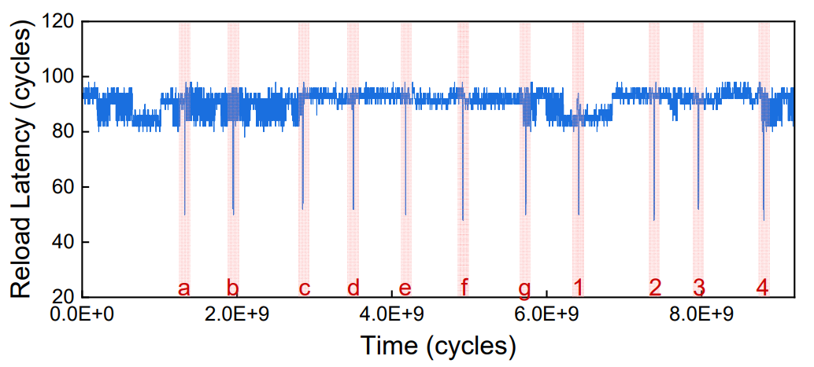
Keystroke Logger
GUI library: GTK
Certain functions are called in libgdk.so upon keystrokes
If we attack addr 0x7b980 of libgdk.so (0.1000.8)
… and the victim is typing “abcedfg…” in gedit.

Slide 18
Flush+Reload
The victim’s data is evicted from the LLC and private caches.

Slide 19
Can we build a cross-core attack that only evicts from the private cache?

Slide 20
Cross-Core Private Cache Attack
New Attack
Higher bandwidth
Higher resolution
Stealthier

Slide 21
Three-Step Model
Attacker and victim
Separate processes
Running on the same platform
Step 1: Attacker evicts the victim’s data, from the private cache only!
Step 2: Attacker waits for victim’s execution
Step 3: Attacker checks whether the victim brought the data back to cache
Repeating these three steps, attacker learns victim’s access pattern

Slide 22
Can we use existing eviction methods?

Slide 23

Cross-Core Private Cache Attack
Eviction methods
CLFLUSH
Set Conflicts
Way 0
Way 1
Way 2
Way 3
Set 0
Set 1
V
A1
A2
A3
…
Set n

Slide 24
Cross-Core Private Cache Attack
Eviction methods
CLFLUSH
Set Conflicts
Way 0
Way 1
Way 2
Way 3
Set 0
Set 1
A4
A1
A2
A3
…
Set n

Slide 25
New eviction method?

Slide 26

Cross-Core Private Cache Attack
New eviction method is necessary
Cache coherence protocol?
MESI protocol.
Exclusive ownership
Can read/write the private cache copy
Shared
Read only
Require for ownership, should only happen upon writes

Slide 27
Can we cause RFO without writing the cache line?

Slide 28
Cross-Core Private Cache Attack
x86 data prefetching instructions
PREFETCHT0, PREFETCHT1, PREFETCHT2 …, for reads.
PREFETCHW, for writes.
PREFETCHW
It prefetches the data into the private cache and changes the coherence state to Modified.
On Intel Core i7-6700, Core i7-6800K, Core i7-7700K, Core i9-10900X,
Property 1: PREFETCHW works on read-only data.
Property 2: PREFETCHW has timing variance.
PREFETCHW is available since Broadwell.
Are the two properties always true on Intel processors?

Slide 29
PREFETCHW Characterization
Processor | Microarch. | LLC Type | Property #1 | Property #2
Core i7-6700 | Skylake | Inclusive | Yes | Yes
Core i7-6800K | Skylake | Inclusive | Yes | Yes
Core i7-7700K | Kaby Lake | Inclusive | Yes | Yes
Core i9-10900X | Cascade Lake | Non-inclu. | Yes | Yes
Xeon Silver 4114 | Skylake-SP | Non-inclu. | Yes | Yes
Xeon Plat. 8151 | Skylake-SP | Non-inclu. | Yes | Yes
Xeon Plat. 8124M | Skylake-SP | Non-inclu. | Yes | Yes
Xeon Plat. 8175M | Skylake-SP | Non-inclu. | Yes | Yes
Xeon Plat. 8259CL | Skylake-SP | Non-inclu. | Yes | Yes
Xeon Plat. 8275CL | Skylake-SP | Non-inclu. | Yes | Yes
Xeon Plat. 8375C | Ice Lake | Non-inclu. | Yes | No

Slide 30
Two cross-core private cache attacks:
Prefetch+Prefetch and Prefetch+Reload

Slide 31
Prefetch+Prefetch

Slide 32
Prefetch+Prefetch
Can we load and time the load instead?
Not by the same attacker’s thread.

Slide 33
Prefetch+Prefetch
Can we load and time the load instead?
Not by the same attacker’s thread.
What if the attacker has a second thread?

Slide 34
Prefetch+Reload

Slide 35
Prefetch+Reload

Slide 36
Experiments

Slide 37
Experiments
Covert channel capacities (with one cache line)
Processor | Prefetch+Reload | Prefetch+Load | Prefetch+Prefetch
Core i7-6700 | 631 KB/s | 709 KB/s | 721 KB/s
Core i7-7700K | 782 KB/s | 840 KB/s | 822 KB/s
Xeon Plat. 8124M | 394 KB/s | 586 KB/s | 556 KB/s
Xeon Plat. 8151 | 476 KB/s | 680 KB/s | 605 KB/s

Slide 38
Experiments
Covert channel capacities (with one cache line)
Processor | Prefetch+Reload | Prefetch+Load | Prefetch+Prefetch
Core i7-6700 | 631 KB/s | 709 KB/s | 721 KB/s
Core i7-7700K | 782 KB/s | 840 KB/s | 822 KB/s
Xeon Plat. 8124M | 394 KB/s | 586 KB/s | 556 KB/s
Xeon Plat. 8151 | 476 KB/s | 680 KB/s | 605 KB/s
Flush+Reload: ~ 270 KB/s
Flush+Flush: ~ 570 KB/s

Slide 39
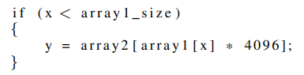
Experiments
Prefetch-based channels with transient execution attacks
Faster Encoding Operation
Remote private cache hits are usually much faster than DRAM accesses.
On Intel i7-6700, 80 cycles vs 250 cycles
Spectre v1 Gadget
When used with Flush+Reload, array2 is flushed.
Encoding access: DRAM access.
When used with Prefetch attacks, array2 stays in cache.
Encoding access: Remote L1 hit. We leak faster!

Slide 40
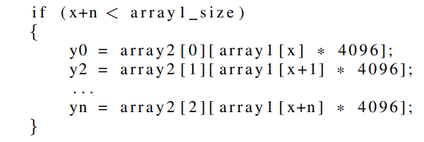
Experiments
Prefetch-based channels with transient execution attacks
Faster Encoding Operation
Remote private cache hits are usually much faster than DRAM accesses.
On Intel i7-6700, 80 cycles vs 250 cycles
Within a transient window, more encoding operations can be performed.
We leak more!
8 bytes can be leaked with Flush+Reload
17 bytes can be leaked with Prefetch+Prefetch

Slide 41
Experiments
Side channel attacks
Attacking the Square-and-Multiply Algorithm in GnuPG to leak the private key.
Attacking the GUI libraries to detect keystrokes.
Temporal resolution
locate the victim event in the time domain.
This is important, e.g., for AES T-table attack.

Slide 42
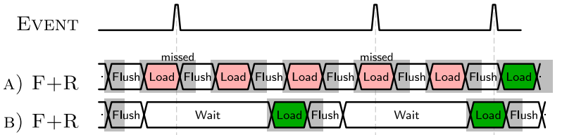
Experiments
Flush+Reload has to be used as a windowed attack
There is a waiting window in each attack iteration.
Resolution: > 5000 cycles (for >99% accuracy)
Prefetch+Prefetch can be used as windowless attack
Prefetchw is concurrent on all Intel processors.
Resolution: ~ 100 cycles

Slide 43
Contribution
Found the vulnerabilities in the implementation of PREFETCHW.
On almost all Intel processors since Broadwell.
Propose a new eviction method for cache attacks.
The first time cache coherence protocol is used for eviction.
Build two cross-core private cache side channel attacks.
Work with both inclusive and non-inclusive LLCs.
Build faster cache covert channels.
Double the amount of leakage in a Spectre-v1 transient window.

Slide 44
Take Away
ISA is very very important.
ISA defines what programmers are allowed to do.
It may not be a good idea to allow programmers directly manipulate micro-architectural states.
Without comprehensively understanding the ISA, secure cache designs might not be secure.
Academic secure cache design proposals mostly follow the “Invalidate_CLFLUSH + prevent_conflicts” direction.

Slide 45
Adversarial Prefetch: New Cross-Core Cache Side Channel Attacks
Yanan Guo¹, Andrew Zigerelli, Youtao Zhang¹, Jun Yang¹
¹University of Pittsburgh
Paper: https://arxiv.org/pdf/2110.12340.pdf
Artifacts: https://github.com/PittECEArch/AdversarialPrefetch

