Slide 1


Leaky Way: A Conflict-Based Cache Covert Channel Bypassing Set Associativity
Yanan Guo, Xin Xin, Youtao Zhang, Jun Yang
University of Pittsburgh

Slide 2






Cache Attacks

Slide 3
Conflict-Based Cache Attacks
Critical step: build cache conflicts to evict the victim’s data.
Prime+Probe, Prime+Scope, Evict+Reload…: requires priming the cache set.
Way 0
Way 1
Way 2
Way 3
Set 0
Set 1
V
…
Set n

Slide 4
Conflict-Based Cache Attacks
Critical step: build cache conflicts to evict the victim’s data.
Prime+Probe, Prime+Scope, Evict+Reload…: requires priming the cache set.
Way 0
Way 1
Way 2
Way 3
Set 0
Set 1
V
A1
…
Set n

Slide 5
Conflict-Based Cache Attacks
Critical step: build cache conflicts to evict the victim’s data.
Prime+Probe, Prime+Scope, Evict+Reload…: requires priming the cache set.
Way 0
Way 1
Way 2
Way 3
Set 0
Set 1
V
A1
A2
…
Set n

Slide 6
Conflict-Based Cache Attacks
Critical step: build cache conflicts to evict the victim’s data.
Prime+Probe, Prime+Scope, Evict+Reload…: requires priming the cache set.
Way 0
Way 1
Way 2
Way 3
Set 0
Set 1
V
A1
A2
A3
…
Set n

Slide 7

Conflict-Based Cache Attacks
Critical step: build cache conflicts to evict the victim’s data.
Prime+Probe, Prime+Scope, Evict+Reload…: requires priming the cache set.
Way 0
Way 1
Way 2
Way 3
Set 0
Set conflicts
Set 1
A4
A1
A2
A3
Priming the set
…
Set n

Slide 8
Can we build set conflicts without priming the set?

Slide 9
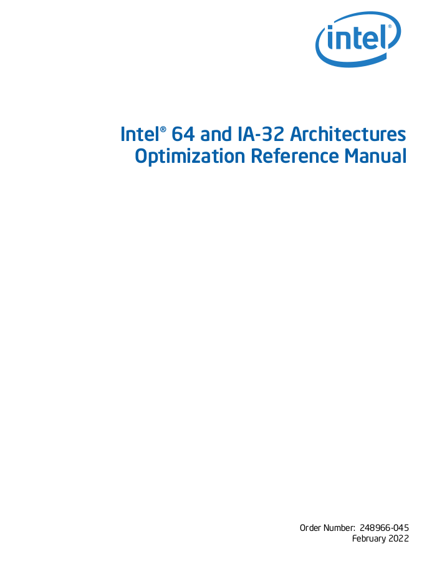
Non-Temporal Prefetch
x86 data prefetching instructions
PREFETCHT0, PREFETCHT1…, regular prefetch instructions.
PREFETCHNTA…, prefetch instruction for non-temporal data.
PrefetchNTA brings data into the L1 cache and the LLC/Snoop Filter.

Slide 10
Non-Temporal Prefetch
x86 data prefetching instructions
PREFETCHT0, PREFETCHT1…, regular prefetch instructions.
PREFETCHNTA…, prefetch instruction for non-temporal data.
PrefetchNTA brings data into the L1 cache and the LLC/Snoop Filter.
“For PrefetchNTA, the fill into the L3 cache or Snoop Filter may not be placed into the Most Recent Used Positioned and may be chosen for replacement faster than a regular cache fill”

Slide 11
How is this implemented in hardware
…especially with inclusive LLCs

Slide 12
Intel Inclusive-LLC Policy
From prior reverse-engineering result: Quad-age LRU (0-3)
Oldest age = 3, youngest age = 0
Insertion Policy
When filled into the LLC, age = 2

Slide 13
Intel Inclusive-LLC Policy
From prior reverse-engineering result: Quad-age LRU (0-3)
Oldest age = 3, youngest age = 0
Insertion Policy
When filled into the LLC, age = 2
Replacement Policy
Evicts the first line with age 3
If not exist, increase every line’s age

Slide 14
Intel Inclusive-LLC Policy
From prior reverse-engineering result: Quad-age LRU (0-3)
Oldest age = 3, youngest age = 0
Insertion Policy
When filled into the LLC, age = 2
Replacement Policy
Evicts the first line with age 3
If not exist, increase every line’s age
Updating Policy
Upon a cache hit, age = age - 1

Slide 15
Intel Inclusive-LLC Policy
From prior reverse-engineering result: Quad-age LRU (0-3)
Oldest age = 3, youngest age = 0
Insertion Policy
When filled into the LLC, age = 2
Replacement Policy
Evicts the first line with age 3
If not exist, increase every line’s age
Updating Policy
Upon a cache hit, age = age - 1

Slide 16
PrefetchNTA Reverse Engineering
Observation 1: LLC treats prefetched data differently than loaded data.
Insertion Policy
When filled into the LLC, age = 2
Updating Policy
Upon a cache hit, age = age - 1
Insertion Policy
When filled into the LLC, age = 3
Updating Policy
Upon a cache hit, age = age
VS
Load
PrefetchNTA

Slide 17
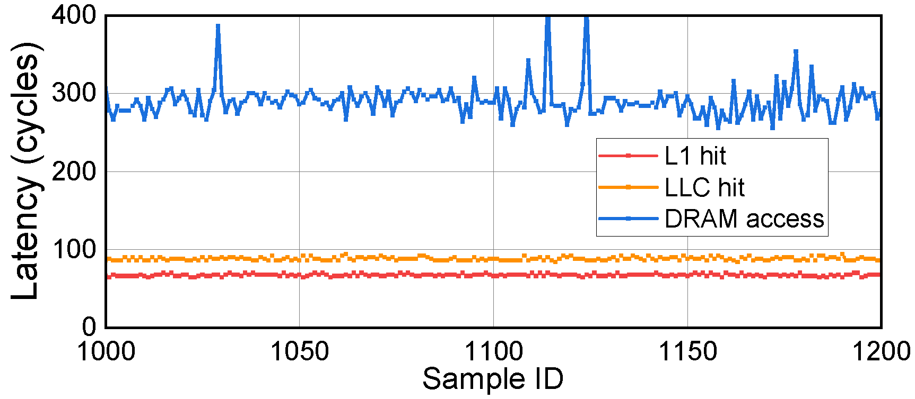
PrefetchNTA Reverse Engineering
Observation 2: The execution time of PrefetchNTA is related to the location of the target data.

Slide 18
What do these observations give us?

Slide 19
Cache Conflicts Bypassing Associativity
Age
PrefetchNTA
Insertion Policy
When filled into the LLC, age = 3
Updating Policy
Upon a cache hit, age = age - 1
Observation 1

Slide 20
Cache Conflicts Bypassing Associativity
PrefetchNTA
Insertion Policy
When filled into the LLC, age = 3
Updating Policy
Upon a cache hit, age = age - 1
Observation 1

Slide 21
Cache Conflicts Bypassing Associativity
PrefetchNTA
Insertion Policy
When filled into the LLC, age = 3
Updating Policy
Upon a cache hit, age = age - 1
Observation 1

Slide 22

Cache Conflicts Bypassing Associativity
Eviction candidate

Slide 23
Cache Conflicts Bypassing Associativity
Prefetch d0
Eviction candidate

Slide 24
Cache Conflicts Bypassing Associativity
Prefetch d1
Eviction candidate

Slide 25
Cache Conflicts Bypassing Associativity
Prefetch d0
Eviction candidate

Slide 26
Covert Channel Based on PrefetchNTA
Sender:
Prefetch sender’s data ds to send “1”.
Not prefetch to send “0”.
Receiver:
Prefetch receiver’s data dr and time the prefetch.
If hit in the LLC: received “0”.
If miss in the LLC: received “1”.

Slide 27
Covert Channel Based on PrefetchNTA
Sender:
Prefetch sender’s data ds to send “1”.
Not prefetch to send “0”.
Receiver:
Prefetch receiver’s data dr and time the prefetch.
If hit in the LLC: received “0”.
If miss in the LLC: received “1”.
Send “1”

Slide 28
Covert Channel Based on PrefetchNTA
Sender:
Prefetch sender’s data ds to send “1”.
Not prefetch to send “0”.
Receiver:
Prefetch receiver’s data dr and time the prefetch.
If hit in the LLC: received “0”.
If miss in the LLC: received “1”.
Send “1”

Slide 29
Covert Channel Based on PrefetchNTA
Sender:
Prefetch sender’s data ds to send “1”.
Not prefetch to send “0”.
Receiver:
Prefetch receiver’s data dr and time the prefetch.
If hit in the LLC: received “0”.
If miss in the LLC: received “1”.
Get the bit
LLC miss!

Slide 30
Covert Channel Based on PrefetchNTA
Sender:
Prefetch sender’s data ds to send “1”.
Not prefetch to send “0”.
Receiver:
Prefetch receiver’s data dr and time the prefetch.
If hit in the LLC: received “0”.
If miss in the LLC: received “1”.
Get the bit

Slide 31
Covert Channel Based on PrefetchNTA
Sender:
Prefetch sender’s data ds to send “1”.
Not prefetch to send “0”.
Receiver:
Prefetch receiver’s data dr and time the prefetch.
If hit in the LLC: received “0”.
If miss in the LLC: received “1”.
Send “0”

Slide 32
Covert Channel Based on PrefetchNTA
Sender:
Prefetch sender’s data ds to send “1”.
Not prefetch to send “0”.
Receiver:
Prefetch receiver’s data dr and time the prefetch.
If hit in the LLC: received “0”.
If miss in the LLC: received “1”.
Get the bit
LLC hit!

Slide 33
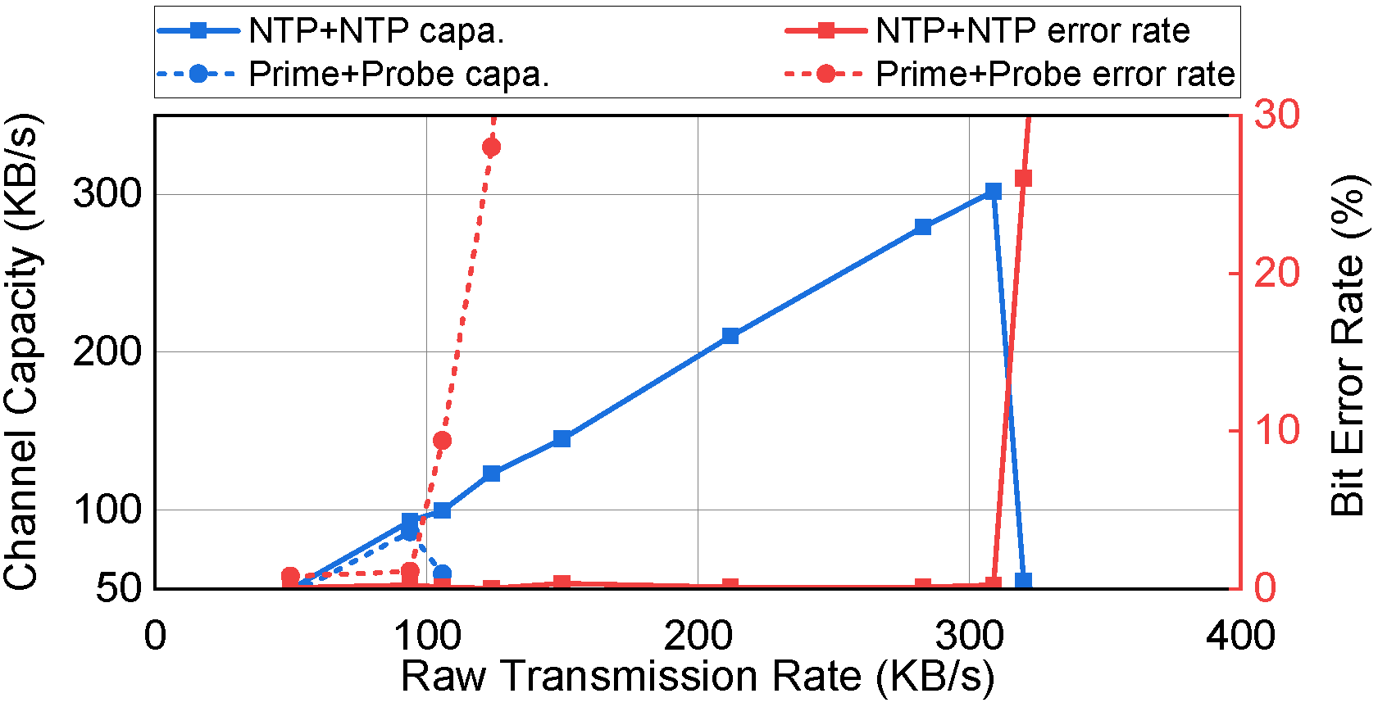
Covert Channel Based on PrefetchNTA
Prior conflict-based covert channels require priming the set
Prime+Probe, Eivct+Reload, Prime+Scope…
This makes conflict-based covert channels slow.

Slide 34
What about side channel attacks?

Slide 35
PrefetchNTA with Side Channel Attacks
The proposed covert channel is unlikely a side channel
We can only leak the victim’s prefetch pattern.
PrefetchNTA makes it easier to manipulate replacement states
We can use it to improve attacks based on replacement states!
E.g., Prime+Scope, 192 cache references to 33 cache references

Slide 36
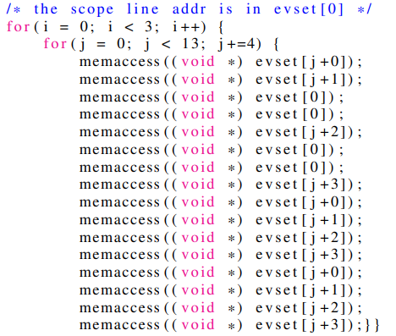
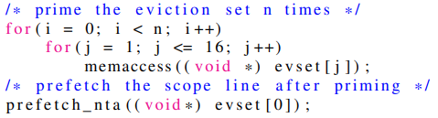
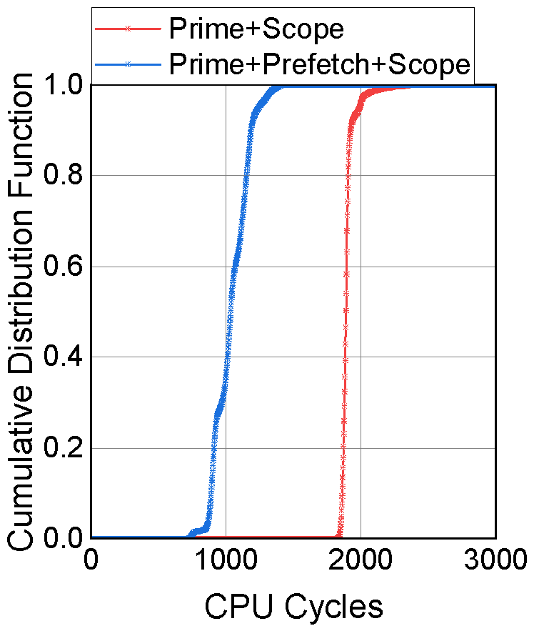
PrefetchNTA with Prime+Scope
Prime+Scope: a high resolution cache attack
Key conditions in Prime+Scope
The attacker knows the eviction candidate of the target LLC set after priming.
This eviction candidate is present in the attacker’s L1 after priming.
33 cache references
192 cache references
Prime stage:
1906 cycles
VS
1043 cycles

Slide 37
More in the Paper
PrefetchNTA with other side channel attacks.
Faster eviction set construction algorithm with PrefetchNTA.
PrefetchNTA with non-inclusive LLCs.
Potential defense methods against prefetch-based attacks.

Slide 38
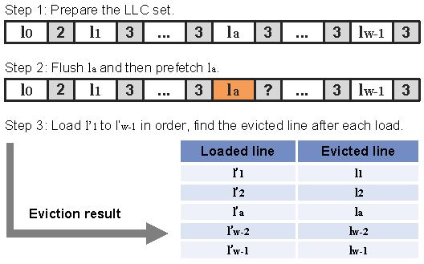
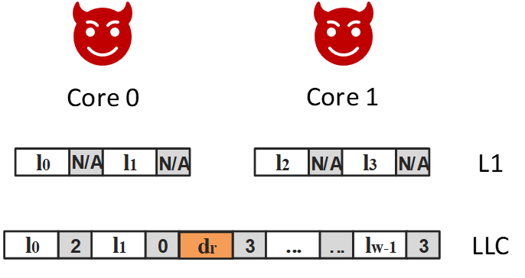
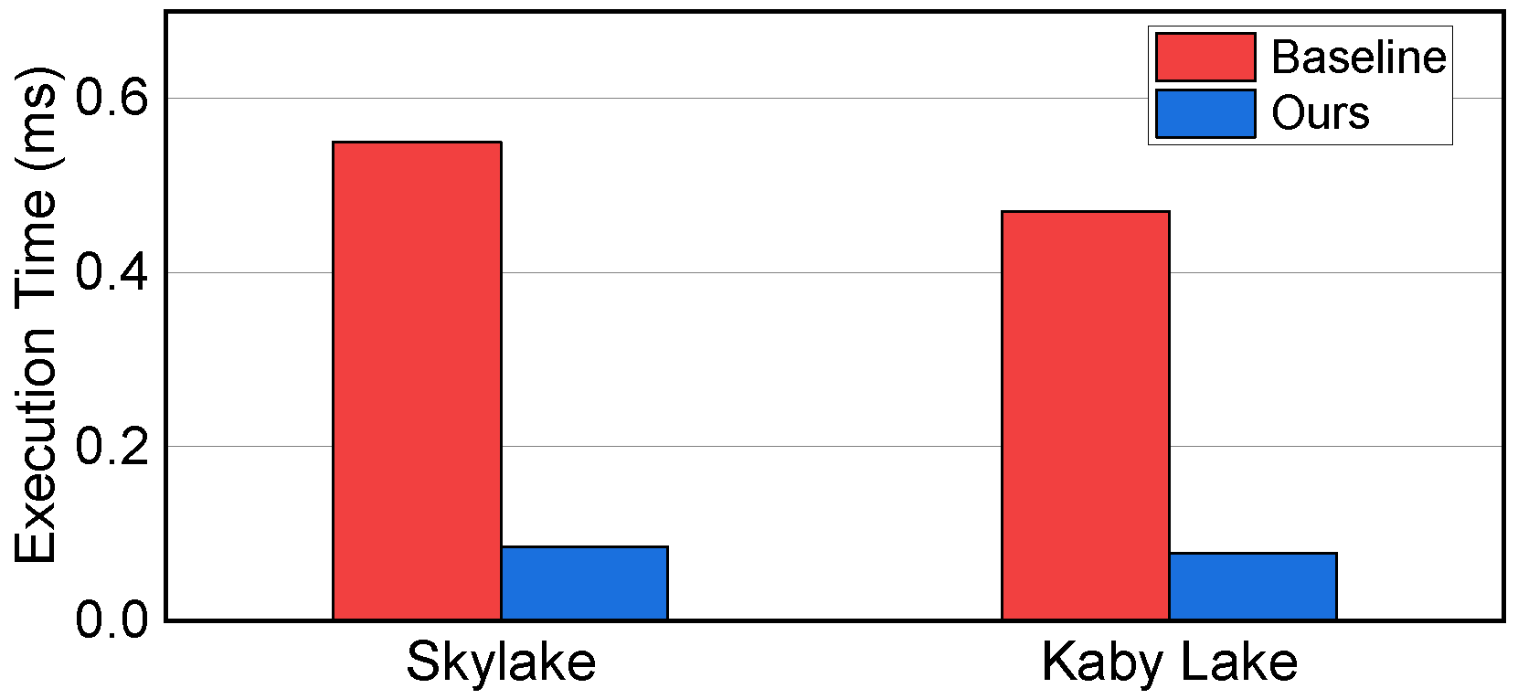
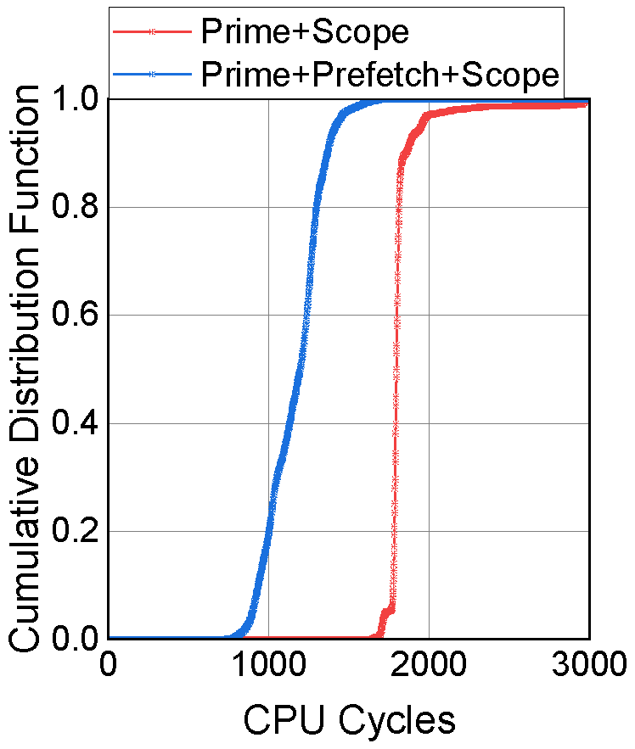
Summary
Reverse Engineering PrefetchNTA
A New Covert Channel
Faster Eviction Set Construction
Improved Cache Side Channels

Slide 39
Leaky Way: A Conflict-Based Cache Covert Channel Bypassing Set Associativity
Yanan Guo, Xin Xin, Youtao Zhang, Jun Yang
University of Pittsburgh
Artifacts: https://github.com/PittECEArch/LeakyWay

