Slide 1


Leaky Way: A Conflict-Based Cache Covert Channel Bypassing Set Associativity
Yanan Guo, Xin Xin, Youtao Zhang, Jun Yang
University of Pittsburgh

Slide 2






Cache Attacks
Notes:
So in the last few years we have seen a lot of cache timing attacks, as a side channel they can be directly used to leak private information from the user the victim running on the same processor.
For example, we can leak the private key from a crypto library, we can fingerprint the website the victim is accessing, or we can even leak what the victim is typing on the keyboard.
And as a covert channel, they can also be used in speculative execution attacks, for example we have seen them in spectre, meltdown, mds and many other attacks.

Slide 3
Conflict-Based Cache Attacks
Critical step: build cache conflicts to evict the victim’s data.
Prime+Probe, Prime+Scope, Evict+Reload…: requires priming the cache set.
Way 0
Way 1
Way 2
Way 3
Set 0
Set 1
V
…
Set n
Notes:
So conflict-based attacks are a very important type of cache attacks. There are essentially three steps in this attack.
Assuming this is the cache array, then in the first step, the attacker trys to evict the victim’s data, so she fills the target set with her own data,
and in the second step, she waits for the victim’s execution,
So if the victim now accesses her data, this data is brought into cache, and one the attacker’s data block will be evicted.
So later in the third step, the attacker accesses all her data in this set again and times the access to know did any of the data get evicted.
And then she can further know whether the victim accessed her data and brought it to this set.

Slide 4
Conflict-Based Cache Attacks
Critical step: build cache conflicts to evict the victim’s data.
Prime+Probe, Prime+Scope, Evict+Reload…: requires priming the cache set.
Way 0
Way 1
Way 2
Way 3
Set 0
Set 1
V
A1
…
Set n
Notes:
So conflict-based attacks are a very important type of cache attacks. There are essentially three steps in this attack.
Assuming this is the cache array, then in the first step, the attacker trys to evict the victim’s data, so she fills the target set with her own data,
and in the second step, she waits for the victim’s execution,
So if the victim now accesses her data, this data is brought into cache, and one the attacker’s data block will be evicted.
So later in the third step, the attacker accesses all her data in this set again and times the access to know did any of the data get evicted.
And then she can further know whether the victim accessed her data and brought it to this set.

Slide 5
Conflict-Based Cache Attacks
Critical step: build cache conflicts to evict the victim’s data.
Prime+Probe, Prime+Scope, Evict+Reload…: requires priming the cache set.
Way 0
Way 1
Way 2
Way 3
Set 0
Set 1
V
A1
A2
…
Set n
Notes:
So conflict-based attacks are a very important type of cache attacks. There are essentially three steps in this attack.
Assuming this is the cache array, then in the first step, the attacker trys to evict the victim’s data, so she fills the target set with her own data,
and in the second step, she waits for the victim’s execution,
So if the victim now accesses her data, this data is brought into cache, and one the attacker’s data block will be evicted.
So later in the third step, the attacker accesses all her data in this set again and times the access to know did any of the data get evicted.
And then she can further know whether the victim accessed her data and brought it to this set.

Slide 6
Conflict-Based Cache Attacks
Critical step: build cache conflicts to evict the victim’s data.
Prime+Probe, Prime+Scope, Evict+Reload…: requires priming the cache set.
Way 0
Way 1
Way 2
Way 3
Set 0
Set 1
V
A1
A2
A3
…
Set n
Notes:
So conflict-based attacks are a very important type of cache attacks. There are essentially three steps in this attack.
Assuming this is the cache array, then in the first step, the attacker trys to evict the victim’s data, so she fills the target set with her own data,
and in the second step, she waits for the victim’s execution,
So if the victim now accesses her data, this data is brought into cache, and one the attacker’s data block will be evicted.
So later in the third step, the attacker accesses all her data in this set again and times the access to know did any of the data get evicted.
And then she can further know whether the victim accessed her data and brought it to this set.

Slide 7

Conflict-Based Cache Attacks
Critical step: build cache conflicts to evict the victim’s data.
Prime+Probe, Prime+Scope, Evict+Reload…: requires priming the cache set.
Way 0
Way 1
Way 2
Way 3
Set 0
Set conflicts
Set 1
A4
A1
A2
A3
Priming the set
…
Set n
Notes:
So conflict-based attacks are a very important type of cache attacks. There are essentially three steps in this attack.
Assuming this is the cache array, then in the first step, the attacker trys to evict the victim’s data, so she fills the target set with her own data,
and in the second step, she waits for the victim’s execution,
So if the victim now accesses her data, this data is brought into cache, and one the attacker’s data block will be evicted.
So later in the third step, the attacker accesses all her data in this set again and times the access to know did any of the data get evicted.
And then she can further know whether the victim accessed her data and brought it to this set.

Slide 8
Can we build set conflicts without priming the set?
Notes:
Or in other words

Slide 9
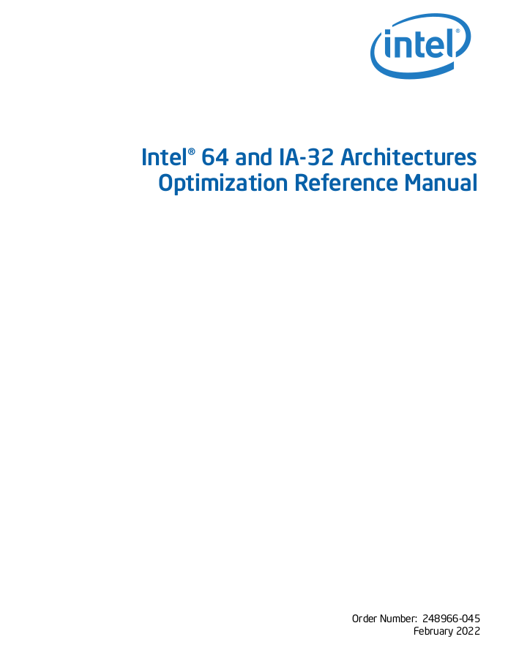
Non-Temporal Prefetch
x86 data prefetching instructions
PREFETCHT0, PREFETCHT1…, regular prefetch instructions.
PREFETCHNTA…, prefetch instruction for non-temporal data.
PrefetchNTA brings data into the L1 cache and the LLC/Snoop Filter.
Notes:
So one thing that got our attention is the prefetch instructions,
These days x86 processors provide many prefetch instructions that programmers and compilers can use to improve the performance.
Most of those instructions are very simple, it’s just when the instruction executes, the target data is brought into a certain cache level.
But, prefetchnta is a little different, according the definition, we are supposed to use this instruction if we are prefetching non-temporal data, data that will likely be only used once.
So the interesting thing here is that what’s special about this instruction, like what’s the benefit of using it?
so if read the reference manual from intel, we can basically learn two things,
First of all, this instruction brings the targe data into the L1 cache and the LLC or the snoop filter depending on the LLC is inclusive or not.
And the second thing is,

Slide 10
Non-Temporal Prefetch
x86 data prefetching instructions
PREFETCHT0, PREFETCHT1…, regular prefetch instructions.
PREFETCHNTA…, prefetch instruction for non-temporal data.
PrefetchNTA brings data into the L1 cache and the LLC/Snoop Filter.
“For PrefetchNTA, the fill into the L3 cache or Snoop Filter may not be placed into the Most Recent Used Positioned and may be chosen for replacement faster than a regular cache fill”
Notes:
…..
So basically, using this instruction we minimize the cache pollution caused by prefetching.

Slide 11
How is this implemented in hardware
…especially with inclusive LLCs
Notes:
Then our question here is that, how is it implemented in hardware? Like how does the cache, the replacement policy know to evict this prefetch data earlier than other data.
And we are especially interested in the implementation when the LLC is inclusive, because eventually our goal is to find a faster way for building eviction sets.

Slide 12
Intel Inclusive-LLC Policy
From prior reverse-engineering result: Quad-age LRU (0-3)
Oldest age = 3, youngest age = 0
Insertion Policy
When filled into the LLC, age = 2
Notes:
So before we try to figure out how is prefetchnta handled in cache hardware, here is some background about the intel LLC policy, so this policy is reversed engineered by prior work, and it has been verified on the fifth to seventh generation of intel core processors with inclusive LLCs.
So basically Intel uses quad-age LRU, so each cache line in a set has an age between 0 to 3.
And 3 is the oldest age, and 0 is the youngest age.
So a cache line is filled into the LLC the age is initialized to be 2,
And when eviction happens, the hardware checks all the ways in the set in order, and evicts the cache line in the first way with age 3.
And if such a cache line does not exist, then it increases every one’s age by one and searches again
And another thing is, when a CPU request hits in the LLC, the age of the cache line is decreased by 1, unless it’s already 0.

Slide 13
Intel Inclusive-LLC Policy
From prior reverse-engineering result: Quad-age LRU (0-3)
Oldest age = 3, youngest age = 0
Insertion Policy
When filled into the LLC, age = 2
Replacement Policy
Evicts the first line with age 3
If not exist, increase every line’s age
Notes:
So before we try to figure out how is prefetchnta handled in cache hardware, here is some background about the intel LLC policy, so this policy is reversed engineered by prior work, and it has been verified on the fifth to seventh generation of intel core processors with inclusive LLCs.
So basically Intel uses quad-age LRU, so each cache line in a set has an age between 0 to 3.
And 3 is the oldest age, and 0 is the youngest age.
So a cache line is filled into the LLC the age is initialized to be 2,
And when eviction happens, the hardware checks all the ways in the set in order, and evicts the cache line in the first way with age 3.
And if such a cache line does not exist, then it increases every one’s age by one and searches again
And another thing is, when a CPU request hits in the LLC, the age of the cache line is decreased by 1, unless it’s already 0.

Slide 14
Intel Inclusive-LLC Policy
From prior reverse-engineering result: Quad-age LRU (0-3)
Oldest age = 3, youngest age = 0
Insertion Policy
When filled into the LLC, age = 2
Replacement Policy
Evicts the first line with age 3
If not exist, increase every line’s age
Updating Policy
Upon a cache hit, age = age - 1
Notes:
So before we try to figure out how is prefetchnta handled in cache hardware, here is some background about the intel LLC policy, so this policy is reversed engineered by prior work, and it has been verified on the fifth to seventh generation of intel core processors with inclusive LLCs.
So basically Intel uses quad-age LRU, so each cache line in a set has an age between 0 to 3.
And 3 is the oldest age, and 0 is the youngest age.
So a cache line is filled into the LLC the age is initialized to be 2,
And when eviction happens, the hardware checks all the ways in the set in order, and evicts the cache line in the first way with age 3.
And if such a cache line does not exist, then it increases every one’s age by one and searches again
And another thing is, when a CPU request hits in the LLC, the age of the cache line is decreased by 1, unless it’s already 0.

Slide 15
Intel Inclusive-LLC Policy
From prior reverse-engineering result: Quad-age LRU (0-3)
Oldest age = 3, youngest age = 0
Insertion Policy
When filled into the LLC, age = 2
Replacement Policy
Evicts the first line with age 3
If not exist, increase every line’s age
Updating Policy
Upon a cache hit, age = age - 1
Notes:
So before we try to figure out how is prefetchnta handled in cache hardware, here is some background about the intel LLC policy, so this policy is reversed engineered by prior work, and it has been verified on the fifth to seventh generation of intel core processors with inclusive LLCs.
So basically Intel uses quad-age LRU, so each cache line in a set has an age between 0 to 3.
And 3 is the oldest age, and 0 is the youngest age.
So a cache line is filled into the LLC the age is initialized to be 2,
And when eviction happens, the hardware checks all the ways in the set in order, and evicts the cache line in the first way with age 3.
And if such a cache line does not exist, then it increases every one’s age by one and searches again
And another thing is, when a CPU request hits in the LLC, the age of the cache line is decreased by 1, unless it’s already 0.

Slide 16
PrefetchNTA Reverse Engineering
Observation 1: LLC treats prefetched data differently than loaded data.
Insertion Policy
When filled into the LLC, age = 2
Updating Policy
Upon a cache hit, age = age - 1
Insertion Policy
When filled into the LLC, age = 3
Updating Policy
Upon a cache hit, age = age
VS
Load
PrefetchNTA
Notes:
And after knowing this policy, we did some reverse engineering work on Intel processors, and we found that the LLC policy for prefetched data is actually different than the policy for loaded data.
Specifically, there are two different things
First of all, when filled into the LLC, the age of the prefetched cache line is initialized o 3 instead of 2,
And the second thing, when a prefetch request hits in the LLC, it does not update the age of the target cache line

Slide 17
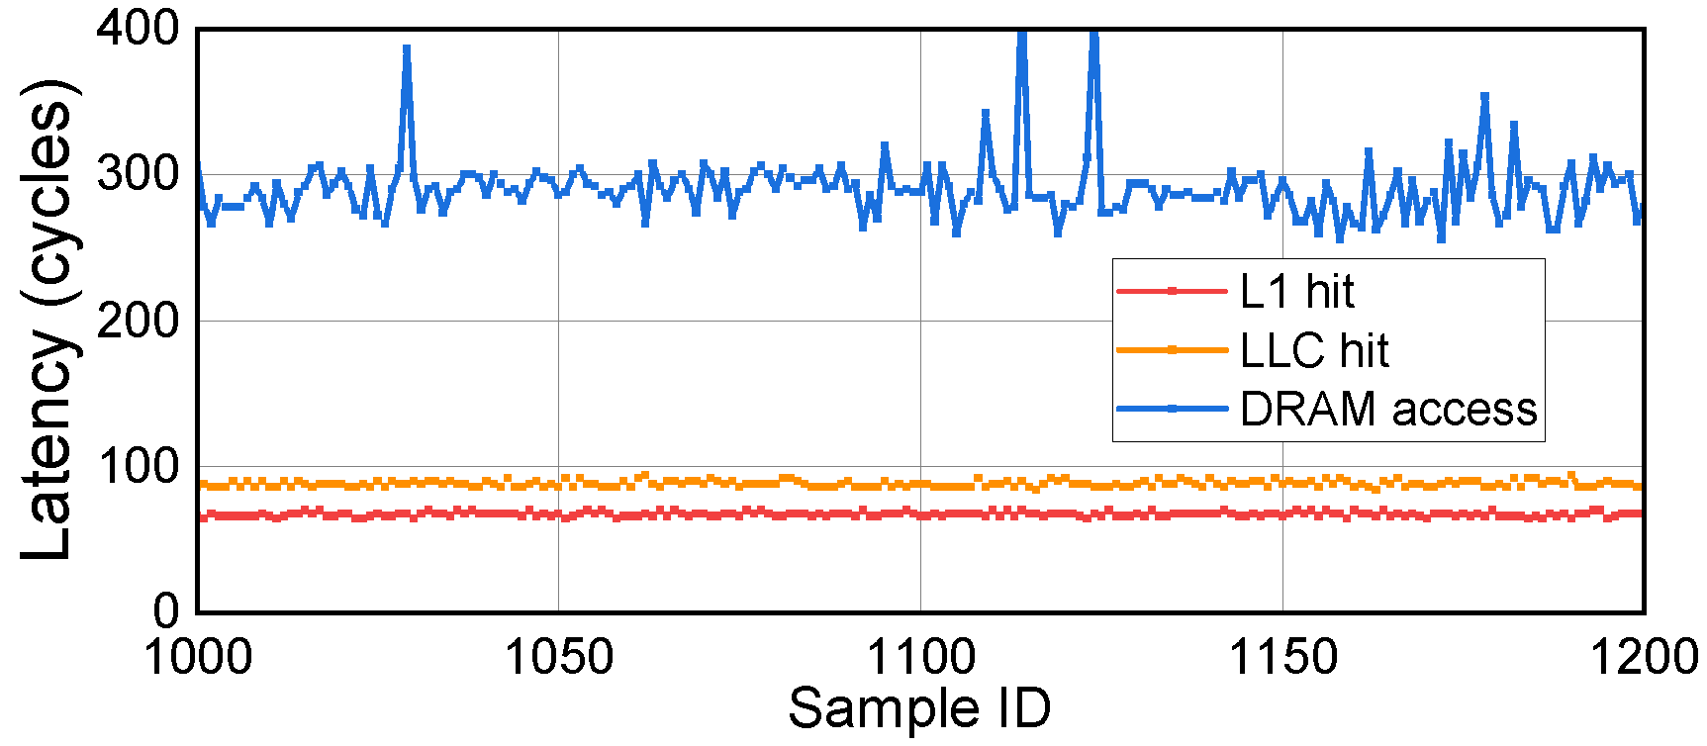
PrefetchNTA Reverse Engineering
Observation 2: The execution time of PrefetchNTA is related to the location of the target data.
Notes:
And we also found that the execution time of prefetchnta is actually related to the location of the target data in the memory hierarchy, just like a regular load instruction,
If the data is in L1 then the instruction executes much faster, if the data is in DRAM, then it execute much slower.

Slide 18
What do these observations give us?
Notes:
So the question here is, what do these observations give us?

Slide 19
Cache Conflicts Bypassing Associativity
Age
PrefetchNTA
Insertion Policy
When filled into the LLC, age = 3
Updating Policy
Upon a cache hit, age = age - 1
Observation 1
Notes:
So here is the first observation again, the LLC policy for prefetchnta
So let’s say this is a LLC set, it’s in a random state with random cache lines
If now we prefetch a cache line into this set, it will replace the first line with age 3, which is l2, and then the prefetched data will be placed there.
And now the prefetched cache line d0 , it becomes the first line with age 3, which means it’s the eviction candidate.
So now if we prefetch another cache line, d1, d1 will evict d0, and it will be placed in d0’s position.

Slide 20
Cache Conflicts Bypassing Associativity
PrefetchNTA
Insertion Policy
When filled into the LLC, age = 3
Updating Policy
Upon a cache hit, age = age - 1
Observation 1
Notes:
So here is the first observation again, the LLC policy for prefetchnta
So let’s say this is a LLC set, it’s in a random state with random cache lines
If now we prefetch a cache line into this set, it will replace the first line with age 3, which is this one, and then d0 will be in this way.
And now d0, the prefetched cache line becomes the first line with age 3, which means it’s the eviction candidate.
So now if we prefetch another cache line, d1, d1 will evict d0, and it will be placed in d0’s position.

Slide 21
Cache Conflicts Bypassing Associativity
PrefetchNTA
Insertion Policy
When filled into the LLC, age = 3
Updating Policy
Upon a cache hit, age = age - 1
Observation 1
Notes:
So here is the first observation again, the LLC policy for prefetchnta
So let’s say this is a LLC set, it’s in a random state with random cache lines
If now we prefetch a cache line into this set, it will replace the first line with age 3, which is this one, and d0 will be in this way.
And now the prefetched cache line d0 , it becomes the first line with age 3, which means it’s the eviction candidate.
So now if we prefetch another cache line, d1, d1 will evict d0, and it will be placed in d0’s position.

Slide 22

Cache Conflicts Bypassing Associativity
Eviction candidate
Notes:
So what if we have two cores and both of them prefetch their data into the same set.
So what’s gonna happen is

Slide 23
Cache Conflicts Bypassing Associativity
Prefetch d0
Eviction candidate
Notes:
Core 0 prefetches d0, it evicts the eviction candidate and becomes the new eviction candidate

Slide 24
Cache Conflicts Bypassing Associativity
Prefetch d1
Eviction candidate
Notes:
And then when core 1 prefetches d1, it evicts d0 and becomes the new eviction candidate

Slide 25
Cache Conflicts Bypassing Associativity
Prefetch d0
Eviction candidate
Notes:
Then when core 0 prefetches d0 again, it evicts d1,
So basically, with prefetchnta, we are able to cause set conflicts, cause evictions without touching the entire set, we can do it by touching only one way of the set, bypassing the set associativity

Slide 26
Covert Channel Based on PrefetchNTA
Sender:
Prefetch sender’s data ds to send “1”.
Not prefetch to send “0”.
Receiver:
Prefetch receiver’s data dr and time the prefetch.
If hit in the LLC: received “0”.
If miss in the LLC: received “1”.
Notes:
Ok so based on this, we propose a covert channel,
So the sender sends a bit by prefetching or prefetching her data
And the receiver prefetches her data and times the prefetch to receive the bit

Slide 27
Covert Channel Based on PrefetchNTA
Sender:
Prefetch sender’s data ds to send “1”.
Not prefetch to send “0”.
Receiver:
Prefetch receiver’s data dr and time the prefetch.
If hit in the LLC: received “0”.
If miss in the LLC: received “1”.
Send “1”
Notes:
So let’s say the receiver’s data dr is already in the LLC set,
if the sender sends 1, she prefetches her data ds

Slide 28
Covert Channel Based on PrefetchNTA
Sender:
Prefetch sender’s data ds to send “1”.
Not prefetch to send “0”.
Receiver:
Prefetch receiver’s data dr and time the prefetch.
If hit in the LLC: received “0”.
If miss in the LLC: received “1”.
Send “1”
Notes:
And it evicts dr.
So

Slide 29
Covert Channel Based on PrefetchNTA
Sender:
Prefetch sender’s data ds to send “1”.
Not prefetch to send “0”.
Receiver:
Prefetch receiver’s data dr and time the prefetch.
If hit in the LLC: received “0”.
If miss in the LLC: received “1”.
Get the bit
LLC miss!
Notes:
Later when the receiver prefetches dr, she will get an LLC miss, so it takes longer to prefetch

Slide 30
Covert Channel Based on PrefetchNTA
Sender:
Prefetch sender’s data ds to send “1”.
Not prefetch to send “0”.
Receiver:
Prefetch receiver’s data dr and time the prefetch.
If hit in the LLC: received “0”.
If miss in the LLC: received “1”.
Get the bit
Notes:
And after this, dr is brought back to the set, it’s the eviction candidate again.

Slide 31
Covert Channel Based on PrefetchNTA
Sender:
Prefetch sender’s data ds to send “1”.
Not prefetch to send “0”.
Receiver:
Prefetch receiver’s data dr and time the prefetch.
If hit in the LLC: received “0”.
If miss in the LLC: received “1”.
Send “0”
Notes:
So now if the sender sends 0, she does not do anything, dr stays there

Slide 32
Covert Channel Based on PrefetchNTA
Sender:
Prefetch sender’s data ds to send “1”.
Not prefetch to send “0”.
Receiver:
Prefetch receiver’s data dr and time the prefetch.
If hit in the LLC: received “0”.
If miss in the LLC: received “1”.
Get the bit
LLC hit!
Notes:
And later when the receiver prefetches, she gets an LLC hit, so it executes faster

Slide 33
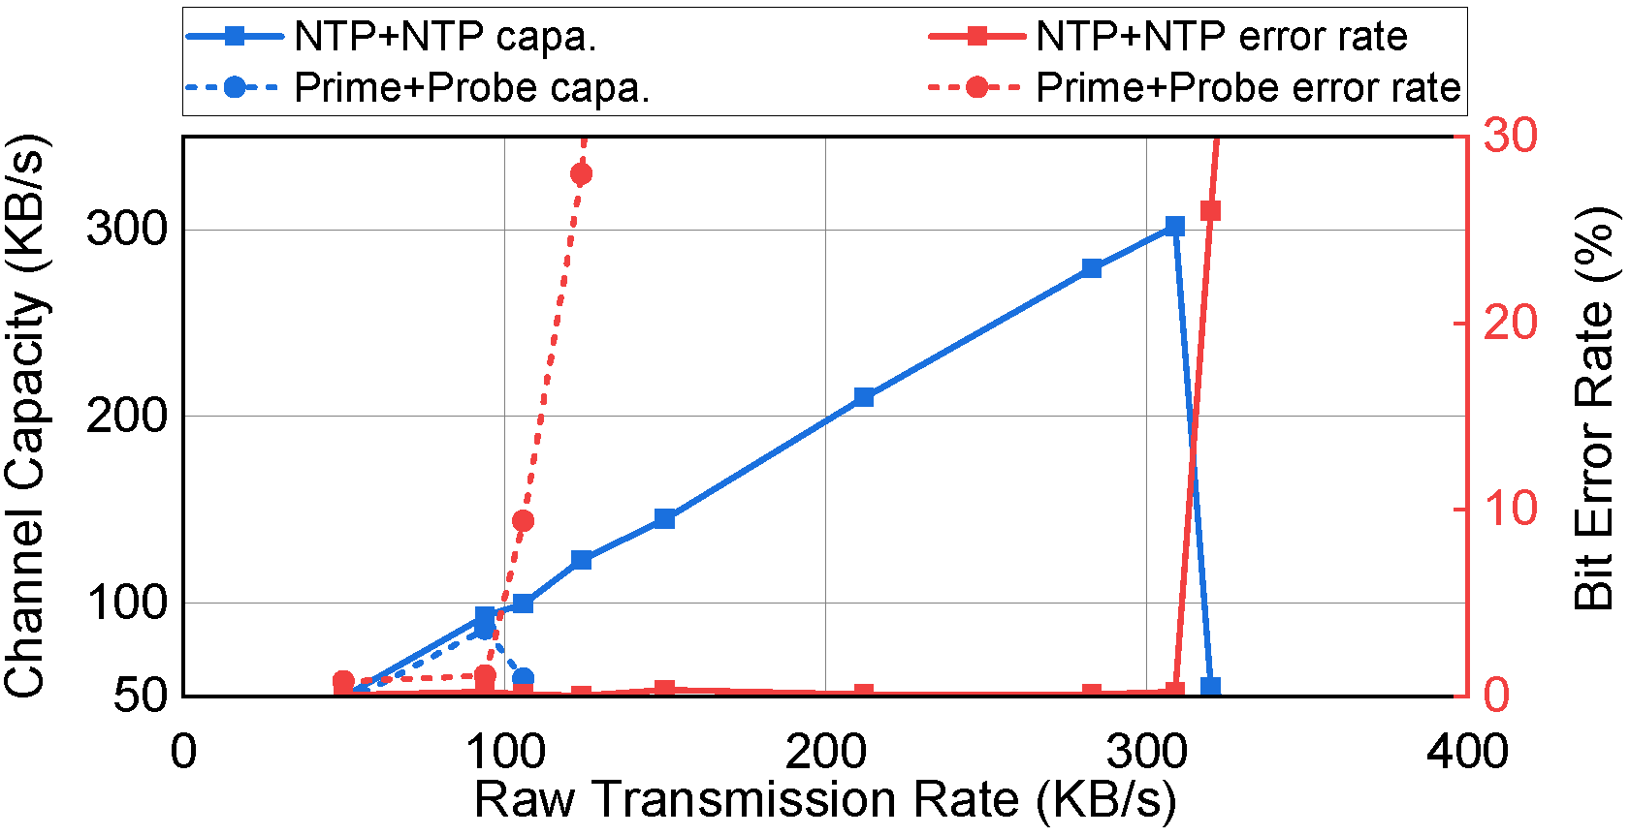
Covert Channel Based on PrefetchNTA
Prior conflict-based covert channels require priming the set
Prime+Probe, Eivct+Reload, Prime+Scope…
This makes conflict-based covert channels slow.
Notes:
Since this covert channel does not require priming the entire set in each iteration, it can be much faster than prior covert channels, for example, we compared the capacity of out channel and prime and probe, and it turns out this new channel is over 3 times faster than prime and probe.

Slide 34
What about side channel attacks?
Notes:
So after we have this covert channel, our question does this covert channel have any chance to be a side channel.

Slide 35
PrefetchNTA with Side Channel Attacks
The proposed covert channel is unlikely a side channel
We can only leak the victim’s prefetch pattern.
PrefetchNTA makes it easier to manipulate replacement states
We can use it to improve attacks based on replacement states!
E.g., Prime+Scope, 192 cache references to 33 cache references
Notes:
Well the short answer is no because in this channel the sender is prefetching her data, so basically in side channel case we only leak the victim’s prefetch pattern which is very unlikely useful in practice
But since prefetchNTA makes it a lot easier than before for an attacker to manipulate the LLC replacement states, we can use it to improve attacks that are based on replacement states

Slide 36
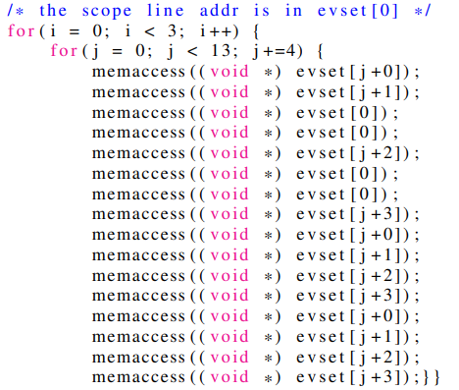
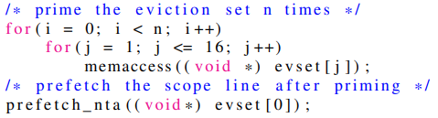
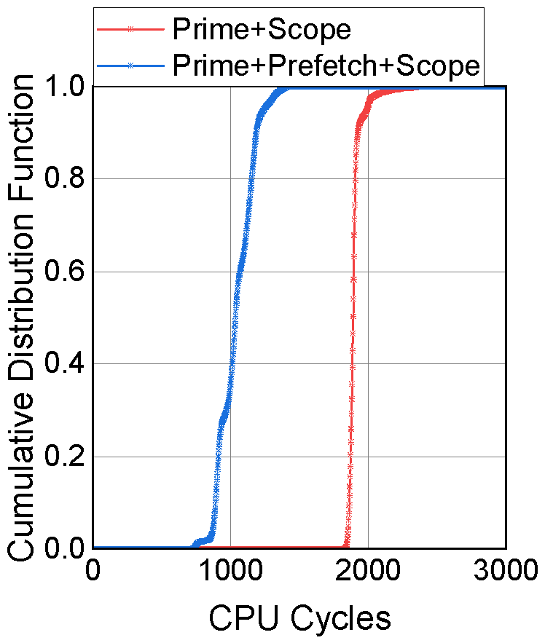
PrefetchNTA with Prime+Scope
Prime+Scope: a high resolution cache attack
Key conditions in Prime+Scope
The attacker knows the eviction candidate of the target LLC set after priming.
This eviction candidate is present in the attacker’s L1 after priming.
33 cache references
192 cache references
Prime stage:
1906 cycles
VS
1043 cycles
Notes:
So there are many such side channel attack, and here we use prime+scope as an example to explain.
So prime+scope is a very new attack, it was proposed at the end of last year, and it’s also a very important attack because it has the highest resolution among all cache attacks.
So there are two key requriements on the priming stage of this attack,
First of all, after priming,
And also,
Sicne these two requirements are kinda contradictory with each other, in prime+Scope they use a very long access pattern to achieve them.
For example, on the skylake processor the access pattern contains 192 cache references. So it makes the priming stage very long, which can hurt the accuracy of the attack.
But if we can use prefetchnta, these two requirements can be easily achieved,
Like we only need to first fill the LLC set to make sure the attacker occupies the set, and at the end, prefetch the target line, because when the attacker prefetches it, it automatically beomes the eviction candidate in the LLC, and it’s filled into L1.
And then we only 33 cache references to achieve these two requirements.
And this can almost cut the latency of the priming stage down to half than before.

Slide 37
More in the Paper
PrefetchNTA with other side channel attacks.
Faster eviction set construction algorithm with PrefetchNTA.
PrefetchNTA with non-inclusive LLCs.
Potential defense methods against prefetch-based attacks.
Notes:
So due to the limited time, we cannot cover everything about this work.
There is actually more information in the paper.

Slide 38
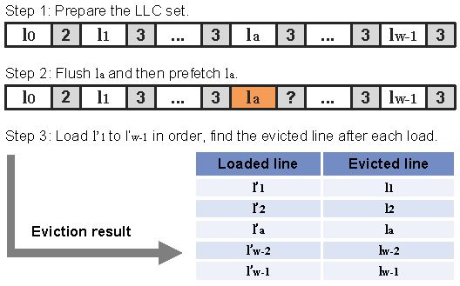
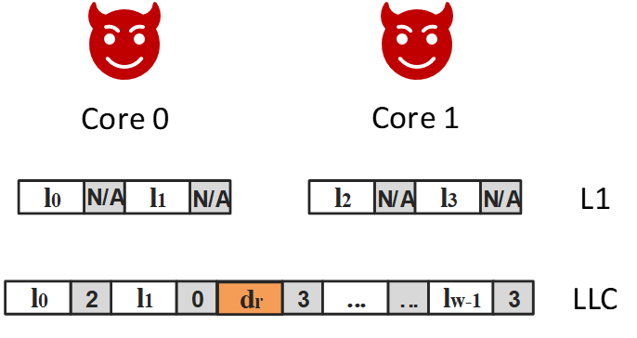
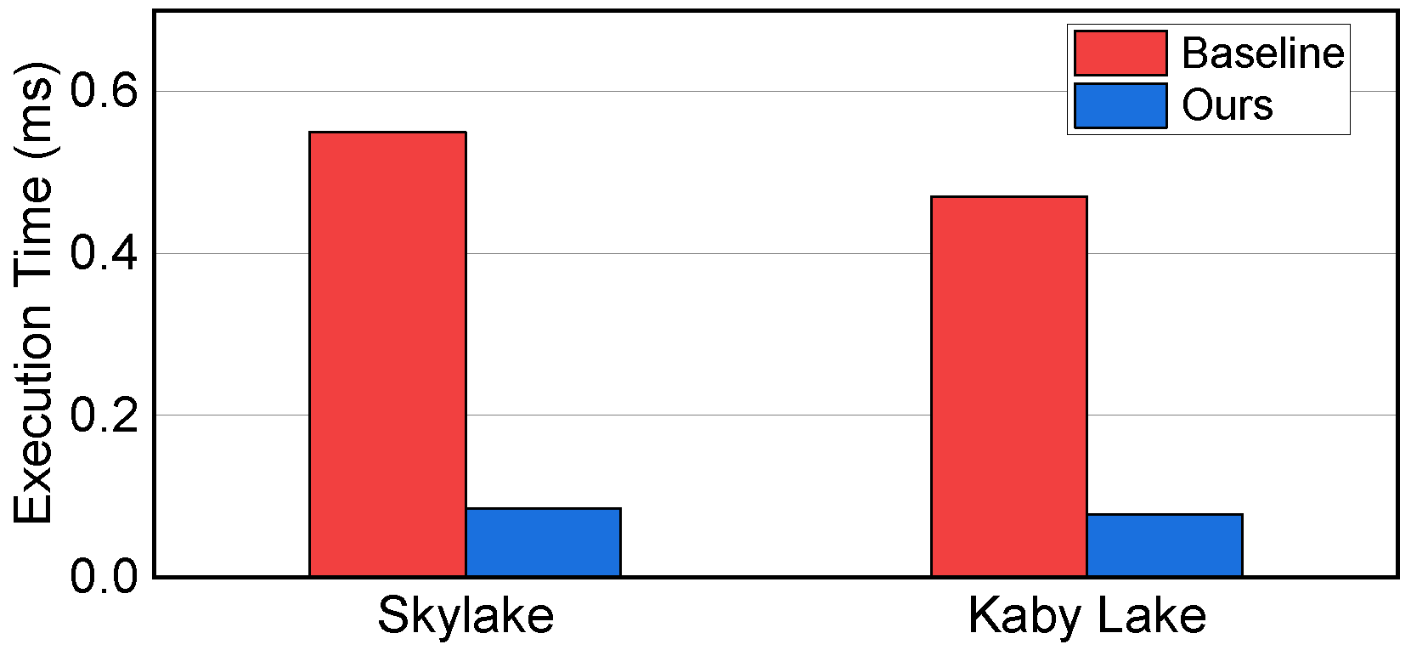
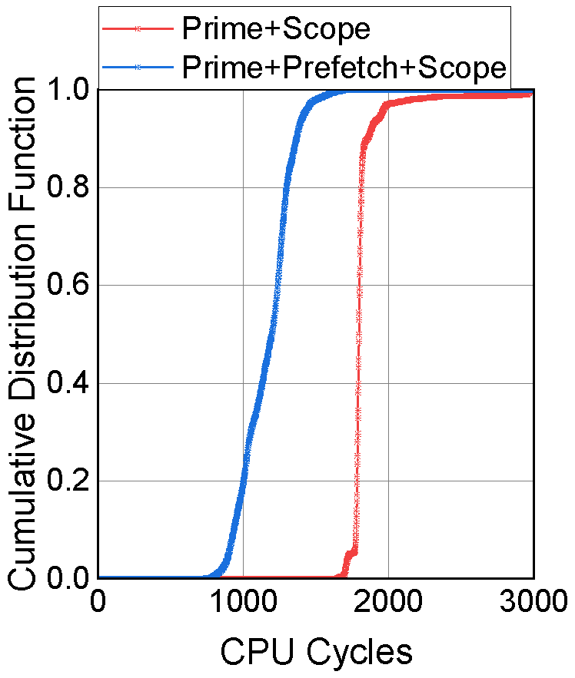
Summary
Reverse Engineering PrefetchNTA
A New Covert Channel
Faster Eviction Set Construction
Improved Cache Side Channels

Slide 39
Leaky Way: A Conflict-Based Cache Covert Channel Bypassing Set Associativity
Yanan Guo, Xin Xin, Youtao Zhang, Jun Yang
University of Pittsburgh
Artifacts: https://github.com/PittECEArch/LeakyWay

