Slide 1

ModelShield: A Generic and Portable Framework Extension for Defending Bit-Flip based Adversarial Weight Attacks
Yanan Guo¹, Liang Liu¹, Yueqiang Cheng², Youtao Zhang¹, Jun Yang¹
¹University of Pittsburgh ²NIO Security Group

Slide 2
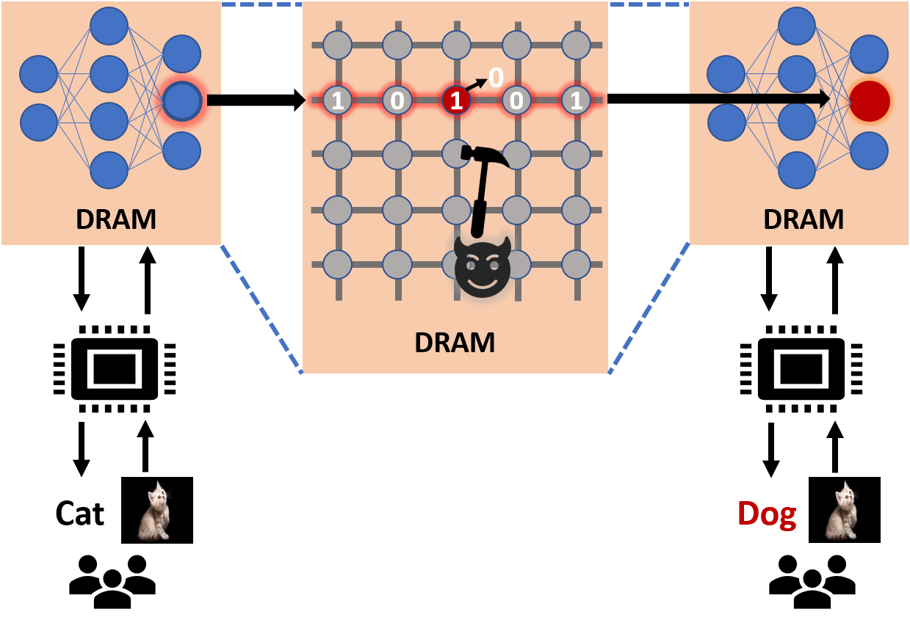
Rowhammer + Bit Flip Attack

Slide 3
Defend Bit Flip Attack
Hardware Modification
High overhead.
Takes a time long to verify and deploy the defense.
Increase DNN’s robustness
Can only makes bit flip attack harder but not impossible.
Baseline: Modifying 28 weights can make ResNet-20 malfunction.
Binarization-aware training: Modifying >500 weights can make ResNet-20 malfunction.
Requirements
Easy implementation.
Compatible with current frameworks.
Negligible performance overhead.

Slide 4
ModelShield
Protect the integrity of the DNN weights
Pre-calculate a hash of the weights in each layer.
Use a cryptographic non-keyed hash.
Store the hash together with weights in memory.
Real-time hash verification.
Verify the hash after the inference completes, before sending user the results.
Problems
What if the attacker change the weights back after inference?
What if the attacker modify the weights and hashes together?
Answers
Hash values are diffused and random.
Rowhammer attackers can only perform one-direction flip in a memory row.

Slide 5
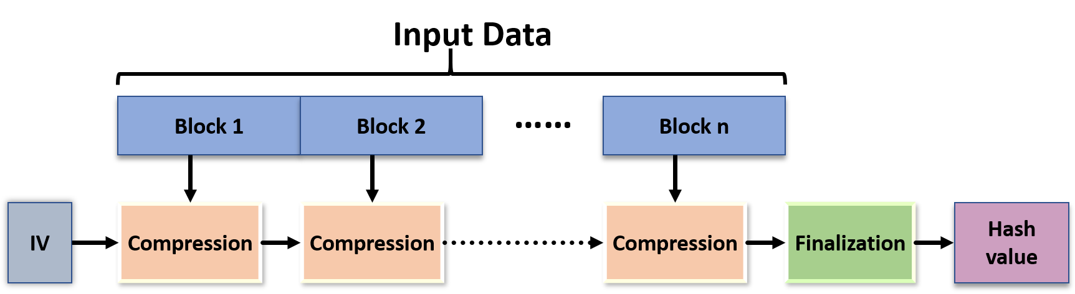
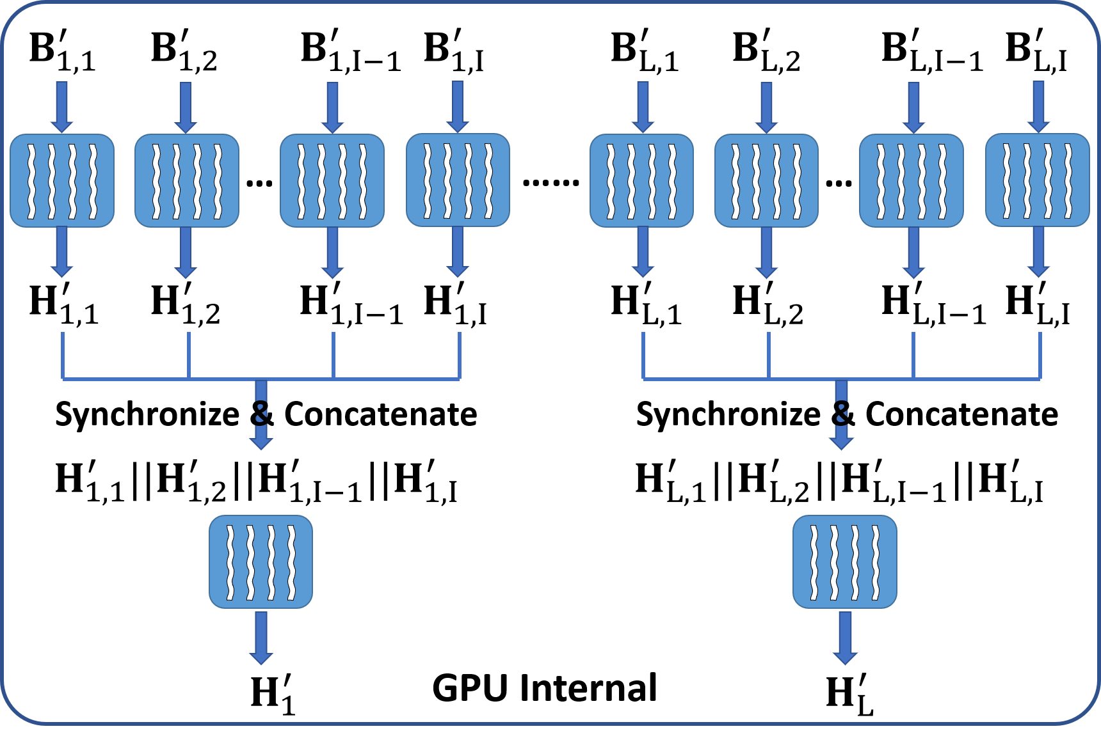
Performance Optimization
Use high-performance non-cryptographic hash
Software hash tree

Slide 6
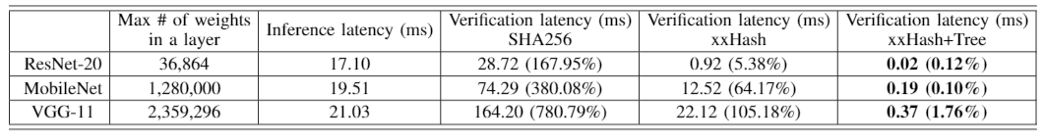
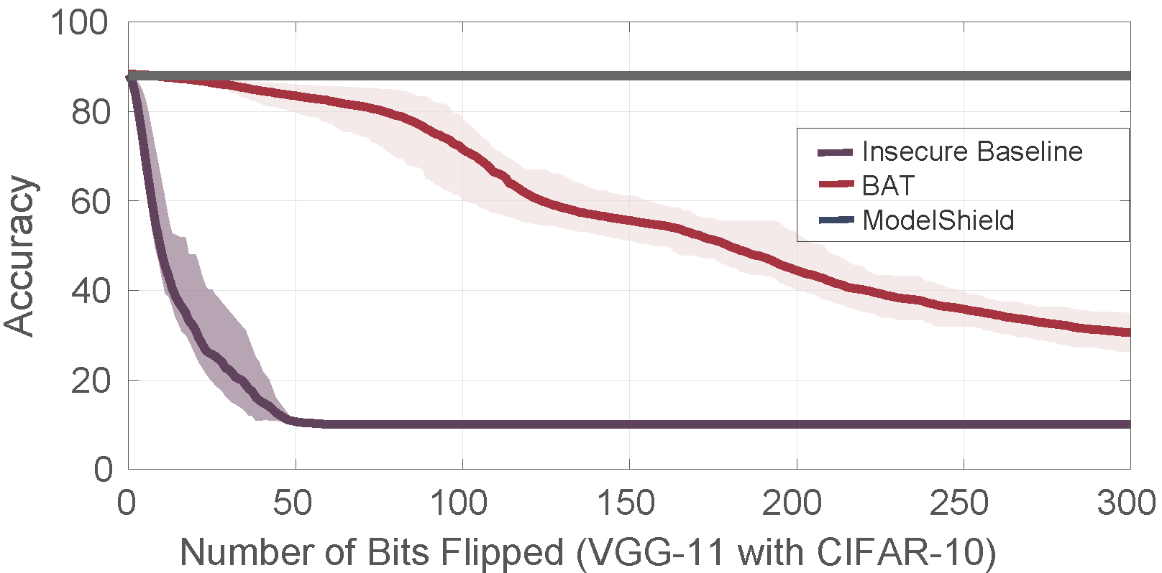
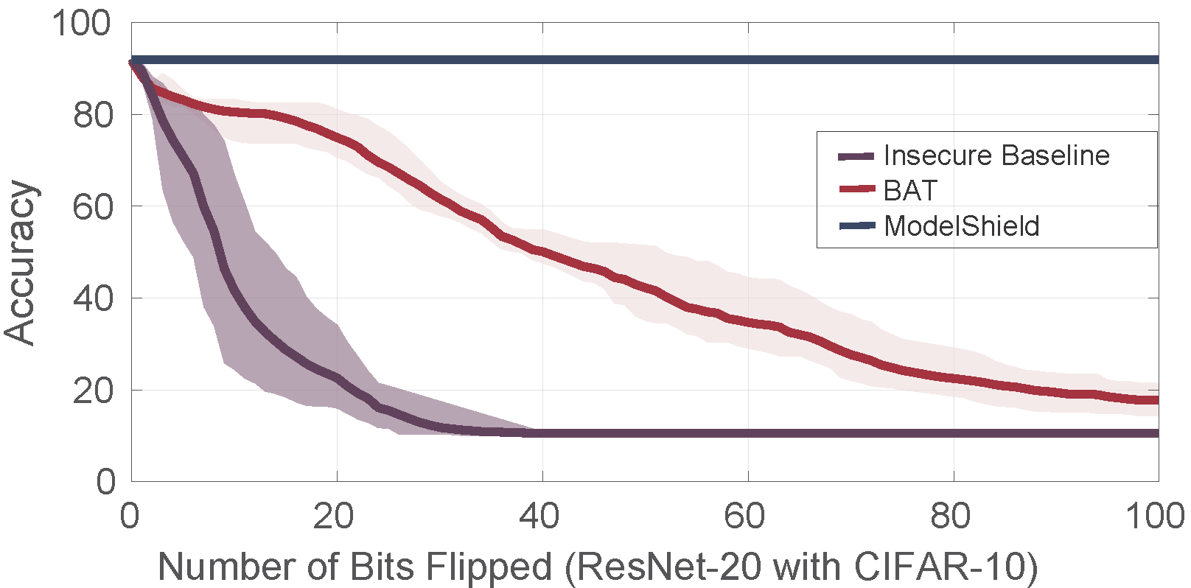
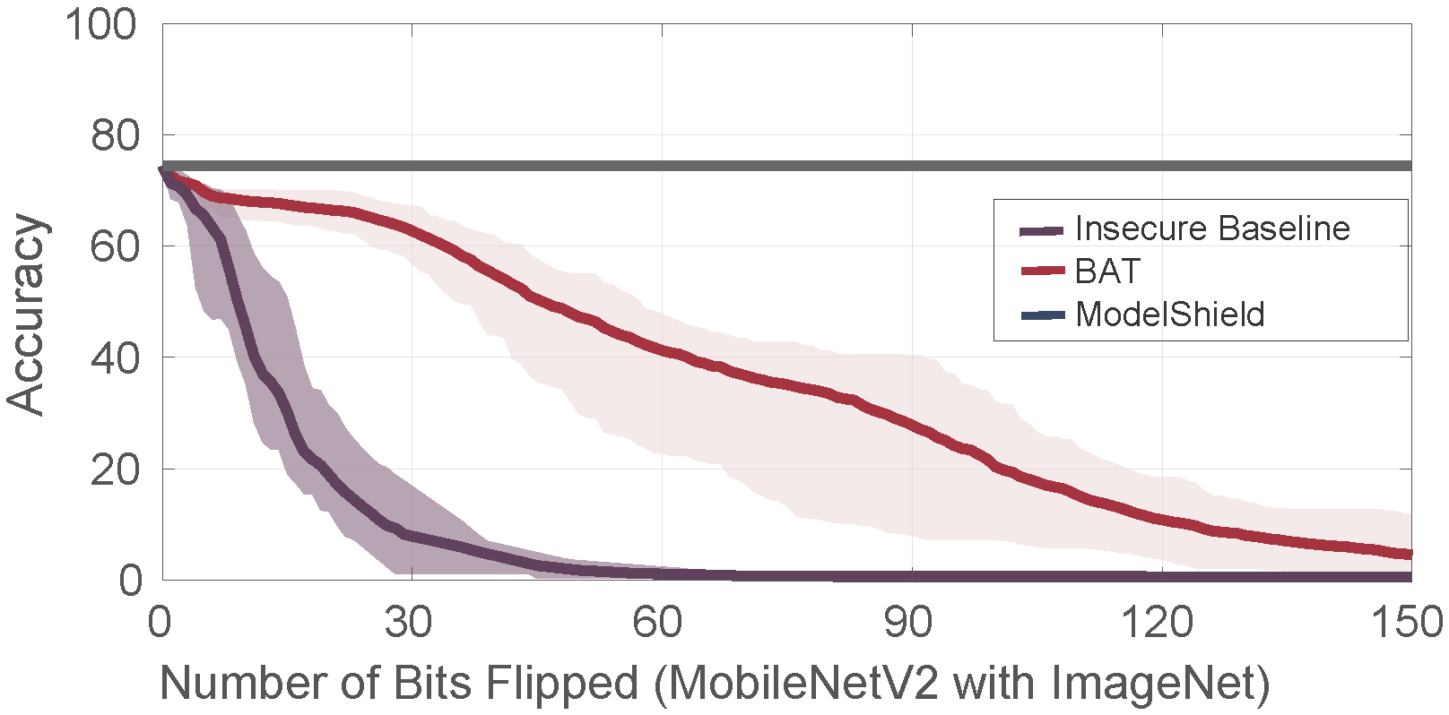
Results
Performance
Security

Slide 7
Thank you!

