Slide 1

Cache Side Channel Attacks on Modern Processors
Yanan Guo
University of Pittsburgh
https://yananguo.com

Slide 2
Outline
Background
Cache Attack -- Flush+Reload
Cache Attack -- Prime+Probe
Our work: Coherence-based cache attacks (S&P’22)
Defenses
Conclusion

Slide 3






Side-Channel Attacks
Bug-free software does not mean safe execution.
Information may leak due to underlying hardware.
Exploit leakage through side-effects.
Power consumption
Execution time
Resource usage

Slide 4
Cache timing side channel attacks:
Attacker monitors the victim's cache access utilization using timing information.

Slide 5
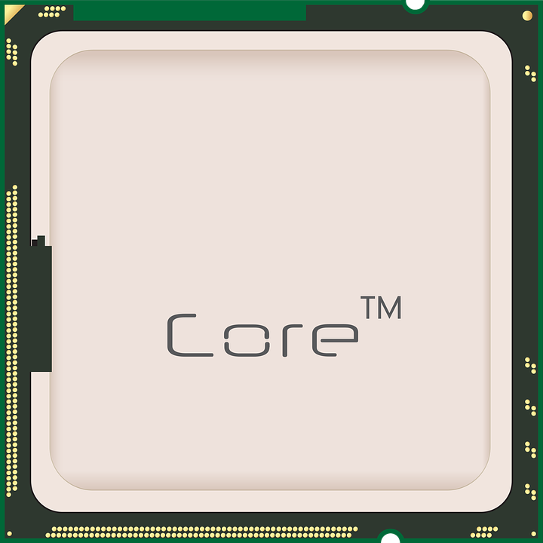
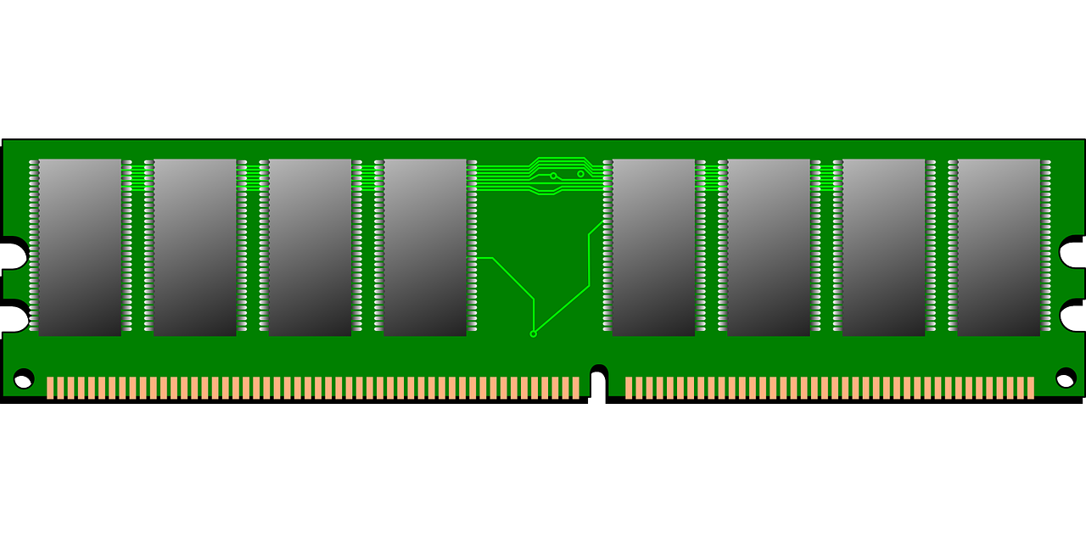
Background: CPU Cache
CPU
Slow!
DRAM

Slide 6
Background: CPU Cache
CPU cache
Slow!
DRAM

Slide 7


Background: CPU Cache
Cache miss
Request
printf("%d", a);
printf("%d", a);
Response
Slow!
DRAM

Slide 8
Background: CPU Cache
Cache miss
Request
a
printf("%d", a);
printf("%d", a);
Response
Slow!
DRAM

Slide 9
Background: CPU Cache
Cache miss
Request
a
printf("%d", a);
printf("%d", a);
Response
Cache hit
Cache hit: faster, less than 60 CPU cycles.​
Cache miss: slower, over 200 CPU cycles.
Slow!
DRAM

Slide 10
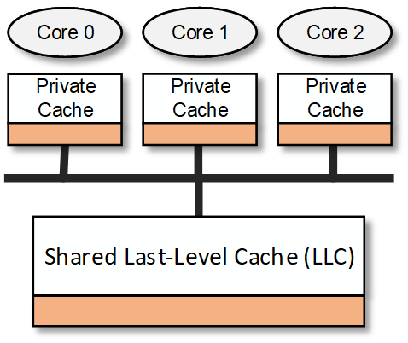
Background: CPU Cache
Cache line

Slide 11
Background: CPU Cache
Set-associative cache
Memory Addresses
Way 0
Way 1
Way 2
Way 3
Set 0
Set 1
…
Set 2^{n}
4-Way Associative Cache

Slide 12
Background: Cache Attacks
Attacker and victim
different processes
Running on the same platform (usually different CPU cores)
Typical three steps:
Step 1: Attacker evicts the data from a cache level.
Step 2: Attacker waits for victim’s execution
Step 3: Attacker checks whether the state of the data is changed
Repeating these three steps, attacker learns victim’s access pattern

Slide 13
An example attack: Flush+Reload

Slide 14

Flush+Reload
Attacker's goal:
Learn the victim's access pattern on Line 0.
Assumption:
Line 0 is shared between attacker and victim (e.g., shared library).
The cache line attacker is interested in.

Slide 15
Flush+Reload
Step 1: The attacker flushes the victim’s data.
clflush:
An x86 instruction.
Takes a virtual address, flushes this address (cache line) from all cache levels.

Slide 16
Flush+Reload
Step 1: The attacker flushes the victim’s data.

Slide 17
Flush+Reload
Step 2: The attacker waits for the victim's execution.

Slide 18
Flush+Reload
Step 3: The attacker reloads the data and times the reload operation.

Slide 19
Flush+Reload
Step 3: The attacker reloads the data and times the reload operation.

Slide 20
Flush+Reload
Victim
Attacker
Time
Access
Flush
Reload
Wait

Slide 21
What can we leak?

Slide 22
Attack 1: RSA Decryption Key
Input: base b, modulo m, exponent e = (e_{n1}...e₀)₂
Output: b^{e} mod m
r = 1
for i = n-1 down to 0 do
r = sqr(r)
…
if e_{i} == 1 then
r = mul(r, b)
…
end
end
Spy addresses (instructions)

Slide 23
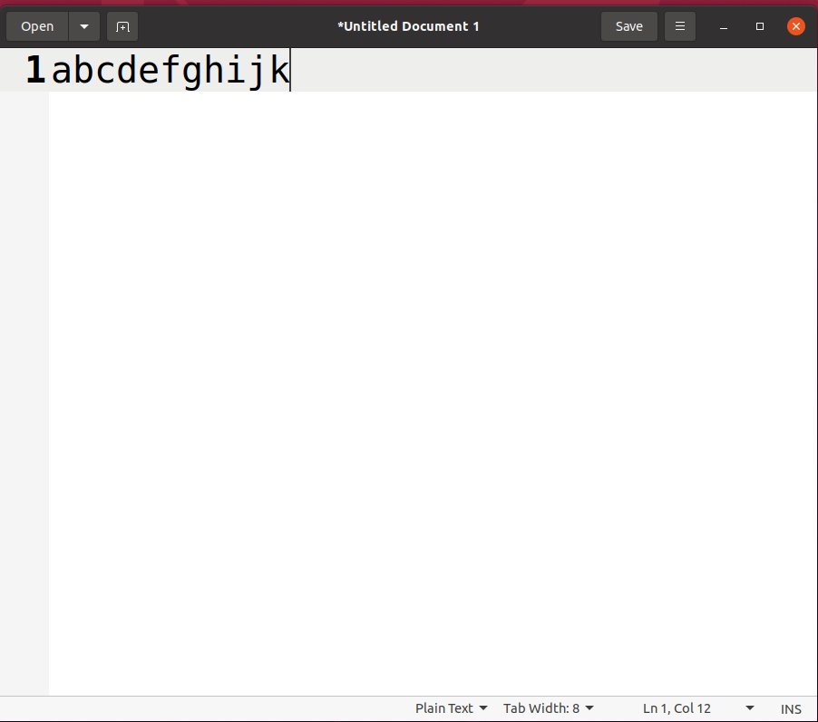
Attack 2: Keystroke Logger
When a key is pressed, certain functions are called in the GDK library.
The attacker can monitor the accesses to that function to detect keystrokes.
How to find that function (addr)?
Profiling...

Slide 24
Another attack: Prime+Probe

Slide 25
Prime+Probe
Step 1: Attacker evicts the victim’s data by priming the set.
Way 0
Way 1
Way 2
Way 3
Set 0
Set 1
V
…
Set n

Slide 26
Prime+Probe
Step 1: Attacker evicts the victim’s data by priming the set.
Way 0
Way 1
Way 2
Way 3
Set 0
Set 1
V
A1
…
Set n

Slide 27
Prime+Probe
Step 1: Attacker evicts the victim’s data by priming the set.
Way 0
Way 1
Way 2
Way 3
Set 0
Set 1
V
A1
A2
…
Set n

Slide 28
Prime+Probe
Step 1: Attacker evicts the victim’s data by priming the set.
Way 0
Way 1
Way 2
Way 3
Set 0
Set 1
V
A1
A2
A3
…
Set n

Slide 29
Prime+Probe
Step 1: Attacker evicts the victim’s data by priming the set.
Way 0
Way 1
Way 2
Way 3
Set 0
Set 1
A4
A1
A2
A3
…
Set n

Slide 30
Prime+Probe
Step 2: Attacker waits for the victim's execution.
Way 0
Way 1
Way 2
Way 3
Set 0
Set 1
A4
A1
A2
A3
…
Set n

Slide 31
Prime+Probe
Step 2: Attacker waits for the victim's execution.
Way 0
Way 1
Way 2
Way 3
Set 0
Set 1
A4
V
A2
A3
…
Set n

Slide 32
Prime+Probe
Step 3: Attacker accesses A1-A4 again and times the access.
Way 0
Way 1
Way 2
Way 3
Set 0
Set 1
A4
V
A2
A3
…
Set n

Slide 33
Cache Attack
Flush-Based Attacks
Eviction
Method
Flush+Reload (2013),
Flush+Flush (2015), Flush+Coherence (2018), Invalidate+Transfer (2015), Reload+Refresh (2020)…
Stateful Cache
Attacks
Conflict-Based Attacks
Prime+Probe (2005),
Evict+Reload (2015), Evict+Time (2006), Prime+Abort (2017), Prime+Scope (2021), Evict+Prefetch (2016)…
Can we find new attack methods?

Slide 34
Cache Attack
Flush-Based Attacks
Eviction
Method
Flush+Reload (2013),
Flush+Flush (2015), Flush+Coherence (2018), Invalidate+Transfer (2015), Reload+Refresh (2020)…
Stateful Cache
Attacks
???
Conflict-Based Attacks
Prime+Probe (2006),
Evict+Reload (2015), Evict+Time (2006), Prime+Abort (2017), Prime+Scope (2021), Evict+Prefetch (2016)…
Can we find new attack methods?

Slide 35
Our Work (S&P 2022)
Flush-Based Attacks
Eviction
Method
Flush+Reload (2013),
Flush+Flush (2015), Flush+Coherence (2018), Invalidate+Transfer (2015), Reload+Refresh (2020)…
Stateful Cache
Attacks
Coherence-Based Attacks
Conflict-Based Attacks
Prime+Probe (2006),
Evict+Reload (2015), Evict+Time (2006), Prime+Abort (2017), Prime+Scope (2021), Evict+Prefetch (2016)…
Can we find new attack methods?

Slide 36
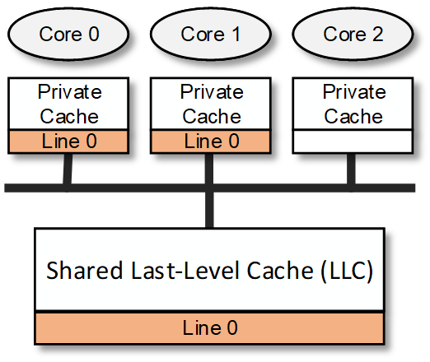
Cache Coherence
Data can be shared by processes/cores.
How do know a copy of cache line is readable/writable?
Need to track the coherence state of each copy of a cache line.

Slide 37
Cache Coherence
x86 processors use MESI (or the variants).
With MESI, invalidation happens upon writes.
Require for ownership (RFO)

Slide 38
Key Insights
Cache coherence protocol can be used for eviction.
RFO can cause cross-core private cache invalidation.
It only happens upon writes.
The shared data between the attacker and victim is typically read-only.
Attacker needs to cause RFO without writing the cache line.
Against the design principle, but maybe possible due to implementation flaws.

Slide 39
Key Insights
x86 data prefetching instructions
PREFETCHT0, PREFETCHT1, PREFETCHT2 …, for reads.
PREFETCHW, for writes.
PREFETCHW
It prefetches the data into the private cache and changes the coherence state to Modified.
On Intel Core i7-6700, Core i7-6800K, Core i7-7700K, Core i9-10900X,
Property 1: PREFETCHW works on read-only data.
Property 2: PREFETCHW has timing variance.
PREFETCHW is available since Broadwell.
Are the two properties always true on Intel processors?

Slide 40
Key Insights
Processor | Microarch. | LLC Type | Property #1 | Property #2
Core i7-6700 | Skylake | Inclusive | Yes | Yes
Core i7-6800K | Skylake | Inclusive | Yes | Yes
Core i7-7700K | Kaby Lake | Inclusive | Yes | Yes
Core i9-10900X | Cascade Lake | Non-inclu. | Yes | Yes
Xeon Silver 4114 | Skylake-SP | Non-inclu. | Yes | Yes
Xeon Plat. 8151 | Skylake-SP | Non-inclu. | Yes | Yes
Xeon Plat. 8124M | Skylake-SP | Non-inclu. | Yes | Yes
Xeon Plat. 8175M | Skylake-SP | Non-inclu. | Yes | Yes
Xeon Plat. 8259CL | Skylake-SP | Non-inclu. | Yes | Yes
Xeon Plat. 8275CL | Skylake-SP | Non-inclu. | Yes | Yes
Xeon Plat. 8375C | Ice Lake | Non-inclu. | Yes | No

Slide 41
Our proposal
Two cross-core private cache attacks
Prefetch+Prefetch
Prefetch+Reload
Threat Model
Attacker and victim are on different processor cores.
Attacker can share data with the victim (e.g., through shared library).
In Prefetch+Prefetch, the attacker has (at least) one thread.
In Prefetch+Reload, the attacker has (at least) two threads.

Slide 42
Prefetch+Prefetch

Slide 43
Prefetch+Prefetch
Can we load and time the load instead?
Not by the same attacker’s thread.

Slide 44
Prefetch+Prefetch
Can we load and time the load instead?
Not by the same attacker’s thread.
What if the attacker has a second thread?

Slide 45
Prefetch+Reload

Slide 46
Prefetch+Reload

Slide 47
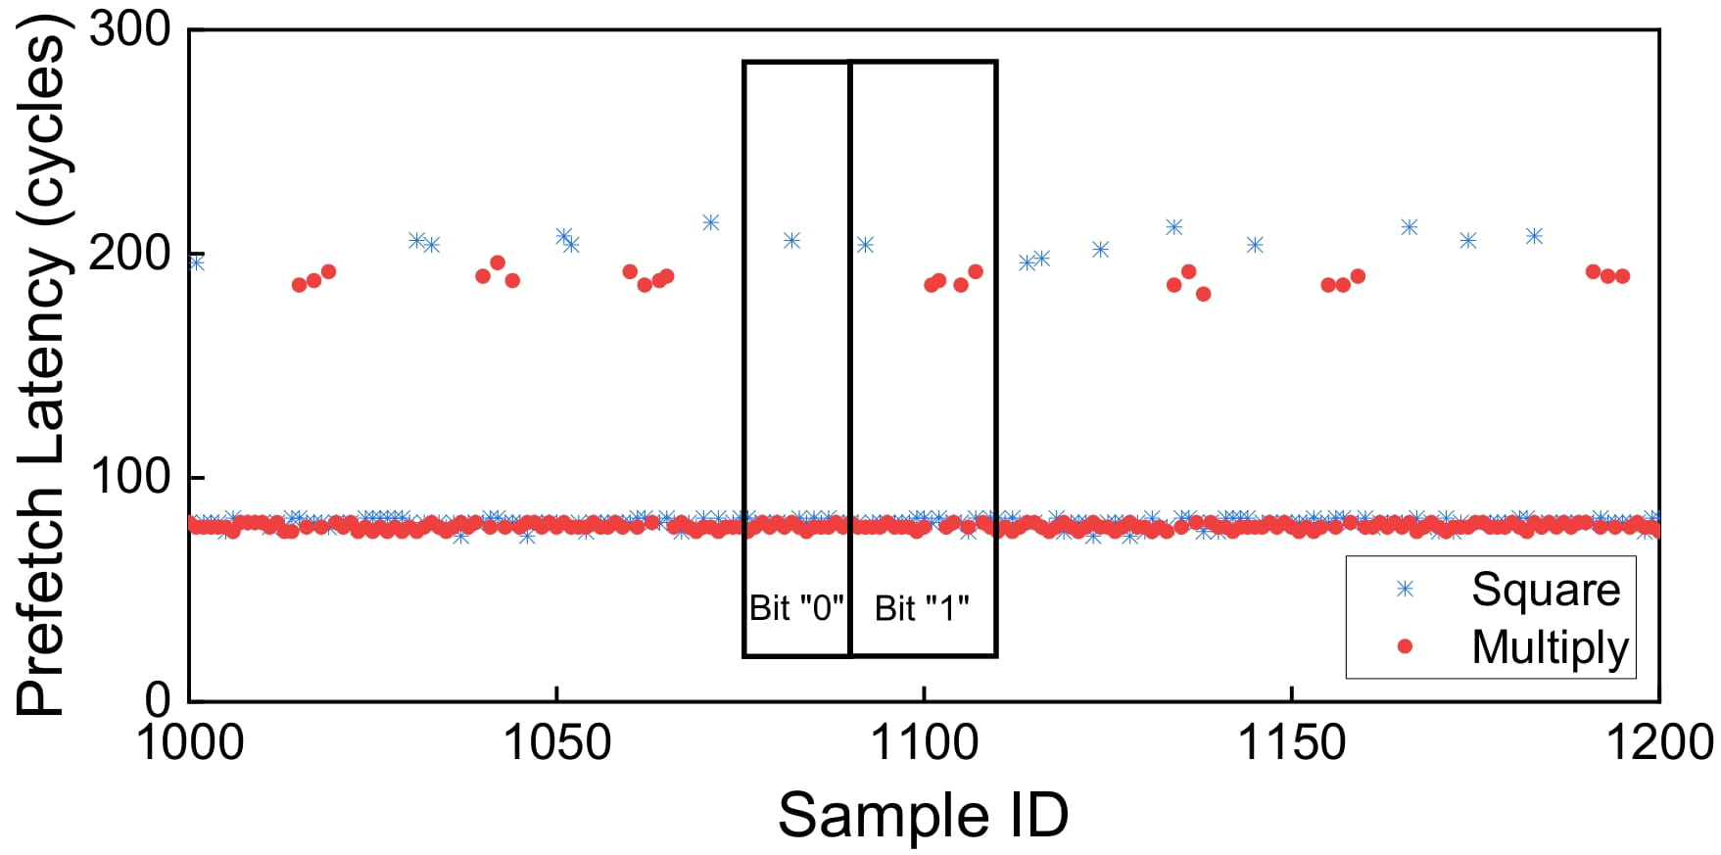
Evaluation-Side Channel
Input: base b, modulo m,
exponent e = (e_{n1}...e₀)₂
Output: b^{e} mod m
r = 1
for i = n-1 down to 0 do
r = sqr(r)
…
if e_{i} == 1 then
r = mul(r, b)
…
end
end
Prefetch+Prefetch Result

Slide 48
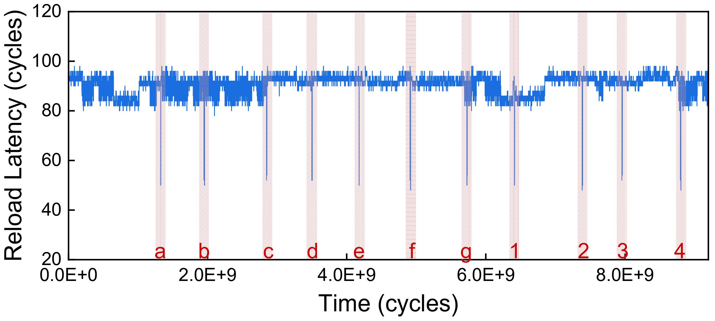
Evaluation-Side Channel
Prefetch+Reload Result

Slide 49
Evaluation-Side Channel
Compared to Flush+Reload?
Much higher temporal resolution.
Flush+Reload requires a waiting window
The window needs to be long enough to not miss a victim's event.
But Prefetch+Prefetch does not need a waiting window.
Temporal resolution: ~100 cycles VS 4000 cycles
Wait

Slide 50
Evaluation-Covert Channel
Covert Channel (隐蔽信道)
Processor | Prefetch+Reload | Prefetch+Load | Prefetch+Prefetch
Core i7-6700 | 631 KB/s | 709 KB/s | 721 KB/s
Core i7-7700K | 782 KB/s | 840 KB/s | 822 KB/s
Xeon Plat. 8124M | 394 KB/s | 586 KB/s | 556 KB/s
Xeon Plat. 8151 | 476 KB/s | 680 KB/s | 605 KB/s
Flush+Reload: ~270 KB/s

Slide 51
Evaluation-Covert Channel
With transient execution attacks
1) The covert channel speed determines the leakage rate of transient execution attacks
Spectre v1 with Prefetch+Prefetch vs Spectre v1 with Flush+Reload: 3.02* faster
Spectre v1 with Prefetch+Reload vs Spectre v1 with Flush+Reload: 1.61* faster
2) Prefetch-based covert channels: faster encoding operation
More secret bytes can be leaked within the transient window
In the Spectre-V1 window
8 bytes can be leaked with Flush+Reload
17 bytes can be leaked with Prefetch+Prefetch
If (x< array1_size)
y0 = array2[array1[x] * 4096];
If (x+n < array1_size){
y0 = array2[0][array1[x] * 4096];
y0 = array2[0][array1[x] * 4096];
…
y0 = array2[0][array1[x] * 4096];}

Slide 52
Defense
How to defend prefetch-based attacks?
Add permission check on prefetchw
Avoid data sharing among processes
Will waste a lot of memory
Modify the cache coherence protocol
Chenlu Miao et al. "SwiftDir Secure Cache Coherence Without Overprotection". In MICRO 2022.

Slide 53
Thanks!

