Slide 1
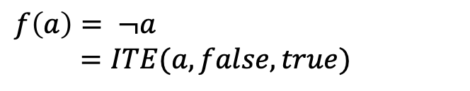
a
$$f\left(a\right)= ¬a$$
$=ITE(a, false, true)$
(a=false)
(a=true)
TRUE
FALSE

Slide 2

c
b
$$f\left(a,b,c\right)=ab+c$$
a
FALSE
TRUE

Slide 3

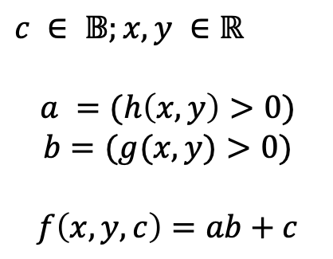

c
$$g\left(x,y\right)>0$$
$c ∈ 𝔹;x,y ∈ℝ$
$$a =(h\left(x,y\right)>0)$$
$$b=(g(x,y)>0)$$
$$f\left(x,y,c\right)=ab+c$$
$$h\left(x,y\right)>0$$
FALSE
TRUE

Slide 4

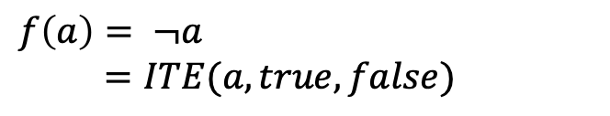


$$\tilde{x}>0$$
$$f\left(a\right)= ¬a$$
$=ITE(a, true, false)$
$$−100+ε_{1}\text{,}$$
$100+ε_{1}$,

