Slide 1
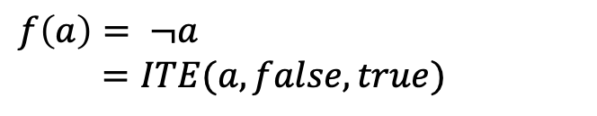
a
$$f\left(a\right)= ¬a$$
$=ITE(a, false, true)$
(a=false)
(a=true)
TRUE
FALSE

Slide 2

c
b
$$f\left(a,b,c\right)=ab+c$$
a
FALSE
TRUE

Slide 3

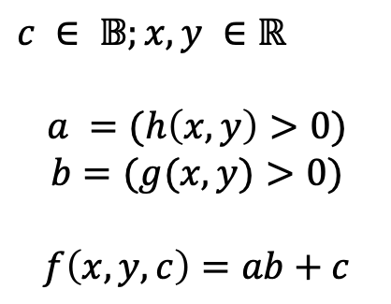

c
$$g\left(x,y\right)>0$$
$c ∈ 𝔹;x,y ∈ℝ$
$$a =(h\left(x,y\right)>0)$$
$$b=(g(x,y)>0)$$
$$f\left(x,y,c\right)=ab+c$$
$$h\left(x,y\right)>0$$
FALSE
TRUE

Slide 4

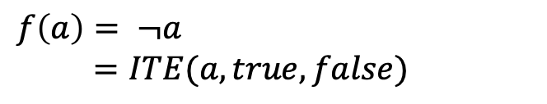


$$\tilde{x}>0$$
$$f\left(a\right)= ¬a$$
$=ITE(a, true, false)$
$$−100+ε_{1}\text{,}$$
$100+ε_{1}$,

Slide 5
DDBuilder
Factory
real(..)
integer(..)
boolean(..)
Constants
Reals.All, …
ConditionManager
NoiseVariableManager
Interface DD<ValueType>
Constants: empty, zero, one, all
Set functions: intersect(..), union(..)
Apply functions (implementation): applyGeneric(..), applySplitGeneric(), …
Real (alias AADD)
Constants (ref.)
Set Functions
Arithmetic functions via apply
LP Solver
Integer (alias IDD)
Constants (ref.)
Set Functions
Arithmetic functions via apply
Boolean (alias BDD)
Constants (ref.)
Set Functions
Boolean functions via apply
UnaryFunction
Math. properties
linearize()
splitPoints
AffineForm
IntegerRange
XBool
ValueRange<*>: Constants empty, zero, one, all; Set functions intersect, union

