Slide 1
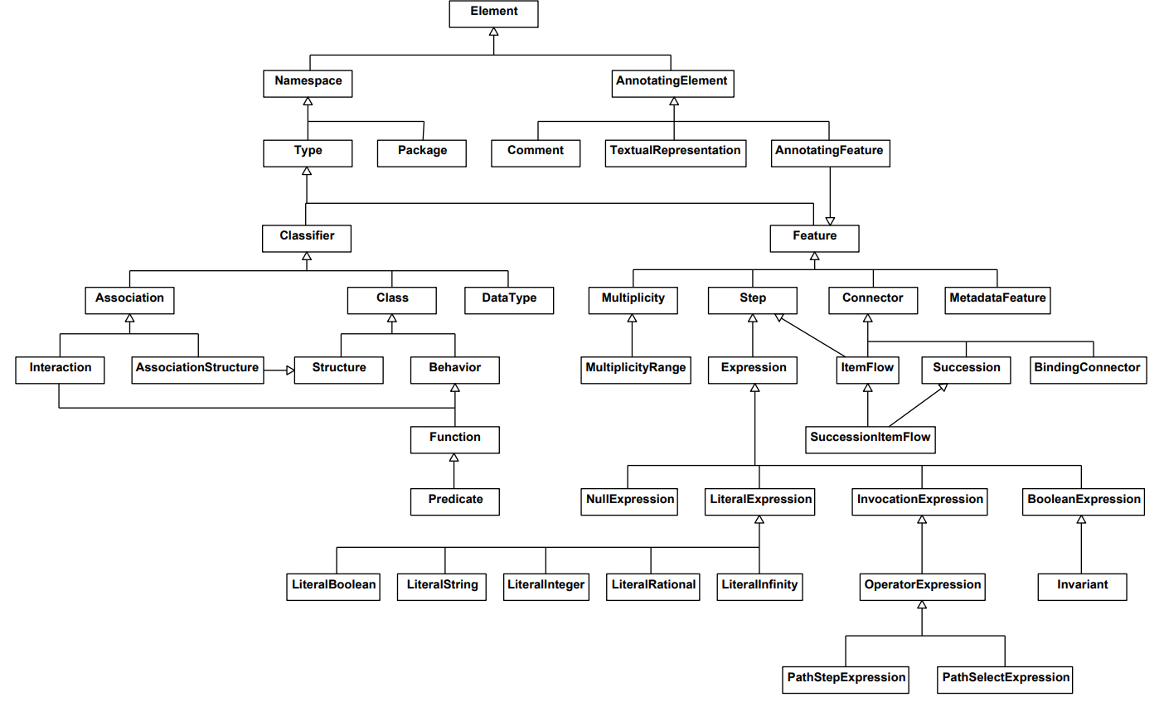
SysML v2 vs. KerML Classes
(Names not matching)
Semantics for constraints
propagation

