Slide 1
SysMD Metamodel Color Badges
Package, Namespace (pure), Annotating Elements = Green, Dark Green
“Structure”
Feature, Structure, Part, Port, Connection, Interface … = Blue
Type, Part Def, Port Def, Connection Def, … = Dark Blue
“Compute”
Expression, Feature with Expression, Attribute, Invariant, etc. = Red
Function, Attribute Def, etc. = Magenta
“Behavior”
Step, Transitions, … ? = Orange
Definitions of Behavior = Dark Orange
Objectives of color badges:
Support navigation in hierarchy, find calculations quickly !
Guide user to Expressions, Invariants for SysMD’s solver (= red)
Structure & Behavior (= red)
Doc, Packages (= green)
Distinguish and at the same link Definitions and Usage by color + same color in darker tone.

Slide 2
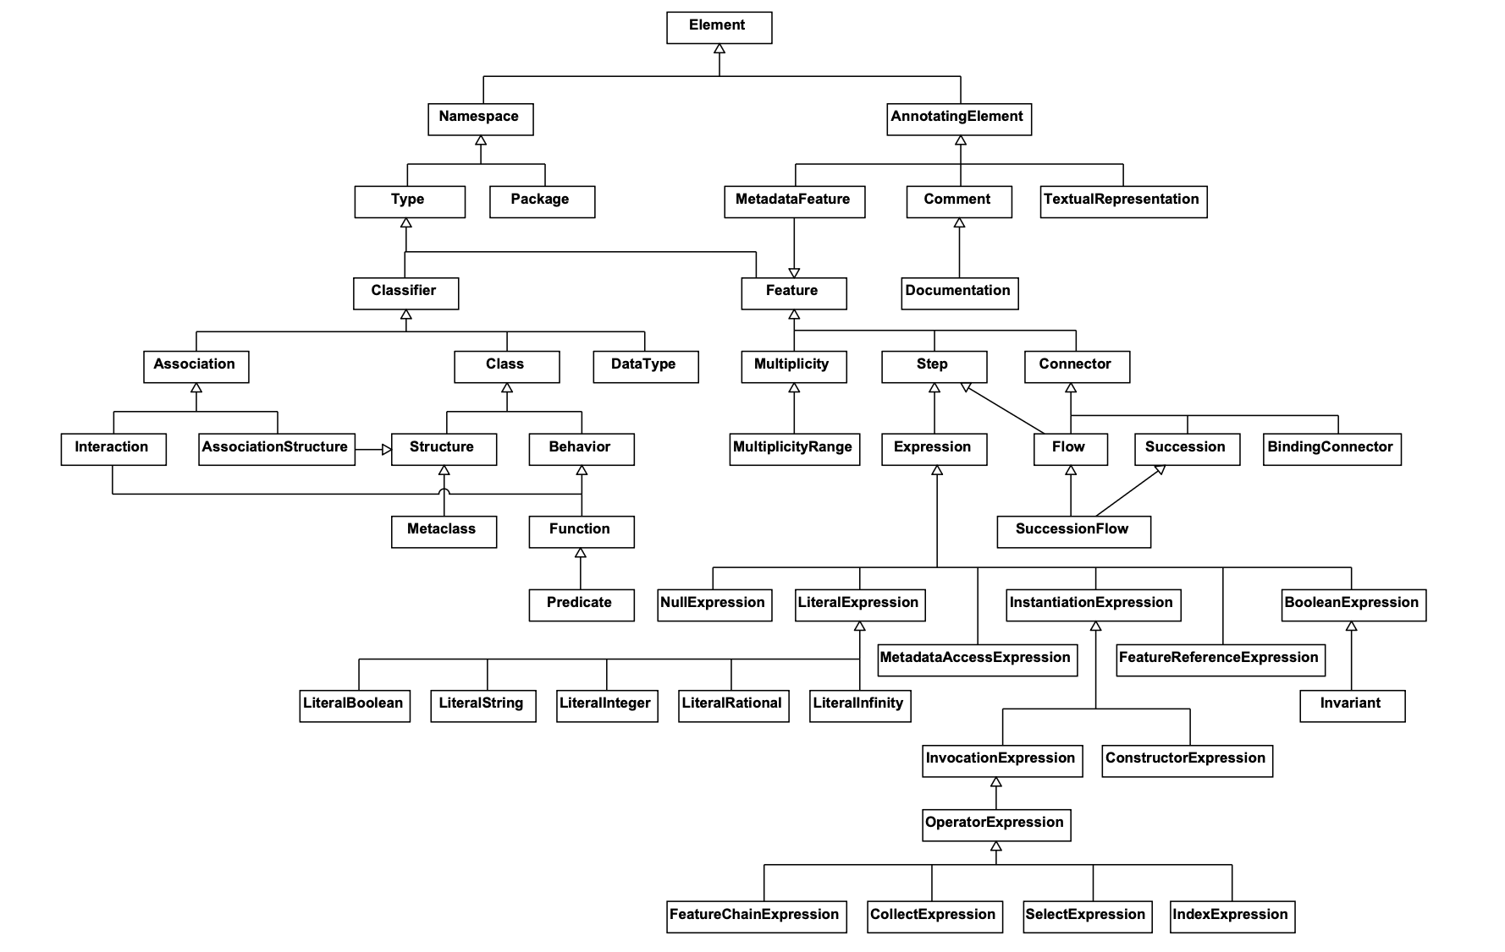
(Model mgmt., Doc)
(Structure, Behavior)
(SysML: Attribute Def, Constraint Def, …)
(SysML: Attribute Def, Constraint Def, …)
Classifications, Definitions = darker tone.
Features, Usages = regular tone.
(Calculations )
(SysML: Attribute Usage, Constraints, …)

