Slide 1
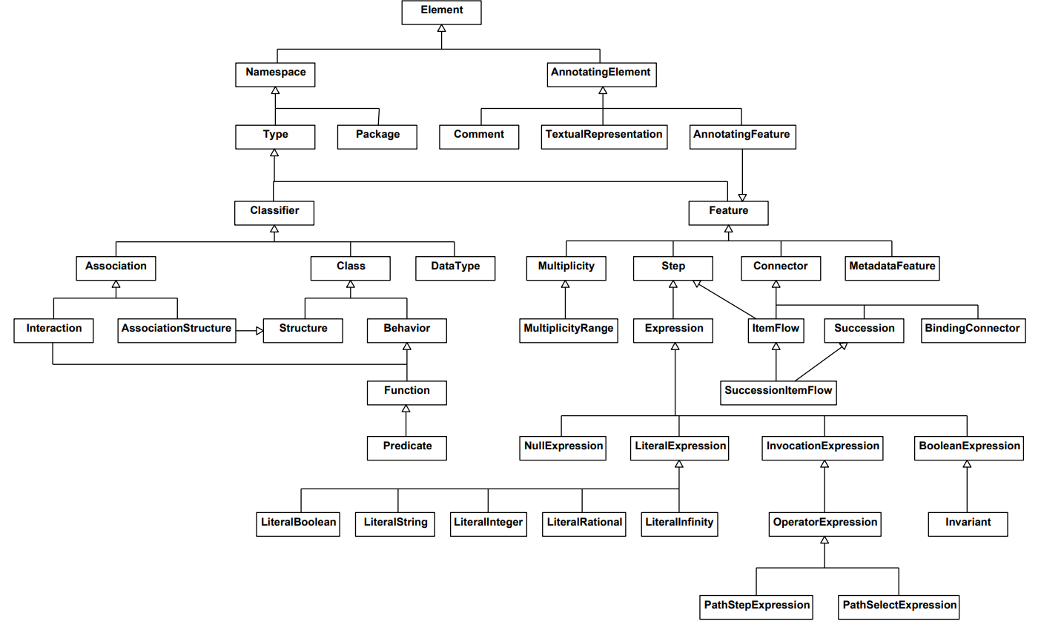
KerML support status
(Names not matching)
Semantics for constraints
propagation

