Slide 1
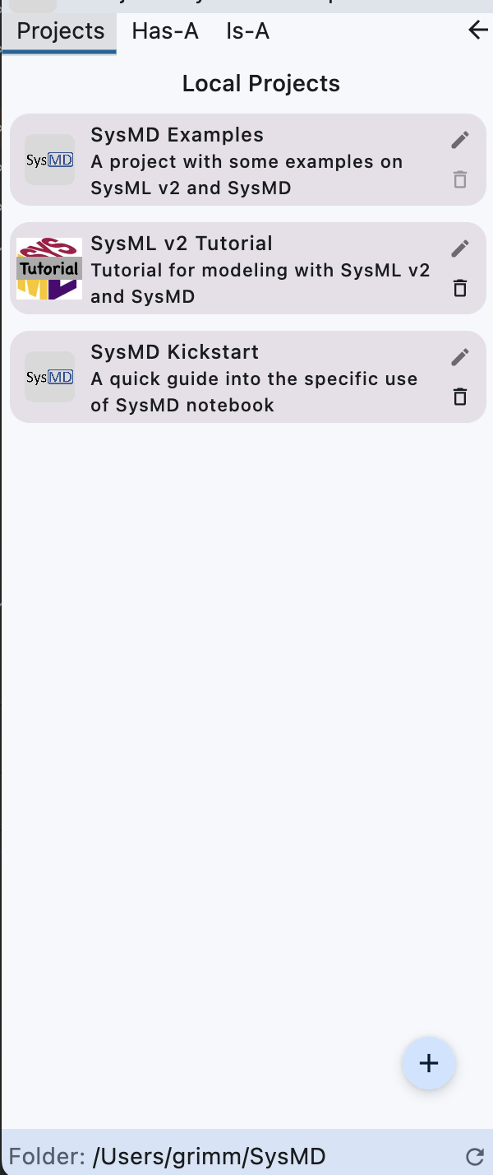
Start session using the project.
Update project infos
Delete the project
Create a new project
Text field for choosing folder with projects.

