Slide 1
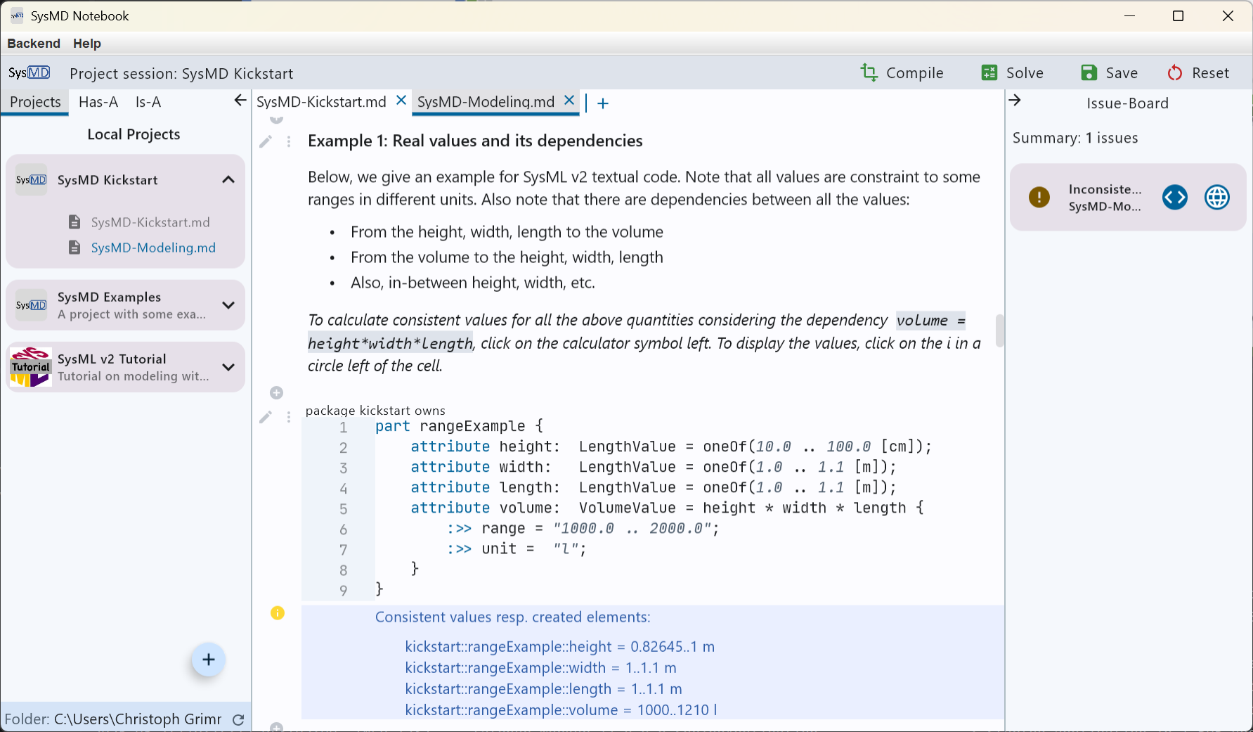
Files of project
Document cell(s)
Code cell(s)
Navigation pane (left): Projects, Ownership tree (has-A), Inheritance tree (is-A)
Board pane (right):
Errors, Issues, Messages
Solver results

Slide 2
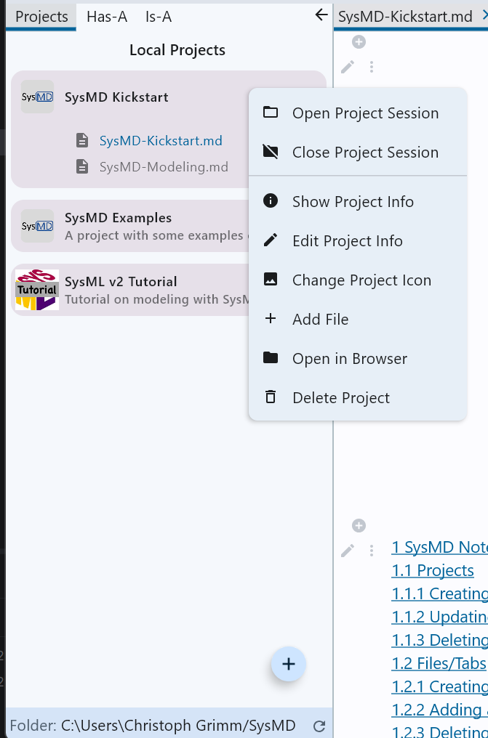
Project in Session
Files are shown
Can be opened in tabs
Compile, Solve, …
Project Menu
Can be selected by Right/double Click
Project
Can be selected by Click
Project Menu
Can be selected by Right/double Click

