Slide 1
Open World Streaming:
Automatic memory management in open world videogames without loading screens
Alejandro Juan Pérez

Slide 2
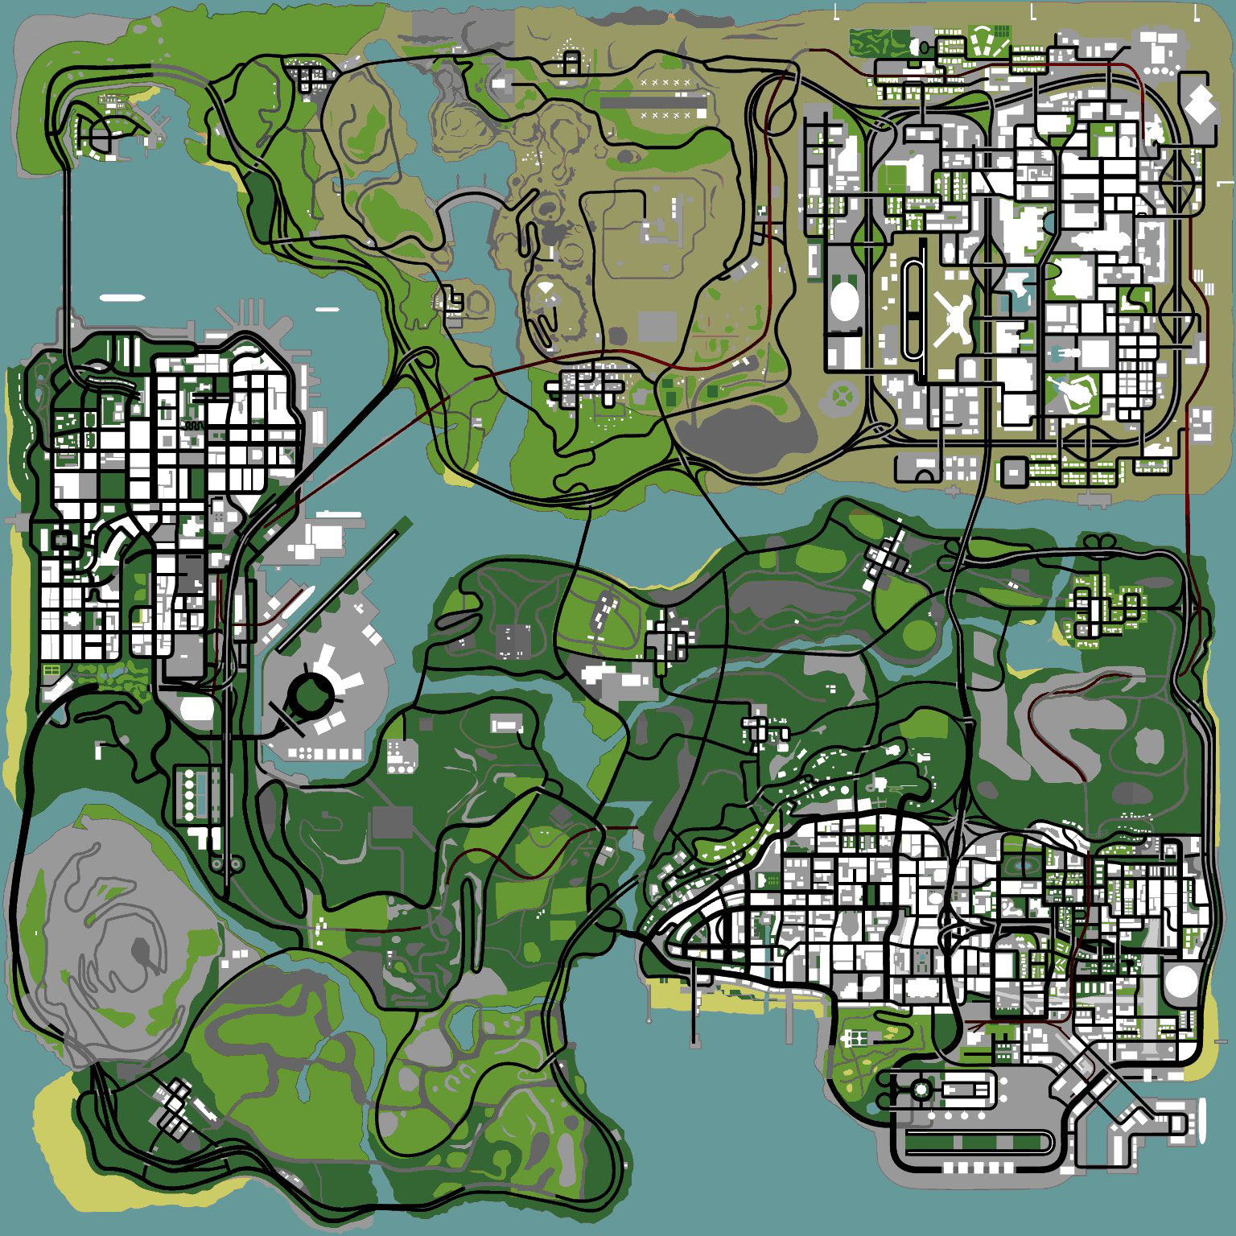
Open world videogames
Big worlds.
Freedom
Non-linear gameplay
Notes:
- Big world
- Non linear story thread
- Freedom on what to do next
- Take missions or not
- (Could get lost)
- Discovery
- Secrets
- Easter eggs

Slide 3
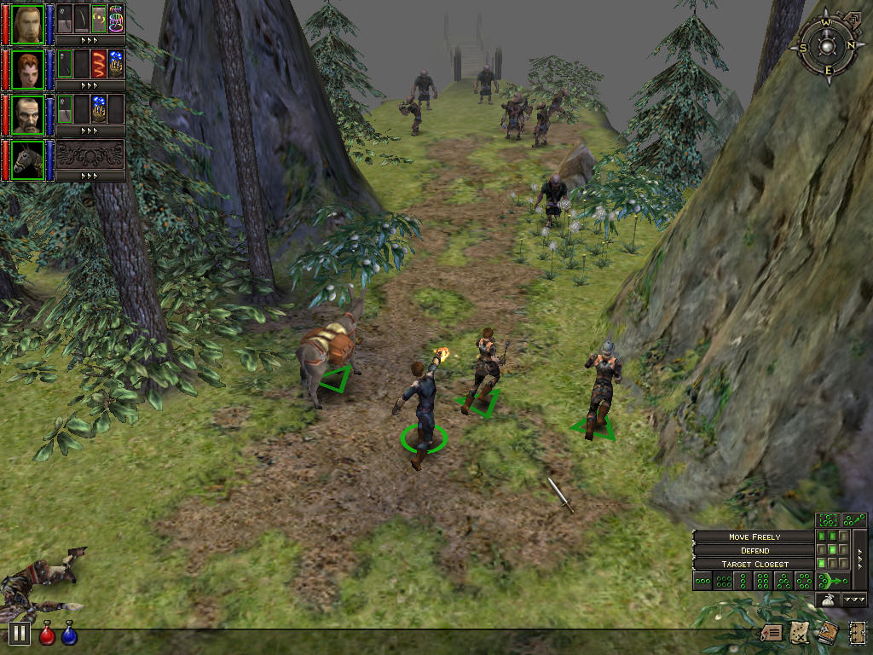
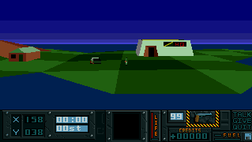
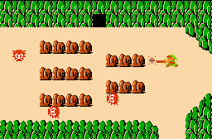
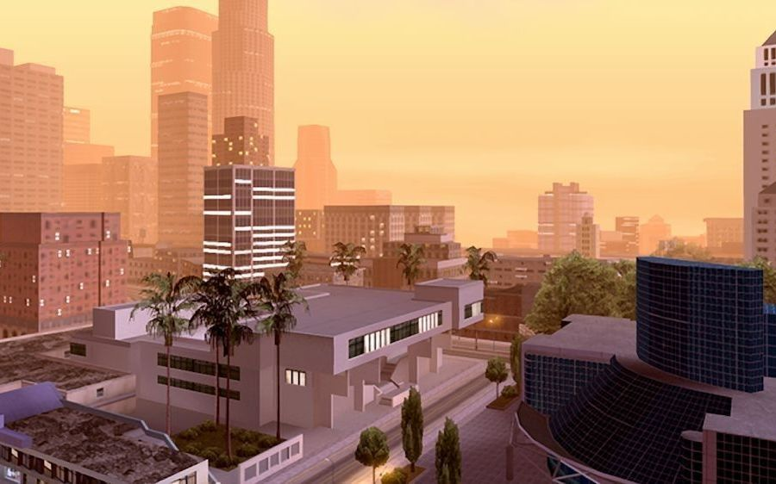
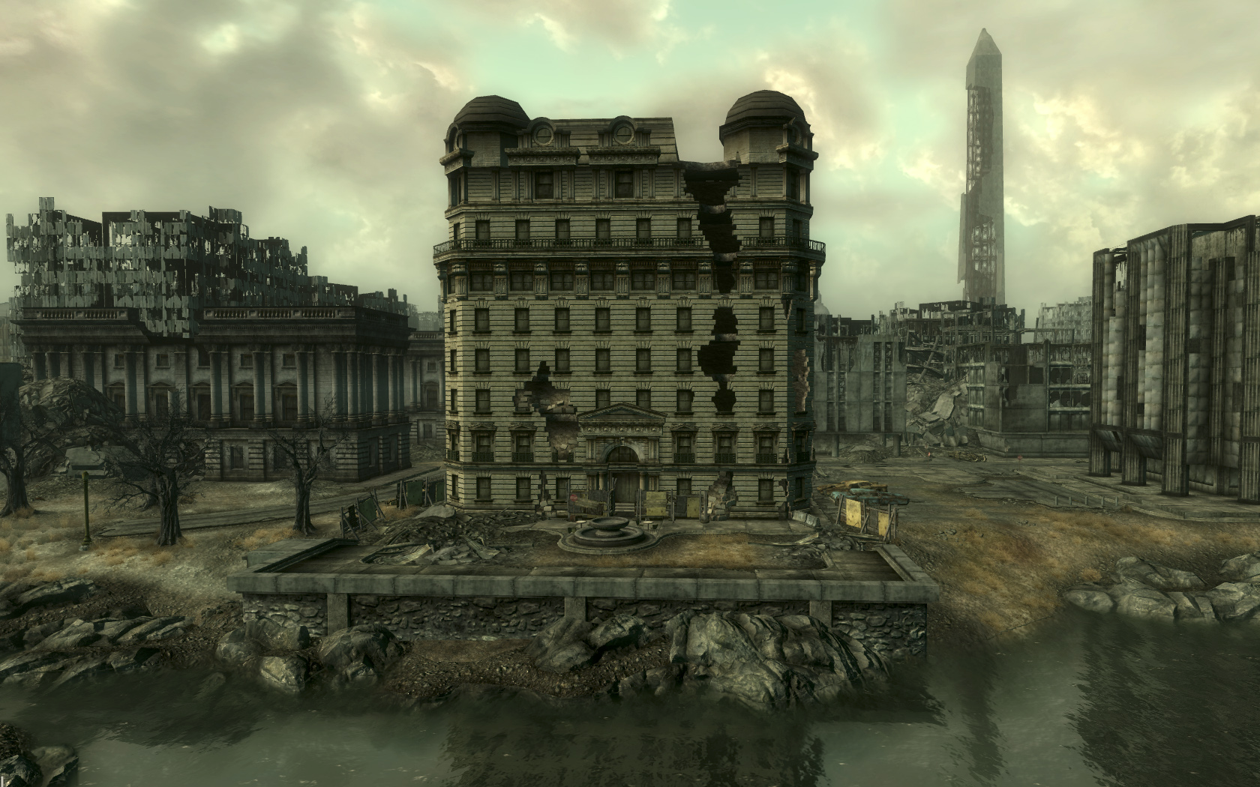
Open world videogames

Slide 4
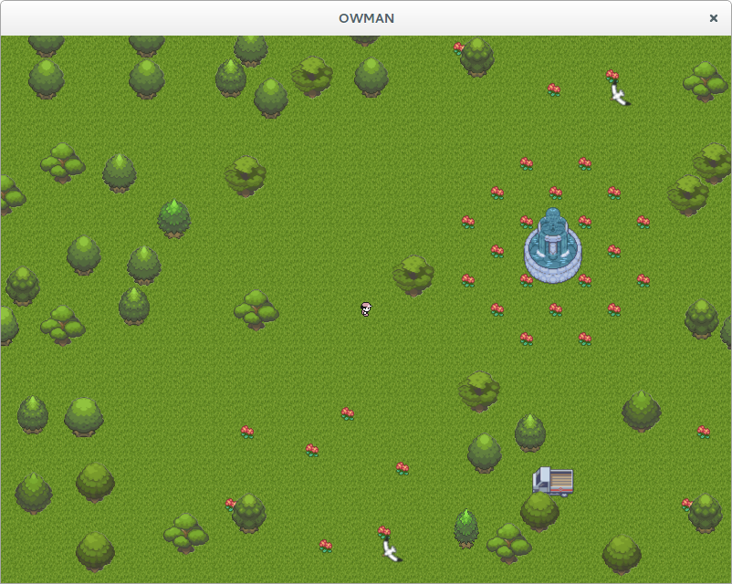

Slide 5
The Continuous World of Dungeon Siege by Scott Bilas

Slide 6
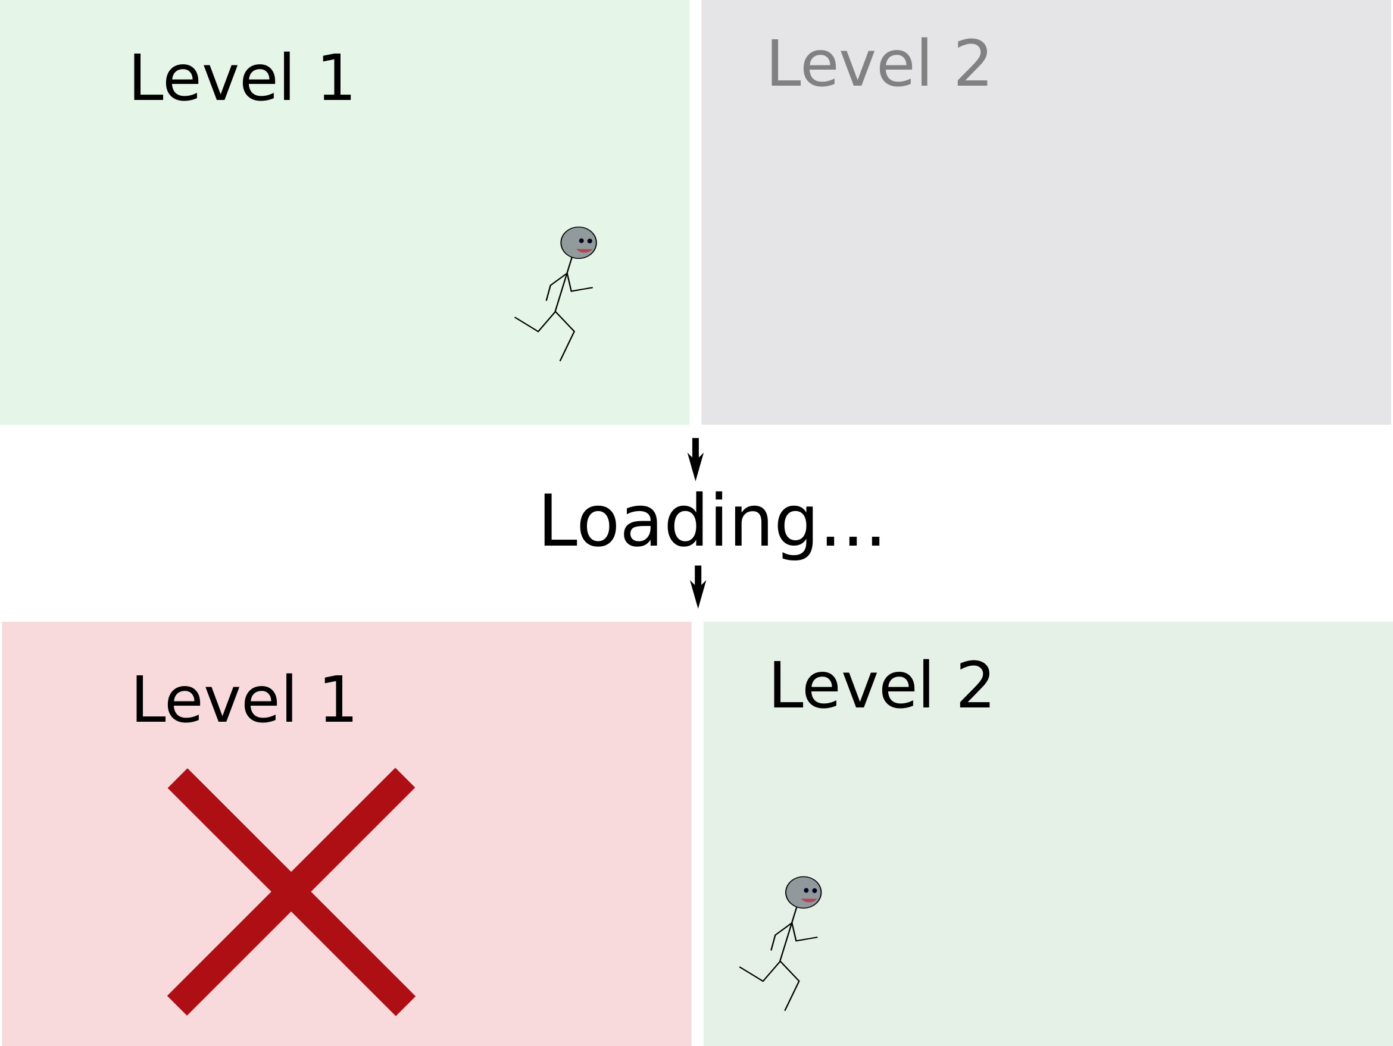
Level-based videogames

Slide 7

Loading screens ...

Slide 8
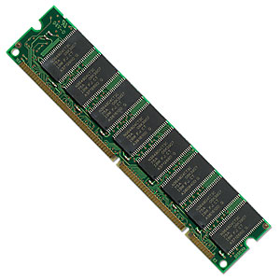
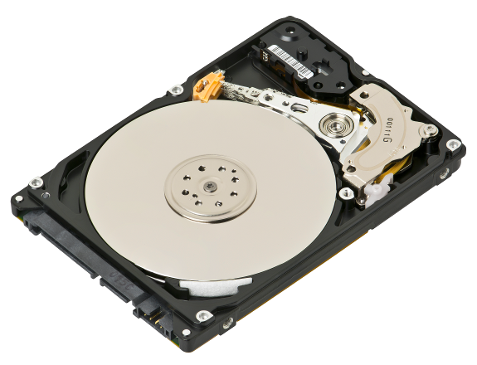
Technology limitations
+ Big
- Slow
- Small
+ Fast

Slide 9
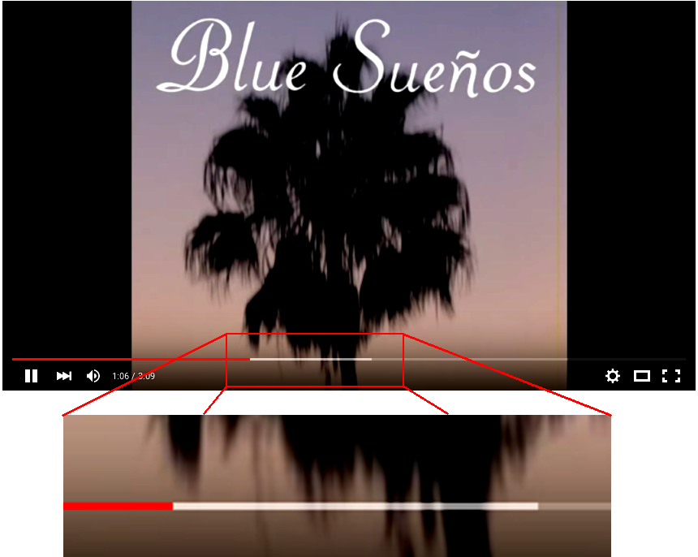
Streaming

Slide 10
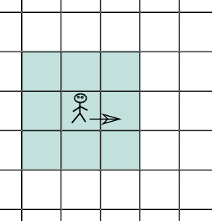
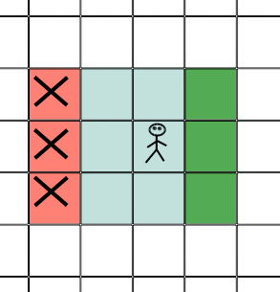
The strategy

Slide 11
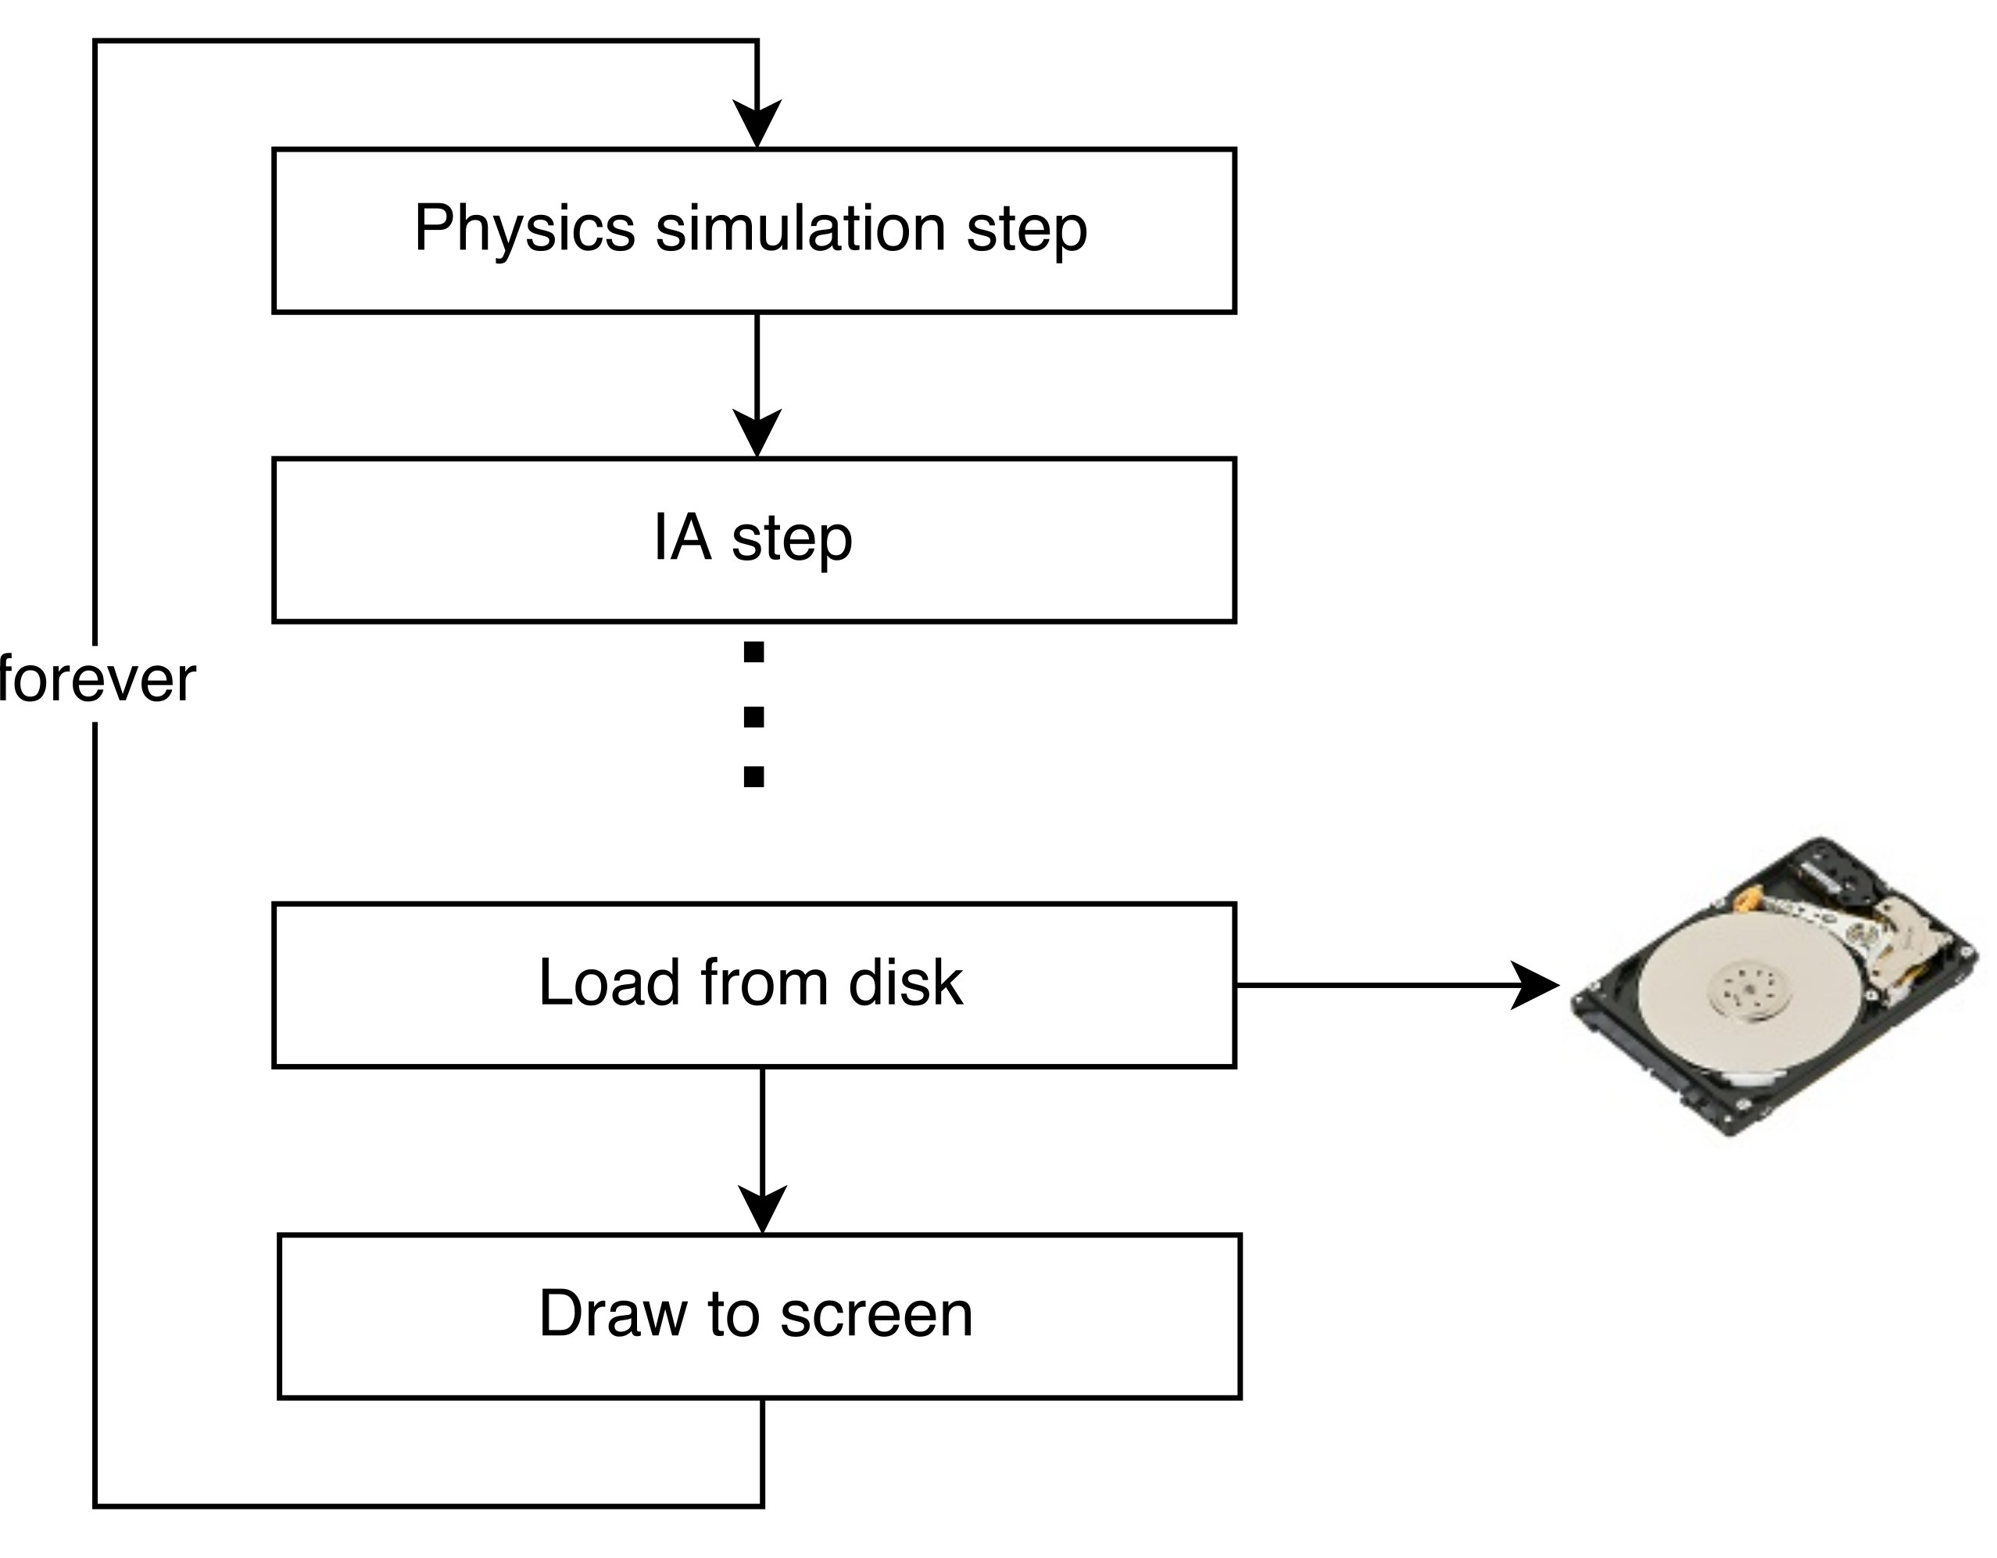
Game loop

Slide 12
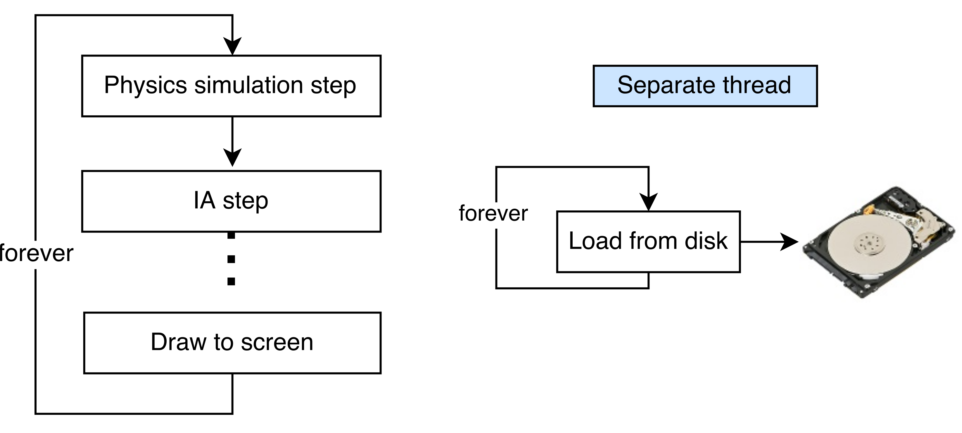
Multithreading

Slide 13
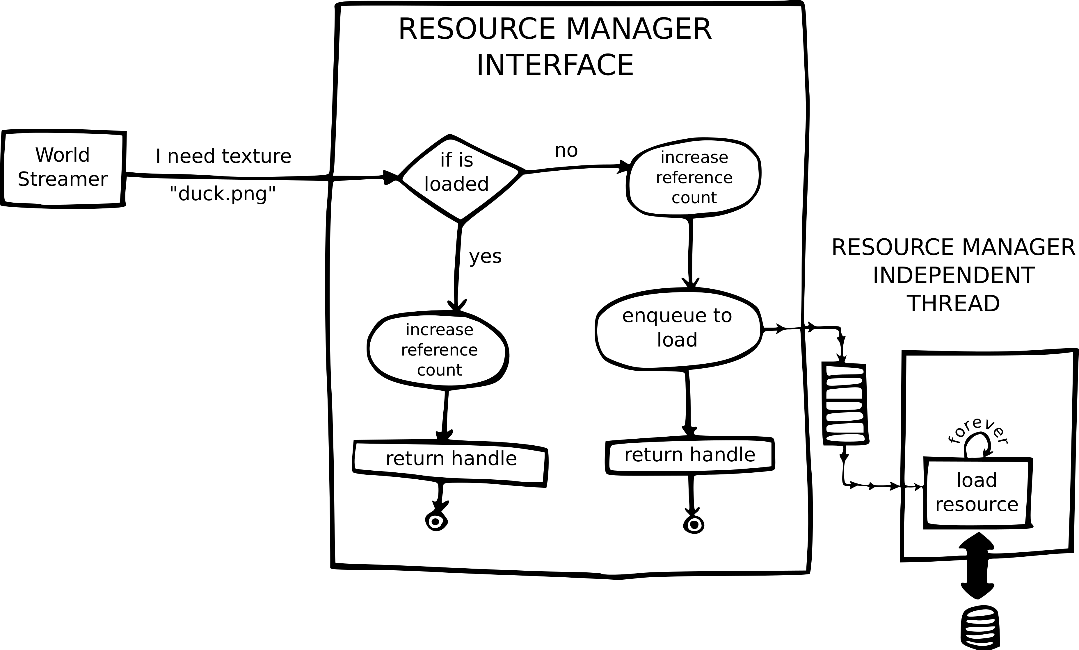

Slide 14
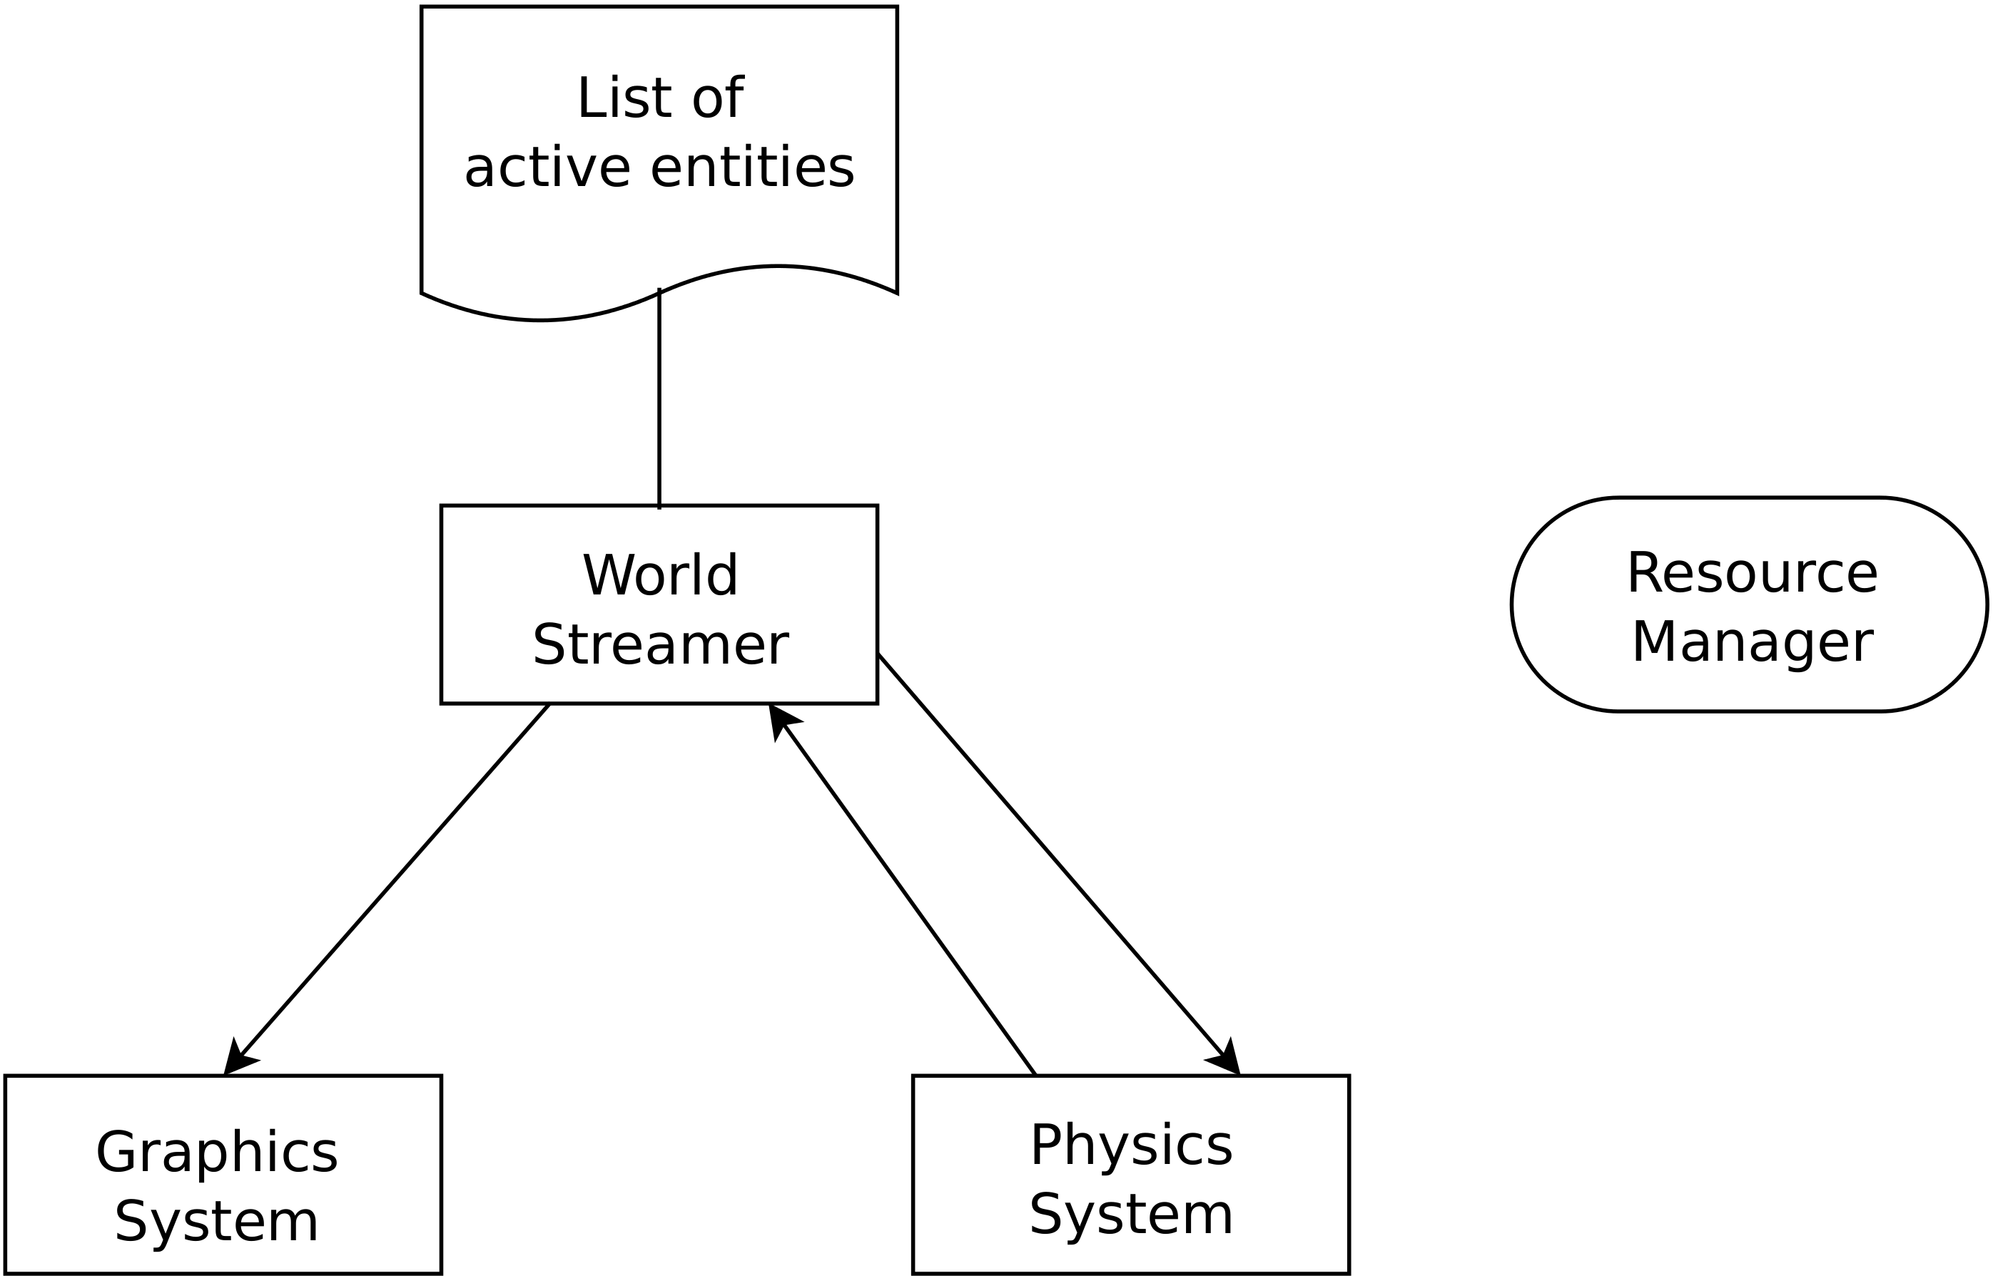
The architecture

Slide 15
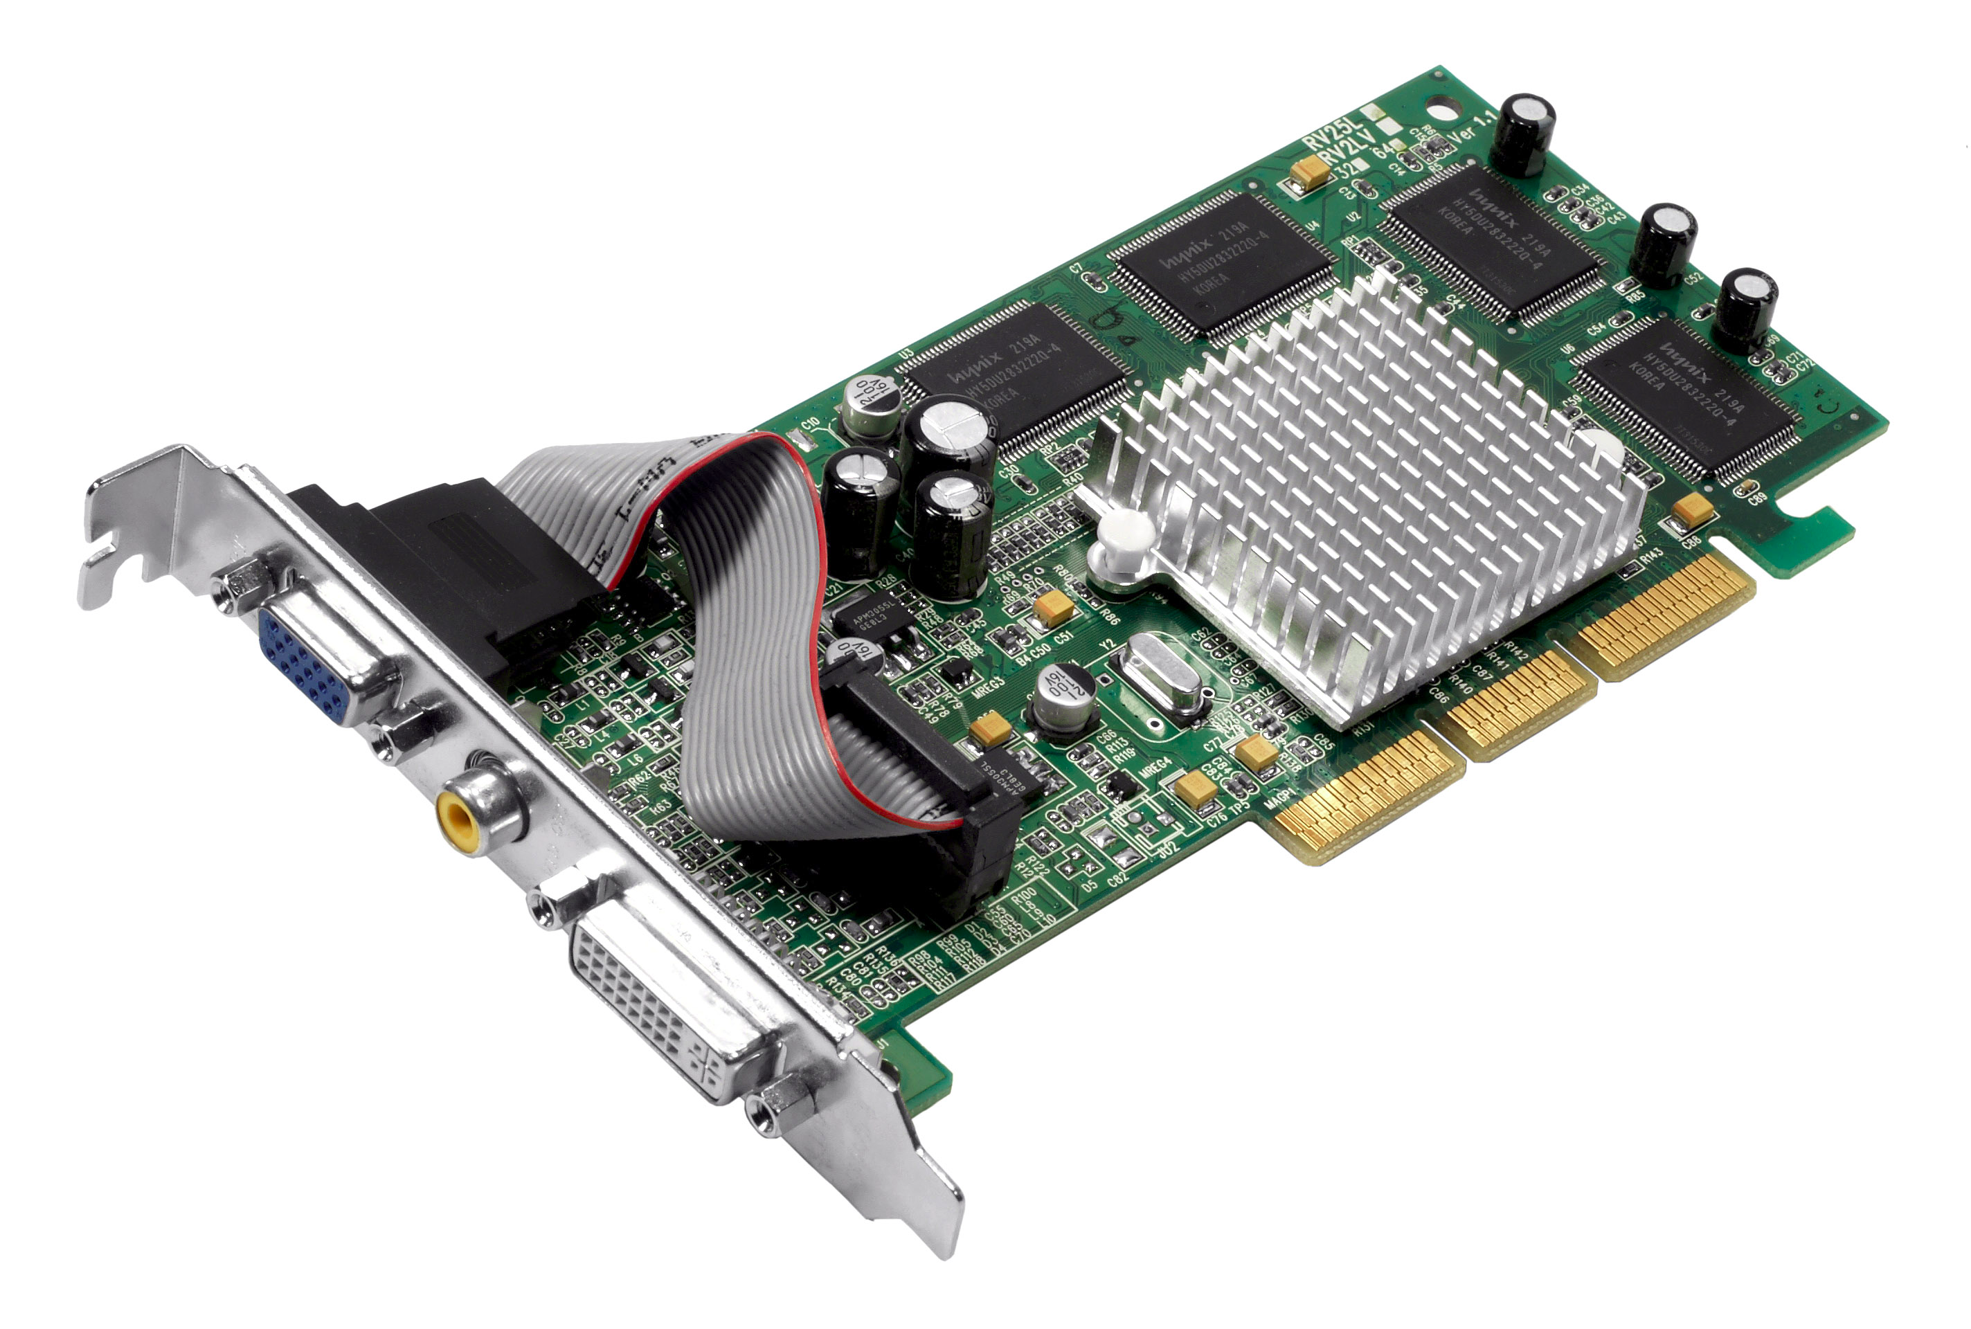
VRAM loading issue
All OpenGL calls must be performed by the same thread.

Slide 16
VRAM loading issue
All OpenGL calls must be performed by the same thread.
Secondary
thread
Main
thread

Slide 17
Precision issue

Slide 18
Use double
Easy to implement
Not scalable
Graphics card might not support
Bad performance

Slide 19
Use fixed point
Fixed precision
Can double precision
Physics engine might not support
Graphics card might not support
Difficult to integrate with other software

Slide 20
Moving the origin of coordinates
Place the origin of coordinates close to the entities.
Store positions as tuple:
  Cell : Vector<int>
  Relative position : Vector<float>

Slide 21
Moving the origin of coordinates
Escalable (2x or more)
Native performance
Good compatibility
Can integrate with other software
Difficult to implement

Slide 22
Demo
https://vimeo.com/159836286

Slide 23
Achieved targets
Stable game engine.
Support for huge worlds.
No loading screens.
Stable FPS.
Accurate physics integration.
Animations.
Abstraction.
Persistence.

Slide 24
More achieved targets
CPU consumption independent of world size.
Very low memory usage wrt world size.
  40K cells → 26 MB
  1M cells → 71 MB
Automatic world generation scripts for arbitrary world size.
Tested with worlds of 10 x 10 Km and millions of entities.

Slide 25
More achieved targets
Used programming patterns.
  Singleton.
  Abstract factory.
  Facade.
  Strategy.
  Etc.
Documented using Doxygen.
Compact code: 13K → 7.5K.
Easy to read.

Slide 26
Languajes, tools and libraries
C++
Python
OpengGL
GLEW
GLM
SOIL
SDL2
RapidXML
Apitrace
Doxygen
Box2D
POSIX threads

Slide 27
Future
Scripting (ongoing).
Sound.
Editor tool.
Data compression.
  4GB → 500MB

Slide 28
https://github.com/tuket/OWMAN

Slide 29
The End
“Streaming is the backbone of everything we do. Everyone at the company understands how it's structured.”
– Adam Fowler, technical director at Rockstar North

