Slide 1
Tirana Bus Usage Analysis
Exploring Usage Patterns, Demographics, and Time Slots for Better Urban Planning

Slide 2
Overview and Objectives
This presentation explores bus usage patterns in Tirana, focusing on:
- Revenue generation by age groups, time slots, and bus lines
- Identifying peak times and high-performing bus lines
- Recommendations to optimize services and enhance commuter experience

Slide 3
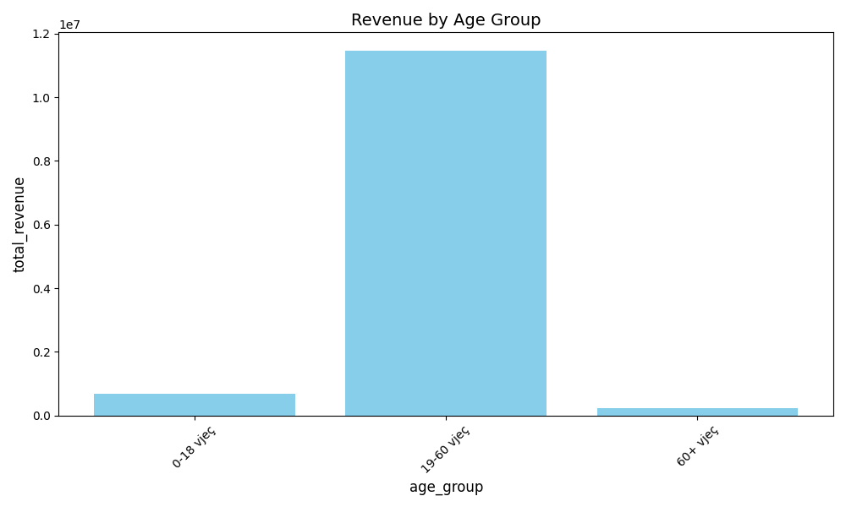
Revenue Breakdown by Age Group

Slide 4
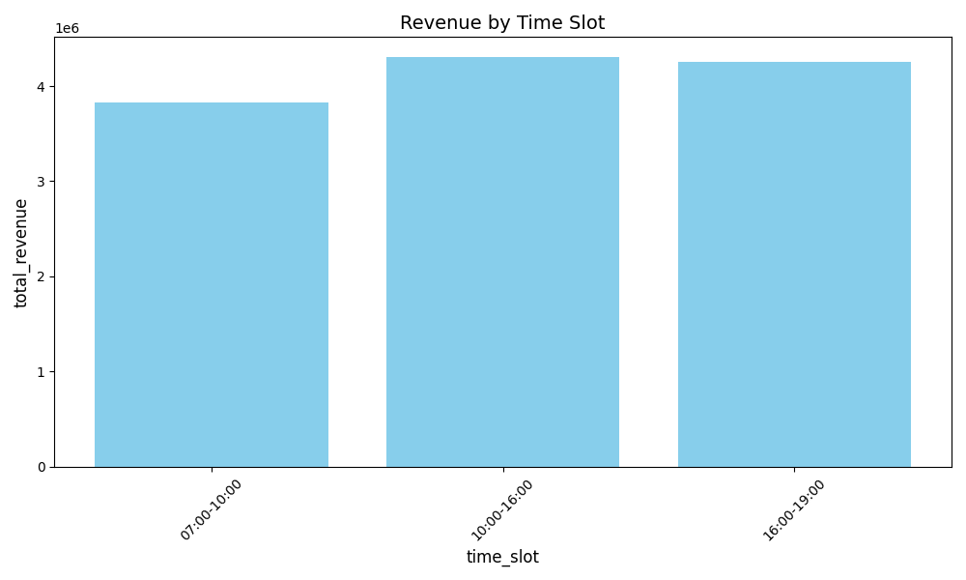
Revenue Breakdown by Time Slot

Slide 5
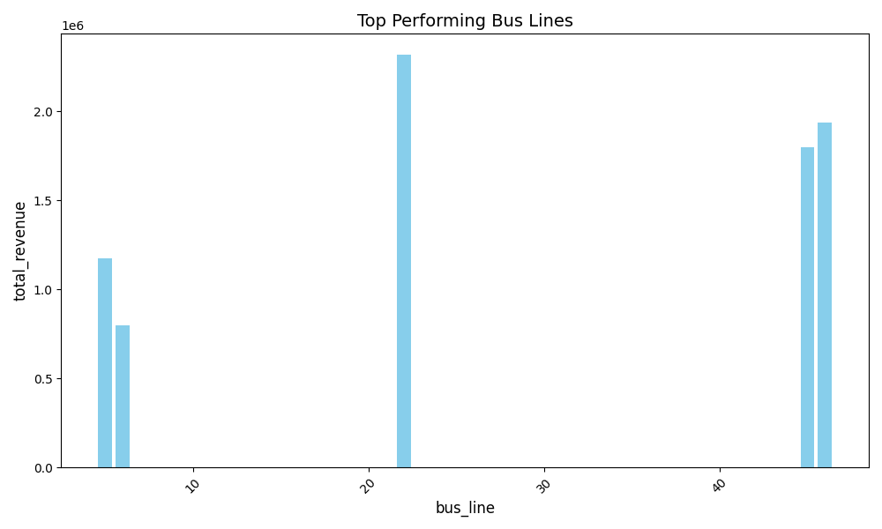
Top Performing Bus Lines

Slide 6
Recommendations
Based on the analysis, we recommend:
- Targeted marketing campaigns for age group 19-60
- Increased bus frequency during peak hours (07:00-10:00)
- Enhanced capacity and services for Bus Line 22
- Implementing a dynamic pricing model to encourage off-peak travel

Slide 7
Conclusion
This analysis provides actionable insights for improving Tirana's public transportation system:
- Enhanced commuter experience through optimized services
- Improved revenue generation and operational efficiency
- Data-driven planning for sustainable urban mobility

