Slide 1
Somewhere Eating
Dennis Shu Liang

Slide 2
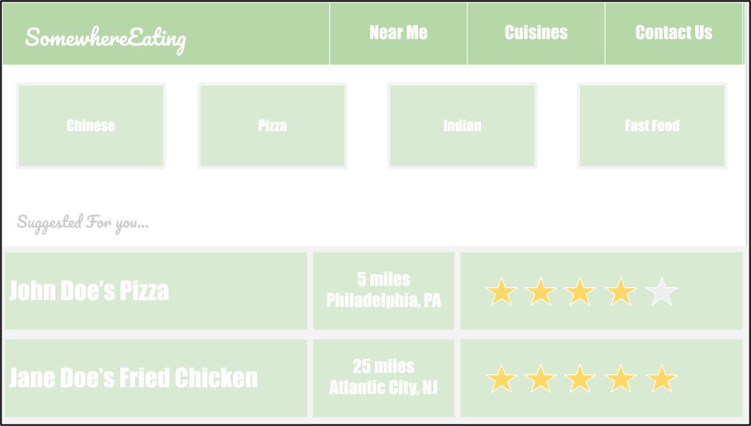
Project Goal
The goal of this project is to create a web application that helps users search for restaurants that they want to find information about (ie. menu, ratings etc.)
Languages/Architecture:
HTML/CSS, React, Node, JavaScript, Zomato API
Interests:
Web Development (front-end & back-end)

