Slide 1
benefitsheild
Employee Benefit management System
-Akshaya Venuvanka

Slide 2
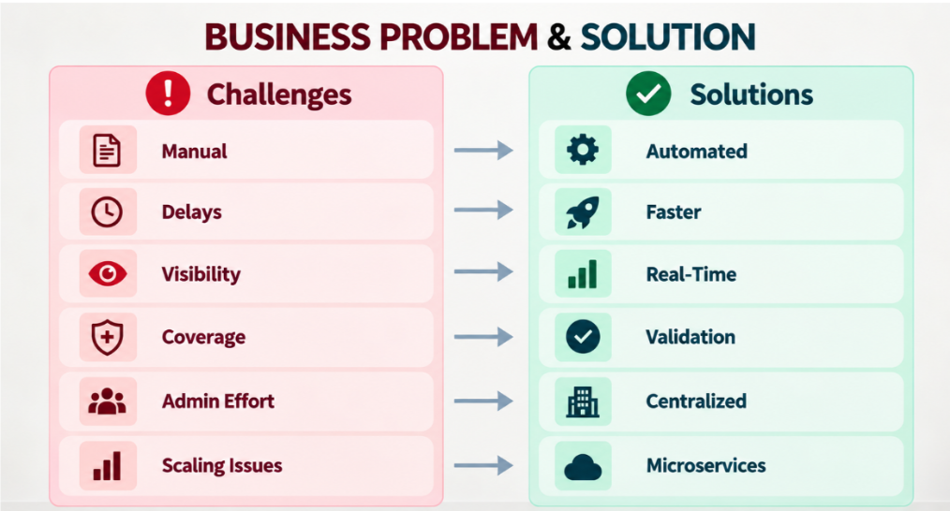

Slide 3
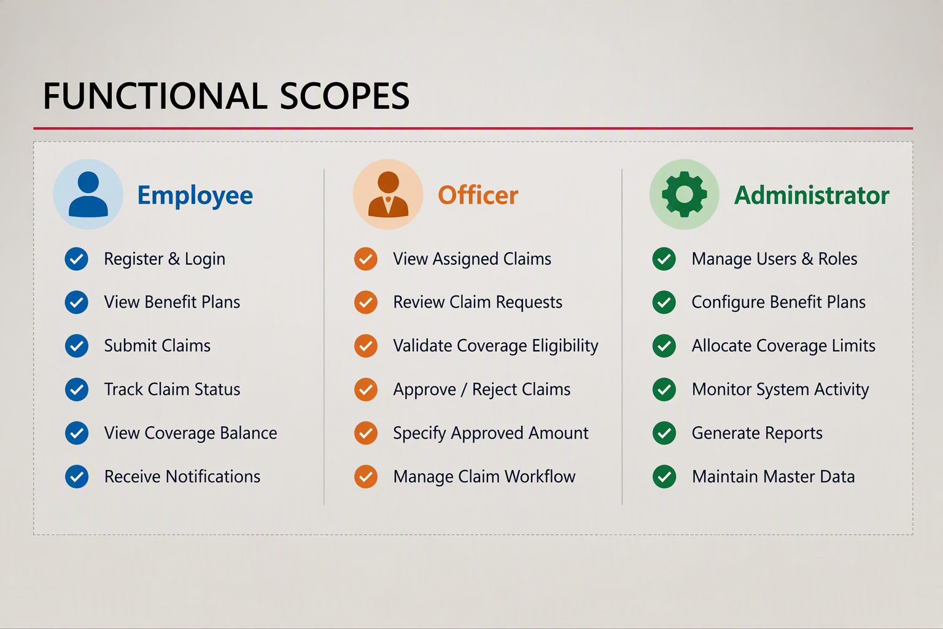

Slide 4
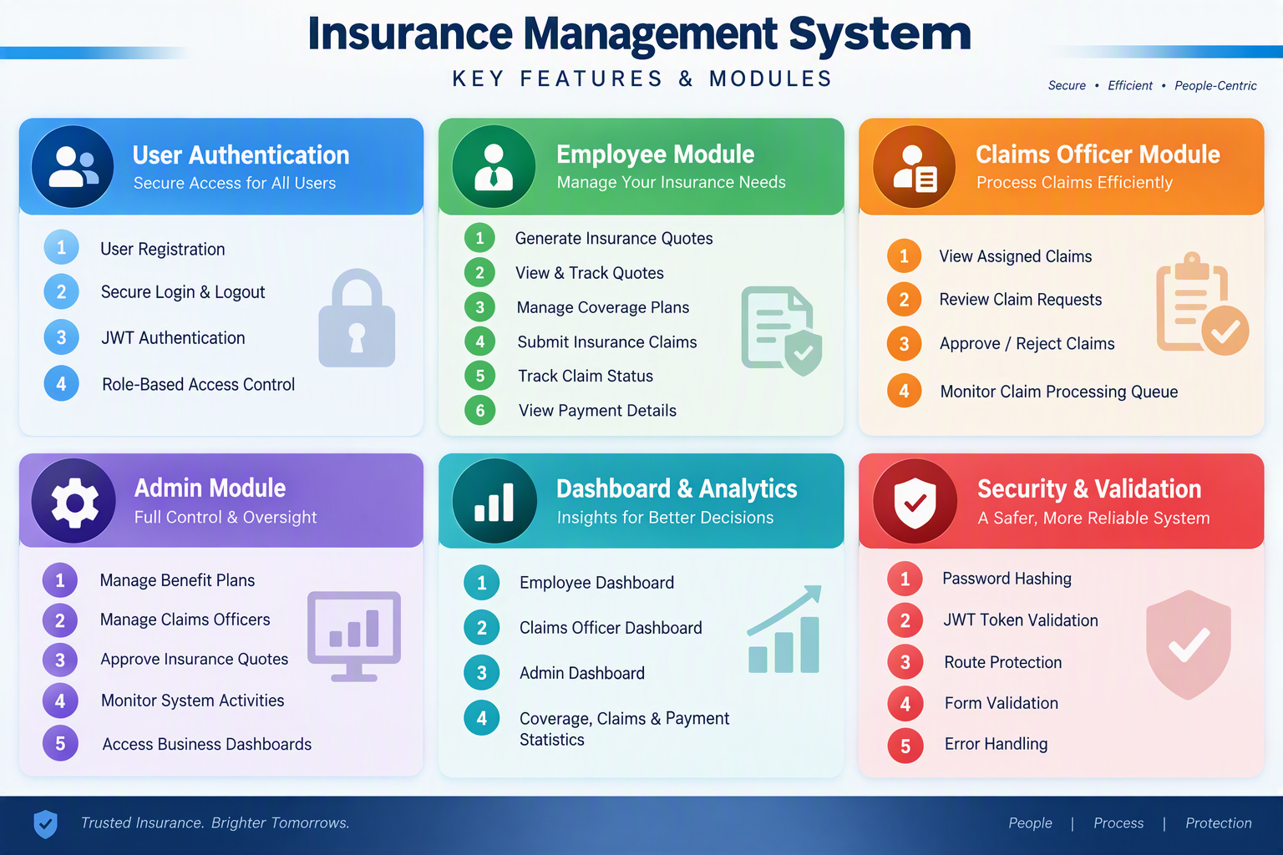
TECHNICAL SCOPE

Slide 5
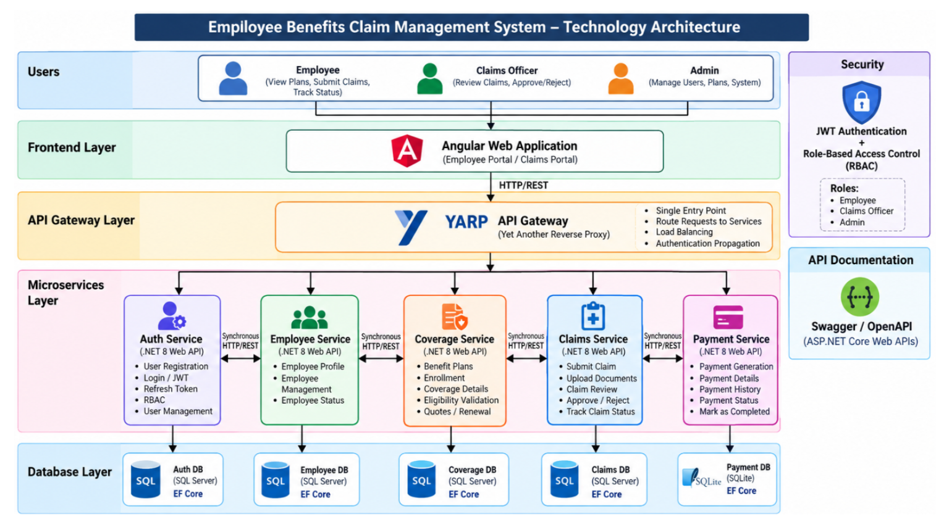

Slide 6
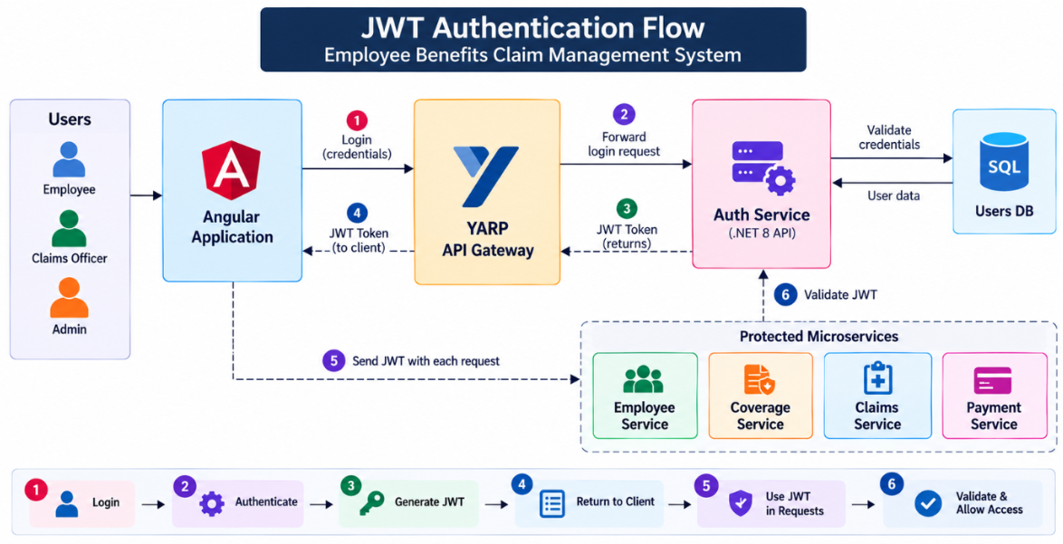

Slide 7
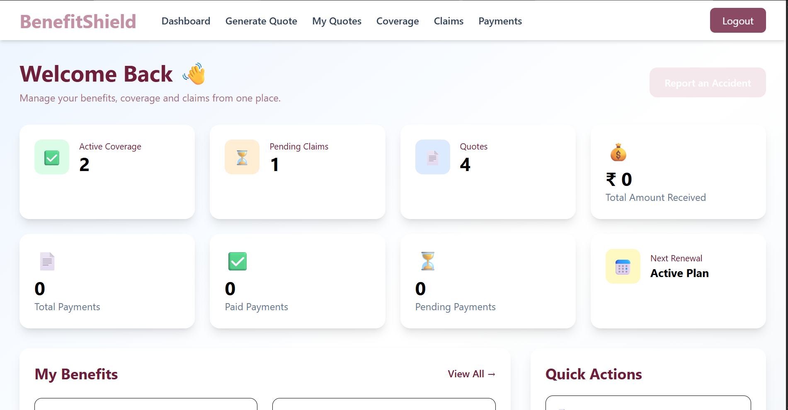

Slide 8
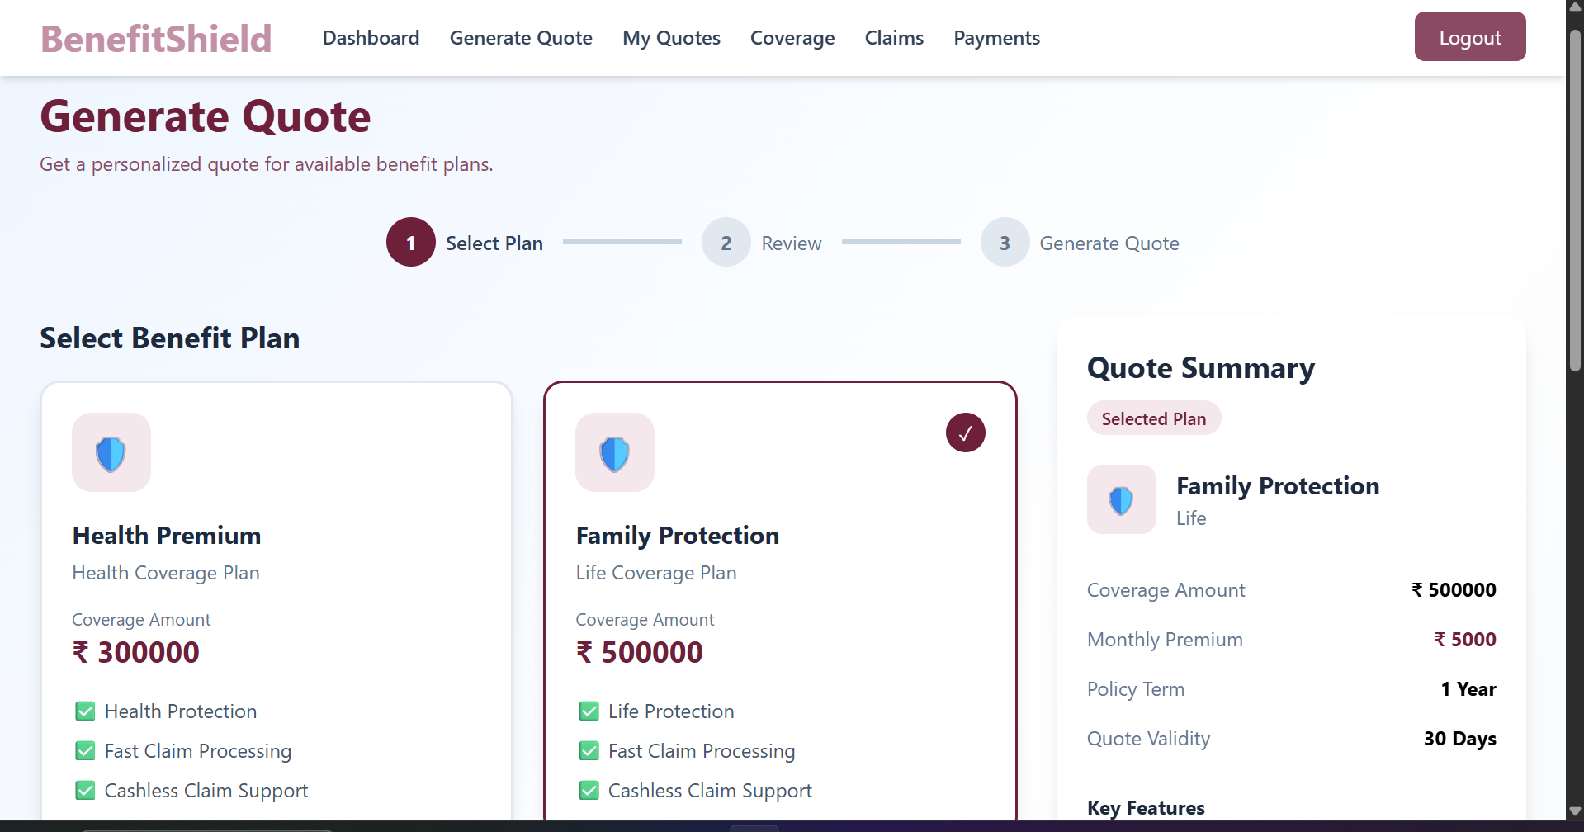

Slide 9
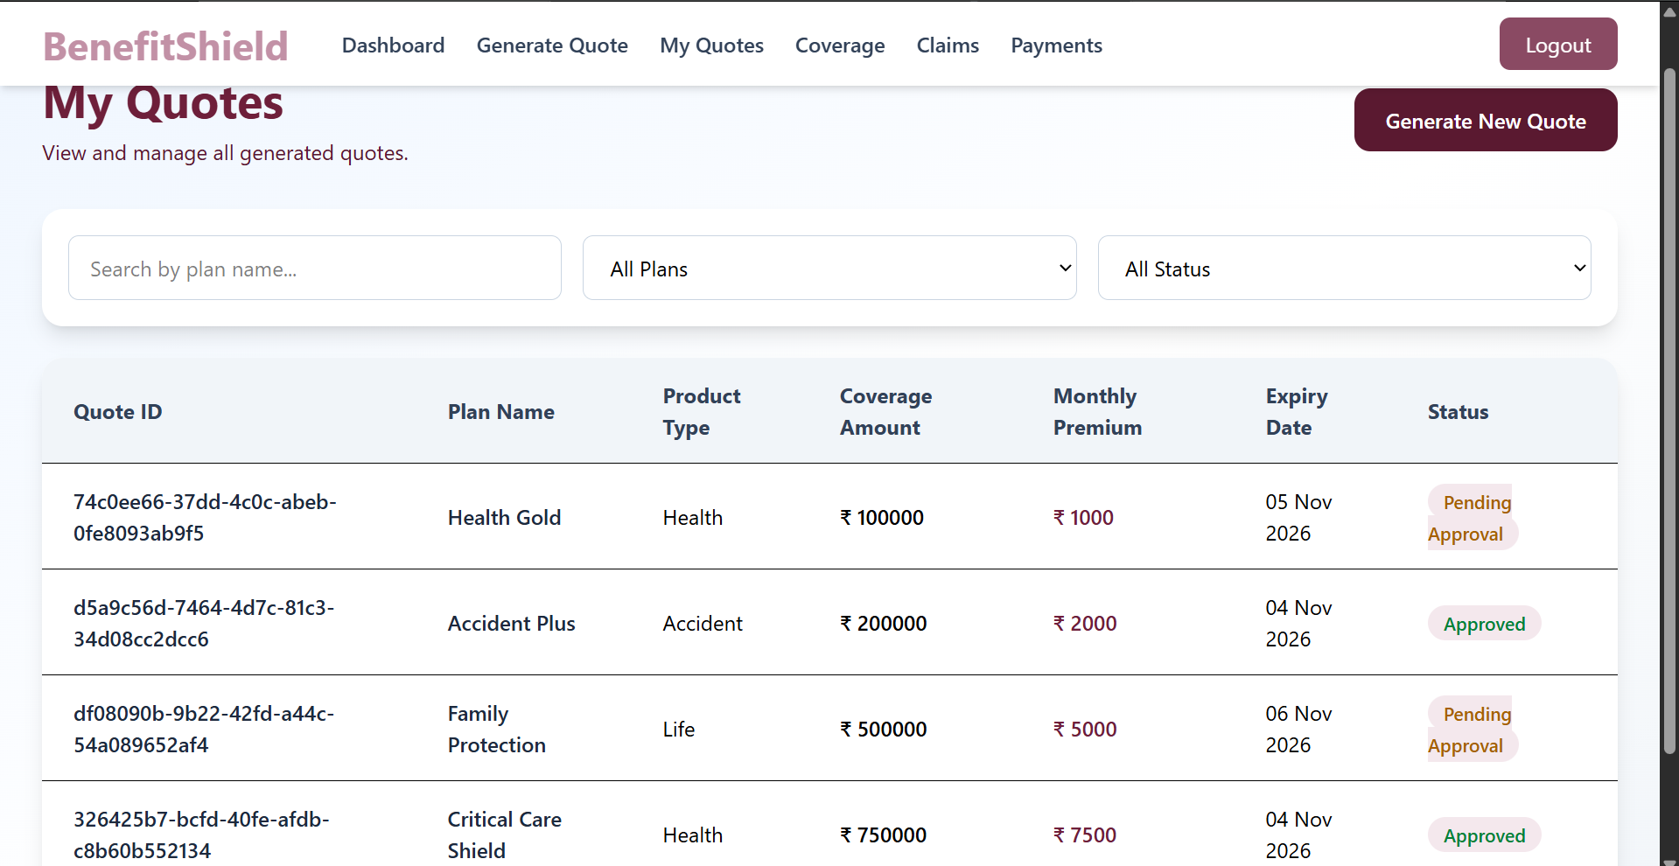

Slide 10
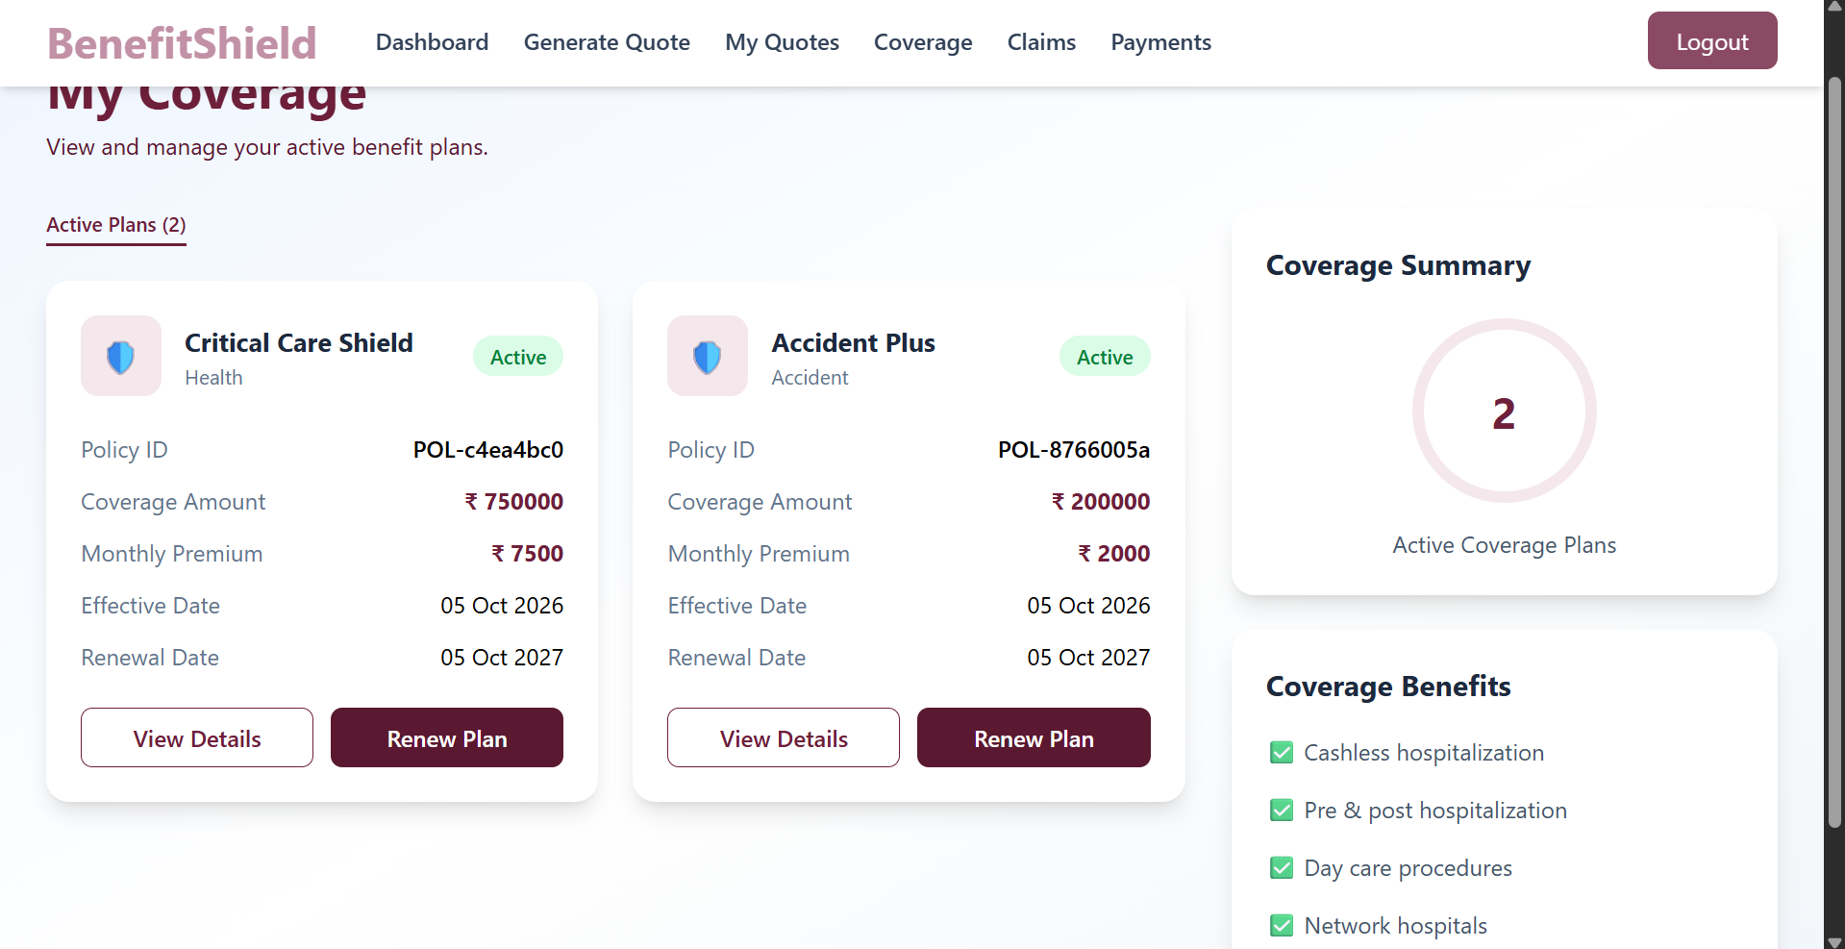

Slide 11
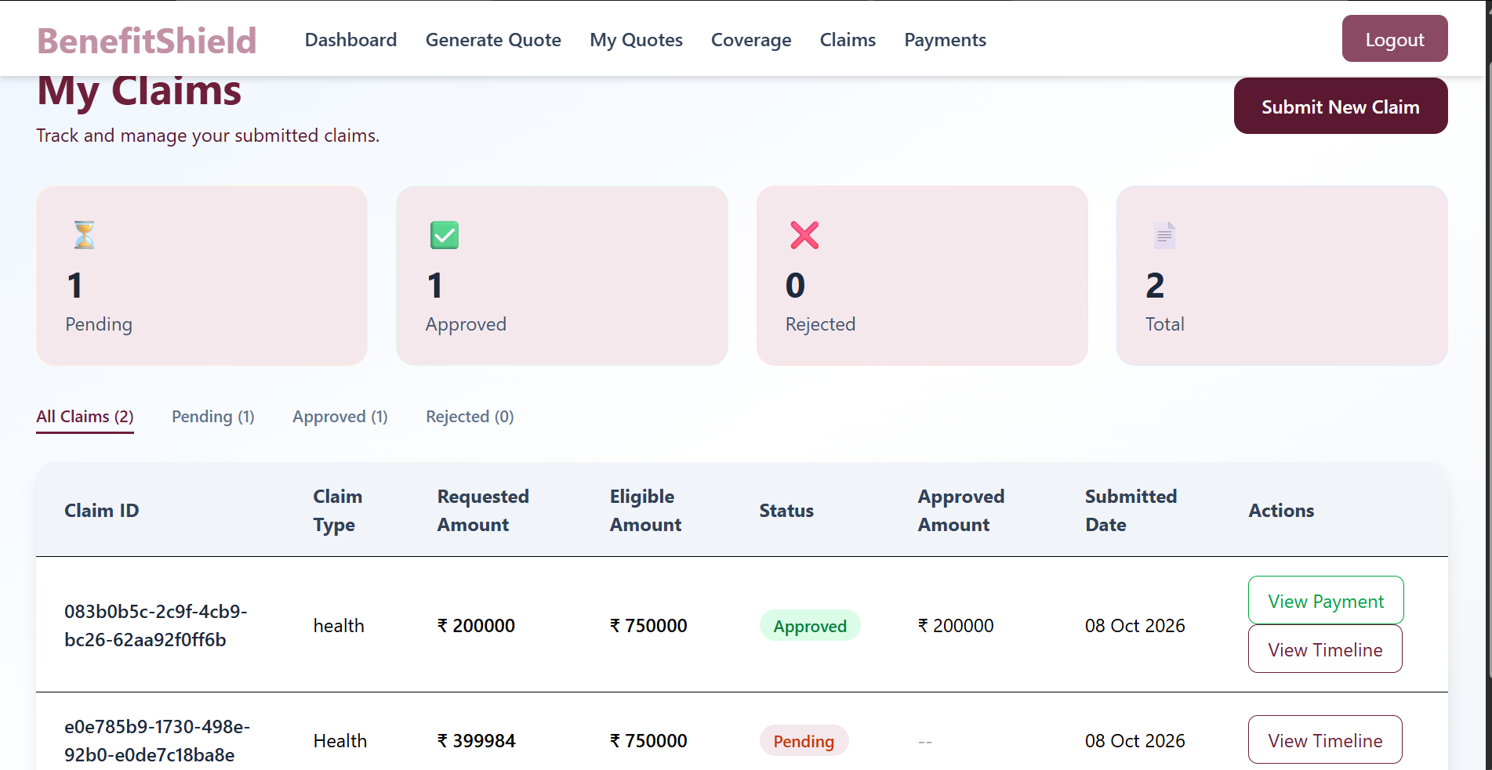

Slide 12
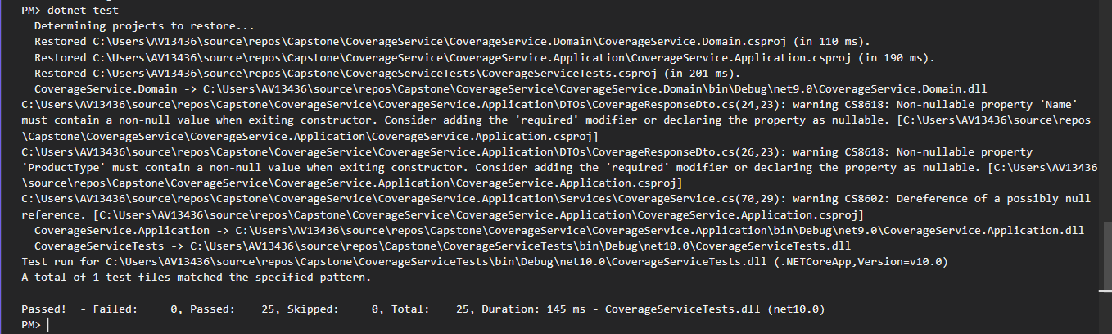
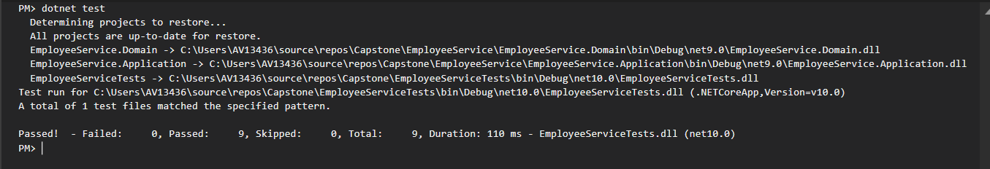
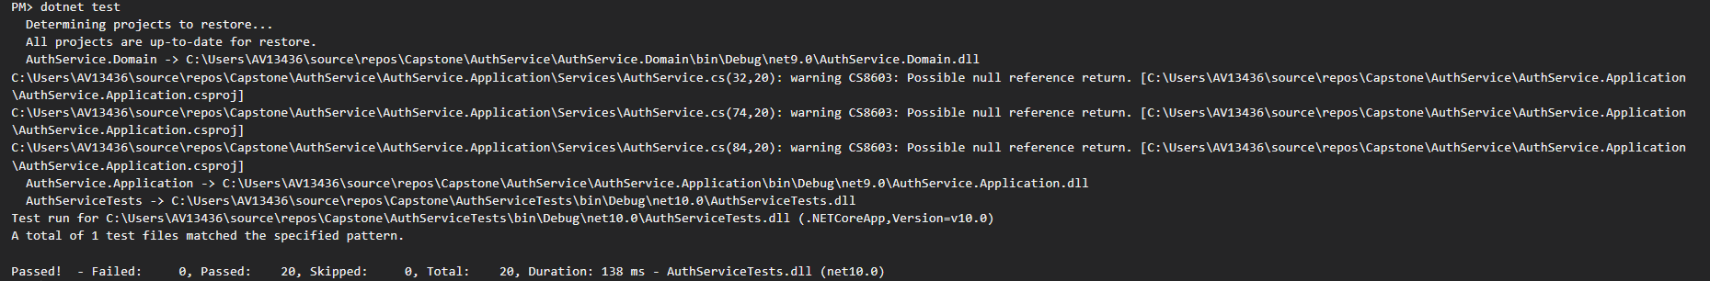
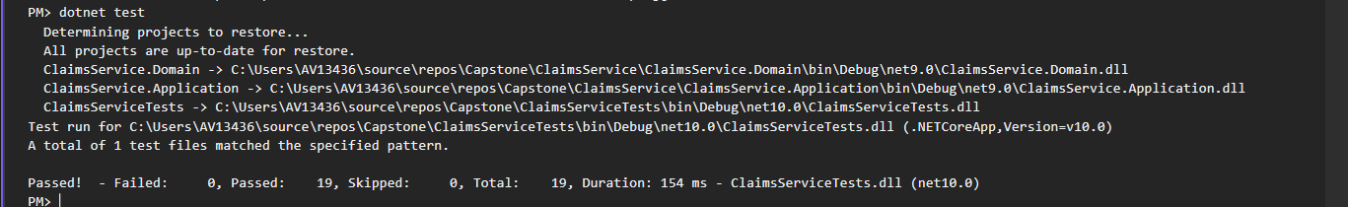
BACKEND TESTING

Slide 13
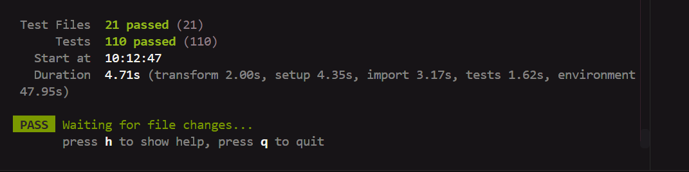
FRONTEND TESTING

Slide 14
CONCLUSION
Successfully developed a secure, scalable, and resilient Employee Benefits Management System.
Implemented Microservices Architecture with Angular, ASP.NET Core, YARP API Gateway, JWT Authentication, and SQL Server.
Enabled end-to-end management of Quotes, Coverage, Claims, and Payments.
Enhanced reliability through Polly-based resilience and fault-tolerant service communication.
"BenefitShield delivers an efficient, secure, and modern employee benefits management solution."

Slide 15
THANK YOU

