Slide 1
How to use the back calculator program “denomfind” for approximated proportions
2022-10-22 (sat)
Toshiyuki Shimono

Slide 2
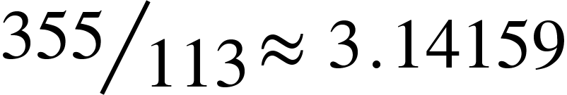
Terminology (1/2)
A fraction is specified in the form of numerator / denominator .
A proportion is the decimal value of a fraction. Its approximation is an approximated proportion, which would be simply called a proportion herein.
ℕ = {1,2,3,… } : The set of all natural numbers.
ℤ = {0 ,±1 ,±2 ,±3 , ..} : consists of integers.
ℝ = { x | - ∞ < x < + ∞ } : all the real numbers.

Slide 3
Terminology (2/2)
There are many ways to round a number :
Round half up ( most commonly used! )
Round up / Round down
Round half to even (ISO 31-0 , JIS Z 8401, IEEE 754)
Round half to odd
TSV is Tab-Separeted Values (cf. CSV with comma).

Slide 4
Regarding this document :
Explains
how to use the command denomfind.
Not explains
the internal design in detail.

Slide 5
“denomfind” is a CLI program.
CLI = Command Line Interface. Not a GUI.
“denomfind” is a program of a Perl script.
You can install :
By “cpan” or “cpanm” command.
cpanm is recommendable considering the un-installment.
cpanm App::denomfind
cpanm –U App::denomfind # uninstall
Not only from metacpan.org but also from GitHub.

Slide 6
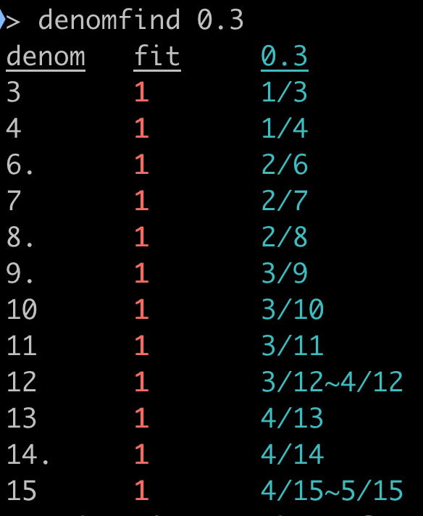
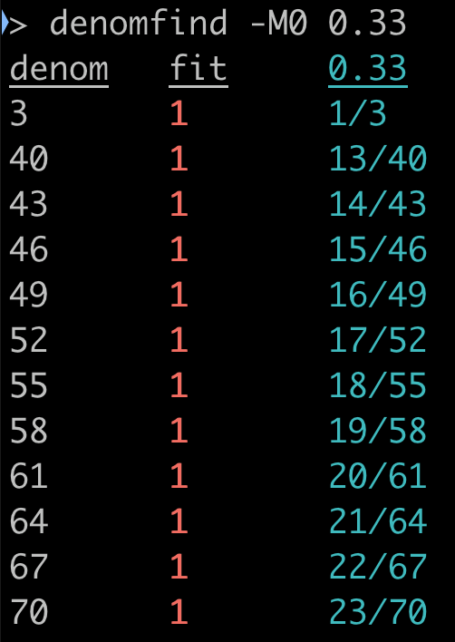
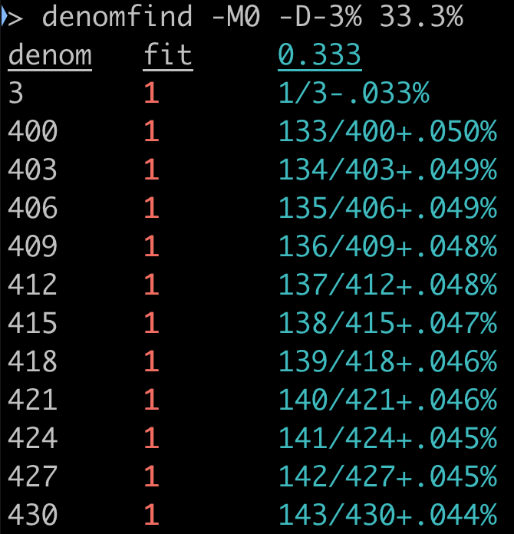
Examples 1 — 0.3, 0.33, and 33.3%
Each fraction is shown on each line.
”denom” means denominator.
12 denoms ∈ ℕ are back calculated
with a feasible numerator ∈ ℤ
regarding the given proportion is rounded.
Each of fraction form is shown in cyan color.
-D-3% on the most right image specifies to show the gap to the proportion.
“fit” (red) will be explained in next page.
Regarding the reducible fractions :
A denom with period (.) : roughly means the fraction is reducible.
To be more exactly (explained later) : the numerators and its corresp. denominators all combined are divisible by their GCD > 1.
“-M0” specifies : not to show the the “reducible” fraction i.e. 2/6 = 3/9 = 4/12 = .. are hidden.

Slide 7
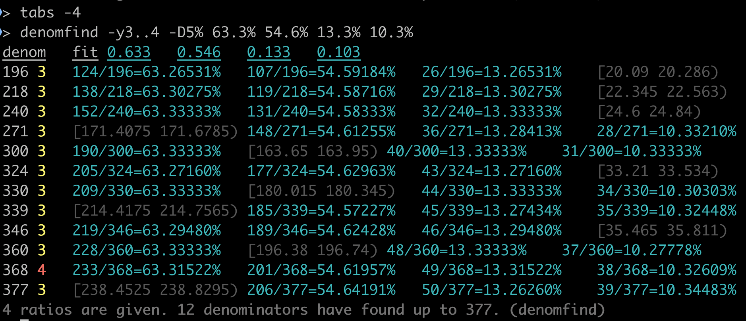
Example 2: proportions with a common denominator
The output forms a TSV table.
The right 4 columns here corresponds with proportions 63.3%, 54.6%, 13.3%, 10.3%.
The 2nd column fit means how many among the (4) proportions can get at least a numerator ∈ ℤ with each denom value.
-y3..4 specifies filtering on fit. i.e. fit with the value 0,1,2 are omitted.
-D5% specifies to show the retrieved fraction value with 5 decimal places in %.
The intervals in faint color indicate the set of the possible numerator on ℝ , which does not contain any integer ℤ.
The command tabs -4 adjusts the screen setting of tab intervals.
The smallest possible denominator ∈ ℕ to yield the 4 rounded proportions is 368.

Slide 8
Usage of denomfind
To find the possible denominator with given multiple rounded proportions.
One can check whether the sample size is large enough.
To check and to correct the numbers such as denominator and rounded proportions.
Quite often, numbers appearing on reports contain a small number of mistakes.
To know how the proportions are rounded.
If the rounding half up is performed on a number twice in a specific way, 3.45% can turn to be 4% via 3.5%.
Deciphering how the numbers are rounded may conclude how carefully the document is yielded.

Slide 9
Feature of denomfind
Simple interface despite the various options.
— How to interact with the program is intentionally designed.
Run such as denomfind 0.167 0.714 firstly.
The output is easily understandable.
You gradually increase functions to use such as options and other commands.
The necessary functions are abundantly provided.
Online manual is provided : denomfind --help
Demo is also provided. You can try denomfind –T1 (1 is changeable.)

Slide 10
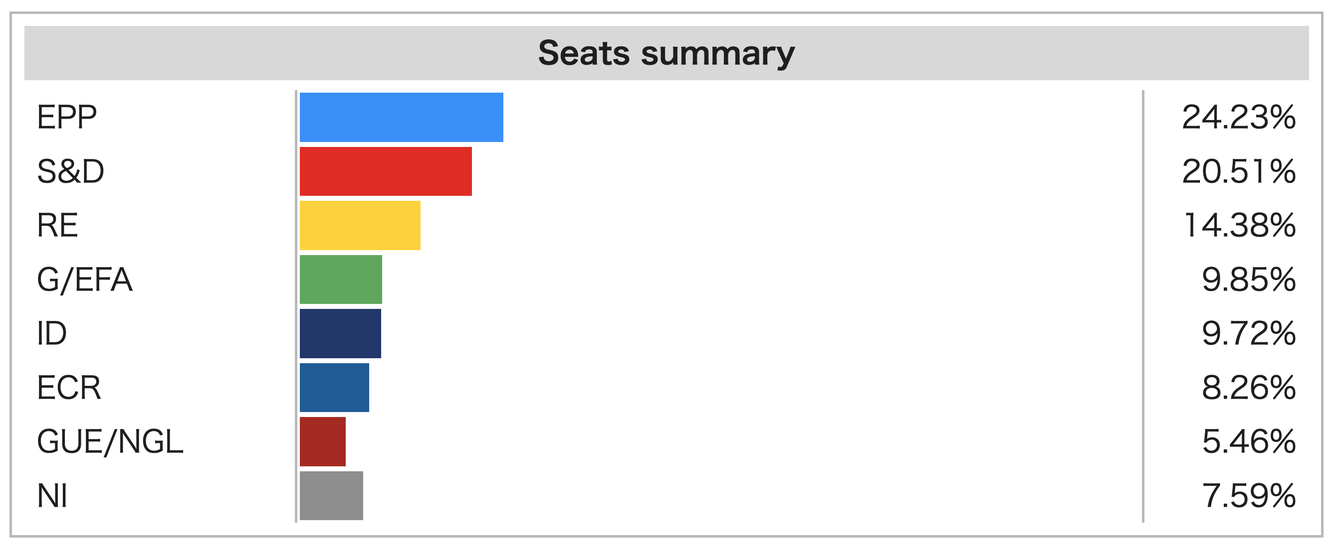
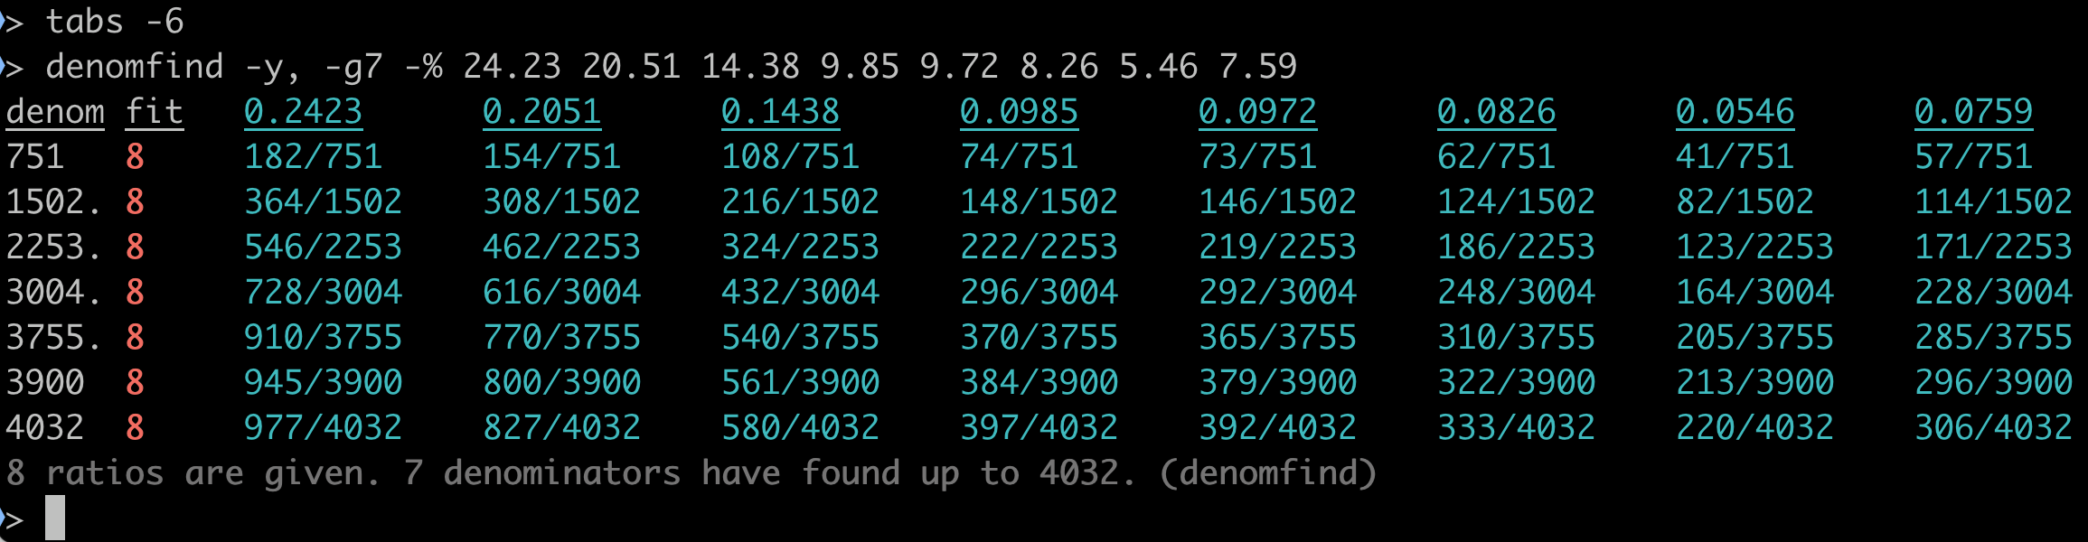
Example 3. Seats summary of 2019 European Parliament Election
https://en.wikipedia.org/wiki/2019_European_Parliament_election
The total seat number seems 751 (if < 1000) from the 8 proportion percentages. –y, filters the fit number being the largest (8; the number of proportions). –g7 specifies to get 7 candidates. –% specifies percentages are given.

Slide 11
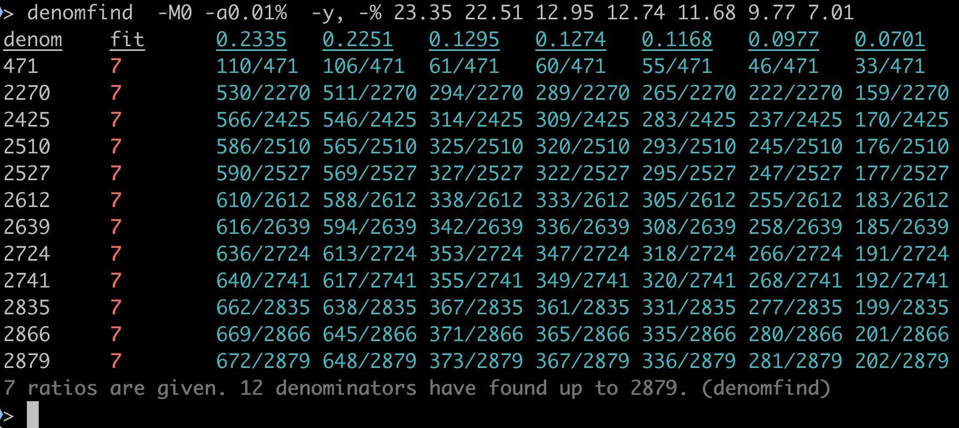
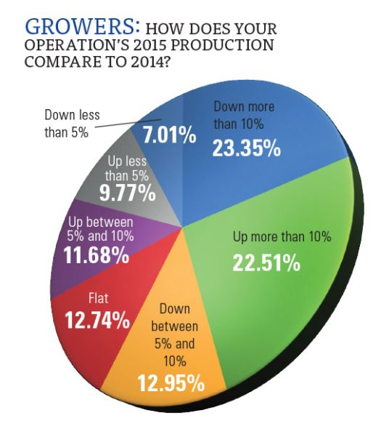
Example4. A pie chart (7 divisions)
The total number of answerer seems to be 471. ”The response was overwhelming, as 750 of you weighed in — including 545 growers — providing valuable insight in an online survey. ”
https://www.growingproduce.com/fruits/fruit-growers-expect-sweet-16/

Slide 12

Example 5. A pie chart (8 divisions)
https://www.helpisherede.com/health-care-providers
From the 8 numbers, 46.4% 11.7% 12.2% 8.5% 7.6% 6.1% 4.4% 3.2%, also with the assumption that the rounding was done by rounding half up,
the possible denominator value is either of
343, 590, 591, 657, 658, 683, 686, 720, 727, 752, 754, 772,
and more in the ascending order.
This graph is cited from :
https://www.dhss.delaware.gov/dhss/dph/files/dedrugoverdosemortsurvrpt2017.pdf
and this article says the original number is 343.
A derivative question : when the candidates of possible integer denominators are calculated, the minimum value among them is quite often the real value. Why?

Slide 13
Various options in rounding
Assuming the rounding
“round down” (floor ; e.g. 0.345 → 0.34) : –f
“round up” (ceil ; e.g. 0.345 → 0.35) : –c
“round half up” is done twice ( e.g. 0.345→0.35→0.4 ) : -5 2
“round half to even” (e.g. 0.335 and 0.345 → 0.34) : -5 e
“round half to odd” (e.g. 0.345 and 0.355 → 0.35) : -5 o
Allowing the error within ±1% : -a 0.01 or -a 1%

Slide 14
Options in the denominator filtering
-g 100 : getting 100 candidates in denominators from the smallest (1).
-g 123,100 : getting 100 candidates in denominators from the 123.
-g 123,-10 : getting 10 candidates from the 123 in descending order.
-y .. : showing every denominator as long as specified by –g option.
-y , : only showing the denominators when every given proportion has at least one corresponding integer numerator.
-y 1.. : showing the denominators when at least one of given proportion has the corresponding integer numerator. (Default)
-y -2.. : showing the denominators when every given proportion has the corresponding integer numerator allowing the exceptions within 2 of the proportions.
N..M means the numerical range. N.. means n to the maximum. ..M means zero to M. When N or M is negative, it means (the maximum)-abs(N or M). Those types of range or a single number can be combined by comma(,).

Slide 15
Options in output
-D0 : showing the fraction form such as 10/33. (Default ※)
-D3 : showing also with 3 decimal places such as 10/33=.303
-D4% : in 4 decimal places in percentage such as 10/33=30.3030%
-D-5 : showing the difference to realize the given proportion with 5 decimal places 10/33-.00003 for a given proportion 0.303
-D-6% : showing the difference to realize the given proportion with 6 decimal places such as 10/33-. 00303% for a proportion 0.303
-I : showing the interval of possible numerators on ℝ, not only ℤ. If the interval contains any integer it is shown in green color.
-Q : showing the numerators in a simplest way. Extra1. When only one proportion is given, the denominator is shown with its prime factorization as well. Extra2. To see all the numerators are odd (2q+1) or even (2q), if they have a common reminder R against a devisor D, they are shown with a form “(Dq+R)” as well.
※ If –D , –I and –Q are not given, -D0 is regarded to be specified internally.

