Slide 1
How to use the back calculator program “denomfind” from given proportions
2022-10-22
Toshiyuki Shimono

Slide 2
Terminology
A fraction is specified in the form of numerator / denominator .
A proportion is the value of a fraction. Its approximation is an approximated proportion.
There are many ways to round a number :
Round half up ( most commonly used! )
Round up / Rounding down
Round half to even (ISO 31-0 , JIS Z 8401, IEEE 754)
Round half to odd
TSV is Tab-Separeted Values (cf. CSV with comma).

Slide 3
Regarding this document
Explains
how to use it.
Not explains
the internal design.

Slide 4
“denomfind” is a CLI program.
CLI = Command Line Interface. Not a GUI.
“denomfind” is a program of a Perl script.
You can install :
By “cpan” or “cpanm” command.
cpanm is recommendable considering the un-installment.
cpanm App::denomfind
cpanm –U App::denomfind # uninstall
Not only from metacpan.org but also from GitHub.

Slide 5
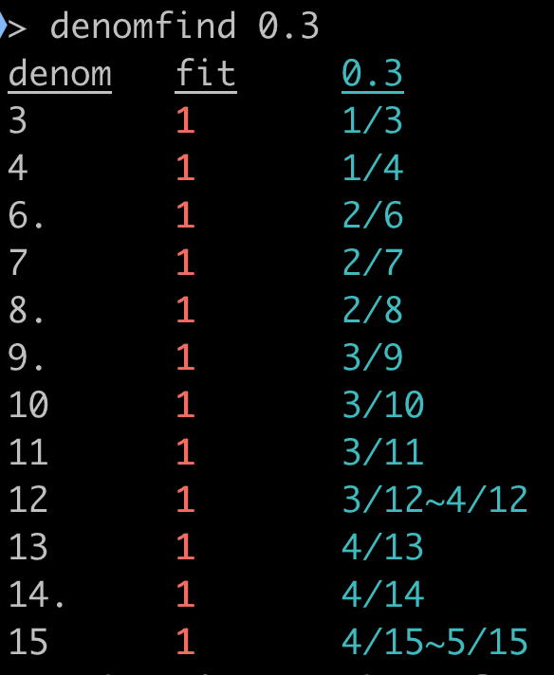
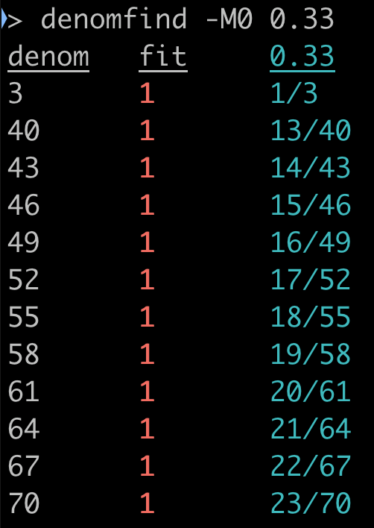
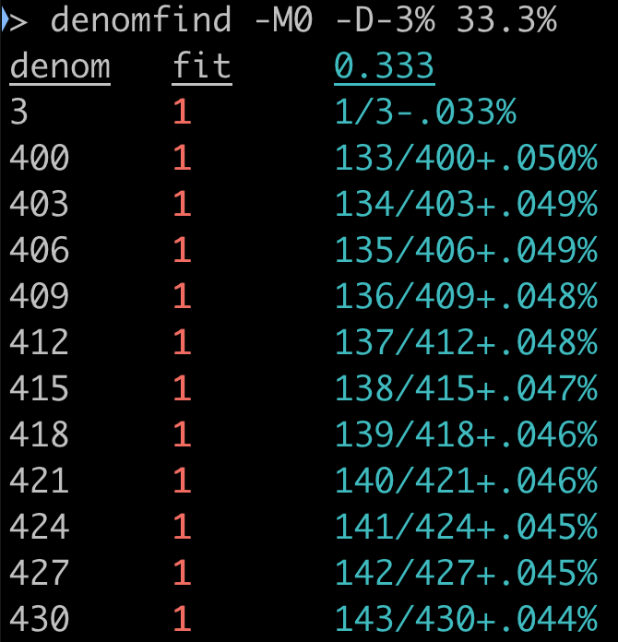
Examples 1 — 0.3, 0.33, and 33.3%
Each fraction is shown on each line.
”denom” means denominator.
12 denoms ∈ ℕ are back calculated
with a feasible numerator ∈ ℤ
regarding the given proportion is rounded.
Each of fraction form is shown in cyan color.
-D-3% on the most right image specifies to show the gap to the proportion.
“fit” (red) will be explained in next page.
Regarding the reducible fractions :
A denom with period (.) : roughly means the fraction is reducible.
To be more exactly (explained later) : the numerators and its corresp. denominators all combined are divisible by their GCD > 1.
“-M0” specifies : not to show the the “reducible” fraction i.e. 2/6 = 3/9 = 4/12 = .. are hidden.

Slide 6
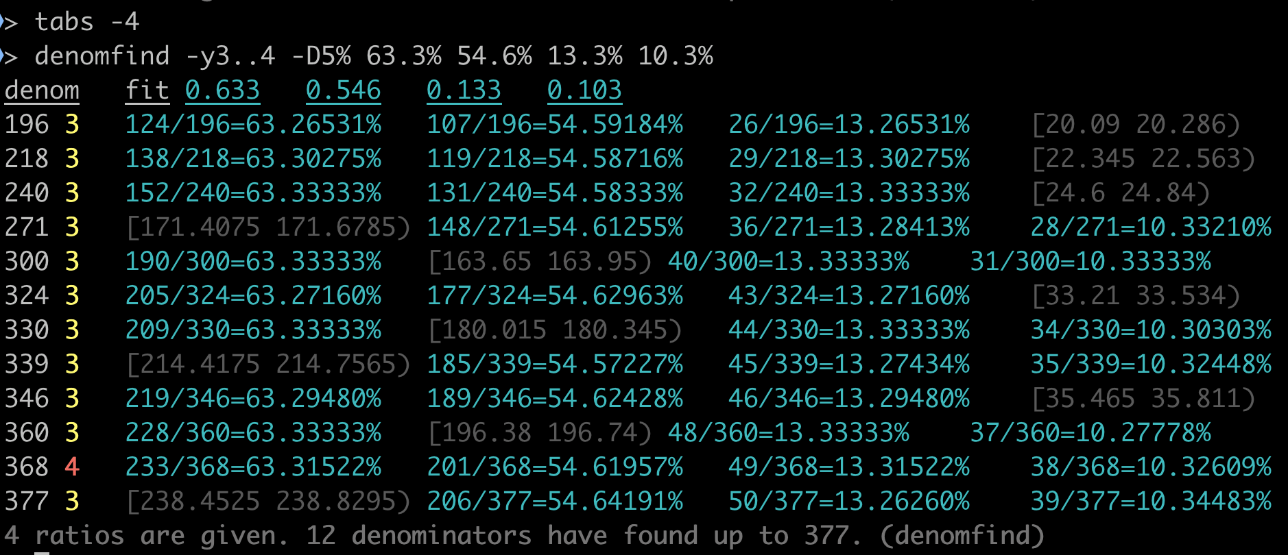
Example 2: proportions with a common denominator
The output forms a TSV table.
The right 4 columns here corresponds with proportions 63.3%, 54.6%, 13.3%, 10.3%.
The 2nd column fit means how many among the (4) proportions can get at least a numerator ∈ ℤ with each denom value.
-y3..4 specifies filtering on fit. i.e. fit with the value 0,1,2 are omitted.
-D5% specifies to show the retrieved fraction value with 5 decimal places in %.
The intervals in faint color indicate the set of the possible numerator on ℝ , which does not contain any integer ℤ.
The command tabs -4 adjusts the screen setting of tab intervals.
The smallest possible denominator ∈ ℕ to yield the 4 rounded proportions is 368.

Slide 7
Usage of denomfind
To find the possible denominator with given multiple rounded proportions.
One can check whether the sample size is large enough.
To check and to correct the numbers such as denominator and rounded proportions.
Quite often, numbers appearing on reports contain a small number of mistakes.
To know how the proportions are rounded.
If the rounding half up is performed on a number twice in a specific way, 3.45% can turn to be 4% via 3.5%.
Deciphering how the numbers are rounded may conclude how carefully the document is yielded.

