Slide 1
a₀₂
a₂₃
a₃₁
a₁₄
start
snow
white
is
end
a₀₃
a₃₃
a₃₂
a₂₄
start
Noun
Noun
Verb
end
b_{3,snow}
b_{3,white}
b_{4,is}
snow
white
is

Slide 2
Adj₁
Verb₂
start₀
Noun₃
end₄

Slide 3
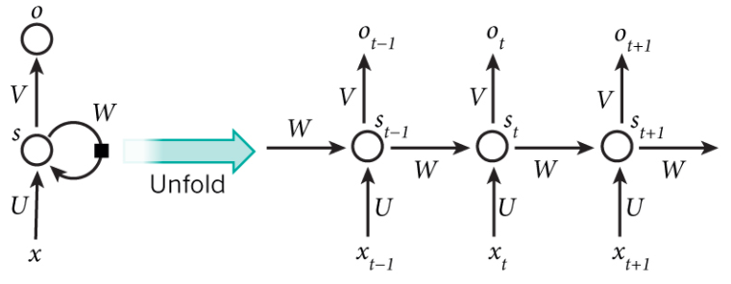





















$$y$$
$$y$$
$$y$$
$$y$$
$$W_{hy}$$
$$W_{hy}$$
$$W_{hy}$$
$$W_{hy}$$
$$W_{hh}$$
$$W_{hh}$$
$$h_{t−1}$$
$$h_{t}$$
$$h_{t+1}$$
$$h$$
$$W_{hh}$$
$$W_{hh}$$
$$W_{hh}$$
$$W_{xh}$$
$$W_{xh}$$
$$W_{xh}$$
$$W_{xh}$$

Slide 4






$$y_{3}$$
$$W_{hy}$$
$$h_{1}$$
$$h_{2}$$
$$h_{3}$$
$$W_{hh}$$
$$W_{hh}$$

Slide 5
$$h_{1}$$
$$h_{2}$$
$$h_{3}$$
France
French

Slide 6
the
acting
was
quite
bad
.
. . .
While
the
acting
was
quite
bad

Slide 7
the
acting
was
quite
bad
.
. . .
. . .
While
the
acting
was
quite
bad

Slide 8
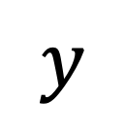
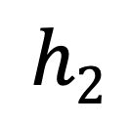
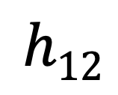
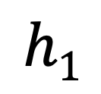
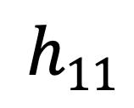
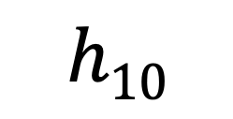
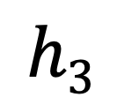
$$y$$
??
$$h1$$
$$h2$$
$$h3$$
$$h10$$
$$h11$$
$$h12$$
. . .
. . .
While
the
acting
was
quite
bad

Slide 9
$$y$$
$$h1$$
$$h2$$
$$h3$$
$$h10$$
$$h11$$
$$h12$$
. . .
. . .
While
the
acting
was
quite
bad

Slide 10
the
acting
was
quite
bad
.
. . .
While
the
acting
was
quite
bad

Slide 11
$$y$$
$$y$$
$$y$$
$$y$$
Noun
Noun
Verb
$$W_{hy}$$
$$W_{hy}$$
$$W_{hy}$$
$$W_{hy}$$
$$W_{hh}$$
$$W_{hh}$$
$$h_{t−1}$$
$$h_{t}$$
$$h_{t+1}$$
$$h$$
$$W_{hh}$$
$$W_{hh}$$
$$W_{hh}$$
$$W_{xh}$$
$$W_{xh}$$
$$W_{xh}$$
$$W_{xh}$$
snow
white
is

Slide 12



CRF
Noun
Noun
Verb
$$y$$
$$y$$
$$y$$
$$y$$
Noun
Verb
$$W_{hy}$$
$$W_{hy}$$
$$W_{hy}$$
$$W_{hy}$$
$$W_{hh}$$
LSTM
$$W_{hh}$$
$$h_{t−1}$$
$$h_{t}$$
$$h_{t+1}$$
$$h$$
$$W_{hh}$$
$$W_{hh}$$
$$W_{hh}$$
$$W_{xh}$$
$$W_{xh}$$
$$W_{xh}$$
$$W_{xh}$$
snow
white
is

Slide 13
start
B-Org
I-Org
I-Org
O
Henry
Ford
Motors
was
start
Org
Org
Org
O
Henry
Ford
Motors
was

