Slide 1
Generating Short Stories in the Style of Famous Authors Using GPT-2
Gavin LeBlanc - Tulane University

Slide 2
Abstract
Generate 100-word fictional stories in the styles of famous authors.
Fine-tune GPT-2 on Project Gutenberg datasets.
Target authors: Jack London, Lewis Carroll.

Slide 3
Introduction
Style transfer in text generation is challenging.
GPT-2 excels at general text generation.
Mimicking specific literary styles remains difficult with limited data.

Slide 4
Methods
Datasets from Project Gutenberg: Jack London, Lewis Carroll.
Data cleaned and tagged with author-specific tokens.
Fine-tuning GPT-2 with Hugging Face Trainer API.
Parameters: Learning rate 5e-5, batch size 1, epochs 3, max steps 250.
Sampling: temperature=1, top_k=50, top_p=0.95.

Slide 5
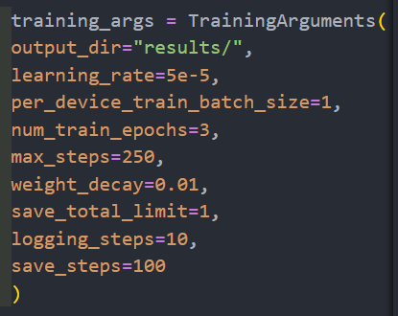
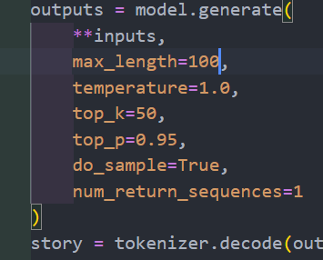
METHODS Part 2

Slide 6
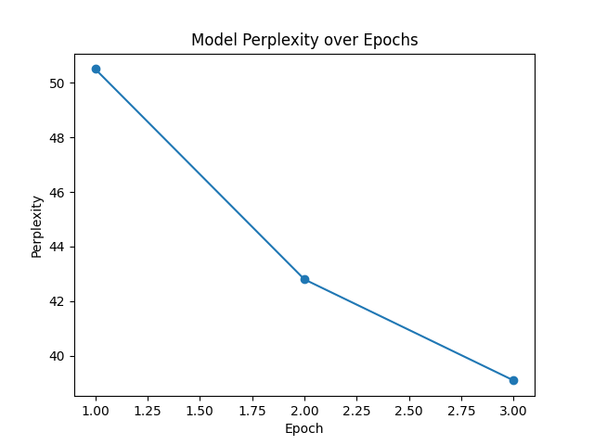
Results
Prompt: 'The princess faced the dragon'.
Jack London output: '...while the horse was sitting and had to think about it.'
Lewis Carroll output: '...but he could see the face of a'.
Perplexity decreases steadily over epochs.

Slide 7
Discussion
Generated stories show early stylistic distinctions.
The Jack London output reflects structured, coherent language typical of narrative prose — showing the model is beginning to capture stylistic cues.
The Lewis Carroll output is a bit less coherent but reflects a whimsical tone, consistent with early learning stages or limited data.
Hardware constraints limit dataset size and training efficiency.
The steady decline on the perplexity plot in the previous slide indicates the model is learning from the data and getting better at predicting the next word.

Slide 8
Future Work
Access more powerful hardware for faster training.
Expand datasets with more works per author.
Experiment with GPT-2 variants (medium, large).

Slide 9
Conclusion
Explores GPT-2 fine-tuning for stylistic story generation.
Overcame limited dataset and hardware constraints.
Early results show promise in style distinction.
Demonstrates potential for transformer-based stylistic generation.

Slide 10
Works Cited
IEEE (2023). Evaluation Metrics for Language Models.
Fan et al. (2018). Hierarchical Neural Story Generation.
ACM (2020). GPT-2 for Interactive Story Generation in Games.
ScienceDirect (2024). Transformer-Based Models for Style Characterization.
ACM (2022). TaleBrush: GPT-Based Story Sketching System.

