Slide 1


A Restaurant Review Multi-Label Sentiment Classifier
04/22/2025
H. Jacob Schenck
Aaron Dumont
CMPS 6730

Slide 2
Summary
Deliverable: We built a multi-label sentiment classifier for restaurant reviews
Goal: Analyze sentiment for overall reviews and specific aspects (food, service, ambiance, price, context) to provide timely feedback for restaurants
Approach: Using keyword spotting for aspect identification and data from the Yelp open database, we compared a TF-IDF + Logistic regression baseline model with a fine-tuned DistilBERT transformer model to predict sentiment for the 5 aspects and an overall review sentiment
Notes:
TF-IDF = term frequency - inverse document frequency - a numerical statistic that reflects the importance of a word within a document relative to a collection of documents. It's used in fields like information retrieval and machine learning to quantify the relevance of words in a document. BERT – bidirectional encoding representations from transformers

Slide 3
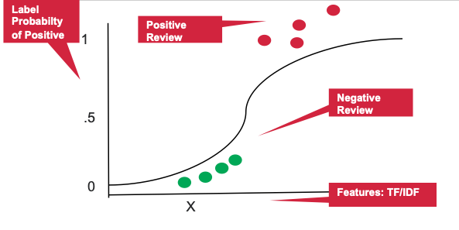
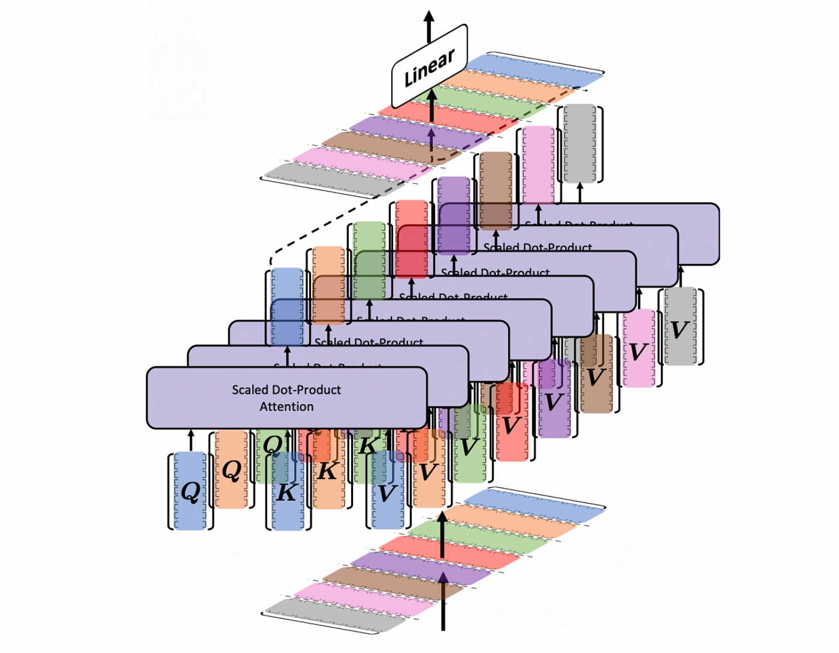
Summary
Conclusions:
The fine-tuned DistilBERT model significantly outperformed the baseline model in classifying sentiment across multiple aspects and overall sentiment

Slide 4

Introduction: Problem & Importance
Problem: There is a need for granular understanding of customer opinions beyond simple positive/negative scores
Restaurants need detailed feedback on specific areas as well as a reliable overall sentiment assessment
Importance: The restaurant industry is highly competitive and reviews strongly influence success
Granular and overall sentiment feedback facilitates continuous improvement
Our classifier provides this detailed breakdown and overall score

Slide 5
Background/Related Work
Our project builds upon existing research in Aspect-Based Sentiment Analysis (ABSA)
We utilized established aspects (food, service, ambiance, price) and included the emerging aspect of context (e.g. birthday, anniversary, etc)
We leveraged a transformer model aligning with recent trends showing their effectiveness for ABSA
We initially focused on the New Orleans area but expanded to include all data in the dataset and implemented a direct multi-output transformer classification (5 aspects+overall) unlike most prior work using techniques like LDA or Naïve Bayes
Notes:
Latent Dirichlet Allocation (LDA) can be used in sentiment analysis to identify the underlying topics and sentiments associated with a collection of texts. By analyzing the word distributions within each topic, you can gain insights into the general sentiment expressed in the text,

Slide 6
Approach
Data Source: Yelp Open Dataset (reviews & businesses)
Filtering: Initially focused on New Orleans area restaurant reviews between 01/2019 and 12/2024 (28, 377) but then expanded to all reviews (~1.5 million) after text preprocessing
Aspect identification: Defined 5 aspects with keyword lists
Sentences classified based on keyword counts
Sentiment scoring (initial): NLTK VADER used to calculate compound sentiment scores for each sentence and for the overall review.
Weighted scores calculated per aspect based on sentence proportion and sentiment
Notes:
NLTK VADER: It's a lexicon and rule-based feeling analysis instrument that is explicitly sensitive to suppositions communicated in web-based media. VADER utilizes a mix of lexical highlights (e.g., words) that are, for the most part, marked by their semantic direction as one or the other positive or negative.

Slide 7
Approach
Preprocessing: Standard steps: lowercasing, punctuation/URL removal, tokenization, stop word removal, lemmatization
Target Creation: Continuous VADER scores (for aspects and overall) binned into 3 categories (negative[0], neutral[1], positive[2]) using fixed thresholds (-0.05, 0.05)
Models:
Baseline: TF-IDF (top 5K features) + Logistic regression using multioutput classifier
Advanced: Fine-tuned DistillBERT with a modified classifier head for multi-output prediction (6 labels*3classes=18 outputs)
Trained with PyTorch, AdamW optimizer, CrossEntropyLoss

Slide 8
Approach
Further Validation/Corroboration:
We compared the same two models using data with human-labeled reviews for overall sentiment using the entire Yelp open dataset (to complement the proxy-labeled data using VADER)

Slide 9
Experiment & Results
Dataset split: 80% train (1,220,250 reviews), 20% test (305,063 reviews)
Baseline comparison: TF-IDF + Logistic Regression against fine-tuned DistilBERT
Evaluation Metrics: Precision, Recall, F1-Score (weighted), Accuracy per aspect and overall. Micro/Macro averages across all 6 labels

Slide 10
Experiment & Results
Key Quantitative Results – Weighted F1-Score on Test Set
Aspect | Baseline Model (TF-IDF+LogReg) | Transformer Model (DistilBERT)
Food | 0.80 | 0.87
Service | 0.79 | 0.86
Ambiance | 0.91 | 0.95
Price | 0.93 | 0.96
Context | 0.85 | 0.91
Overall | 0.92 | 0.95
Micro Avg (All) | 0.88 | 0.92
Macro Avg (All) | 0.79 | 0.86
Notes:
F1 weighted average is a robust metric for evaluating sentiment classification models, especially when dealing with imbalanced datasets, as it combines the precision-recall balance of the F1 score with a weighting scheme based on class prevalence. Micro Avg: Aggregates counts globally (instance-level average). Favors larger classes. Macro Avg: Averages per-class scores (class-level average). Treats all classes equally. Weighted Avg (Weighted F1): Averages per-class scores, weighted by class size (class-level average adjusted for imbalance).

Slide 11
Experiment & Results
Error Analysis – The model distinguishes (+)/(-) for food and service well but struggles more with ambiance, price and context
Potentially due to fewer training examples in those categories
Notes:
F1 weighted average is a robust metric for evaluating sentiment classification models, especially when dealing with imbalanced datasets, as it combines the precision-recall balance of the F1 score with a weighting scheme based on class prevalence

Slide 12
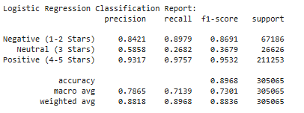
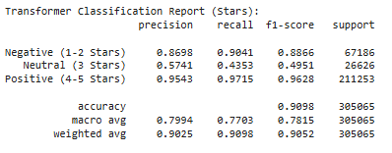
Experiment & Results - Human-Labeled Data
Key Quantitative Results
These data report similar results to those seen with VADER-classified data. The transformer model also still appears superior.

Slide 13
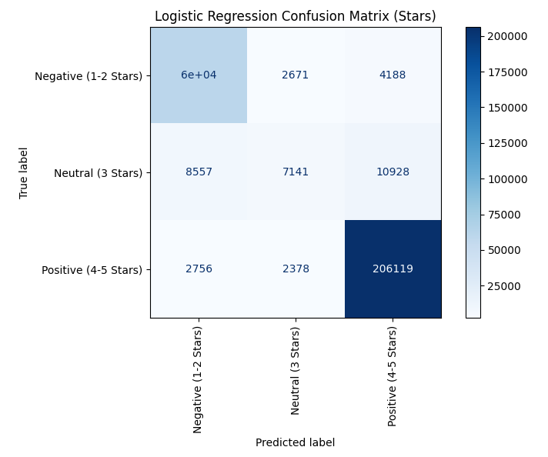
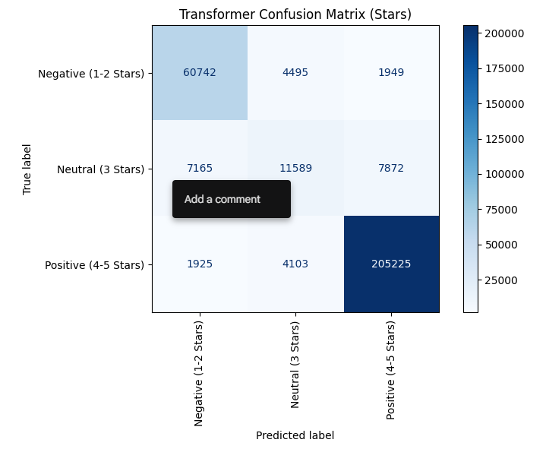
Experiment & Results - Human-Labeled Data
Notes:
F1 weighted average is a robust metric for evaluating sentiment classification models, especially when dealing with imbalanced datasets, as it combines the precision-recall balance of the F1 score with a weighting scheme based on class prevalence

Slide 14
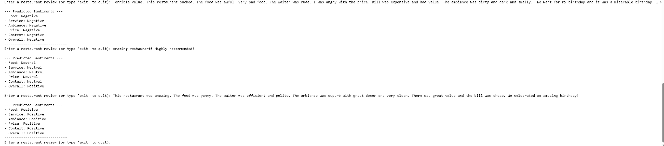
Demonstration

Slide 15
Conclusion & Future Work
Fine-tuned transformer models (DistilBERT) are highly effective for multi-aspect and overall sentiment classification
Significantly outperforms traditional methods like logistic regression
Granular and simultaneous overall analysis is feasible and valuable

Slide 16
Conclusion & Future Work
Future Ideas
Refine aspect keyword lists
Add more training data, especially for weaker categories (e.g. ambiance, price, context)
Hyperparameter tuning for the transformer model
Manual tuning of sentiment score cutoffs
Possibly explore explainability techniques (LIME, SHAP) to understand model decisions

Slide 17
References
Akhtar, Z., Ahmad, T., Khan, M. A., & Ul Abidin, S. Z. (2024). Explainable Aspect-Based Sentiment Analysis Using Transformer Models. Applied Sciences, 8(11), 141. https://www.mdpi.com/2504-2289/8/11/141
Al-Twairesh, N., & Al-Khalifa, H. (2021). Sentiment classification and aspect-based sentiment analysis on yelp reviews using deep learning and word embeddings. Journal of Decision Systems, 30(2-3), 226-252. https://www.tandfonline.com/doi/abs/10.1080/12460125.2020.1864106
Duan, T. (2018). Aspect-based Opinion Mining with Yelp Restaurant Reviews. Duke University Statistical Science Theses. https://dukestatsci.github.io/thesis-sp18-duan-sentiment/
Gan, Q., Ferns, B.H., Yu, Y., Jin, L (2016). A text mining and multidimensional sentiment analysis of online restaurant reviews. Journal of Quality Assurance in Hospitality and Tourism.https://www.tandfonline.com/doi/abs/10.1080/1528008X.2016.1250243?casa_token=3343pqRoCCwAAAAA:nULDsc5QgFROIP2shCOffBtXiwK_DoOktl2cm0OvD5CdNiU9nCmnH_mOKjlzP-yrIPv5Cfo4SSoumw
Musa, A., Adam, F. M., Ibrahim, U., & Zandam, A. Y. (2024). HauBert: A transformer Model for Aspect-based Sentiment Analysis of Hausa-Language movie reviews. Proceedings of the 5th International Electronic Conference on Applied Sciences. https://sciforum.net/paper/view/20914
Peng, G. (2020). Aspect Based Rating Prediction For Yelp Customer Review. Master's Paper, University of North Carolina at Chapel Hill. https://cdr.lib.unc.edu/downloads/4f16c8090?locale=en

Slide 18


THANK YOU

