Slide 1

Human-Computer Interaction through Hand Gesture Recognition and Voice Commands

Slide 2
Abstract
Hand gesture recognition is pivotal for natural human-computer interaction, yet improving accuracy and speed remains a challenge. Traditional methods with external devices like gloves or LEDs can disrupt interaction flow. This study proposes a comprehensive gesture recognition system with four modules to address these challenges. The first module, using Genetic Algorithm and Otsu thresholding, accurately distinguishes hand gestures from input images, ensuring precise interaction. The second module expands functionality beyond document handling, facilitating navigation through folders and drives for enhanced productivity. The third module employs the convex hull method for finger counting, enabling responsive gesture interpretation and action execution. Additionally, adaptive filtering and YCbCr filtering enhance hand detection amidst varying conditions. The innovative Gesture Customization Module allows users to define and customize gestures dynamically, tailoring the system to individual preferences and workflows. This feature fosters user engagement and satisfaction. Together, these modules create a robust gesture recognition system that balances accuracy and speed while offering flexibility and customization. This system promises intuitive human computer interaction across diverse applications and environments, enhancing overall usability and effectiveness.
Keywords: Hand Gesture recognition, Human-computer interaction, Otsu thresholding, Gesture customization, Dynamic gesture mapping, Gesture-based navigation

Slide 3
Introduction
Imagine interacting with your computer as easily as you do with another person. Natural human-computer interaction (HCI) strives for this, relying heavily on accurate hand gesture recognition and voice commands. But achieving high accuracy and speed in these areas remains a hurdle. Traditional methods often use bulky gloves or special equipment, disrupting the natural flow of interaction.
This research proposes a groundbreaking gesture recognition system to overcome these limitations. It's not just about recognizing hand movements; it's a multi-module system designed for precision and user control. The first module acts like a gatekeeper, using clever algorithms to distinguish hand gestures from background noise in images, ensuring accurate recognition. But it goes beyond simple gestures. Imagine navigating folders or even counting on your fingers – this system can handle it, boosting your productivity.
Another innovative feature is the ability to adapt to different lighting conditions. The system utilizes advanced filtering techniques to pick up your hand movements even in varying environments. What's truly revolutionary is the user customization module. You can define and personalize your own gestures, tailoring the system to your specific needs and workflow.
Voice control works hand-in-hand with gestures. The system listens to your commands, interprets them, and executes the corresponding actions. This seamless combination promotes user engagement and satisfaction, fostering a truly intuitive HCI experience. This robust system doesn't just improve accuracy and speed; it strikes a balance between functionality and user control. By offering customization and adapting to different environments, the system has the potential to revolutionize HCI across various applications and create a more natural and efficient way to interact with computers.

Slide 4
Methodology
Data Collection:
The data is created which consists of different types of hand gestures that are created by customized ones
Hand Image:
Role of Hand Input Images: Hand input images are essential in facilitating natural and intuitive interactions between users and digital devices within the realm of Human-Computer Interaction (HCI). These images play a crucial role in enhancing the usability and accessibility of various HCI applications by providing a visual representation of hand movements, poses, or gestures.
Definition of Hand Image: In the context of HCI, hand input images refer to a series of images that capture the movements, poses, or gestures of a human hand. These images serve as a visual input mechanism for users to control and interact with digital devices or interfaces, offering a more intuitive and engaging user experience.
Static Hand Input Images: One type of hand input image is static hand input images, which depict the hand in a particular pose or position. These images are valuable in HCI as they allow users to input commands or interact with digital interfaces by recognizing specific hand gestures or positions, enabling seamless communication between the user and the device.
Enhancing Usability and Accessibility: By utilizing hand input images, HCI applications can enhance usability and accessibility for users, especially in scenarios where traditional input methods may be challenging or cumbersome. The visual nature of hand images provides a more natural and user-friendly way for individuals to interact with technology, bridging the gap between human actions and digital responses.

Slide 5
Hand Detection in Human-Computer Interaction
Hand detection is a crucial process in human-computer interaction that involves identifying and locating human hands within an image or video frame. This initial step is essential as it serves as the foundation for further analysis, such as recognizing specific gestures or actions performed by the hands.
The primary goal of hand detection is to accurately pinpoint the regions of an image or video that contain human hands. This is typically achieved by creating bounding boxes or keypoints around the detected hands, which then enable subsequent analysis, such as gesture recognition or hand tracking.
In the context of hand gesture recognition and voice command integration, hand detection plays a pivotal role in identifying the presence of hands in the user interface. By accurately detecting and locating the hands, the system can then interpret and respond to the gestures or commands issued by the user effectively.
The process of hand detection involves utilizing computer vision techniques and algorithms to analyze visual data and identify patterns that correspond to human hands. This involves complex computations to differentiate between hands and other objects or backgrounds present in the image or video frame.
By accurately identifying and locating human hands, hand detection sets the stage for more advanced interactions between users and computing systems. It forms the basis for seamless integration of hand gestures alongside voice commands, enhancing the overall user experience in human-computer interaction scenarios.

Slide 6
Pre-Processing: Preprocessing in hand gesture recognition involves several steps to enhance the quality of input data before feeding it into a machine learning model.
Image Acquisition: Hand gestures are typically captured using cameras or depth sensors. Ensuring good lighting conditions and camera settings can improve the quality of the input images.
Image Cropping: The captured image may contain irrelevant background information. Cropping the image to focus only on the region of interest (ROI) containing the hand can reduce unnecessary information and speed up processing.
Noise Reduction: Image noise can degrade the performance of hand gesture recognition algorithms. Techniques like Gaussian blurring or median filtering can help reduce noise while preserving important features.
The Hand Tracking Module: A Handy Toolbox for Hand Interaction
This module offers a pre-built toolkit for various applications that rely on hand movements. It acts like a single, reusable block of code that takes care of everything hand-related, saving developers time and effort.
Grabbing Video Frames: It uses OpenCV to capture live video from your webcam, providing the raw material for hand detection.
Spotting Hands: Different techniques like color filtering, shape recognition, or even pre-trained AI models can be used to find hand regions in the video.
Identifying Key Points: Once hands are located, the module zooms in to pinpoint specific locations like fingertips and knuckles, like marking key points on a map.
Tracking Finger Movements: By following these key points, the module tracks how your fingers move and bend, allowing it to understand gestures like pointing or clenching a fist.

Slide 7
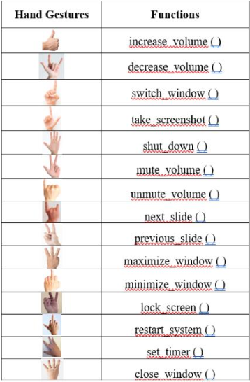
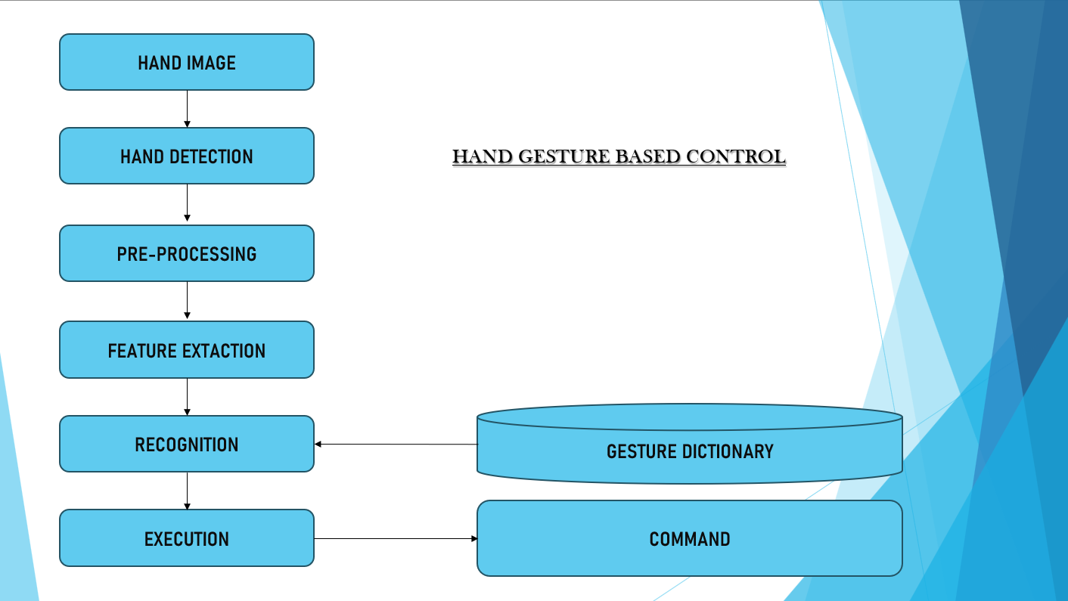
Recognition: The system recognizes specific gestures or actions based on finger counting results and possibly other hand gestures by using the convex hull method. Gestures such as thumbs up, pointing, or making a closed fist may trigger different actions or commands
Gesture Dictionary: A gesture dictionary, also referred to as a gesture library, is a collection of reference gestures that the system can recognize. Each gesture in the dictionary is associated with a specific meaning or command
Command: The system executes the command associated with the recognized gesture. This may involve sending a signal to a device, performing an action on a computer, or controlling a robot.
Execution: Once a gesture is recognized, the system translates the recognized gesture into a corresponding command

Slide 8
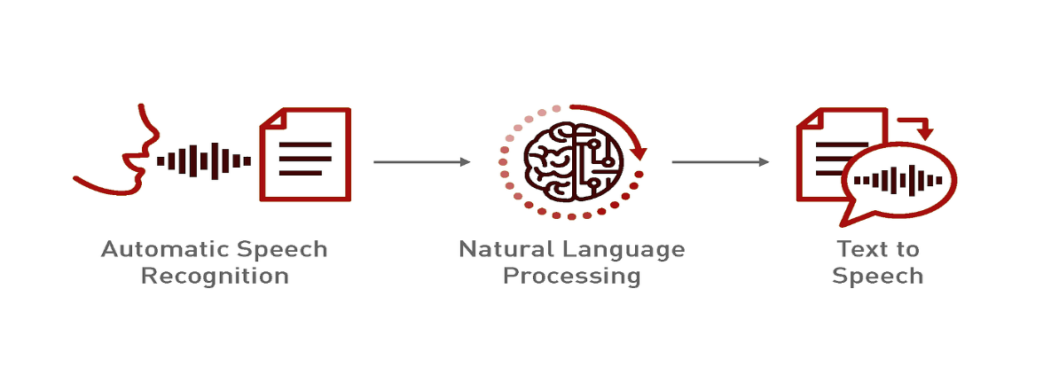
Methodology (Voice Based)
Capturing Audio
Preprocessing
Recognition
Decoding
Output
Input Voice Commands: A Natural Language Interface
Within voice-controlled systems, input voice commands represent spoken instructions issued to the device. This method replaces traditional keyboard or mouse input, allowing users to interact with the system verbally. The core component of a voice command is the action verb, which clearly specifies the desired operation. Examples include "activate application," "adjust volume," or "compose message.“
This natural language interface offers a hands-free and potentially more efficient alternative to conventional input methods, streamlining user interaction and enhancing accessibility.
Conversion of Voice into Text using Speech Recognition Module:
Once you've spoken your command, the voice control system relies on a clever tool called a speech recognition module. This module acts like a translator, taking the sound waves you spoke into the microphone and converting them into text the system can understand. It does this by analyzing the sound waves and comparing them to patterns in its database, essentially matching the sounds to pre-programmed word and phrase blueprints
Capturing
Audio Preprocessing
Recognition
Decoding
Output

Slide 9
Understanding the command given by the User
Natural Language Processing: Decoding User Intent
Speech-to-text conversion, the voice control system employs Natural Language Processing (NLP) techniques to comprehend the user's intended meaning within the spoken command. This multi-step process aims to extract semantic information and user goals.
Part-of-Speech Tagging: This initial stage categorizes each word according to its grammatical function (e.g., noun, verb, adjective). By understanding the sentence structure, the system can better grasp the relationships between words.
Intent Recognition: Here, the core action or objective conveyed by the user is identified. For instance, the command "open YouTube" translates to an intent of accessing a video platform.
Contextual Understanding: In certain situations, the system may leverage the conversational context or prior user interactions to refine its understanding. For example, if a previous command was "play music," a subsequent "play next" would likely be interpreted as playing the next song in a playlist.
Turning Words into Actions: Command Processing
Matching Commands: It checks its database of commands (like "open YouTube") to find the right action. Simple commands go straight to execution.
Extracting Details: Some commands need extra info (arguments) like URLs for websites. The system uses NLP to find these from what the user said.
Putting it into Action: With the command and any arguments figured out, the system triggers specific functions to perform the task. These functions control settings, launch apps, interact with websites, or play media.
Making it Happen: These functions interact with the system (like adjusting volume) or external services (like opening a web page) to carry out the user's request.

Slide 10
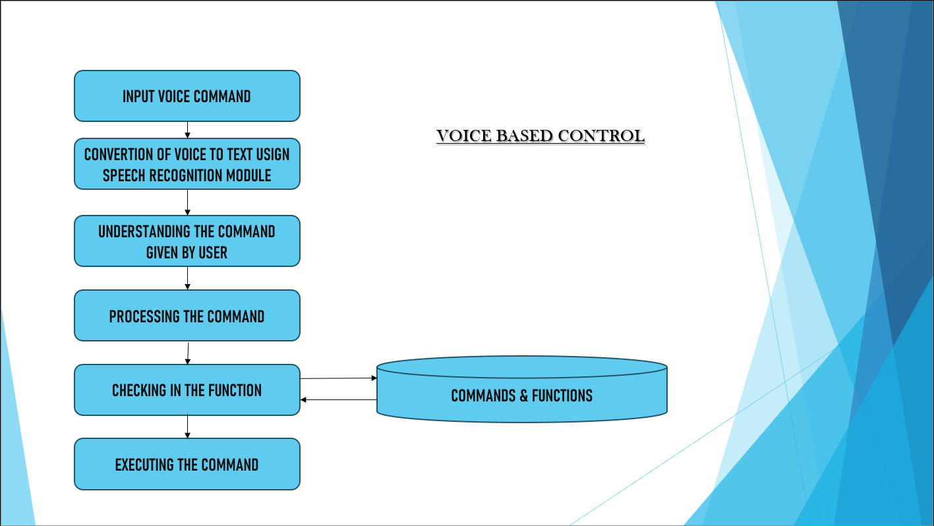
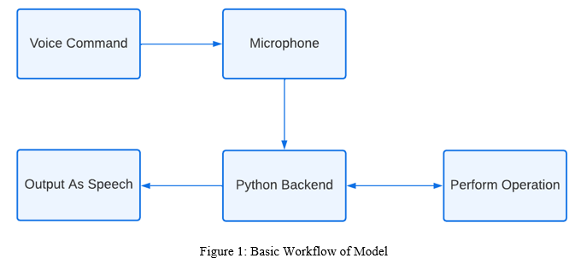
Command Recognition: A Foundation for User Interaction
Within the voice control system, a critical component lies in the command recognition module. This module functions as a centralized database, acting as a repository for two essential elements:
Supported Command Inventory: This inventory maintains a comprehensive list of all valid spoken phrases users can employ to interact with the system. These phrases represent the user's intended actions, such as "open YouTube" or "adjust volume."
Function Mapping: For each supported command, the database establishes a clear association with a specific function within the system's codebase. These functions are pre-written routines designed to execute the desired actions upon invocation. For example, the command "open YouTube" might map to a function that launches the YouTube application.
Executing the command: If the system finds a match for the user's command in its database, it executes the corresponding function. These functions are essentially a set of pre-written instructions that tell the system how to perform specific actions.

Slide 11
THANK YOU

