Slide 1

GAYATRI VIDYA PARISHAD COLLEGE OF ENGINEERING FOR WOMEN(AUTONOMOUS)
TOPIC:ROLE OF EDUCATION IN SOCIAL DEVELOPMENT
NAME:ALTHI MANASA
ROLL NO:325103210009
BRANCH:CSE-1

Slide 2

WHAT IS A SOCIAL DEVELOPMENT?
Process of improving people’s quality of life included
Focus on better education , health, and basic needs.
Growth of communities where everyone feels included.
Support for reducing poverty and inequality.
Better relationships among people in society.

Slide 3

Why education matters for society?
Foundation for building skilled and knowledgeable citizens.
Support for economic growth by preparing people for jobs.
Reduction of poverty through better opportunities.
Promotion of equality among different social groups.
Development of responsible,informed decision makers.

Slide 4


HOW EDUCATION REDUCES INEQUALITY?
Equality access to knowledge for all groups in society.
More job opportunities for people from poor backgrounds.
Improved confidence and communication skills for everyone.
Support for marginalized communities to grow and succeed.
Fair competition in exams and careers based on skills.

Slide 5


GOVERNMENT SUPPORT FOR EDUCATIOM IN 2025
Increased focus on digital learning tools and smart classrooms.
Expansion of scholarships for poor and rural students.
More funding for improving school infrastructure.
Support for teacher training and skill development.
Efforts to make education accessible in remote areas.
News programs to strengthen science,coding,and vocational skills

Slide 6
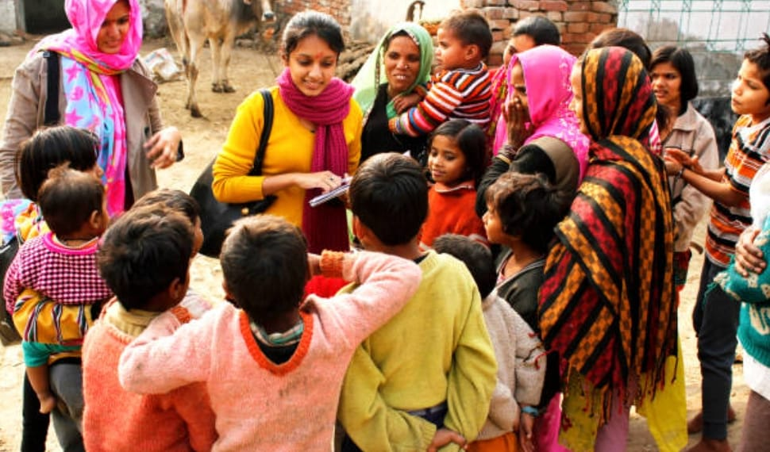

SUPPORT FOR POOR AND TRIBAL COMMUNITIES
Special scholarships to help students continue education.
Free uniforms,textbooks,and learning materials.
Residential schools and hostels for children in remote areas.
Extra coaching and bridge courses to close learning gaps.
Health checkups and nutrition programs to support learning.
Skills training centers for jobs and self employment.

Slide 7


SKILL DEVELOPMENT AND INNOVATION PROGRAMS
Training for youth in modern job skills like coding,design,and technology.
Workshops for communication,teamwork,and problem solving.
Support for vocational courses in trades like electronics,carpentry,and tailoring.
Innovation labs in schools and colleges to encourage new ideas.
Government partnerships with industries for practical training.
Internship and apprenticeship opportunities for hands on training.

Slide 8
ANY QUIRIES?

Slide 9
THANK YOU

