Slide 1

YC startup, Inc.
A template that tells you how to build a seed deck
Notes:
This is the title page. It has the name of your company, and a one line description of what you do.
This is the only place in the deck where you can only have 1 slide for what you need to show. Any of the other slides in this deck should be treated as a first slide of a set. If you can keep the set to n=1, that’s ideal, but if you need more, that’s ok. You probably don’t want any set here where n > 3. This is a seed deck, remember.

Slide 2
Founders build bad seed decks
This wastes a huge amount of time
Bad seed decks mean they don’t raise the money they need
No money means companies are forced to survive on revenue
Notes:
This is where you clearly state the problem. Particulars of how this problem impacts real world people/businesses are valuable.

Slide 3
Our template solves this problem
It’s fast to use
Simple to explain
Improves lives and cleans teeth
Notes:
This is the solution. You want to explain what you do very clearly, in as few words as possible. Describe the concrete benefits you provide

Slide 4
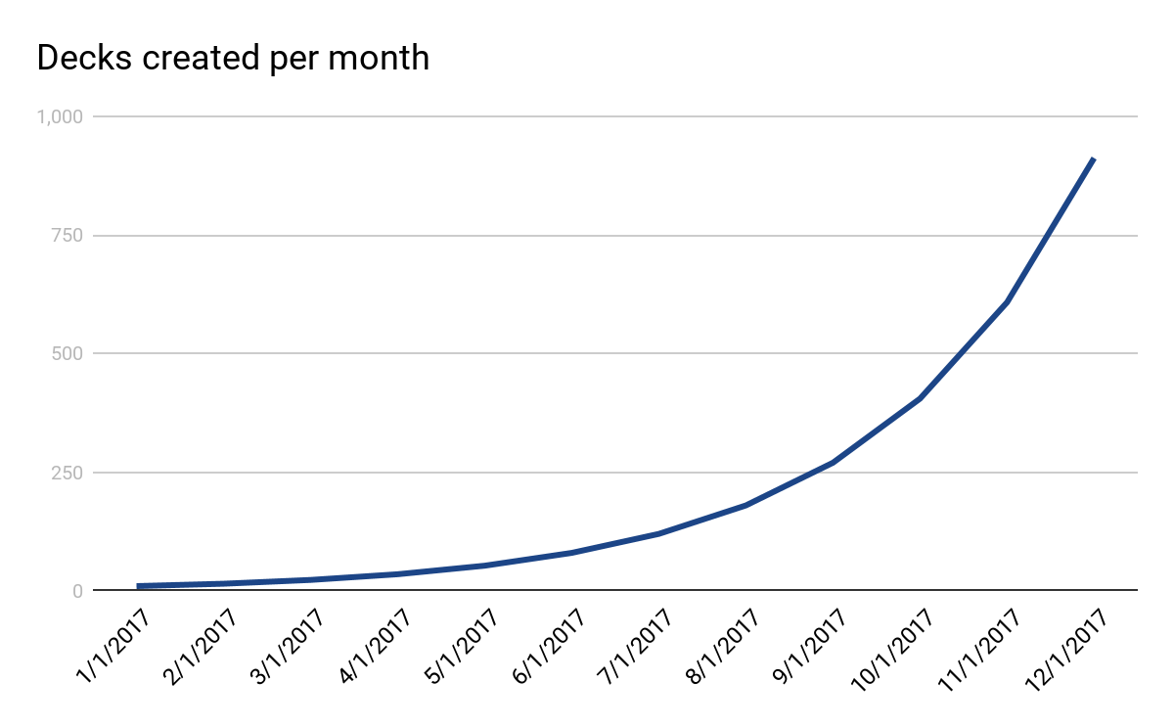
All the companies are using us
50% growth per month. Every month.
100% retention
Notes:
Show off your traction (if you have it). Make the numbers clear and meaningful. It’s unlikely your curve will be this smooth. That’s ok.
Add some context next to the chart if you’ve got some great stats you want to add.

Slide 5
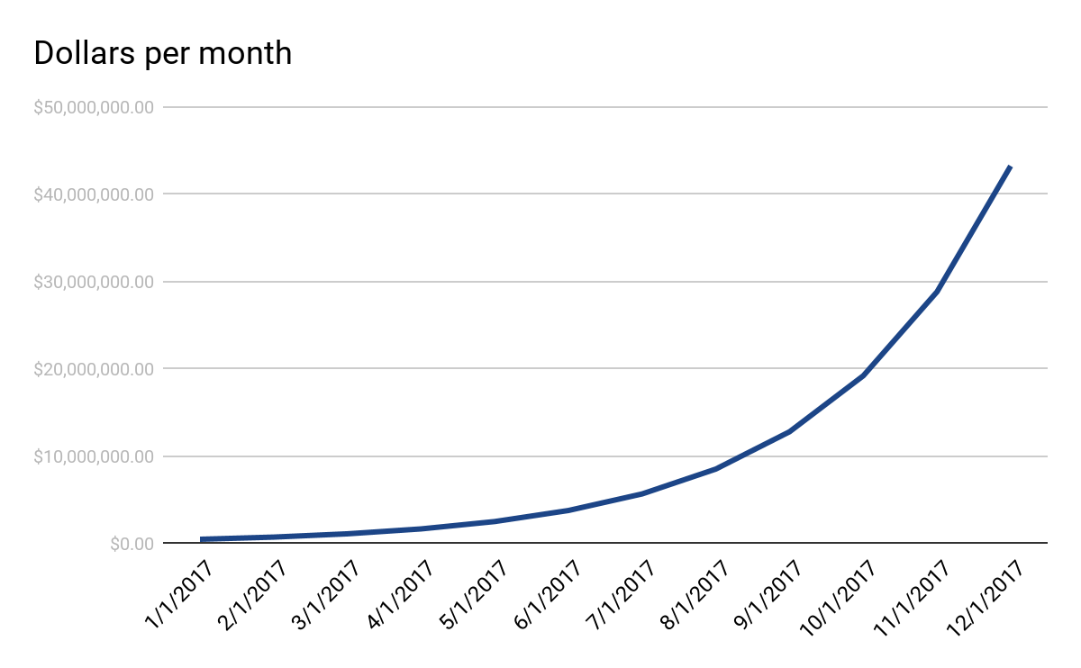
Money raised thanks to our decks
US$s, not C$s
95% better than fundraises without our decks
Notes:
Got more metrics? Awesome! Add them!
Trick slide! Revenue would be better here, but this is ok.

Slide 6
Our decks work because of science
Time to create a deck is 90% less
Edward Tufte approved
We pick better color schemes
Have you heard of the power of paper?
Notes:
Tell the investor what makes you so special, what makes this work, what your insights are. This might take more than one slide.

Slide 7
We make money on every deck
5% of all capital raised + 1% royalty on business revenue
That’s $6m in revenue last year alone
Free to produce new decks, because we don’t do any work, it’s a google slide template
Notes:
Business model is important. You probably don’t know all the details yet, but you should know a lot of them. Lay it out. If you need more space to dig into something complicated, add slides.

Slide 8
Future growth
There are 1000 slide decks made in SF every day
That’s the first market, but it’s slowed because of how hard decks are to build
We’re going to make decks bigger, better, and easier, which means more decks
Notes:
What’s the market here? Is it going to be big? Will you make it big? How much money are you going to make off this thing? Convince the investor that they’re going to make lots of money with you

Slide 9
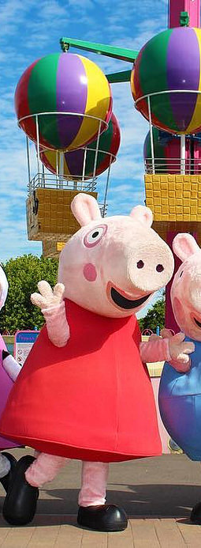

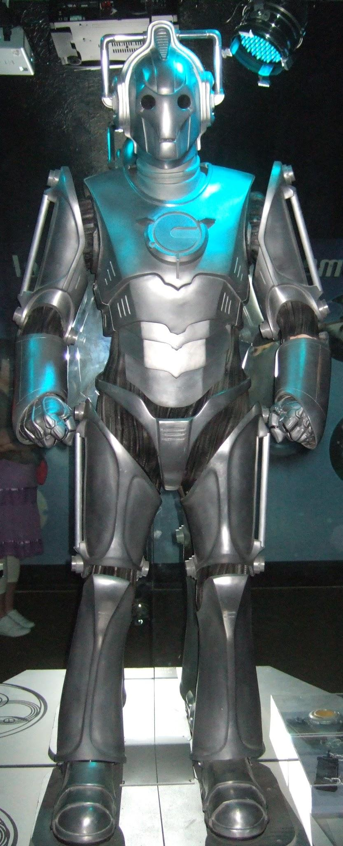
Team
CTO with lots of experience
CEO who knows how to pitch
VP eng who does not sleep
Notes:
Team! So important at seed. Talk about what makes your team particularly well suited to the problem. This should be about founders. Nobody cares about your advisors.

Slide 10
What we need
$1.5m
This is for engineers and marketing
With this money, we’ll hit all the milestones for our next round within 2 days
Thanks
Notes:
Tell the investor how much money you need, and what it gets you. If you can lay out where you’ll be inside of a year, which should make you Series A ready, that’s powerful. It does *not* include your valuation, cap, or other fundraising terms.

