Slide 1




Econometrics Project 2: Estimating the production function using panel data techniques
Tulga Kagan Temel – 3168178
Eren Batuhan Es – 3153944
Doruk Efe Kanber – 3163051

Slide 2
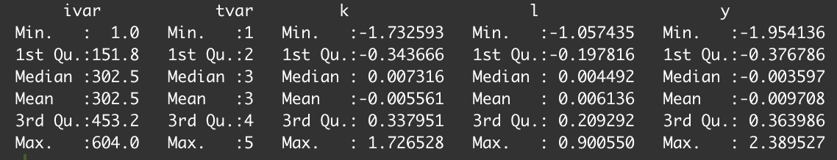
Dataset Overview
Variables:
Individual identifier (ivar): This variable identifies each unique firm in the dataset.
Time identifier (tvar): This variable represents different time periods for which data is collected.
Explanatory variable: ln(labor) (l): It is the natural logarithm of the labor input for each firm and time period.
Explanatory variable: ln(capital) (k): It is the natural logarithm of the capital input for each firm and time period.
Dependent variable: ln(output) (y): It is the natural logarithm of the output for each firm and time period.
Number of firms: 604
Time periods: 5
Total observations: 3020

Slide 3

Data Exploration
After checking if there are missing values(na) in the dataset, we visualize the cariables to get an understanding of their distributions:
The histogram of ln(output) suggests that the variable is approximately normally distributed. The density plots of ln(labor)and ln(capital) show a unimodal distribution, indicating the presence of a central tendency.

Slide 4
The scatter plots of ln(output) with ln(capital) and ln(labor) display positive relationships, which can be further examined through regression analysis.

Slide 5
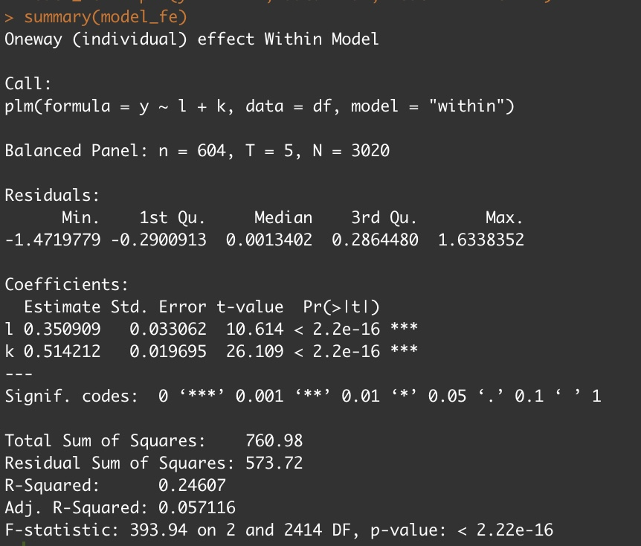
Estimation Results - Fixed Effects Model (FE)
Coefficients:
ln(labor) (l): The estimated coefficient is 0.350909, with a standard error of 0.033062. The t-value is 10.614, and the p-value is less than 2.2e-16, indicating a statistically significant relationship between ln(labor) and ln(output).
ln(capital) (k): The estimated coefficient is 0.514212, with a standard error of 0.019695. The t-value is 26.109, and the p-value is less than 2.2e-16, indicating a statistically significant relationship between ln(capital) and ln(output).
Model statistics:
R-Squared: The fixed effects model explains approximately 24.6% of the variation in ln(output).
F-statistic: The F-statistic is 393.94 with 2 and 2414 degrees of freedom, and the p-value is less than 2.22e-16, indicating overall model significance.

Slide 6
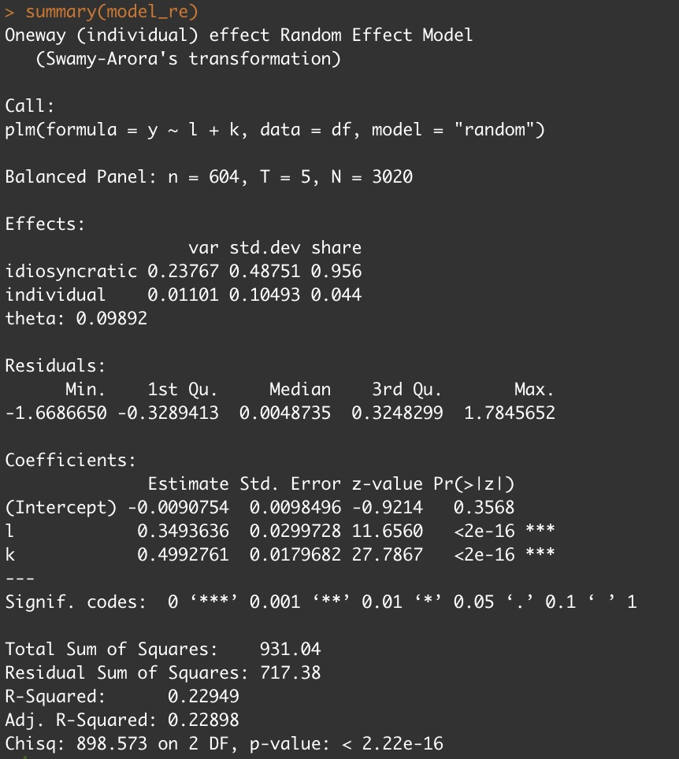
Estimation Results - Random Effects Model (RE)
Coefficients:
ln(labor) (l): The estimated coefficient is 0.3493636, with a standard error of 0.02997. The t-value is 12.656, and the p-value is less than 2e-16, indicating a statistically significant relationship between ln(labor) and ln(output).
ln(capital) (k): The estimated coefficient is 0.499276, with a standard error of 0.017968. The t-value is 27.7867, and the p-value is less than 2e-16, indicating a statistically significant relationship between ln(capital) and ln(output).
Model statistics:
R-Squared: The fixed effects model explains approximately 22.9% of the variation in ln(output).
Chisq: The chi-square value is 898 on 2 DF, p-value < 2.22e-16 indicating overall model significance.

Slide 7
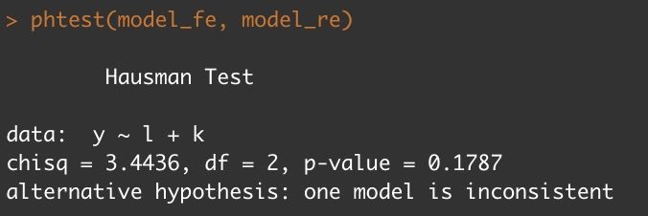
Hausman Test and Estimator Selection
Hausman Test: The Hausman test is used to determine whether the fixed effects (FE) or random effects (RE) estimator is more appropriate for our econometric analysis.
Test Result: The Hausman test resulted in a chi-square value of 3.4436 with 2 degrees of freedom and a p-value of 0.1787.
Interpretation: Since the p-value is greater than the conventional significance level of 0.05, we fail to reject the null hypothesis. This indicates that there is no significant difference between the FE and RE estimators. Therefore, we select the more efficient and consistent random effects (RE) estimator for our analysis.

Slide 8
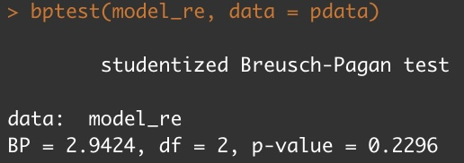
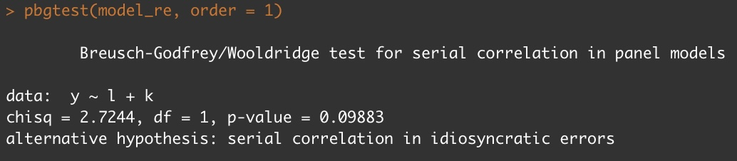
Heteroscedasticity and Serial Correlation Tests
Heteroscedasticity: Heteroscedasticity refers to the violation of the assumption that the error terms have constant variance across observations.
Breusch-Pagan Test: The Breusch-Pagan test is used to detect the presence of heteroscedasticity in our model.
Test Result: The Breusch-Pagan test resulted in a test statistic (BP) of 2.9424 with 2 degrees of freedom and a p-value of 0.2296.
Interpretation: Since the p-value is greater than the conventional significance level of 0.05, we do not have sufficient evidence to conclude that heteroscedasticity is present in our model.
Serial Correlation: Serial correlation (autocorrelation) occurs when the error terms in a regression model are correlated with each other over time.
Wooldridge Test: The Wooldridge test is used to detect serial correlation in panel data models.
Test Result: The Wooldridge test resulted in a chi-square value of 2.7244 with 1 degree of freedom and a p-value of 0.09883.
Interpretation: Since the p-value is greater than the conventional significance level of 0.05, we do not have sufficient evidence to conclude the presence of serial correlation in the idiosyncratic errors of our panel data model.
Note: It is important to acknowledge that these tests have their limitations, and further diagnostic checks should be conducted to ensure the validity of our results.

Slide 9
Summary of Findings
The analysis aimed to estimate a production function using panel data techniques.
The dataset consisted of 604 firms observed over a period of 5 time periods, resulting in a total of 3020 observations.
The fixed effects (FE) and random effects (RE) models were estimated to examine the relationship between ln(labor) and ln(capital) as explanatory variables and ln(output) as the dependent variable.
The FE model showed that both ln(labor) and ln(capital) have a statistically significant positive effect on ln(output).
The RE model also confirmed the positive and statistically significant relationship between ln(labor), ln(capital), and ln(output).
The Hausman test suggested that the RE estimator is more efficient and consistent than the FE estimator, and thus, it was chosen as the preferred estimator for this analysis. The tests for heteroscedasticity and serial correlation did not provide evidence to reject the null hypotheses, indicating that the assumptions of constant variance and no serial correlation were met.

Slide 10
Conclusion
In conclusion, the findings suggest that both labor and capital inputs positively contribute to the production of output in the analyzed firms.
The random effects model is recommended as it considers unobserved individual-specific effects and provides more efficient and consistent estimates.
The absence of heteroscedasticity and serial correlation in the model enhances the reliability of the results.
These findings have implications for understanding the factors driving firm-level production and can inform decision-making processes in areas such as resource allocation and efficiency improvement.
Further research could explore additional variables or alternative econometric models to gain deeper insights into the production process and uncover potential sources of productivity growth.

Slide 11
Thank you!

