Slide 1
Database Design & Applications
(SS ZG 518)
Functional Dependencies
Chennupati R Prasnna
CS&IS Dept.

Slide 2
Functional Dependencies and Normal forms
1.Functional dependencies
2. Definitions
3.Functional dependencies with example
4. Reasoning about FDs
5.Trivial functional Dependencies
6. Closure of FDs
7.Computing closure of FD’s
8.Inferred FDs
9. Armstrong’s Axioms
10. Projecting FDs
11.Designing relational schemas
12.Decompostion
13.Normal forms
1 SSZG 518 Database Design & Applications

Slide 3
Functional Dependencies
Framework for systematic design and optimization of relational schemas.
Generalization over the notion of keys
Crucial in obtaining correct normalized schemas.

Slide 4
Definitions
In any relation R, if there exists a set of attributes A₁, A₂ …A_{n} and an attribute B such that if any two tuples have the same values for A₁, A₂ …A_{n} then they also have the same values for B.
A functional dependency(FD) of the above form is written as
A₁, A₂ …A_{n} → B
Functional dependencies define properties of the schema and not of any particular tuple in the schema.

Slide 5
Definitions
If A₁, A₂ …A_{n} can uniquely determine many attributes, they can all be clubbed together in one expression.
A₁, A₂ …A_{n} → B₁
A₁, A₂ …A_{n} → B₂
A₁, A₂ …A_{n} → B₃
…..
A₁, A₂ …A_{n} → B_{m}
→
A₁, A₂ …A_{n} → B₁B₂B₃ … B_{m}

Slide 6
Definitions
Keys revisited: If a subset of attributes can uniquely determine the entire tuple, then they are called super keys.
minimal super keys and candidate keys can be defined analogously.

Slide 7
Functional Dependencies
Consider the relation:
Movies (title, year, length, filmTypes, studio, star)
We can identify some FDs as the following:
title, year → length
title, year → star
However, note that
title, year → star
may not always be true!

Slide 8
Reasoning about FDs
Transitivity:
In any relation R, if A → B and B → C, then the FD
A →C also holds for R.
Example:
if “Employee Number” → “Job” and “Job” → “Salary”, then
“Employee_Number” → “salary”

Slide 9
Reasoning about FDs
Two FDs S= A →B and T= C →D are said to be equivalent if the set of relation instances satisfying S is the same as the set of relation instances satisfying T.
We say that S follows T, if the set of all relation instances satisfying T also satisfies S.
FDs S and T are equivalent, if S follows T and T follows S.

Slide 10
Trivial Functional Dependencies
Note that in the Movies relation:
title, year → title
An FD where the right hand side is contained within the left hand side is called a trivial FD.
If there is at least one element on the RHS that is not contained in the LHS, it is called non-trivial, and if none of the elements of the RHS are contained in the LHS, it is called completely non-trivial FD.

Slide 11
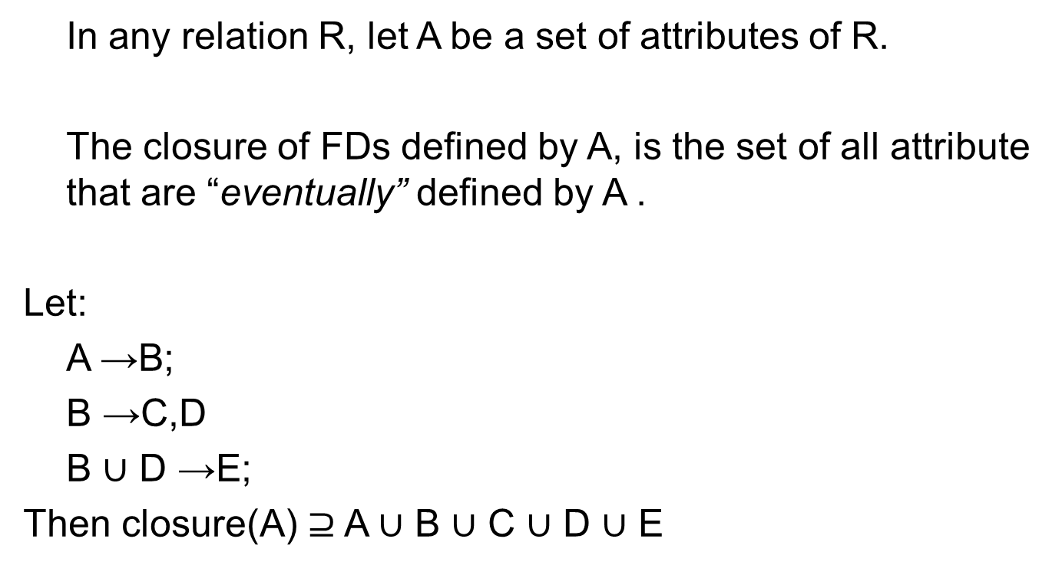
Closure of FDs

Slide 12
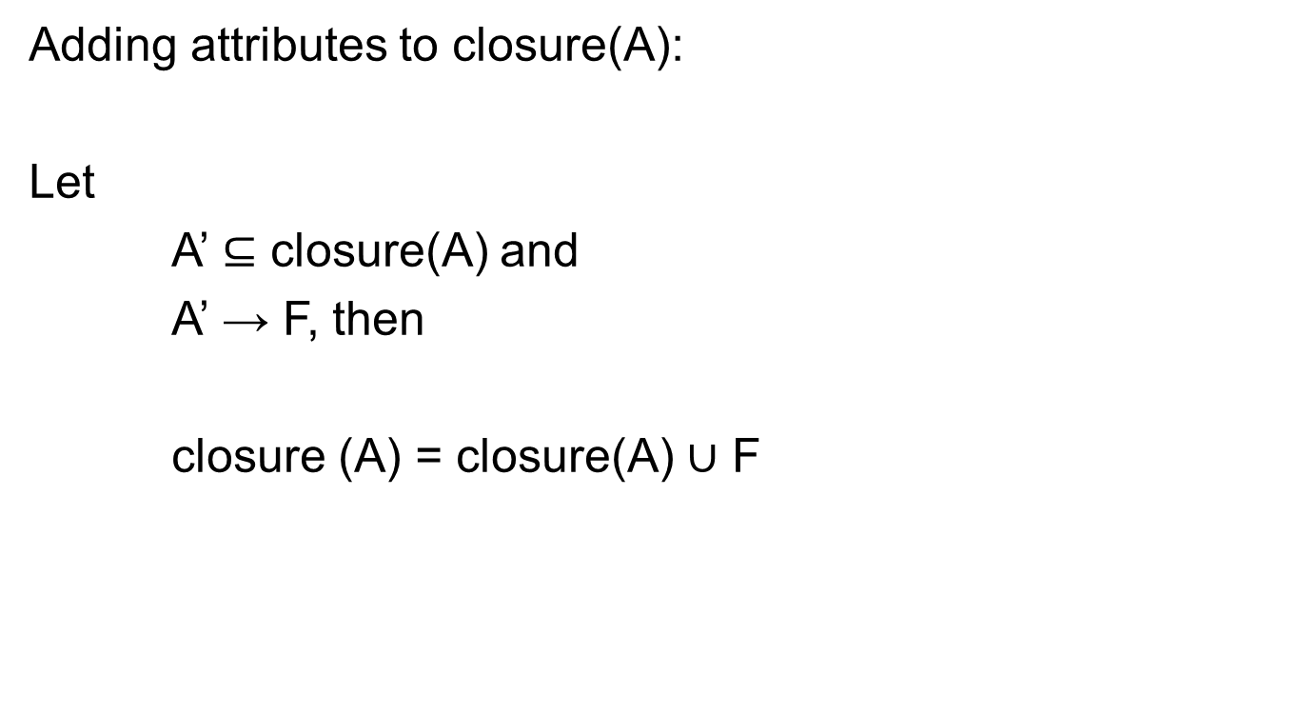
Closure of FDs

Slide 13
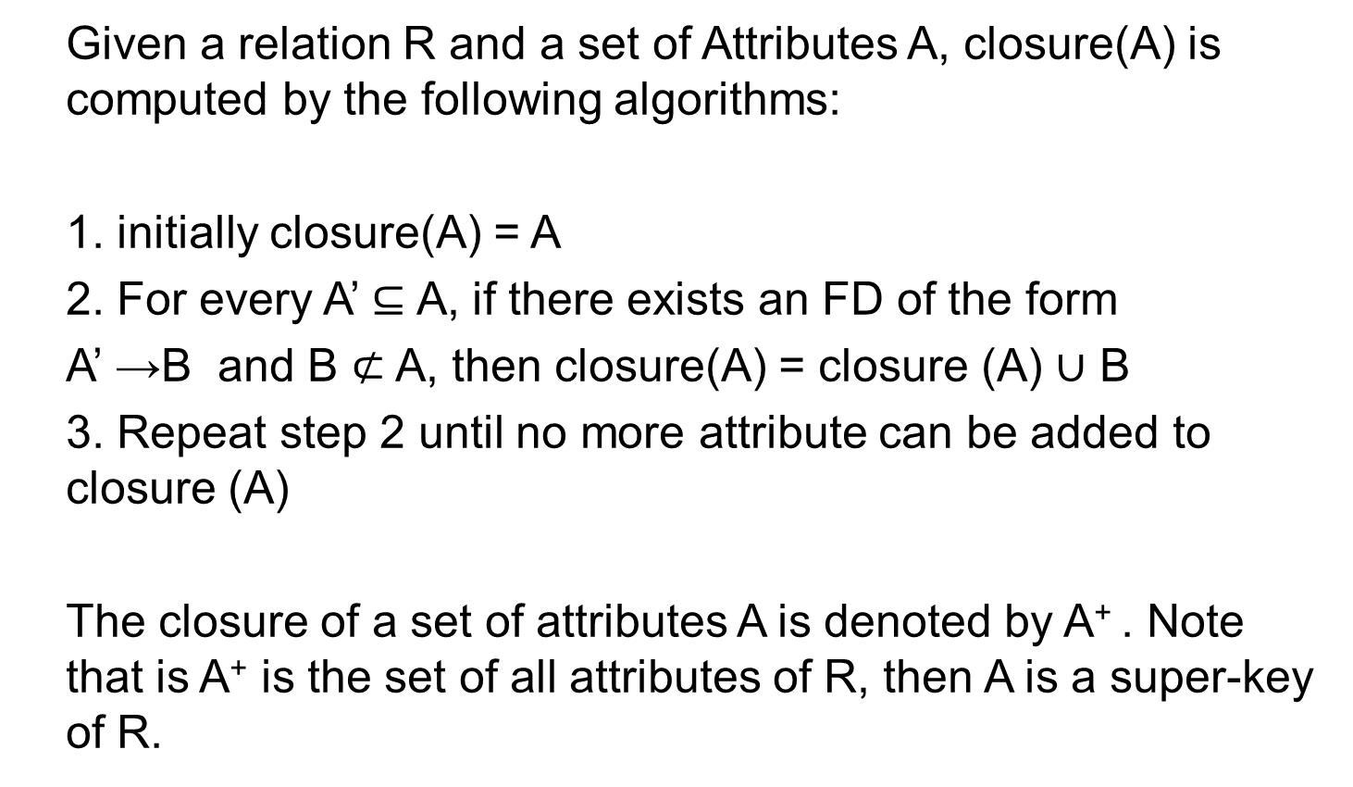
Computing closure of FDs

Slide 14
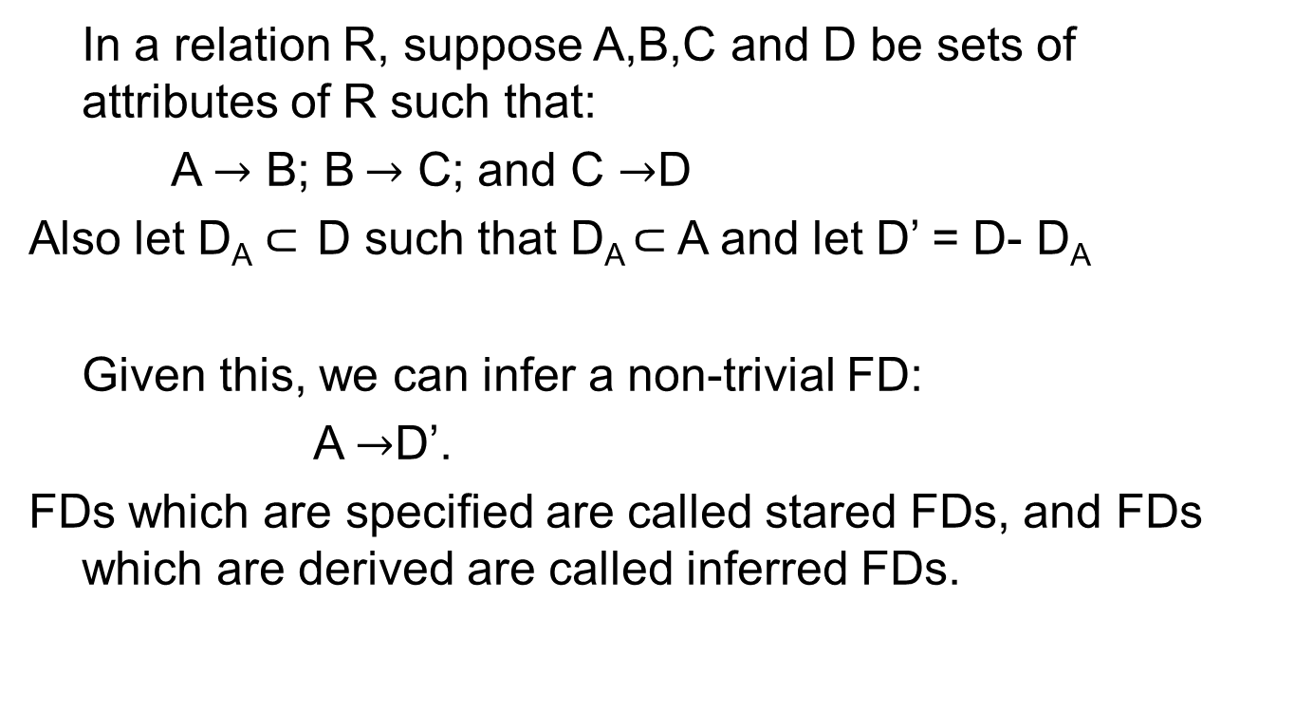
Inferred FDs

Slide 15
Inferred FDs
A given set of FDs from which the set of all FDs for a relation can be inferred, is called the basis of the relation.
If the basis is such that no subset of the basis is also a basis , then it is said to be a minimal basis for the relation.

Slide 16
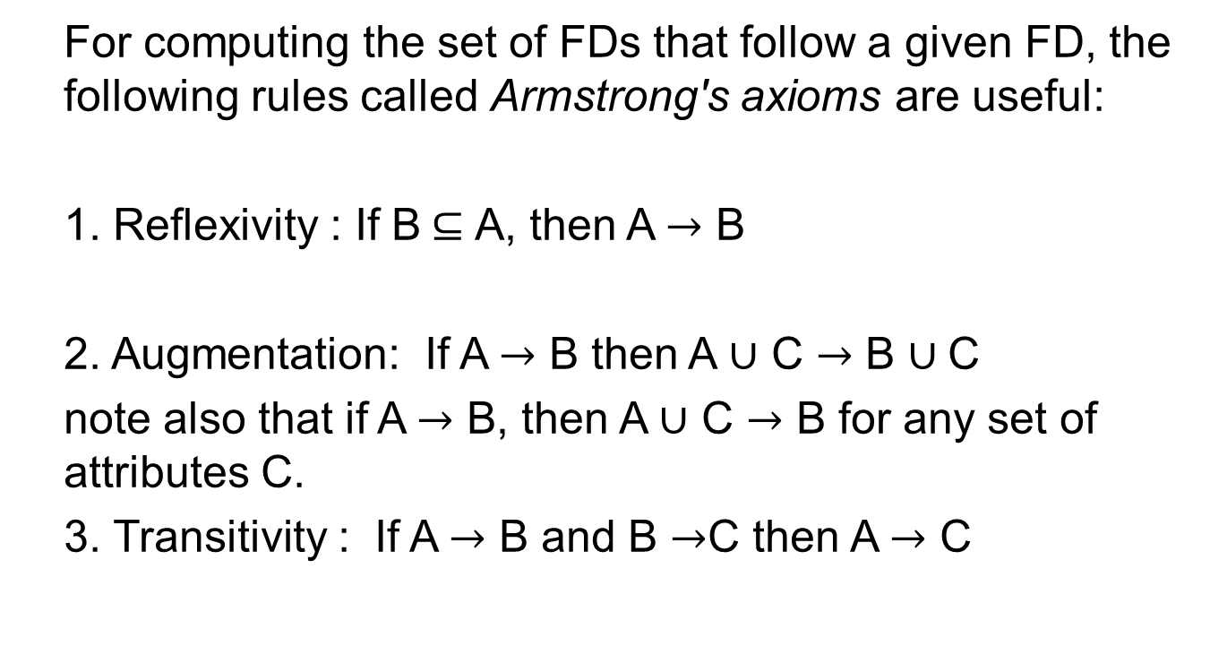
Armstrong’s Axioms

Slide 17
Projecting FDs
Let R be a relation and F(R) be the set of all FDs in R
Suppose relations S is projected from R, by removing some attributes. How can we infer F(S) ?
FDs that belong to F(S) are those which:
1. Follow from F(R)
2. Involve only attributes of S

Slide 18
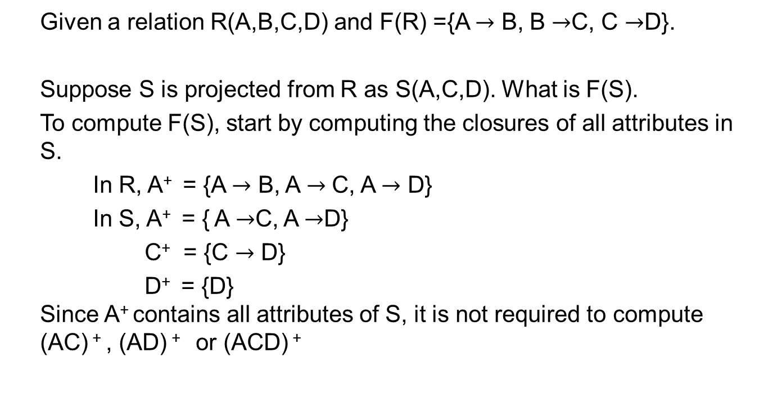
Projecting FDs

Slide 19
Designing Relational schemas
In a carelessly designed relational schema, functional dependencies
Are “improper”. This leads to the following problems:
Redundancy: information is repeated across tuples.
Update anomalies: If information is repeated across tuples, then an update of any such information has to be performed across all tuples containing the information.
Deletion anomalies: If information is repeated across tuples, deletion of information has to be performed across all these tuples.

Slide 20
Designing Relational Schemas
Consider the Movies (title, year, length, filmTypes, studio, star)
where:
title, year → length
title, year → star
But
title, year → star need not be true.
For each movie star of a given movie, the title, year, length and studio information has to be repeated. If any of these values have to be updated or deleted, they should consult all tuples where they occur.

Slide 21
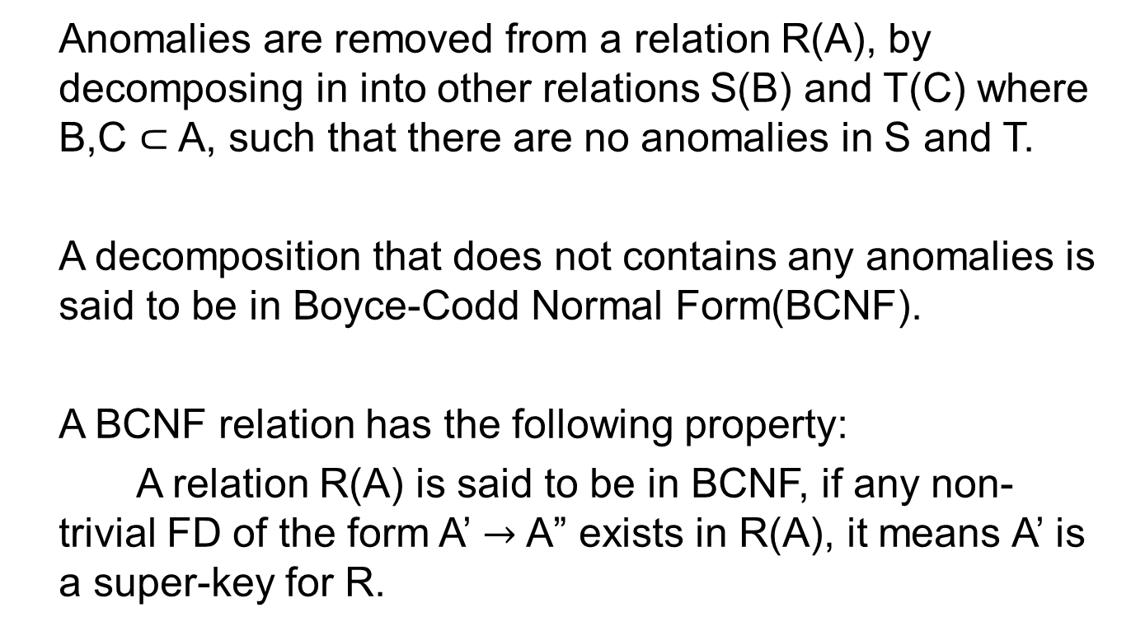
Decomposition

Slide 22
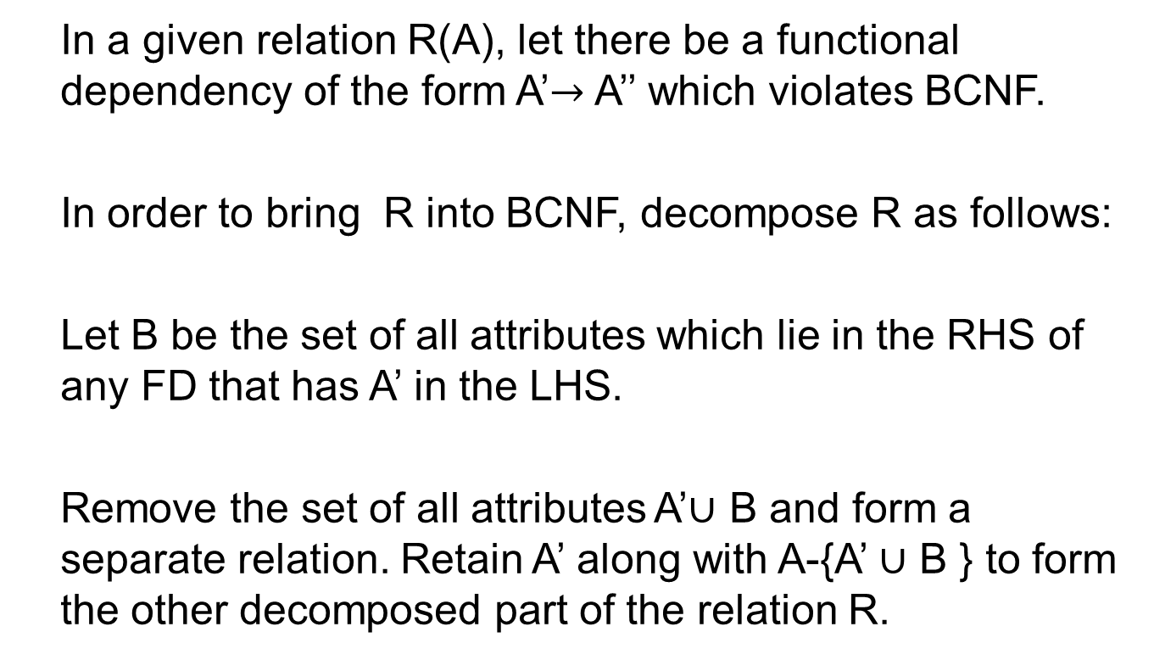
Decomposition

Slide 23
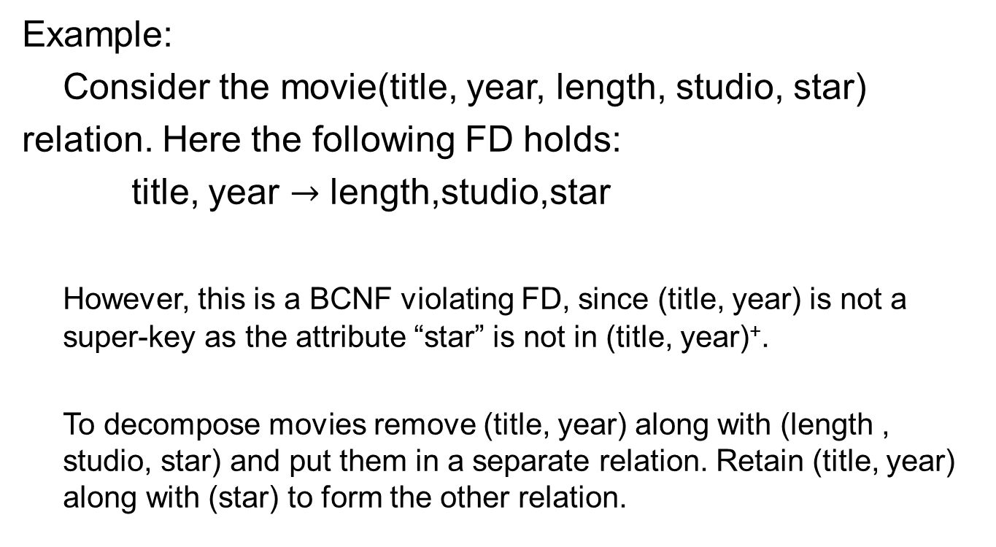
Decomposition

Slide 24
Decomposition
Hence:
Movies(title,year,length,studio,star) is decomposed into
into
Movies1(title,year,length,studio) and
Movies2(title,year,star)

Slide 25
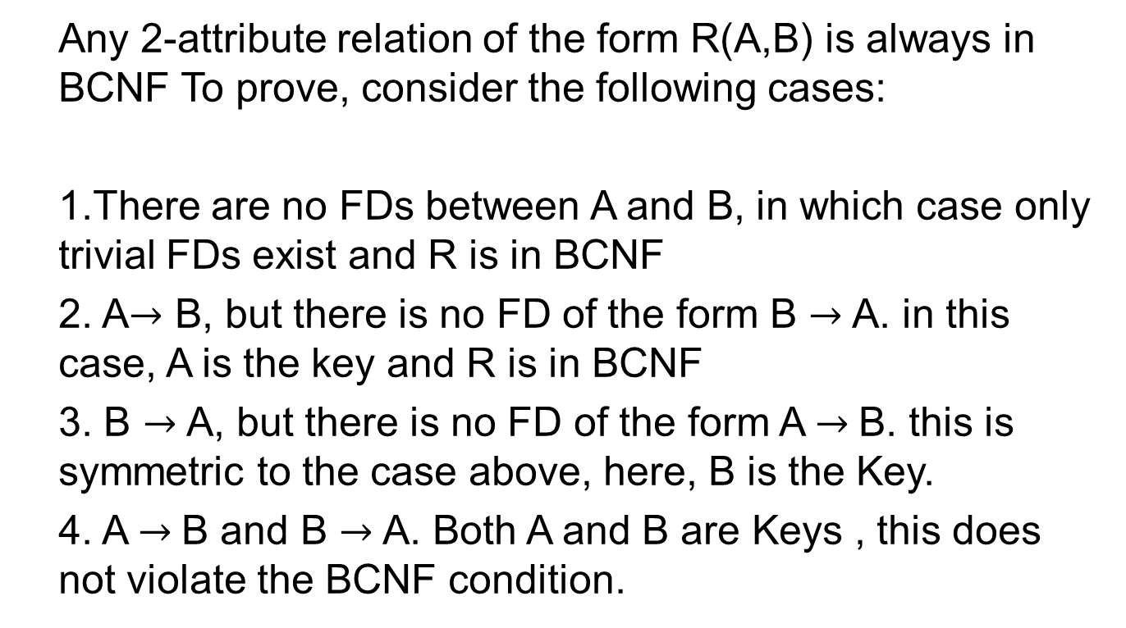
2-attribute Relations

Slide 26
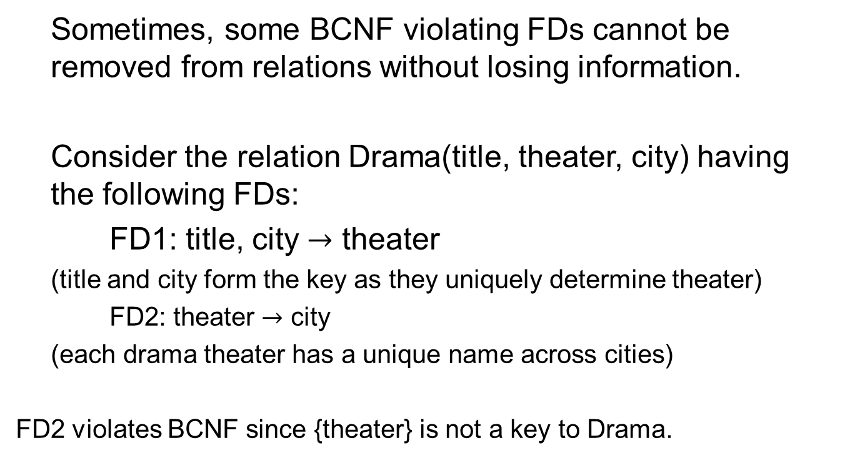
Third Normal Form (3 NF)

Slide 27
Third Normal Form (3NF)
Based on FD2, if we decompose Drama into the relations
Drama1(title, theater) and Drama2(theater, city) it will be incorrect!
This is because in the join of the relation Drama1 and Drama2,(title, city) will no longer be the key!

Slide 28
Third Normal Form (3NF)
Consider the example tables:
Drama1 Drama1
Title | Theater
Yugan | Kalaraga
Yugan | Guru Nanak Bhavan
Assare | Kalaranga
Theater | City
Kalaraga | Bangalore
Guru Nanak Bhavan | Mumbai

Slide 29
Third Normal Form(3NF)
A join between Drama1 and Drama 2 gives the table:
Note that (theater, city) no longer uniquely determine title!
Title | Theater | City
Yugan | Kalaranga | Bangalore
Yugan | Guru Nanak Bhavan | Mumbai
Aasare | Kalaranga | Bangalore

Slide 30
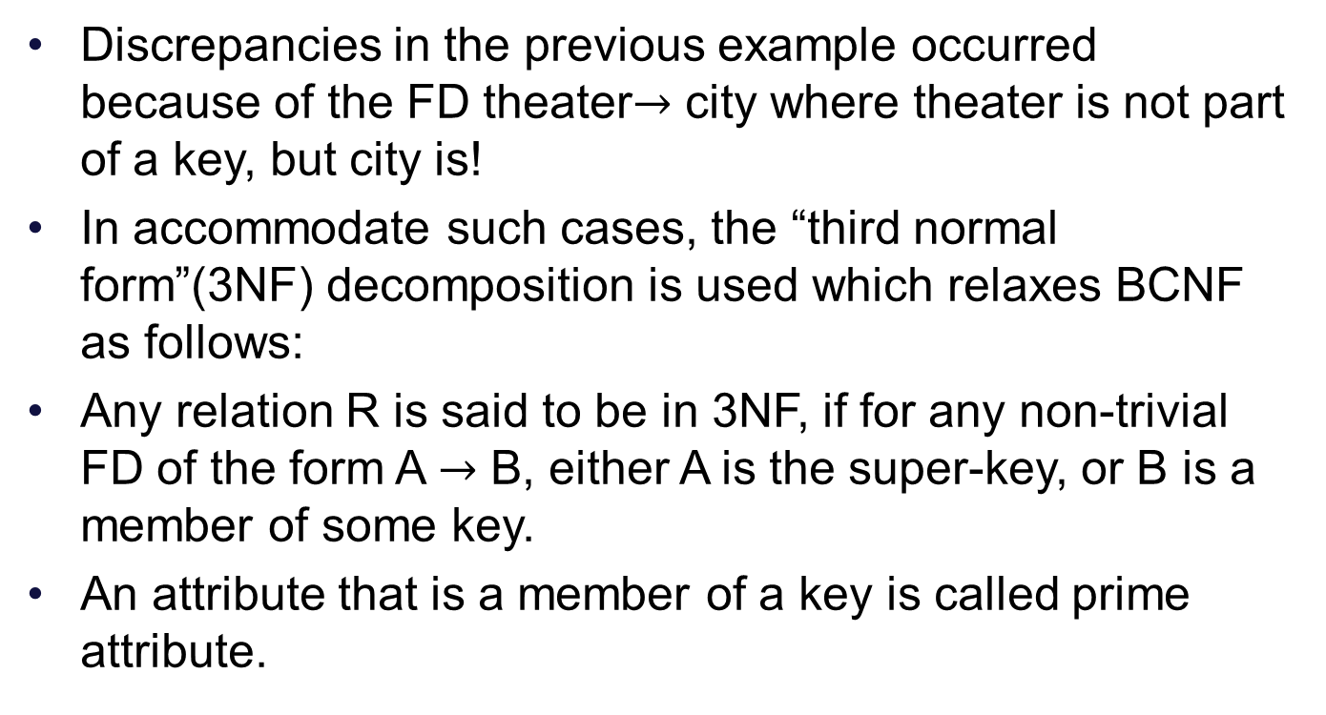
Third Normal Form (3NF)

Slide 31
Multi-valued Dependencies
In some cases, even if a relation is in BCNF, there could still be redundancies.
Consider the relation:
  Drama(title, theater,director,genre)
  Drama is in BCNF
  A given drama may have one or more genres. For every entry of genre, the theater and genre attributes have to be repeated.

Slide 32
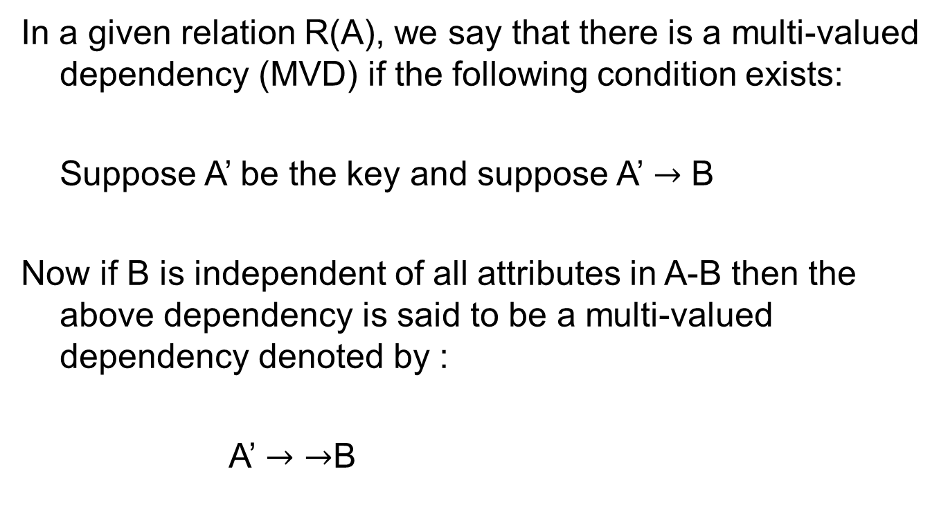
Multi-valued Dependencies

Slide 33
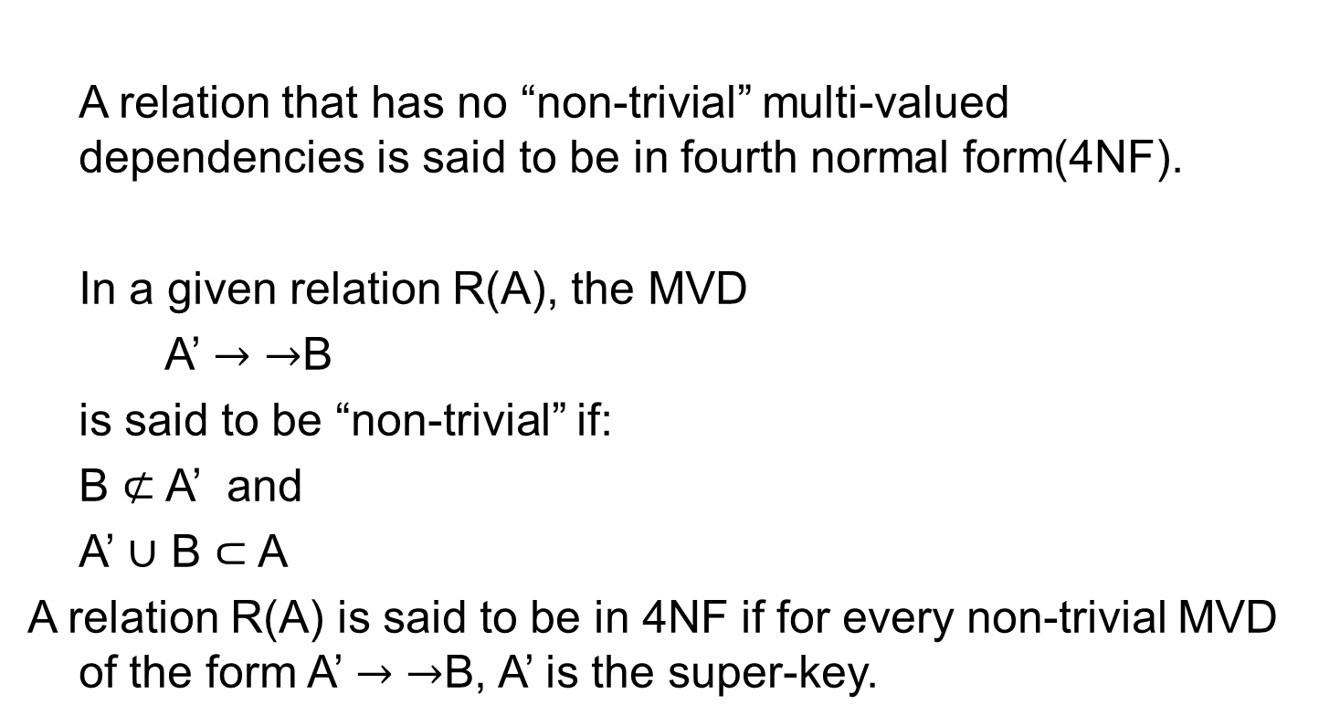
Fourth Normal Form (4NF)

Slide 34
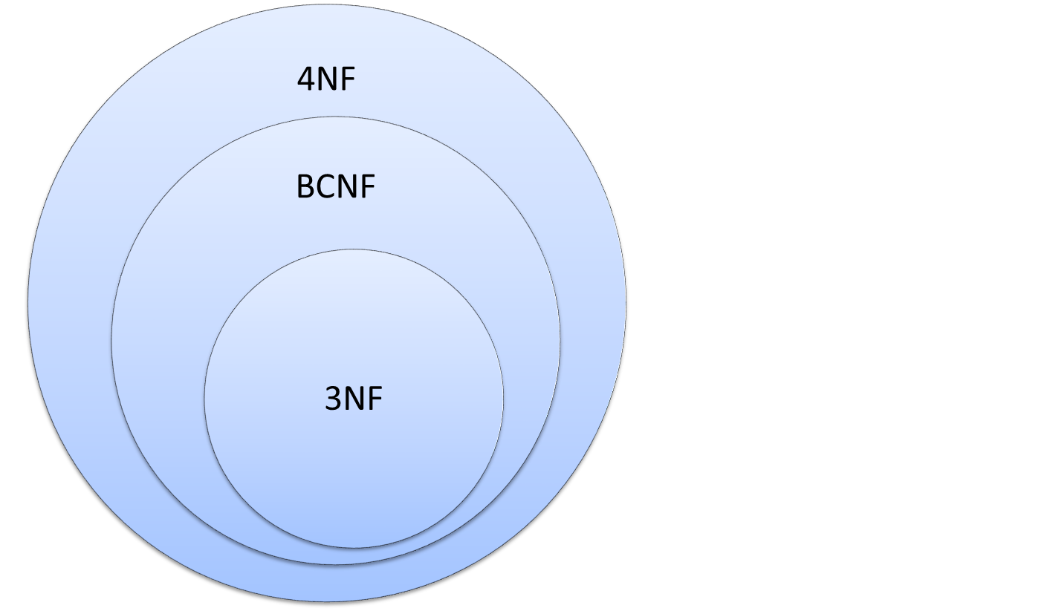
Relationship between NFs
Notes:
Note that 4NF implies BCNF implies 3NF

Slide 35
Summary
Functional Dependencies (FD)
Transitivity, Reflexivity and Augmentation properties of FDs
Trivial and non –trivial FDs
BCNF and Decomposition into BCNF
3NF
MVDs and 4NF

