Slide 1
Database Design & Applications
(SS ZG 518)
Storage Structures
Chennupati R Prasnna
CS&IS Dept.

Slide 2
Memory Hierarchies
Primary Storage
  Registers
  Cache memory
  Ram
Secondary Storage
  Magnetic disks
  Magnetic taps
  CD rom (read only/ write once)
  Flash memory

Slide 3
Secondary Storage characteristics
Random access versus sequential access
Read- write, write-0nce, read-only
Character versus block data access

Slide 4
Storage of Databases
Need data to be stored “ permanently” or persistently for long periods of time
Usually too big to fit in main memory
Low cost of storage per unit of data and the definition of “very large databases”
Primary and secondary (Auxiliary) file organizations

Slide 5
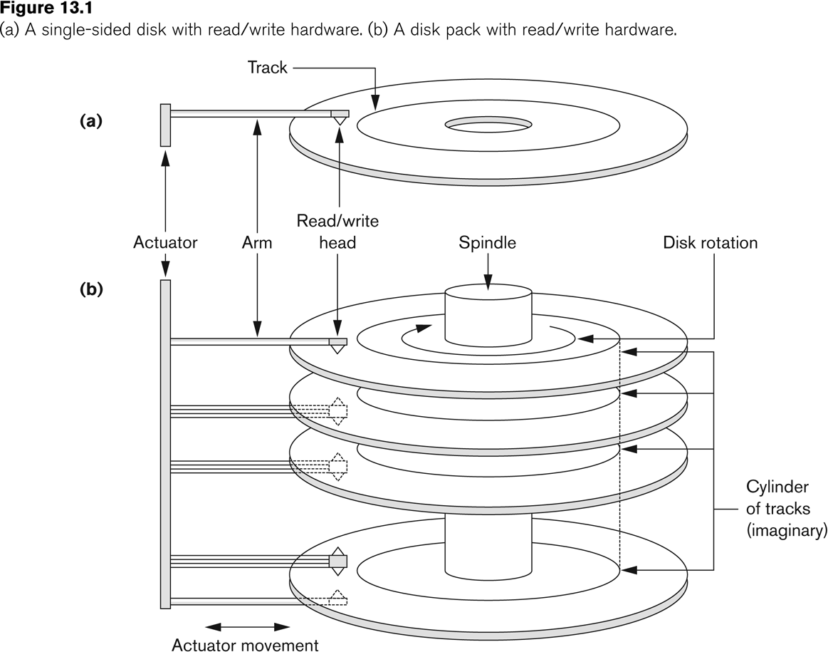
Hard disk

Slide 6
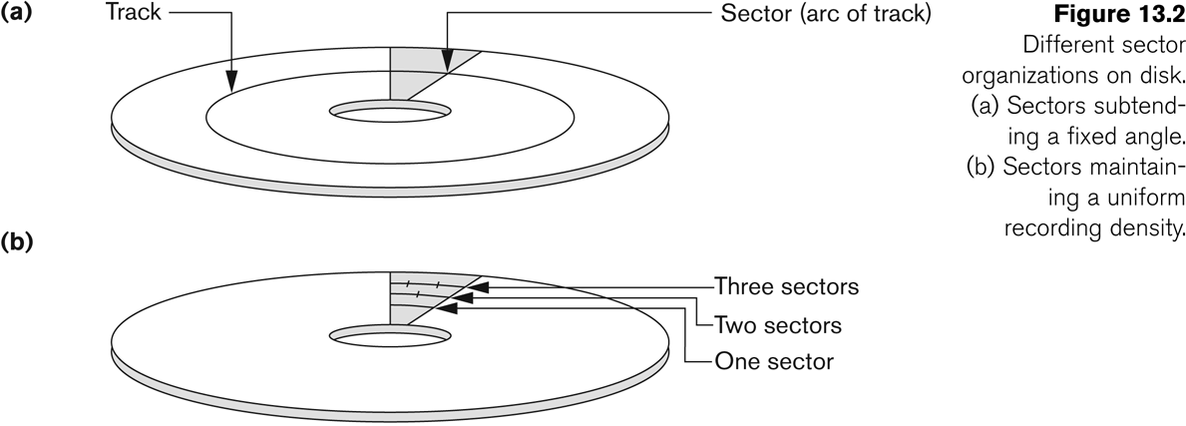

Slide 7
Disk access time

Slide 8
File organization
Relations usually stored in files as logical “records” and read in terms of physical “blocks”
File organization refers to the way records are stored in terms of blocks and the way blocks are placed on the storage medium and interlinked
Types of organizations
  Unsorted
  Sorted
  Hashing

Slide 9
Records
Represents a tuple in a relation
A file is a sequence of records
Records could be either fixed – length or variable –length
Records comprise of a sequence of fields (column, attribute)

Slide 10
Blocks
Refer to physical units of storage in storage devices (example :sections in hand disks, pay in virtual memory)
Usually (but not necessarily) stores records of a single file
Of fixed length, based on physical characteristics of the storage/computing device and operating system.
Storage device is either defragmented or fragmented depending on whether contiguous sets of records lie in contiguous blocks.

Slide 11
Blocking factor
The number of records that are stored in a block in called the “blocking factor”. Blocking factor is constant across blocks if record length is fixed, or variable otherwise
If B is block size and R is record size, then blocking is
  bfr =[B/R]
Since R may not exactly divide B, there could be some left-over space in each block equal to.
B-(brf*R) bytes

Slide 12
Spanned and Unspanned records
When extra space in blocks are left unused, the record organization is said to be “unspanned”.
unused
Record1 | Record2 | Record3

Slide 13
Spanned and Unspanned Records
In “spanned” record storage, records can be split so that they “span” across blocks
block m
Record4(part)
block p
Record1 | Record2 | Record3
Record 4 (remaining)

Slide 14
Spanned and unspanned records
When record size is greater than block size (i.e. R > B), use of “spanned” record storage is compulsory

Slide 15
Average blocking factor
For variable length records, with the use of record spanning the “average” record length can be used in bfr computation to compute the number of blocks required for a file of records
b = [(r/bfr)]
where b is the no of blocks required to store a file having r
Records of variable length with the overall blocking factor bfr.

Slide 16
Unordered file organization
Record1
Record2
Record3
Block m
Block p
Record 4
Also called a “pile file”

Slide 17
Pile files
Simplest file organization
Records are inserted in the order of their arrival
Usually requires secondary files for efficient search
Insertion : very easy
Search on non-indexed attribute very expensive

Slide 18
Record Deletion in Pile files
Deletion by fragmentation.
Inefficient in terms of space usage
Record 1 | Record 2 | Record 3
Record 1 |  | Record 3

Slide 19
Record updation in pile files
when record length is fixed, records can be updated in place
When record length is variable, marker based updation is required
Record 1 | Record 2 | Record 3
Record 4 (remaining) | Record 2

Slide 20
Sorted files
File organization where records are sorted based on the value of some field called the ordering field
Ordering field should be a key field(unique for each record) and belong to an ordinal domain (where values can be compared)
Insertion and deletion: both expensive
Updation may involve physical migration of record, if ordering field is modified
Searching : binary search based on ordering field efficient

Slide 21
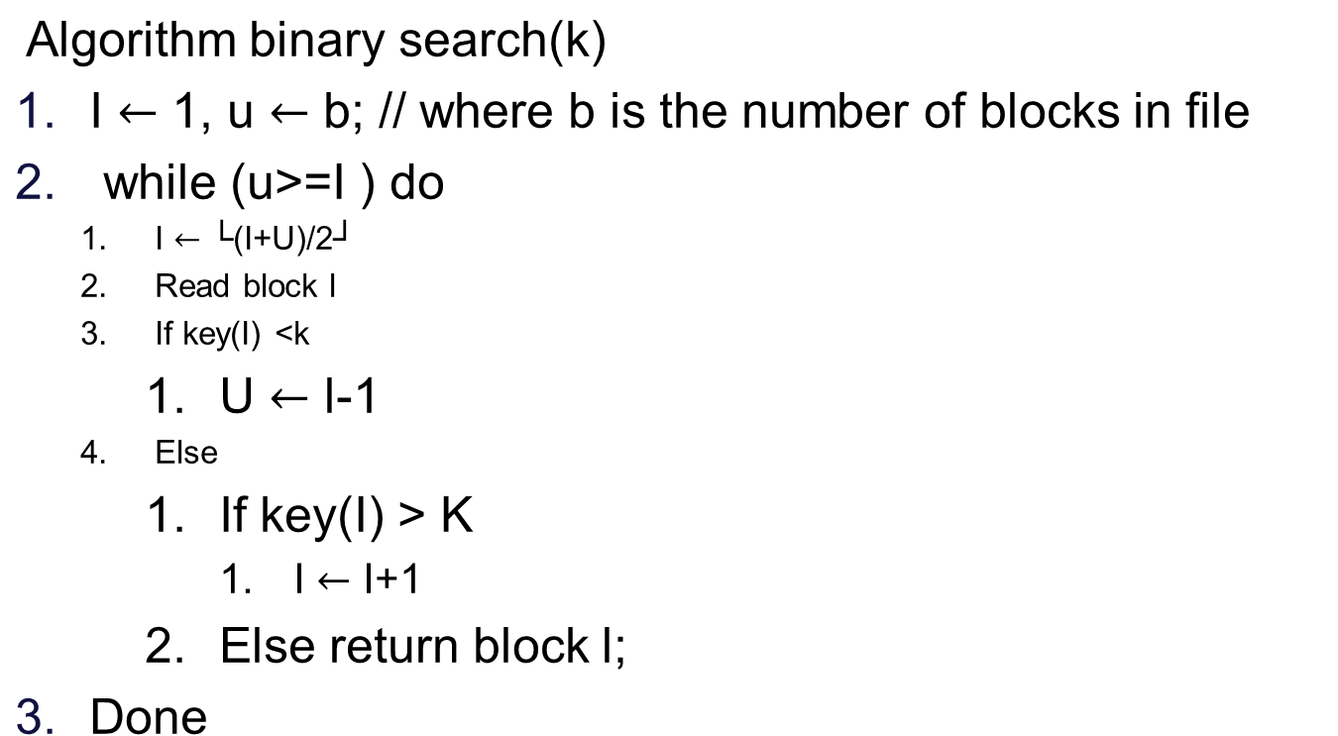
Binary search

Slide 22

Sorted files
Record 1
Record 3
Record 7
Record 4
Record 2
Record 8
Master file (sorted)
Overflow file (unsorted)
Making insertion and updation efficient in sorted files

Slide 23
Sorted files
More efficient the pile-file for key based searches
Suitable mainly for random-access devices
A better choice when database is mostly read-only and queries are mostly key-based retrievals

Slide 24
Next lecture

Slide 25
Hashing techniques
Provide very fast access to records on certain search conditions.
Search condition should be an equality condition on a “key” field
Uses a “hashing function” or a “randomizing function” to map keys onto “buckets” hosting records
Primary suited for random-access devices

Slide 26
Internal(in-memory) hashing
Used as a internal data structure to quickly access records that are read into memory
Uses a static array of M buckets indexed from 0 to M-1
Several candidates for the hash function:
  K mod M, folding the key, sampling the key, etc.

Slide 27
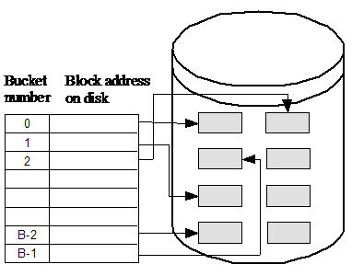
External hashing

Slide 28
External hashing
Uses two levels of indirection:
  Hashing to buckets and searching within buckets
A bucket is a disk block or a set of contiguous blocks
A bucket can hold more than one record
Sequential search within buckets

Slide 29
Overflows
Occurs when a bucket receives more records than it can hold. Overflow management techniques
Open addressing
  Use the next available bucket
Chaining
  Pointers to extra buckets called overflow buckets
Rehashing
  Use of second hashing function to see if it can hash without overflow

Slide 30
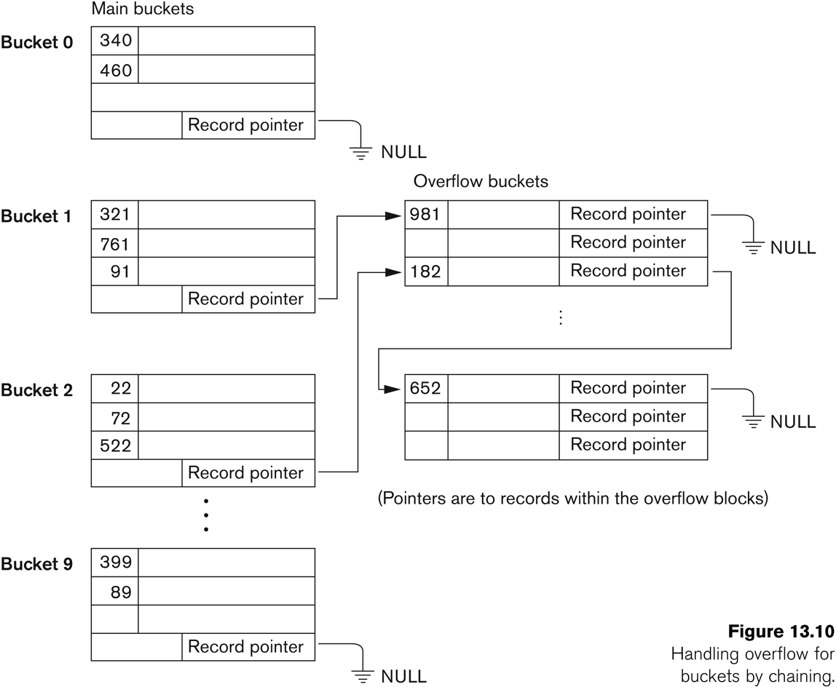
Handling overflows with chaining

Slide 31
Dynamic Hashing
Hashing where the no of buckets are fixed are static hashing
Inefficient when data set is skewed few overflowing buckets and large number of nearly empty buckets
Wastage of space(in maintaining buckets) and time (sequential searching of overflow buckets)
Extensible or dynamic hashing : number of buckets change dynamically in accordance with data requirements.

Slide 32
Dynamic Hashing
No of buckets may grow or shrink depending on additions and deletions
Overall strategy:
  Start with a single bucket
  Once full, split the bucket into two,
  Redistribute records between the two split buckets using some method ensuring near-uniform distribution

Slide 33
Dynamic Hashing
Assume keys to be made of binary strings
Bucket for all records

Slide 34
overflow !
Bucket for all records starting with 0
0
Bucket for all records starting with 1
1

Slide 35
Dynamic hashing
overflow !
Bucket for all records starting with 0
0
Bucket for all records starting with 10
1
0
1
Bucket for all records starting with 11

Slide 36
Dynamic hashing
Bucket for all records starting with 0
0
1
Bucket for all records starting with 0

Slide 37
Extensible hashing
Uses a global directory of 2^{n} bucket addresses here, n is called the global depth of the directory
Higher order d<=n bits of the key are treated as index into the directory
Address in the directory maps to the buckets containing the records

Slide 38
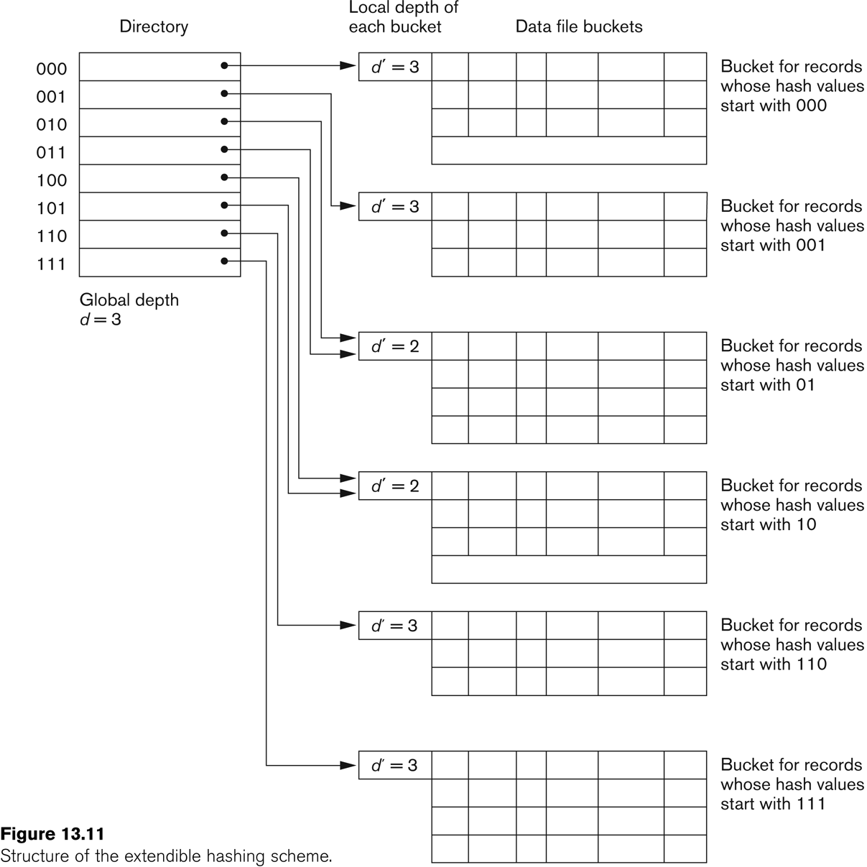
Extensible hashing

Slide 39
Try your self problems
Assume that we use Extendible hashing technique in some situation and we use the hash function (K mod 8). Assume that a bucket (one block) can accommodate 2 records. Now insert the records with following keys in the same order and show the dynamic structure of the hashing scheme (using a simple sketch) after each insertion. Keys to be inserted are: 18, 36, 3, 9, 16, 23, 40, 54, 33. Show the structure of the directory and buckets at each step, and the local and global depths. Start with Global depth-2, Local depth-1. Consider LSB of the hash value for directory entries.

Slide 40
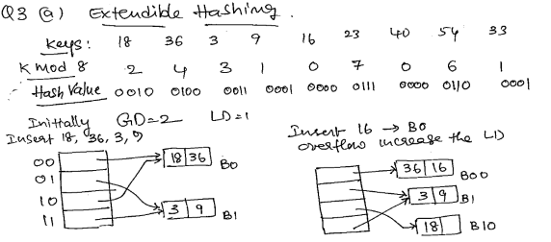

Slide 41
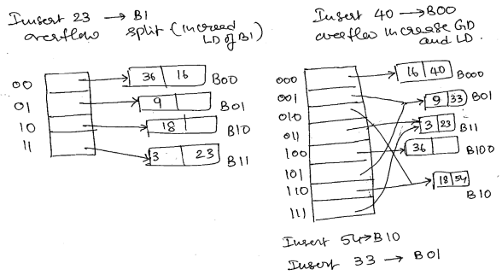

Slide 42
Thank you

