Slide 1
Database Design & Applications
(SS ZG 518)
Chennupati R Prasanna
CS&IS Dept.

Slide 2
Indexing
    Content
    What is Indexing
    Primary and Secondary indexes
    Dense and Sparse Indexing
    Multilevel Indexing
    Designing Primary and Multilevel Indexes
1 SSZG 518 Database Design & Applications

Slide 3
Introduction to Indexing
Indexes (Access Structures) are used to speed up the retrieval of records in response to certain search conditions.
Ex: Get all employees details where age=50;
Get employee details for eid=329; etc.
In real world databases, indexes may be too large to be handled efficiently.
Hence some sophisticated techniques are to be used.
2 SSZG 518 Database Design & Applications

Slide 4
The criteria for evaluating the hashing or indexing techniques –
Access time
Insertion time (new indexes or new records)
Deletion time
space overhead
Some times more than one indexing may be required for a file.
The attribute /field used for constructing index structure for a file is called an ‘indexing field/attribute’ .
3 SSZG 518 Database Design & Applications

Slide 5
If the index field is a key, it is called as search key or indexing key.
Indexes on key attributes:
Built on ordering key(PK) – Primary index
Non-ordering Key - Secondary index on key attribute
Indexes on non-key attributes:
Ordering non-key -- Clustering Index
Non-ordering non-key attribute – Secondary index on non-key
Hence, a file can have at most one primary index or one clustering index, but not both.
4 SSZG 518 Database Design & Applications

Slide 6
4 SSZG 518 Database Design & Applications

Slide 7
Indexing
Ordering field
Nonordering field
(secondary index)
Key
(primary index)
Non-key
(Clustering index)
key
Non-key
5 SSZG 518 Database Design & Applications

Slide 8
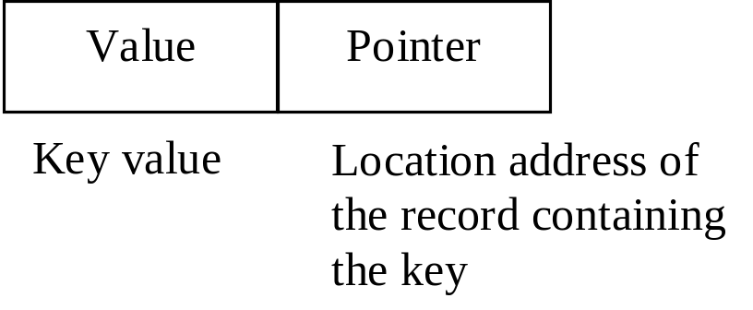
Data record: Similar kind of records(of a relation/table) are stored in a single file containing blocks. These are called data records and will have fields specified on the relation.
Index record: Like data records, index records are also stored in database. Any index record normally has two fields.
6 SSZG 518 Database Design & Applications

Slide 9
Dense Index : In this, an index record appears for every data file record.
Sparse Index : Index records are created only for some data file records. This occupies less space.
A primary index and clustering index are non-dense.
SQL Commands to create indexes:
Usually when we declare PK, an index is created automatically.
CREATE INDEX EMP_IND ON EMP(eid);
DROP INDEX EMP_IND;
7 SSZG 518 Database Design & Applications

Slide 10
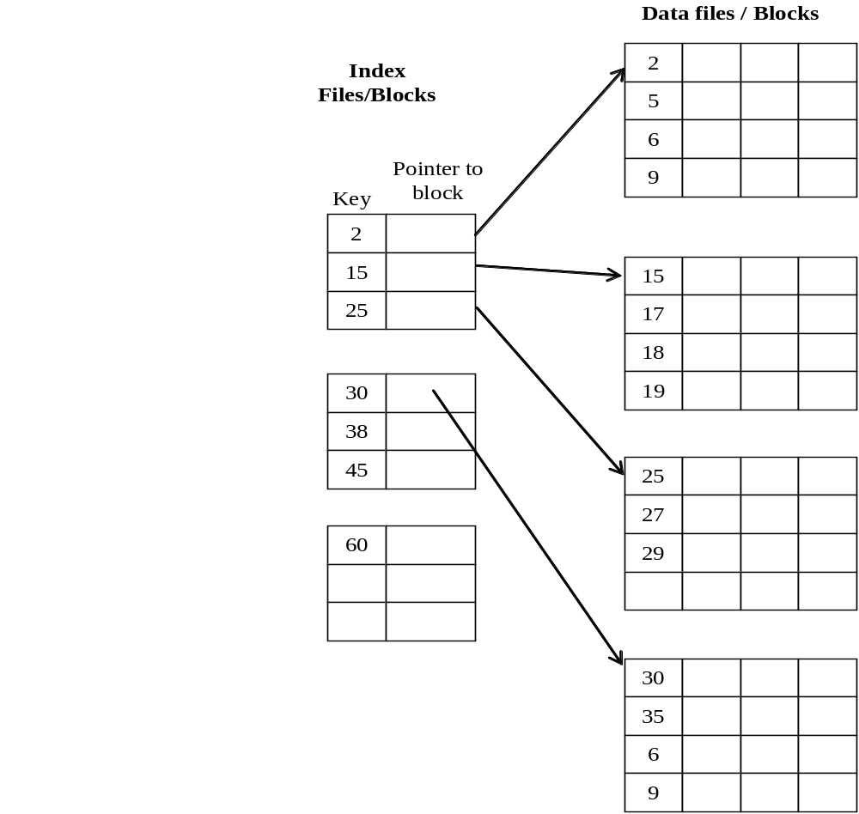
Primary Indexing
8 SSZG 518 Database Design & Applications

Slide 11
Designing a Primary index
Ex 1:
Assume that we have an ordered file with 80000 records stored on disk. Block size is 512 Bytes. Record length is fixed and it is 70 Bytes. Key field(PK) length is 6 Bytes and block pointer is 4 Bytes. Assume unspanned record organization
Design a Primary index on primary key.
9 SSZG 518 Database Design & Applications

Slide 12
Solution:
Size of disk block=512 Bytes; record length=70 Bytes
Block pointer=4 Bytes. Key field=6 bytes; total records=80000
No. records per block(Bfr)= floor (512/70)=7.31=7
No. of data blocks needed= ceil( 80000/7)= 11429
Index record length= key + pointer=6+4=10 Bytes
Blocking factor for index (Bfr_{i}) = floor(512/10)=51
(known as fan-out)
No. of index blocks = Ceil(11429/51)= 225
No. of block accesses= ceil of (log₂ 225) + 1 = 8+1=9
10 SSZG 518 Database Design & Applications

Slide 13
11 26/02/2015 SSZG 518 Database Design & Applications Dr.R.Gururaj

Slide 14
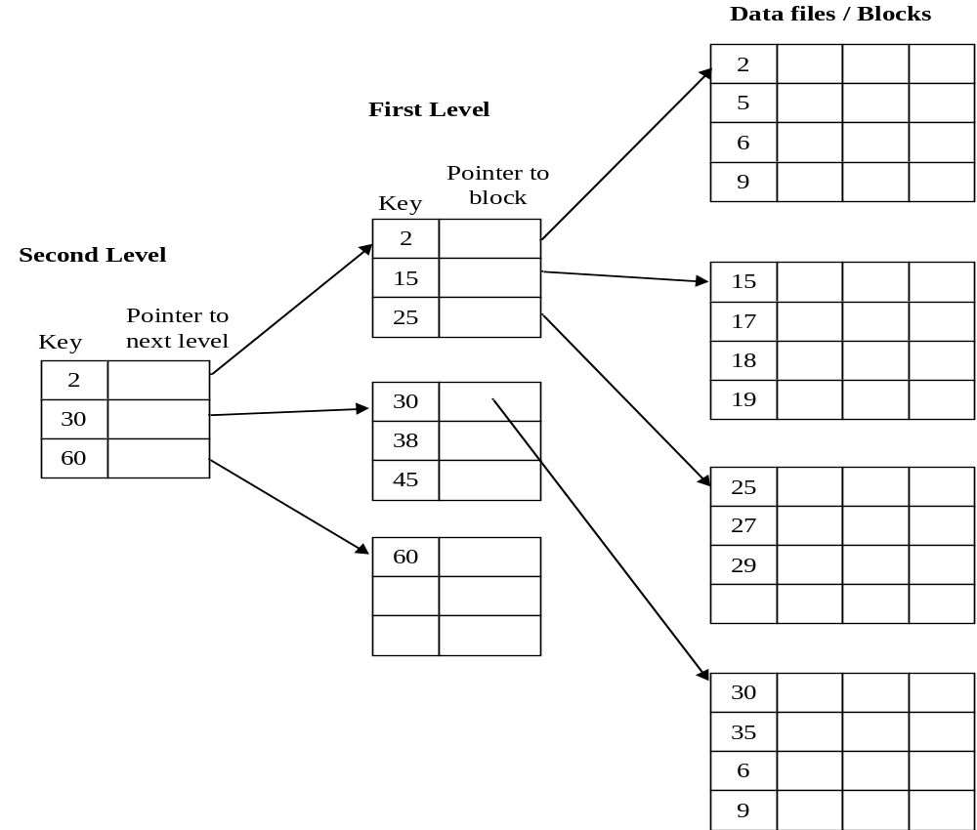
Multilevel Indexing (Two levels)
12 SSZG 518 Database Design & Applications

Slide 15
Designing a multilevel index
Ex 2:
Assume that we have an ordered file with 80000 records stored on disk. Block size is 512 Bytes. Record length is fixed and it is 70 Bytes. Key field(PK) length is 6 Bytes and block pointer is 4 Bytes. Assume unspanned record organization
Design a multilevel index on primary key.
How many levels are there.
How many blocks are there in each index level.
13 SSZG 518 Database Design & Applications

Slide 16
Solution :
Size of the disk block=512 Bytes; record length=70 Bytes
Block pointer=4 Bytes. Key field=6 bytes; total records=80000
No. records per block(Bfr)= floor (512/70)=7.31=7
No. of data blocks needed= ceil( 80000/7)= 11429
Index record length= key + pointer=6+4=10 Bytes
Blocking factor for index = floor(512/10)=51 - fanout
No. of index blocks in first level= Ceil(311429/51)= 225
No. of index blocks in 2nd level= Ceil(225/51)= 5
No. of index blocks in 3rd level= Ceil(5/51)= 1 top level
No. of levels in indexing structure=t=3
No. of block accesses= No. index levels + 1= t+1=4
14 SSZG 518 Database Design & Applications

Slide 17
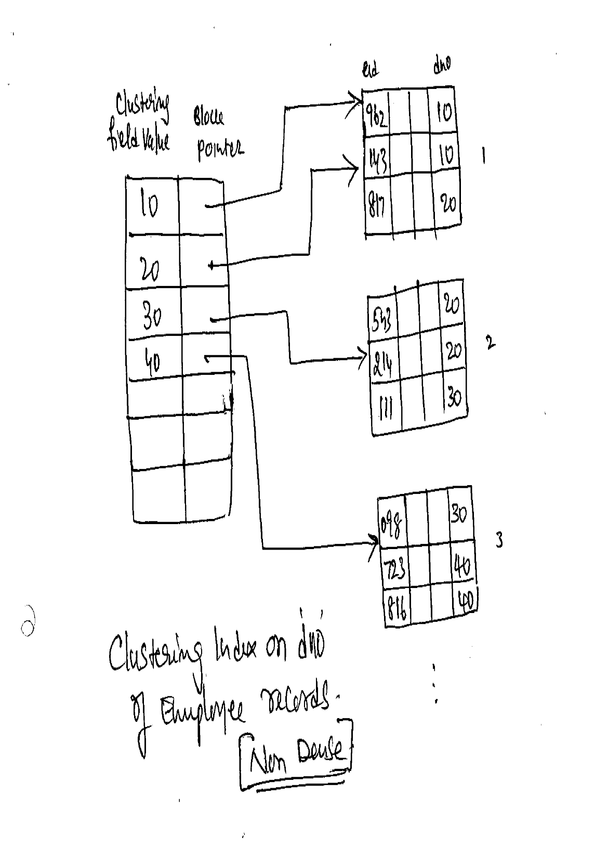
Clustering Index on
Ordering Non-key
22 26/02/2015 SSZG 518 Database Design & Applications Dr.R.Gururaj

Slide 18
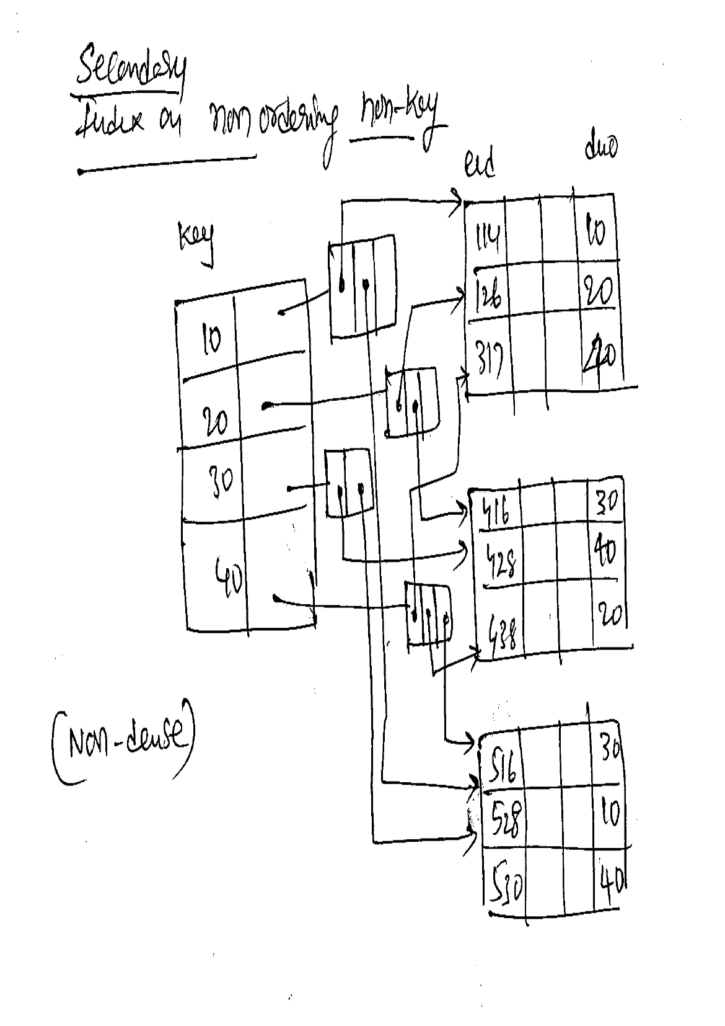
Secondary Index on
Non-ordering, Non-key
23 26/02/2015 SSZG 518 Database Design & Applications Dr.R.Gururaj

Slide 19
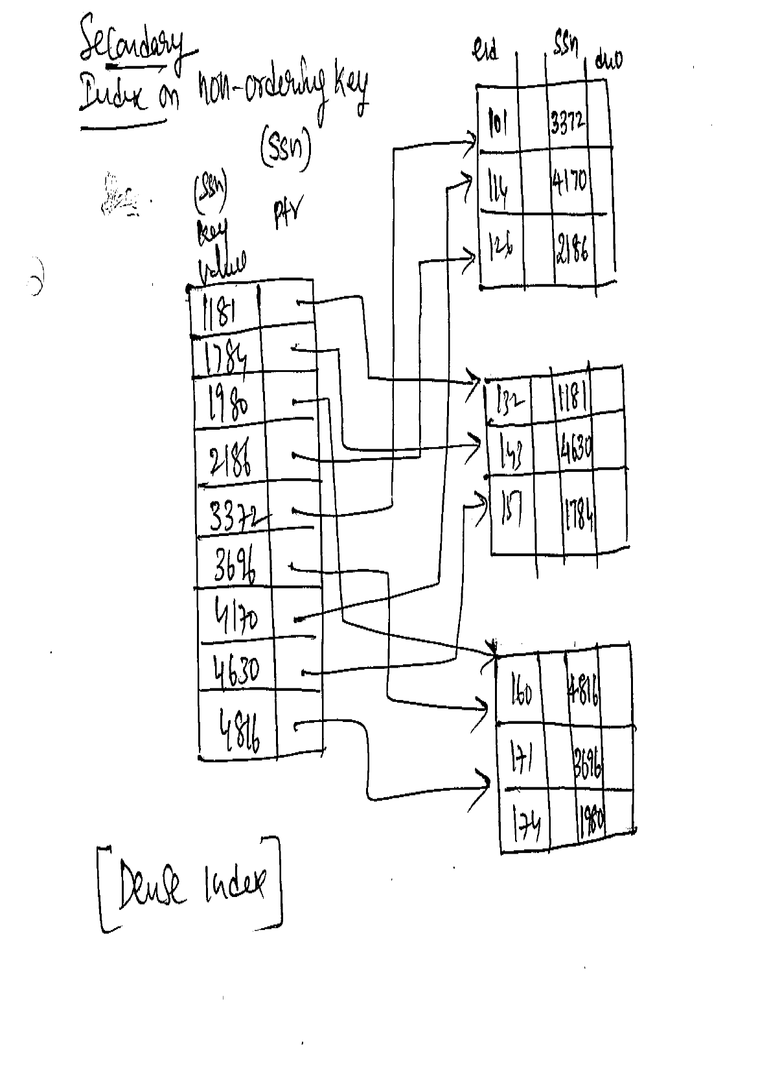
Secondary Index on Non-ordering key
24 26/02/2015 SSZG 518 Database Design & Applications Dr.R.Gururaj

Slide 20
Thank you

