Slide 1
Transaction Processing
Viswanathan Hariharan
Bangalore Center

Slide 2
Contents
Concept of transaction
Problems due to concurrent execution of transaction
  Schedule of transactions to avoid these problems
Problems due to transaction aborts
  How to recover transactions

Slide 3
Concept of Transaction
Example of transaction
Withdraw Rs.1000 from Account A
  Read ‘Current balance’ of Account ‘A’ from database into variable ‘Balance’
  Balance = Balance - 1000
  Write ‘Balance’ into ‘Current balance’ of Account ‘A’ into database
Deposit Rs.2000 into Account B
  Read ‘Current balance’ of Account ‘B’ from database into variable ‘Balance’
  Balance = Balance + 2000
  Write ‘Balance’ into ‘Current balance’ of Account ‘B’ into database

Slide 4
Concept of Transaction
Transfer Rs.3000 from Account A to Account B
  Read ‘Current balance’ of Account ‘A’ from database into variable ‘Balance’
  Balance = Balance - 3000
  Write ‘Balance’ into ‘Current balance’ of Account ‘A’ into database
  Read ‘Current balance’ of Account ‘B’ from database into variable ‘Balance’
  Balance = Balance + 3000
  Write ‘Balance’ into ‘Current balance’ of Account ‘B’ into database

Slide 5
Concept of Transaction
A Transaction is a sequence of operations on a database
  It takes the database from one consistent state to another consistent state
  It is atomic in nature, that is either all of the operations should be carried out or none at all.
  Partial execution of a transaction is not allowed, as it may result in inconsistent state of database
Implementation of transaction
  Typically transactions are implemented in application programs that include DB commands for retrieving data, inserting, updating & deleting data

Slide 6
Examples of Transaction processing systems
Airline reservation
Banking system
Online shopping

Slide 7
How to define transactions?
Transfer Rs.3000 from Account A to Account B
Begin Transaction
  Read ‘Current balance’ of Account ‘A’ from database into variable ‘Balance’
  Balance = Balance - 3000
  Write ‘Balance’ into ‘Current balance’ of Account ‘A’ into database
  Read ‘Current balance’ of Account ‘B’ from database into variable ‘Balance’
  Balance = Balance + 3000
  Write ‘Balance’ into ‘Current balance’ of Account ‘B’ into database
End transaction

Slide 8
Desirable properties of Transaction
“ACID” properties
Atomicity: A transaction is an atomic unit of processing; it is either performed in its entirety or not performed at all. (DBMS must find a way to remove effects of partial transactions)
Consistency preservation: A correct execution of the transaction must take the database from one consistent state to another. (Responsibility of program)
Isolation: A transaction should be executed as if it is not interfered by any other transaction. (DBMS should control concurrent execution of transactions to ensure serializability)
Durability: The changes applied to the data by a committed transaction must not be lost because of any future failure.

Slide 9
Concurrent execution of transactions and its problems
Concurrent execution can lead to following problems:
  Lost update
  Dirty read
  Incorrect summary
  Unrepeatable read

Slide 10
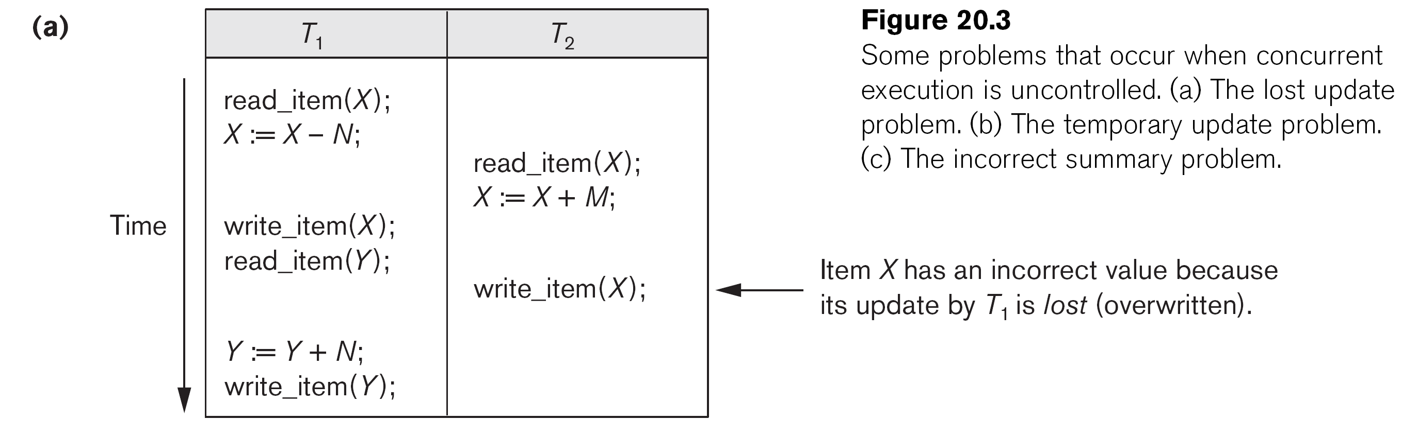
Lost update
Transfer Rs. N from X to Y
Deposit Rs. M into X
The above info is taken from the book “Database Systems” by Elmasri & Navathe

Slide 11
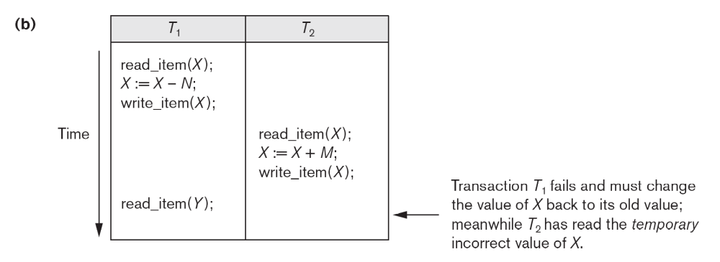
Dirty Read
Since T2 uses incorrect value of X, the results are incorrect
The above info is taken from the book “Database Systems” by Elmasri & Navathe

Slide 12
Incorrect summary
Transfer N passengers from Flight X to Flight Y
Find total seats booked across all flights
The above info is taken from the book “Database Systems” by Elmasri & Navathe

Slide 13
Unrepeatable read
This problem can occur when T1 has read X, then T2 modifies it, then when T1 reads X again it finds a new value.
T1 | T2
Read X (available seats) Read (X) – This is different from what it got in first step | Read X X = X -5; Write (X)

Slide 14
How to avoid these problems?
Ensure that transactions are either serial transactions (executed one after another - no concurrent transactions) or
Ensure that transactions are serializable, that is, they are equivalent to a serial transaction

Slide 15
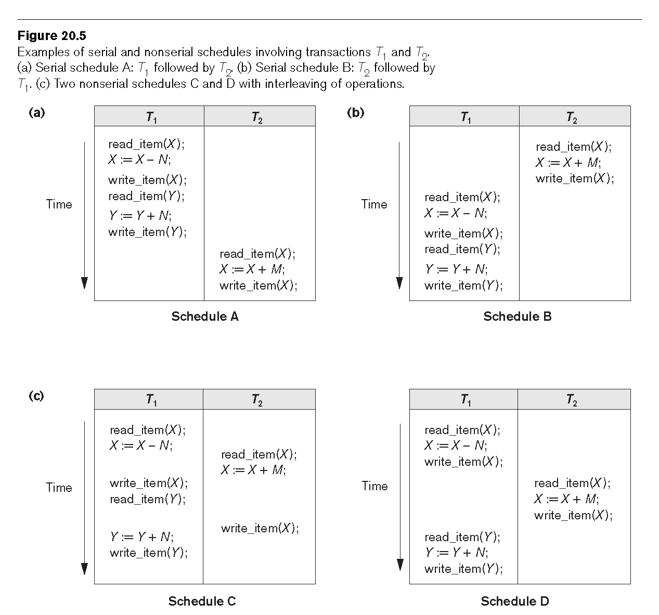
Serial transactions & Serializable transactions
T1, T2
T2, T1
Interleaved and Not serializable
Interleaved but serializable as T1, T2
The above info is taken from the book “Database Systems” by Elmasri & Navathe

Slide 16
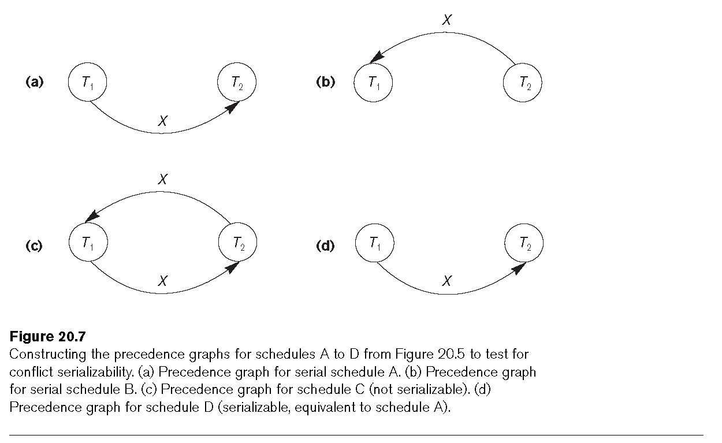
Precedence graph of transactions for testing serializability
The above info is taken from the book “Database Systems” by Elmasri & Navathe

Slide 17
Problems due to transaction abort
Partial execution of transaction leads to inconsistent state
Transfer Rs.3000 from Account A to Account B
  Read ‘Current balance’ of Account ‘A’ from database into variable ‘Balance’
  Balance = Balance - 3000
  Write ‘Balance’ into ‘Current balance’ of Account ‘A’ into database
  Read ‘Current balance’ of Account ‘B’ from database into variable ‘Balance’
  Balance = Balance + 3000
  Write ‘Balance’ into ‘Current balance’ of Account ‘B’ into database
System crash
Result:
Only one account is updated
This is an invalid / inconsistent state

Slide 18
Situations leading to aborted transactions
System crash
Program encounters error due to a bug
  Ex. Divide by zero is encountered and the program needs to be terminated
Program encounters exception conditions
  Ex. Insufficient funds in account or account is in Suspended state. Hence program needs to abort the transaction
Disk crash

Slide 19
How to recover the database from aborted transactions?
Maintain a Log of all actions by a transaction
  Types of log records:
    [start_transaction,T]: Records that transaction T has started execution.
    [write_item,T,X,old_value,new_value]: Records that transaction T has changed the value of database item X from old_value to new_value.
    [read_item,T,X]: Records that transaction T has read the value of database item X.
    [commit,T]: Records that transaction T has completed successfully, and affirms that its effect can be committed (recorded permanently) to the database.
    [abort,T]: Records that transaction T has been aborted.
  Note: Log must be written before the an item is updated in the database

Slide 20
Recovering from aborted transactions
Recover DB to a consistent state (say using a Checkpoint technique)
For transactions that could not complete successfully (that do not have a Commit record)
  Undo effect of Write operations of the transaction by tracing backward through the log and resetting all items changed by Write operation to their old values
For transactions that have completed successfully (that have a Commit record in the log)
  Redo actions using updates recorded in log, if the disk is not updated from memory buffers before the crash

Slide 21
Example of Log
T1 | T2
Begin Read X Write X System crash | Begin Read Y Write Y End (Commit)
Recovery steps Undo update of X (Rollback of uncommitted Txn) Redo update of Y

Slide 22
Another problem due to aborted transactions
Committed transactions may also get rolled back
T1 | T2
Begin Read X Write X Abort | Begin Read X Write X
Cascade roll back Recoverable Cumbersome but acceptable
T1 | T2
Begin Read X Write X Abort | Begin Read X Write X End (Commit)
Cascade roll back Un-Recoverable (violates Durability property) Not acceptable
So, transactions should not only be Serializable but should also be Recoverable (ensuring Durability property)

Slide 23
Appendix

Slide 24
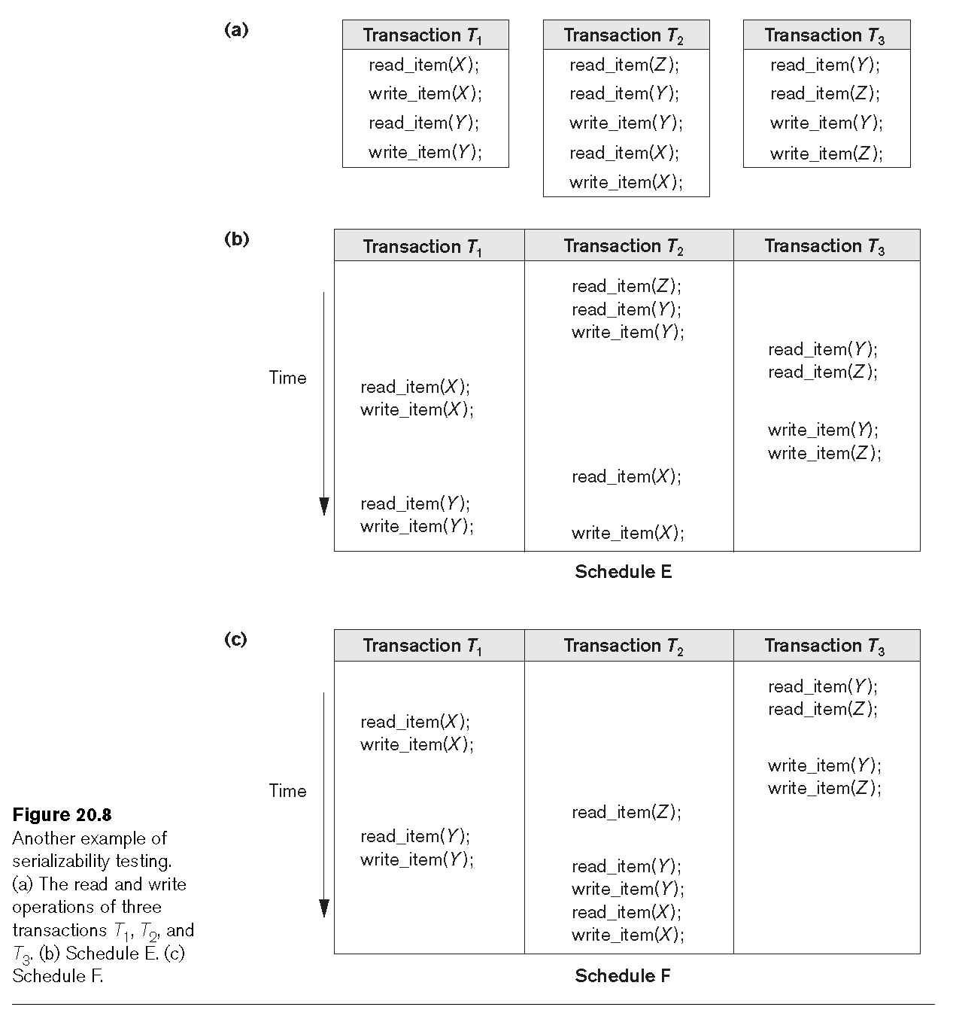
Another example of serializablity testing
The above info is taken from the book “Database Systems” by Elmasri & Navathe

Slide 25
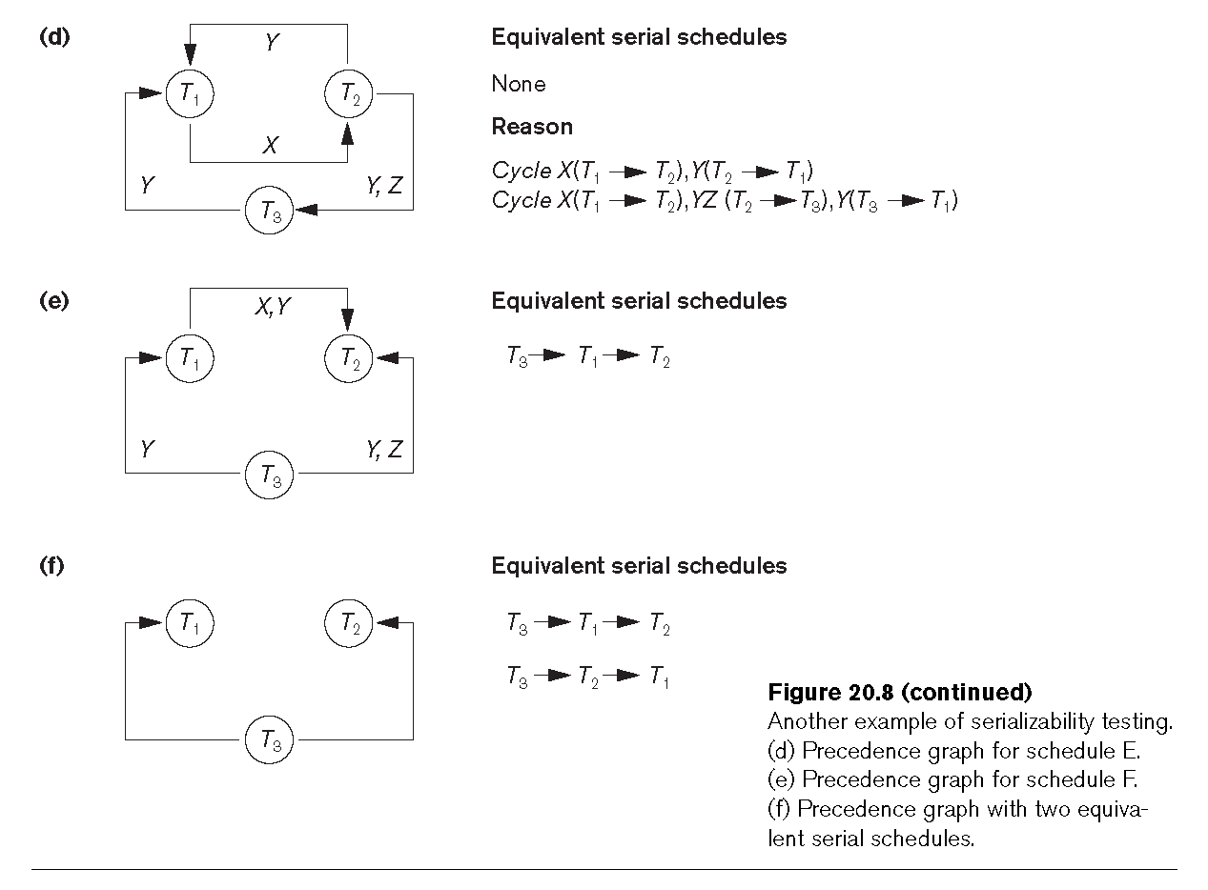
Precedence graph of transactions for testing serializability
The above info is taken from the book “Database Systems” by Elmasri & Navathe

