Slide 1
Concurrency control
Viswanathan Hariharan
Bangalore Center

Slide 2
Contents
Recap: Need for concurrency control
Concurrency control using locks
  2-phase locking protocol
  Deadlock resolution
Concurrency control using Timestamp ordering

Slide 3
Concurrent execution of transactions and its problems
Concurrent execution can lead to following problems:
  Lost update
  Dirty read
  Incorrect summary
  Unrepeatable read

Slide 4
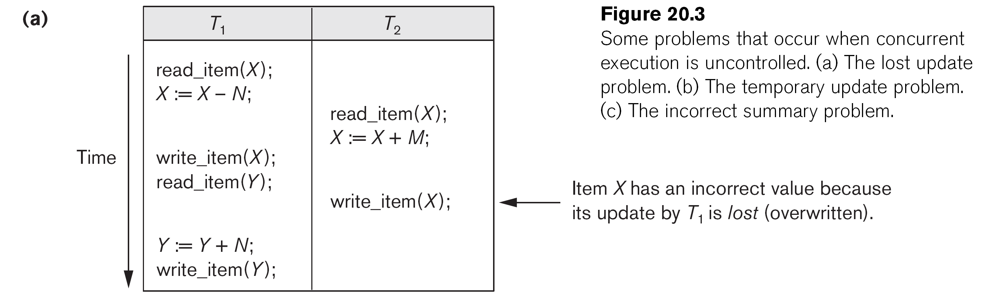
Lost update
T1 overwrites X which was updated by T2
Transfer Rs. N from X to Y
Deposit Rs. M into X
The above info is taken from the book “Database Systems” by Elmasri & Navathe

Slide 5
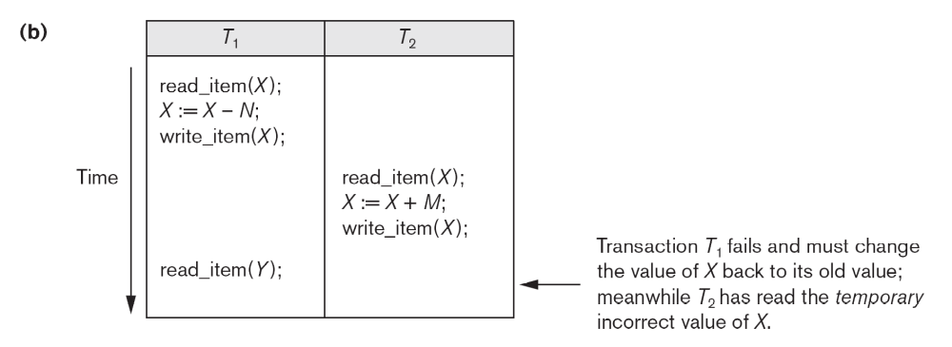
Dirty Read
T2 reads new value of X (updated by T1)
Then T1 fails and X is restored to its old value
So T2 has read an incorrect value of X
The above info is taken from the book “Database Systems” by Elmasri & Navathe

Slide 6
Incorrect summary
T2 tries to find total seats booked across all flights
During this process, T1 updates X but has not yet updated Y
This results in incorrect total
Transfer N passengers from Flight X to Flight Y
Find total seats booked across all flights
The above info is taken from the book “Database Systems” by Elmasri & Navathe

Slide 7
Unrepeatable read
This problem can occur when T1 has read X, then T2 modifies it, then when T1 reads X again it finds a new value.
T1 | T2
Read X (available seats) Read (X) – This is different from what it got in first step | Read X X = X -5; Write (X)

Slide 8
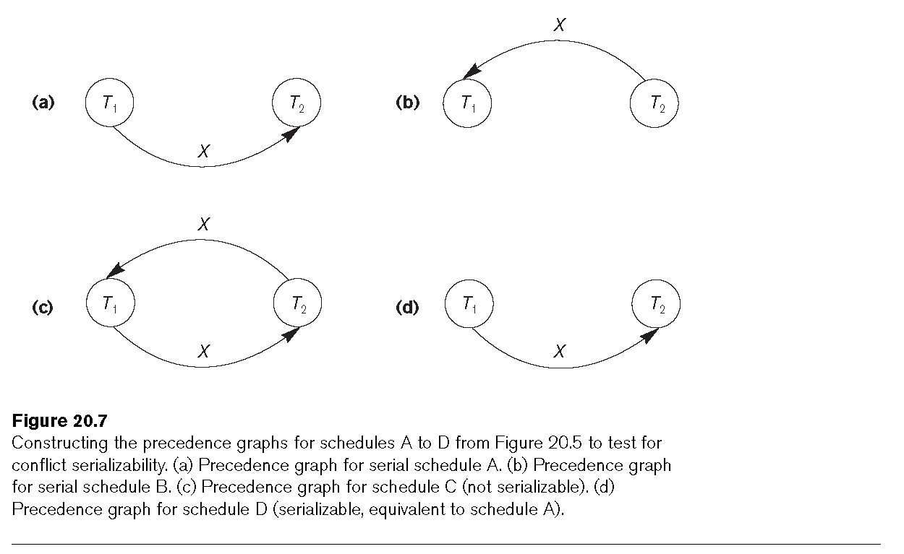
How to avoid these problems?
We can avoid these problems if we ensure serial transactions or serializable transactions
A & B are serial schedule
D is serializable
C is not serializable
So DBMS must ensure that schedule (c) does not occur

Slide 9
How to achieve serializable transactions?
There are 2 techniques:
2-phase locking protocol
Timestamp ordering of transactions

Slide 10
Binary lock
Binary locking
  A data item can exist in 2 states
    Locked
    Unlocked
  Process
    A Txn must lock the item it wants to Read or Write before doing so
    If another Txn is holding the lock, the Txn must wait
    After its use, a txn releases the lock
  Observation
    This is too restrictive because even if 2 or more txns just want to read a data item, they need to wait
    We may recollect that conflict happens only when one of the txns is trying to write and the other has read or written the same data item

Slide 11
Shared & Exclusive locks
(Also called Read lock & Write lock)
In this technique, a data item can exist in 3 states
  Share locked or Read locked
  Exclusive locked or Write locked
  Unlocked (not locked by any txn)

Slide 12
Property of Share lock & Exclusive lock
When a data item is Share locked, other txns can also acquire Share lock on the same data item but no one can acquire an Exclusive lock on it
When a data item is Exclusive locked by a txn, no other txn can acquire any lock (Share or Exclusive) on the item

Slide 13
Rule for locking
Rule while Reading a data item
Before reading acquire a Share lock (Read lock)
Share lock request is successful when the data is not locked or Share locked by another txn
A Share lock fails when another transaction has an Exclusive lock on the data item

Slide 14
Rule for locking
Rule while Writing a data item
Before Writing a data item, acquire an Exclusive (Write) lock on it
Exclusive lock request succeeds only when the data items is not locked by anyone
If the item is already locked - either Share locked or Exclusive locked - then the Exclusive lock request fails

Slide 15
2-phase locking (2PL) protocol
We can not ensure serializability just by locking data before using it.
We need to follow a certain discipline or protocol called 2-phase locking protocol

Slide 16
2-phase locking protocol
In this protocol, every txn consists of 2 phases:
Expanding phase / Growing phase (Phase 1)
  Locks are acquired and no locks are released during this phase
Shrinking phase (Phase 2)
  Locks are released and no locks are acquired
Growing phase
Keep acquiring locks
Shrinking phase
Keep releasing locks
Read lock
Write lock
Unlock
Time

Slide 17
Examples of transactions adhering & not adhering to 2PL
T1 (Adheres to 2-phase locking) | T2 (Does not adhere to 2-phase locking)
Write lock (x) Read (x) X = X – 1000 Write (x) Write lock (y) Read (y) Y = Y + 1000 Write (y) Unlock (x) Unlock (y) | Write lock (x) Read (x) X = X-1000 Write (x) Unlock (x) // Releases lock during growing phase Write lock (y) Read (y) Y = Y + X Write (y) Unlock (y)
If all Txns follow 2-phase locking protocol (discipline) then the transactions will be serializable and will not interfere with one another

Slide 18
2-phase locking (2PL)
What we discussed so far is called Basic 2-phase locking (Basic 2PL)
Though this guarantees serializability, it does not guarantee durability
Read lock (x)
Write lock (y)
Read (y)
Y = Y +10
Write (y)
Write lock (z)
T2 uses Y updated by T1
T2 Commits
Later T1 aborts
T1
Unlock (y)
Abort
Time
Write lock (y)
Read (y)
Y = Y +10
Write (y)
T2
Commit
Time

Slide 19
Strict 2-phase locking
This protocol guarantees durability also
Since items modified are released at the end, there is no danger of some one using uncommitted data
Read lock
Write lock
Release Read locks
Release Write locks
Time
Commit txn

Slide 20
Deadlock
Locking causes deadlocks
What is deadlock?: When 2 or more transactions wait for lock on data locked by another txn, in a cyclic manner
Waiting for T₂ to release lock on item X
Txn
T₂
Txn
T₁
Txn
T₂
Item X
Item Y
Waiting for T₁ to release lock on item Y
Txn
T₁
Txn
T₃
Item Z

Slide 21
Deadlock resolution
There are 2 ways to address deadlocks
Deadlock prevention
Deadlock detection & then breaking the deadlock

Slide 22
Deadlock prevention techniques
Wait-Die method:
  If an older transaction T1 tries to acquire a lock on an item X that is already locked by a younger txn T2, then T1 waits for T2 to release lock on X
  If a younger transaction T2 tries to acquire a lock on an item X that is already locked by an older txn T1, then T2 Aborts (dies)
  This ensures that Older transaction may wait on a Younger txn but never the other way round. Thus a cycle never gets formed
Waiting for T₂ to release lock on item X
T₁
_{Older txn}
T₂
_{Younger txn}
X
Waiting for T₁ to release lock on item Y
T2 dies when it tries this

Slide 23
Deadlock prevention techniques
Wound-Wait:
  If an older txn T1 tries to acquire a lock on X, already locked by T2 (younger txn), then T2 is aborted and T1 acquires the lock
  If a younger txn T2 tries to acquire a lock on Y, already locked by T1 (older txn), then T2 waits
  This ensures that a younger transaction may wait on an Older txn but never the other way round. Thus a cycle never gets formed
Waiting for T₂ to release lock on item X
T2 is aborted when this happens
X
T₁
_{Older txn}
T₂
_{Younger txn}
Waiting for T₁ to release lock on item Y

Slide 24
Deadlock detection & breaking
Since deadlocks are not common, it is more practical to detect deadlocks and break them when it happens
Wait graph:
  Construct a wait graph. If deadlock is detected, Abort one of the younger txns.
Timeout: (More practical & simple)
  If a txn waits for more than a system defined timeout period, assume that there is a deadlock and then Abort that transaction
Txn
T₂
Item X
Item Y
Txn
T₁
Txn
T₃
Item Z

Slide 25
Concurrency control using Timestamp ordering of transactions
2-phase locking is one way to control concurrent txns and ensure serializability of transaction
Another technique (though less popular) is call Timestamp ordering of txns

Slide 26
Concurrency control using Timestamp ordering of transactions
This technique ensures that the serializable order = time order of txns
T1 T2 T3
Read X
Write X
Write X
Precedence graph based on access of data
Starting time of Txns

Slide 27
Concurrency control using Timestamp ordering of transactions
Read X
Write X
Write X
X
X
X = Not Allowed
X
T1
T2
T3
How does DBMS ensure Time order = Serializable order?
  DBMS ensures that T1 will always be the first to read or write compared to T2 & T3
  If T1 tries to Read a data item written by T2 or T3, it will abort T1 and re-start the txn
  If T1 tries to Write a data items read or written by T2 or T3, it will abort T1 and re-start T1

Slide 28
Concurrency control using Timestamp ordering of transactions
Thus we have ensured serializability (isolation)
But this does not guarantee durability (cascade delete)
How to ensure durability?
  Cascade delete happens when a txn tries to use data that is not yet committed by previous txn
  Solution:
    If T2 (younger txn) tries to read or write X that is updated by T1, then T2 waits for T1 to Commit.
    Thus, T2 will not read an uncommitted data and hence there will not be a need for cascade delete

Slide 29
Appendix

Slide 30
Deadlock prevention
Deadlock prevention is good when deadlocks are frequent
Deadlocks are frequent when txns involve large number of data items and run for a long period of time
In practice, deadlocks are not very frequent because
  Txns do not contend for the same resources
  Txns are short, involving small number of data items
In such situations, deadlock prevention techniques may lead to unnecessary txn aborts

Slide 31
Rigorous 2-phase locking

Slide 32
Conservative 2-phase locking

