Slide 1
Database recovery
Viswanathan Hariharan
Bangalore Center

Slide 2
Contents
Types of failures
Typical recovery procedure
Recovery concepts
Recovery algorithms
  Deferred update technique
  Immediate update technique
  Shadow paging technique
Recovery from catastrophic failures

Slide 3
Types of failure
Main goal of recovery is to ensure Atomicity of txns and restore DB to the most recent consistent state
Types of failures:
System crash
Program encounters error due to a bug
  Ex. Divide by zero is encountered and the program needs to be terminated
Program encounters exception conditions
  Ex. Insufficient funds in account or account is in Suspended state. Hence program needs to abort the transaction
Disk crash

Slide 4
Typical procedure for recovery
Identify txns that have updated the items on disk, but could not complete the txn (Commit). These changes need to be reversed (Rolled back, Undo)
If a txn has committed but not updated the items disk, then Redo the update on disk

Slide 5
Typical procedure for recovery
Maintain a log of DB related operations such as:
    [start_transaction,T]: Records that transaction T has started execution.
    [write_item,T,X,old_value,new_value]: Records that transaction T has changed the value of database item X from old_value to new_value.
    [read_item,T,X]: Records that transaction T has read the value of database item X.
    [commit,T]: Records that transaction T has completed successfully, and affirms that its effect can be committed (recorded permanently) to the database.
    [abort,T]: Records that transaction T has been aborted.
Make use of the log to undo & redo updates

Slide 6
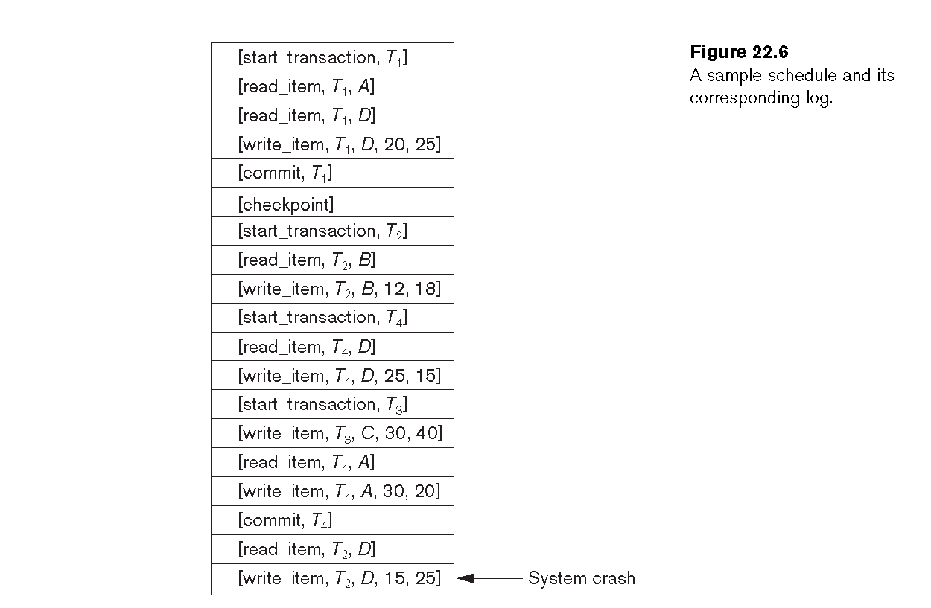
Sample log

Slide 7
Recovery concepts
Write Ahead Log (WAL): Before data on Disk is updated, the log record should be written
Disk blocks: Data on disk is organized in blocks of equal size. Each block contains a number of DB records. Disk blocks also store Log records
DBMS buffers: Main memory containing Disk blocks (Data & Log)
  When a txn updates data, data in DB buffers are updated.
  When a txn reaches a commit point, Log buffers are flushed to disk
  When log buffers are full, they are flushed to disk
  When Data buffers are full & need to be replaced, Data buffers are flushed to disk. But before that, log records (log buffers) need to be flushed to the disk, to ensure WAL

Slide 8
Deferred update technique
Do not update the DB on disk until Commit point is reached.
Keep writing to DB buffers
Upon reaching Commit point, write all log records to disk & then write data to disk
Begin Txn
Commit Txn
DB buffers
2
1
Memory
Log
Data

Slide 9
Deferred update technique
Advantage:
  Since we are not updating the DB on disk, there is no need to Undo updates.
  Please note that Redo may be required if Commit record is written to log but DB on disk has not been fully updated.
  Hence this technique is also called No-Undo/Redo technique
Disadvantage:
  We need large amount of main memory for DB buffers

Slide 10
Immediate update technique
(Most often in practice)
Write data item updates & log records to DB buffers
When DB buffers are full and need to be flushed, write the log records first and then write the DB disk blocks
On reaching Commit point,
  First write all log records to disk, including Commit record
  Then, write data items to DB on disk
Recovery steps involve Redo & Undo
Begin Txn
Commit Txn
DB buffers
2
1
Log
Data

Slide 11
Checkpoint
To recover, we must start from the beginning of the log to do Undo & Redo. This is time consuming
To avoid this problem, DBMS can do a Checkpoint operation at frequent intervals as follows:
  Write all the DB buffers to disk
  Write a Checkpoint record to the Log along with information about all the active txns at the time of Checkpointing
Please note that during Checkpointing all the txns are suspended to achieve a quite state

Slide 12
Effect of Checkpoint
Since all DB buffers are written to disk, all txns that have committed before checkpoint, have their updates reflected on the disk
Hence at the time of recovery, we need not Redo these updates
During recovery we only need to worry about updates that have taken place after the Checkpoint

Slide 13
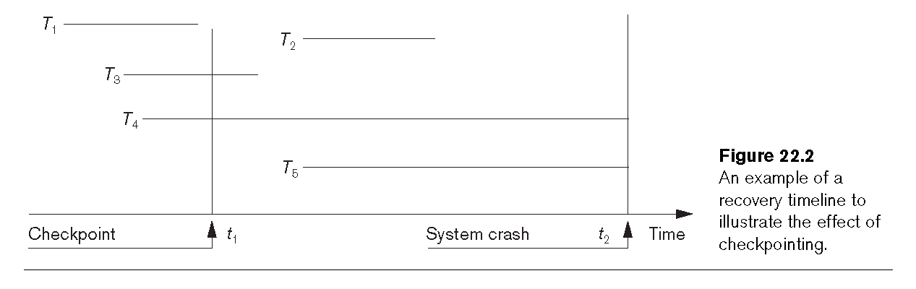
Example of Checkpoint

Slide 14
Recovery using Checkpoint record
Identify the last Checkpoint record
Get the list of txns active at the time of Checkpoint
Go forward and identify all txns that committed and all txns that could not commit
Undo all incomplete txns, by starting from the end of log and reversing the updates using the before image information
Redo all the committed txns, starting from the Checkpoint record up to the end of the log

Slide 15
Shadow paging technique
In this technique, we maintain 2 copies of the data on disk – data before txn (old page) and data during txn (new page)
All updates to data on disk are done on a new page
Once the txn commits, we dis-regard the old page
If txn aborts, then we disregard the new page
The old page is also called as Shadow page
Old page
Old page
New page
New page
Shadow page
Current page

Slide 16
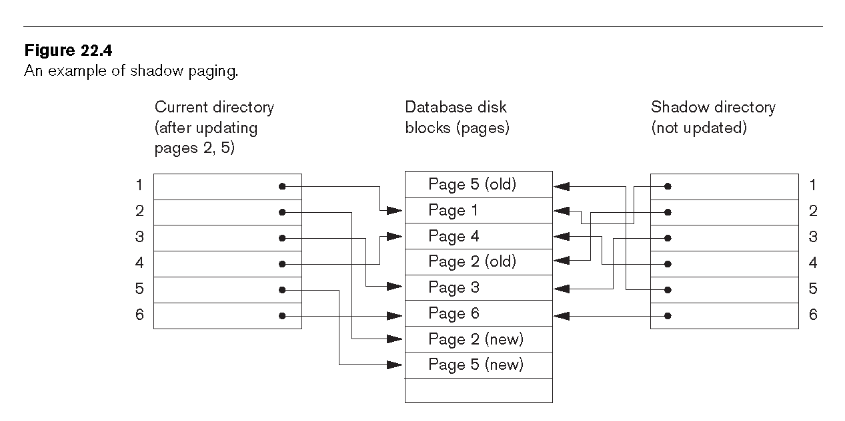
Example of Shadow paging

Slide 17
Shadow paging technique
Disadvantages:
  Difficult to keep related pages close together
  Garbage collection is needed to collect freed pages (old or new)
Disk blocks
Page
Page
Page
Page
Page
Page
Page

Slide 18
DB recovery from catastrophic failures
Examples of catastrophic failures: Earthquake, flood, disk crash
Strategy
  At certain intervals of time take full DB backup and start a new log
  Store the backup in a different city / location, so that the catastrophe does not impact both locations
  Also keep backing up the log more frequently than backing up the DB
  In the event of catastrophe, create a new DB using the backed up DB and reapply the updates using the log

Slide 19
Appendix

Slide 20
Fuzzy checkpoint
Checkpoint operation might take time especially when the amount of DB buffers are large. This delays the txns
In this scenario, a Fuzzy checkpoint approach is adopted, as follows:
  Write a ‘Begin Checkpoint’ record to Log
  Write all DB buffers to Disk
  Write a ‘End Checkpoint record’ to log
Please note that during Fuzzy Checkpointing txns are not suspended

