Slide 1
Database Design & Applications
(SSZG 518)
Chennupati R Prasanna
CS&IS Dept.

Slide 2
Query Processing and Optimization
    Content
    Introduction to query execution
    SQL to Relational algebra
    Algorithms for JOIN
    Query tree and Query graph
    Heuristics in Query optimization
    Cost components
    Database tuning
1 SSZG 518 Database Design & Applications

Slide 3
Introduction to Query Processing and Optimization
Here we discuss the techniques used by a DBMS to process, optimize, and execute high-level queries.
The process involves following steps:
Scanning - identifying the language tokens
Parsing- Syntax checking
Validation – checking the attributes and relations mentioned in the query valid or not.
Generate query tree/ query graph- representation of the query
Devise an execution strategy- to retrieve data from the files
Query optimization- Choosing a suitable strategy from the available set of strategies for the query, and generate execution plan.
Code generation – generating code for the plan
Execution
2 SSZG 518 Database Design & Applications

Slide 4
Steps Processing a high-level query
Query in high-level Language (SQL)
Scanning/parsing/validation
Code can be executed
Directly (interpreted)
Or
Stored and executed Later
Internal representation of the query
Query Optimizer
Execution Plan
Query Code generator
Code to execute the query
Runtime Database processor
Result of Query
3 SSZG 518 Database Design & Applications

Slide 5
Translating SQL queries into Relational Algebra
An SQL query is first translated into an equivalent relational algebra expression- represented as a query tree data structure.
SQL queries are decomposed into query blocks.
A query block forms the basic unit that can be translated into algebraic operators and optimized.
A query block contains single SELECT-FROM-WHERE clause with optional GROUP BY and Having clauses.
Hence nested queries within a query are identified as separate query blocks.
4 SSZG 518 Database Design & Applications

Slide 6
SELECT Lname, Fname
FROM EMPLOYEE
WHERE Salary > (SELECT MAX(Salary) FROM Employee WHERE Dno=5);
Inner block is:
(SELECT MAX(Salary)
FROM Employee
WHERE Dno=5); // Let ‘c’ represents the result returned from the inner block.
£ _{MAX Salary} (σ _{Dno=5} (EMPLOYEE))
The outer block is:
SELECT Lname, Fname
FROM EMPLOYEE
WHERE Salary > c ;
π_{Lname, Fname}(σ _{Salary>c} (EMPLOYEE))
The query optimizer would then choose an execution plan for each block.
5 SSZG 518 Database Design & Applications

Slide 7
Algorithms for external sorting
Sorting is one of the primary algorithms used in query processing.
The typical external sorting algorithm uses a sort-merge strategy.
This starts by sorting small subfiles called runs – of the main file and then merges the sorted runs, creating larger sorted subfiles that are merged in turn.
This algorithm requires buffer space where the actual sorting and merging of runs is performed.
6 SSZG 518 Database Design & Applications

Slide 8
Phases:
Sorting phase: In this phase, runs (portions or pieces) of the file that can fit in the available buffer space are read into main memory and sorted using an internal sorting algorithm, and written back to the disk as temporary sorted subfiles (or runs).
Merging phase: in this phase, the sorted runs are merged during one or more passes. In each pass, one buffer block is needed to hold one block from each of the runs being merged., and one block is needed for containing one block of the merge result.
7 SSZG 518 Database Design & Applications

Slide 9
Implementing the JOIN operation
JOIN operation is the one of the most time consuming operations.
Most of them are Equijoin and Natural join.
8 SSZG 518 Database Design & Applications

Slide 10
Implementing the JOIN operation
If relation R is joined with S on R.A=S.B
Nested-loop join (brute forcing)
  For every record t in R (outer loop), retrieve every record from S (inner loop) and test if they satisfy the join condition.
Single-loop join (using an access structure to retrieve matching records)
If there exists an indexing for one of the attributes used in joining, say B in S, then for each record in R, retrieve all records in S using the access path.
9 SSZG 518 Database Design & Applications

Slide 11
3. Sort-merge join
If records in R and S are physically sorted by value of join attribute A and B, both files are scanned concurrently in order of join attributes, matching the records that have the same values for A and B.
4. Hash join
  The records of R and S are hashed to the same hashfile using the same hash function on the join attributes A of R and B of S as hash keys.
  Partitioning- First , the file with fewer records (say R)is hashed to buckets.
  Probing- a single phase through the other file S hashes records to probe the appropriate bucket, and combine matching records of R in the bucket.
10 SSZG 518 Database Design & Applications

Slide 12
Other Algorithms
For implementing:
SELECT
PROJECT
SET operations
Implementing Aggregate operations and GROUP BY
Implementing Outer Joins
Note: refer to Sections 15.3 to 15.5 of the Text Book.
11 SSZG 518 Database Design & Applications

Slide 13
Query Optimization
A Query Tree is a tree data structure that corresponds to a relational algebra expression.
It represents the input relations of the query as leaf nodes of the tree, and represents the relational algebra query as internal nodes.
The execution of the query tree consists of executing an internal node operation whenever its operands are available and then replacing the internal node by the relation that results from executing the operation.
The execution terminates when the root node is executed and produces the result relation for the query.
12 SSZG 518 Database Design & Applications

Slide 14

SELECT Fname , salary
FROM EMPLOYEE, DEPARTMENT
WHERE Dname=‘Accounts’ and Dno=Dnumber;
π_{Fname, salary} (EMPLOYEE _{Dno=Dnumber} (σ _{Dname=‘Accounts’} (Department)))
π_{Fname, salary}
π_{Fname, salary}
σ Dname=‘Accounts’ AND Dno=Dnumber
Dno=Dnumber’
X
σ_{Dname=‘Accounts’}
E
D
D
E
(A) Query tree corresponding to the RA query (B) Initial query tree
13 SSZG 518 Database Design & Applications

Slide 15
Query Graph
Another representation of a query is query graph.
Relations in the query are represented by relation nodes, which are displayed as single circles.
Constant values, typically from the query selection conditions, are represented by constant nodes, which are displayed as double circles or ovals.
Selection and join conditions are represented by the graph edges.
Finally the attributes to be retrieved from each relation are displayed in square brackets above each relation.
Query graphs will not indicate the order of operations.
As an optimizer needs to show the order of operations for the query, query trees are preferred.
14 SSZG 518 Database Design & Applications

Slide 16
SELECT Fname , salary
FROM EMPLOYEE, DEPARTMENT
WHERE Dname=‘Accounts’ and Dno=Dnumber;
π_{Fname, salary} (EMPLOYEE _{Dno=Dnumber} (σ _{Dname=‘Accounts’} (Department)))
[Fname, salary]
Dno=Dnumber’
D
E
_{Dname=‘Accounts’}
‘Account’s
Query Graph corresponding to the RA query
15 SSZG 518 Database Design & Applications

Slide 17
Heuristic Optimization of Query Trees
A query parser will generate a standard initial query tree that corresponds to the SQL query, without doing any optimization.
These initial trees are inefficient if executed directly.
Now it is the job of the heuristic query optimizer to transform this initial query tree into a final query tree that is efficient to execute.
The optimizer must include rules for equivalence among relational algebra expressions that can be applied to initial tree.
Heuristic query optimization rules then utilize these equivalence expressions to transform the initial tree into the final, optimized query tree.
16 SSZG 518 Database Design & Applications

Slide 18
π_{Fname, salary}
π_{Fname, salary}
σ Dname=‘Accounts’ AND Dno=Dnumber
σ_{Dno=Dnumber}
X
X
D
E
σ _{Dname=‘Accounts’}
E
D
17 SSZG 518 Database Design & Applications

Slide 19
π_{Fname, salary}
π_{Fname, salary}
σ_{Dno=Dnumber}
σ_{Dnumber=Dno}
X
X
π_{Dnumber}
E
π_{Dnumber}
π_{ssn,Dno,Fname,salary}
σ _{Dname=‘Accounts’}
σ _{Dname=‘Accounts’}
E
D
D
18 17/03/2015 SSZG 518 Database Design & Applications Prof.R.Gururaj

Slide 20
π_{Fname, salary}
Dno=Dnumber’
π_{Dnumber}
π_{ssn,Dno,Fname,salary}
σ _{Dname=‘Accounts’}
E
D
19 SSZG 518 Database Design & Applications

Slide 21
Outlines of Heuristic Optimization Algorithm
    Break up conjunctive SELECT operations (helps in moving SELECT operations down in different branches).
    Move each SELECT as far down the query tree as possible
    More restrictive SELECT condition need to be executed first
    Combine a CARTESIAN PRODUCT with a subsequent SELECT in the tree into a JOIN , if the condition represents a JOIN.
    Break up PROJECT operations and move them as far down as possible in different branches.
21 SSZG 518 Database Design & Applications

Slide 22
Cost Components of Query Execution
    Access cost to secondary storage- This is the cost of searching for, reading and writing data blocks on the disk.
    Storage cost- cost of storing intermediate files generated
    Computation cost- in-memory searching, sorting and merging
    Memory usage cost- number of memory buffers needed
    Communication cost- cost of shipping he query to database site and shipping back the result to the place where the query is originated.
22 SSZG 518 Database Design & Applications

Slide 23
Physical Database Design and Tuning (Ch. 16)
Physical design is an activity where the goal is not only to create the appropriate structuring of data in storage but to do so in a way that guarantees good performance.
Factors that affect physical database design:
Analyzing the database queries and transactions- files required, attributes used in selection, select condition type, join attributes, result attributes. Similarly for update operations we analyze the request.
Analyzing the expected frequency on invocation of queries and transactions.
Analyzing the time constraints of queries and Transactions.
Analyzing the expected frequency of updates.
Analyzing the uniqueness constraints on the attributes
23 SSZG 518 Database Design & Applications

Slide 24
Physical Database Design Decisions
Indexing:
Whether to index an attribute (key or attribute used in selection or join condition)
What attribute or attributes to index (multiattribues may be indexed if used in queries)
Whether to set up a clustered index (for range queries advisable)
Whether use hash index over a tree index (B+ trees support both equality and range; hash indexes support only equality conditions)
Whether to use dynamic hashing.
24 SSZG 518 Database Design & Applications

Slide 25
Database Tuning
Revising the physical design decisions after the deployment, based on the actual statistics about the use of applications, queries, transactions , and views is called as database tuning.
Goals:
To make applications run faster
To lower the response time of queries and transactions
To improve the overall throughput
25 SSZG 518 Database Design & Applications

Slide 26
Tuning options:
Tuning indexes: new indexes may be needed, need to drop some less frequently used indexes, drop indexes on files that undergo heavy changes.
Tuning the database design: Denormalization, partitioning
Tuning Queries: to make queries to use indexes
26 SSZG 518 Database Design & Applications

Slide 27
Ex.1
For the following SQL query, give the initial query tree for the equivalent relational algebraic expression, and also give the optimized final query tree after applying standard heuristics on it.
SELECT B.book_title, P.pubname, A.authorName
FROM Book B, Publisher P, Author A, Auathor_Book AB
WHERE P.pid= B.pid and AB. aid= A.aid and B.isbn=AB.isbn and B.cat=’Engg’;
27 SSZG 518 Database Design & Applications

Slide 28
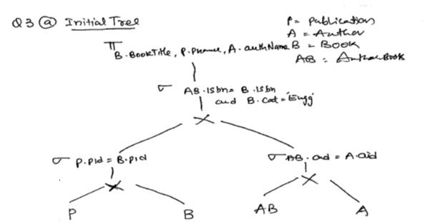
28 SSZG 518 Database Design & Applications

Slide 29
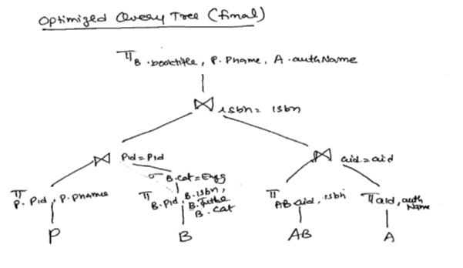
29 SSZG 518 Database Design & Applications

Slide 30
Homework
Consider the following SQL query on COMPANY database, and transform the query into equivalent relational algebraic expression. Draw the initial query tree for the relational algebraic expression and also derive the optimized query tree after applying standard heuristics on it.
SELECT E.eid, E.name, D.dname
FROM EMP as E, DEPT as D
WHERE E.dno=D.dnum AND E.age>40 AND D.location=’Mumbai’;
30 SSZG 518 Database Design & Applications

Slide 31
    Summary
    Introduction to query execution
    SQL to Relational algebra
    Sorting Algorithms
    Algorithms for SELECT and PROJECT
    Algorithms for JOIN
    Query tree and Query graph
    Heuristics in Query optimization
    Cost components
    Database tuning
31 SSZG 518 Database Design & Applications

