Slide 1
Database Design & Applications
(SS ZG 518)
Chennupati R Prasanna
CS&IS Dept.

Slide 2
Conceptual Database Design (ER Modeling) Ch. 3 & 4
    Content
    ER Model
    Steps in Database Design Process
    Entities, Attributes, and Associations
    ER Notations
    Enhanced ER modeling
    Super-class and sub-class representation
1 Chennupati R Prasanna SSZG 518 Database Design & Applications

Slide 3
Major Steps in Database Design Process
  Step 1: Requirement analysis
    Understanding the domain
    Identifying the data to be stored
    Identifying the constraints
  Step 2: Conceptual Database design
E-R modeling/UML
  Step 3: Logical Database Design
Designing tables and relationships
  Step 4: Refinement of schema
  Step 5: Physical database design
    Indexing
    Clustering
    Storage formats
2 Chennupati R Prasanna SSZG 518 Database Design & Applications

Slide 4
ER Modeling
ER Model is a popular high-level (conceptual) data model.
It is an approach to designing Semantic Conceptual schema of a Database.
ER model allows us to describe the data involved in a real-world environment in terms of objects and their relationships, which are widely used in design of database.
ER model provides preliminary concepts or idea about the data representation which is later modified to achieve final detailed design.
3 Chennupati R Prasanna SSZG 518 Database Design & Applications

Slide 5
ER Modeling
Important concepts/notions used in ER modeling are-
Entity is an object in real-world or some idea or concept which can be distinguished from other objects.
Ex.: person, school, class, department, weather, salary, temperature etc.
Entity has independent existence.
Each entity belongs to an Entity type that defines the structure.
Entity Set is a Collection of similar objects.
4 Chennupati R Prasanna SSZG 518 Database Design & Applications

Slide 6
Concepts used in ER
Attribute: reflects a property of an object or entity. We have following types of attributes.
> Simple attribute
> Composite attribute
> Single valued attribute
> Multi-valued attribute
> Derived attribute
> Stored attribute
Key : Is an Attribute of an entity type whose value can uniquely identify an entity in a set.
5 11/01/2015 Dr.R.Gururaj SSZG 518 Database Design & Applications

Slide 7
Concepts used in ER
Relationship: The association between entities is known as relationship.
Domain of an attribute: The set of possible values is known as domain of an attribute
Chennupati R Prasanna SSZG 518 Database Design & Applications

Slide 8


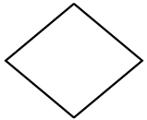


Notations used in ER
Notations used in ER modeling are shown below.
 | Entity Type
 | Weak Entity Type
 | Relationship Type
 | Identifying Relationship type
 | Attribute
Chennupati R Prasanna SSZG 518 Database Design & Applications

Slide 9


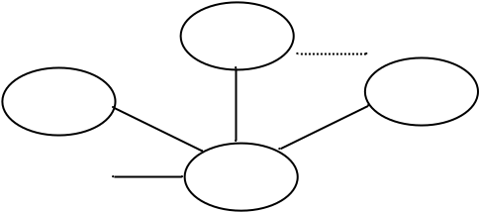

Notations used in ER
 | Key Attribute
 | Multivalued Attribute
 | Composite Attribute
 | Derived Attribute
Chennupati R Prasanna SSZG 518 Database Design & Applications

Slide 10
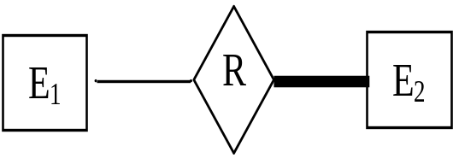
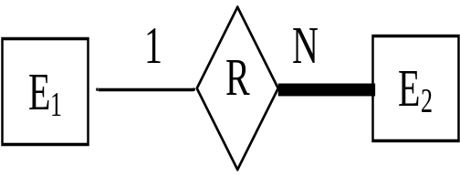
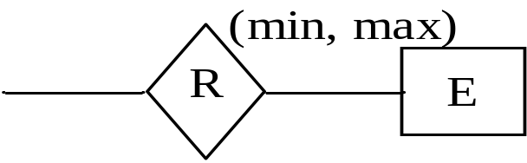
Notations used in ER
 | Total Participation of E₂ in R
 | Cardinality ratio 1; N for E₁; E₂ in R
 | Structural Constraint (min, max) on Participation of E in R
Chennupati R Prasanna SSZG 518 Database Design & Applications

Slide 11
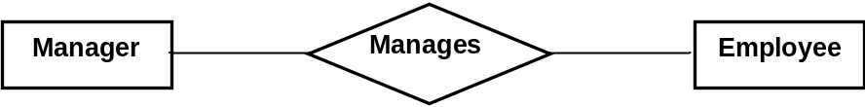

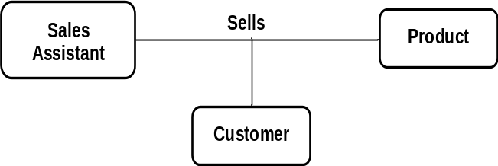
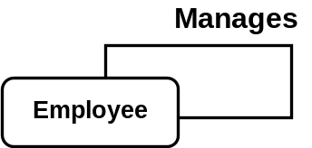
Relationships in ER
Relationships
Degree of a Relationship
If there are two entity types involved it is a binary relationship type
If there are three entity types involved it is a ternary relationship type
Unary relationships are also known as a recursive relationship
It is possible to have n-ary relationship (e.g. quaternary or unary)
Chennupati R Prasanna SSZG 518 Database Design & Applications

Slide 12




Relationships in ER
Cardinality of a relationship
Relationships are rarely one-to-one.
For example, a manager usually manages more than one employee.
This is described by the cardinality of the relationship,
for which there are four possible categories.
One to one (1:1) relationship
One to many (1:M) relationship
Many to one (M:1) relationship
Many to many (M:N) relationship
Chennupati R Prasanna SSZG 518 Database Design & Applications

Slide 13
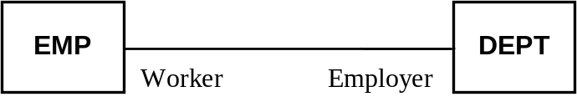
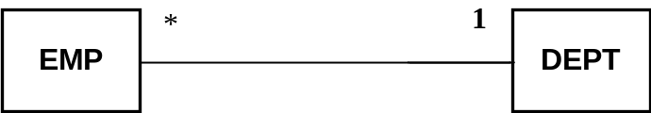

Relationships in ER
Participation Constraint
If all the entities of an entity type are involved in the relationship then that entity type’s involvement said to be total in that relationship. In the below relationship if each employee is associated with at least one dept. Then the participation of EMP is total. Here, EMP works for DEPT.
If, only few entities of the set are involved the participation is partial.
Association Role:
Multiplicity
Association Name & Direction:
Chennupati R Prasanna SSZG 518 Database Design & Applications

Slide 14
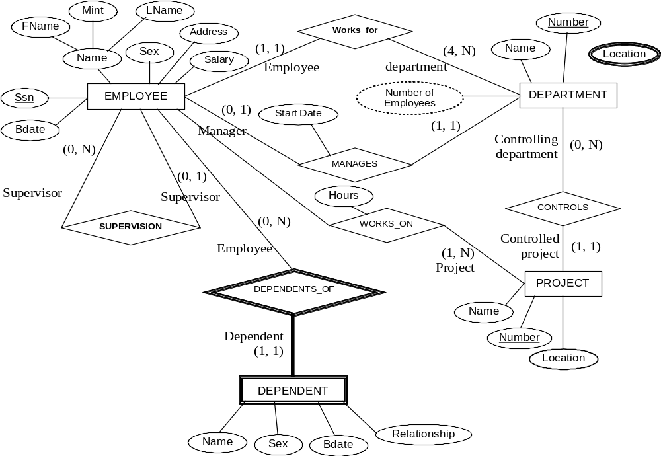
ER Diagram for the Company DB schema, with all role names
Chennupati R Prasanna SSZG 518 Database Design & Applications

