Slide 1
Database Design & Applications
(SS ZG 518)
Chennupati R Prasnna
CS&IS Dept.

Slide 2
Relational Data Model & Relational Constraints (Ch.5)
    Content
What is Relational model
Characteristics
Relational constrains
Representation of schemas
Operations on relations and constraints
1 SSZG 518 Database Design & Applications

Slide 3
Relational Model
Edgar Codd proposed Relational Data Model in 1970.
It is a representational or implementation data model.
Using this representational (or implementation) model we represent a database as collection of relations.
The notion of relation here is different from the notion of relationship used in ER modeling.
Relation is the main construct for representing data in relational model.
Every relation consists of a relation schema and Relation instance.
2 SSZG 518 Database Design & Applications

Slide 4
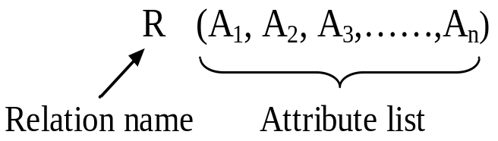
Relation Schema is denoted by
The number of columns in a relation is known as its degree or arity’.
Relation instance or Relation State (r) of R (thought of as a table)
Each row in the table represents a collection of related data.
Each row contains facts about some entity of same entity-set.
R = (A₁, A₂, A₃,……., A_{n})
r(R) is a set of n tuples in R
r = {t₁, t₂, t₃,…….,t_{n}}
r is an instance of R each t is a tuple and is a ordered list of values.
t = (v_{1 ,} v_{2 ,…,} v_{n} ) where v_{i} is an element of domain of A_{i}
3 SSZG 518 Database Design & Applications

Slide 5
Entities of each type/set are stored as rows in a single relation.
Hence in general, a relation corresponds to a single entity type in ER diagram.
In some cases a relationship between two entities can have some specific attributes which can be captured in a relation (table).
A row is called a tuple.
The columns of the table represent attributes of that entity type.
The column header is known as attribute or field.
Data type or format of an attribute: is the format of data for that attribute. Ex. Character strings, numeric, alphanumeric etc.
Values that can appear in a column for any row is called the domain of that attribute.
3 SSZG 518 Database Design & Applications

Slide 6
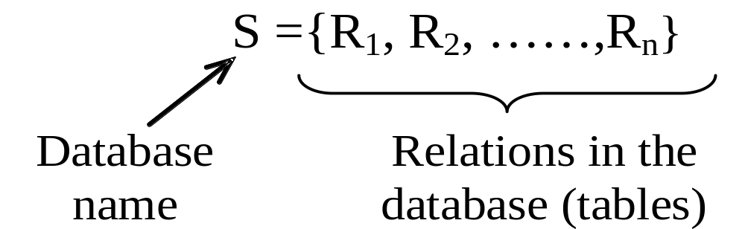
Relational Database Schema is denoted by
4 SSZG 518 Database Design & Applications

Slide 7
Attribute A of relation R is accessed by notation- R.A.
Ex: Student (name, age, branch). Here Student is the relation name.
Student.age - denotes age attribute of Student relation.
Characteristics of a Relation:
Ordering of tuples is not significant.
Ordering of values in a tuple is important.
Values in a tuple under each column must be atomic (simple & single).
5 SSZG 518 Database Design & Applications

Slide 8

5 SSZG 518 Database Design & Applications

Slide 9
Relational Model Terminology
Informal Terms |  | Formal Terms
Table |  | Relation
Column Header |  | Attribute
All possible Column Values |  | Domain
Row |  | Tuple
Table Definition |  | Schema of a Relation
Populated Table |  | State of the Relation
6 SSZG 518 Database Design & Applications

Slide 10
Relational Constraints
Constraints are restrictions on data of a relation.
Domain level Constrains – Format of data Ex. Character numeric etc.
Semantic – Not NULL etc.
Entity integrity constraints – Primary key, unique key
Referential integrity constraints– Foreign key
7 SSZG 518 Database Design & Applications

Slide 11
Relational Constraints
Dependencies –
Functional dependency : What attributes value defines the value of another attribute is known as dependency.
This concept is used in database design.
8 SSZG 518 Database Design & Applications

Slide 12
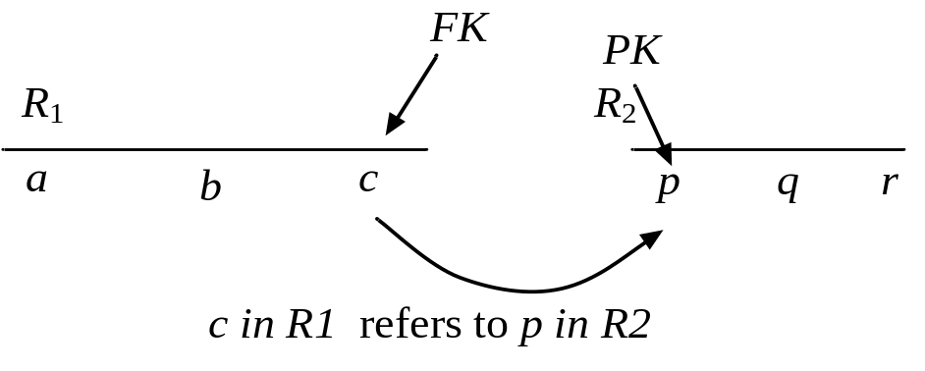
Referential integrity
The Referential Integrity constraint is specified between two relations and is used to maintain consistency among the tuples of two relations.
The FK attribute R₁ has the same domain as the primary key attribute of R₂.
The attribute c in R₁ is said to reference the attribute p in R₂.
9 SSZG 518 Database Design & Applications

Slide 13
Referential integrity
The value of FK in a tuple t of R₁ either occurs as a value under p in R₂ for some tuple, or is a NULL.
R₁ → is known as referencing relation
R₂ →is known as referenced relation
Constraints can be specified while defining the structure & also as triggers.
10 SSZG 518 Database Design & Applications

Slide 14
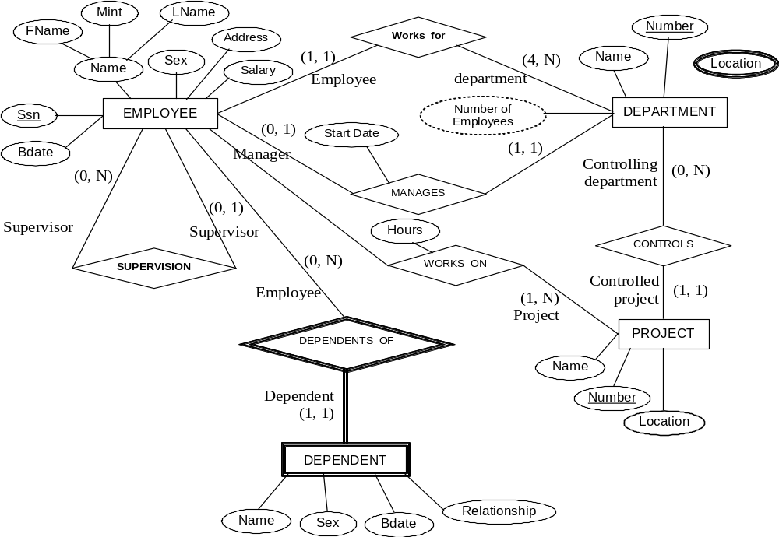
ER Diagram for the Company DB schema, with all role names

Slide 15

Relational Schema Representation
11 SSZG 518 Database Design & Applications

Slide 16

Relational Schema Representation
12 SSZG 518 Database Design & Applications

Slide 17
    Actions need to be taken when FK is set , on operations like update, insert, and delete.
If insert a tuple in R1 where the value for c is not in p of R2, then don’t allow.
What if a tuple in R2 is deleted:
Cascade, don’t allow, set to default, set to null.
What if update on R2’s p happens:
Cascade, don’t allow, set to default, set to null.
13 SSZG 518 Database Design & Applications

Slide 19
Operations on Relations and constraints
The following table indicates the constraints need to be taken care while
performing certain operations on a relation.
Operation on relations | Constraints need to be taken care
Insert | Null, Not Null, PK, unique, FK, format, Domain
Delete | FK
Update | Null, Not Null, PK, unique, FK, domain, and Semantic
14 SSZG 518 Database Design & Applications

Slide 20
Operations on Relations and constraints
Emp
FK
Dept
eid | ename | age | dno
101 | kiran | 28 | 10
105 | Gopi | 32 | 20
121 | Ahmed | 29 | 20
136 | John | 28 | 20
138 | Mike | 30 | 30
143 | Ali | 38 | 10
dnum | dname | dloc
10 | Mark | Che
20 | Prod | Hyd
30 | Acct | Bgl
Cascade
Set to null
Set to default
Restrict/Reject
Operation | Care for constraints
Insert | PK, Unique, null, notnull, format
Update | PK, Unique, null, notnull, format, FK
Delete | FK
Operation | Care for constraints
Insert | PK, Unique, null, notnull, format, FK
Update | PK, Unique, null, notnull, format, FK
Delete | No care
15 SSZG 518 Database Design & Applications

Slide 21
Exercise Problem-1
Q1.Assume a Book Publishing scenario. We have Books, Publishers, and Authors. A Book is authored by one or more Authors, and published by only one Publisher. Each publisher has at least one book published. Each author might have authored zero to any number of books. Book will have ISBN# (as unique identification), Title and cost attributes. Author will have author# (unique) , name (has first name and last name as sub-components), city, and contact# (many contact#s are possible) as attributes. Publishers are identified by publisher name and will have city, CEO as other attributes.
Now, draw the ER diagram for the above description. Indicate- cardinality, keys, attributes, min-max, and participation constraints for entity-types involved in the relationships. Use specialization wherever necessary. Assume necessary data.
16 SSZG 518 Database Design & Applications

Slide 22
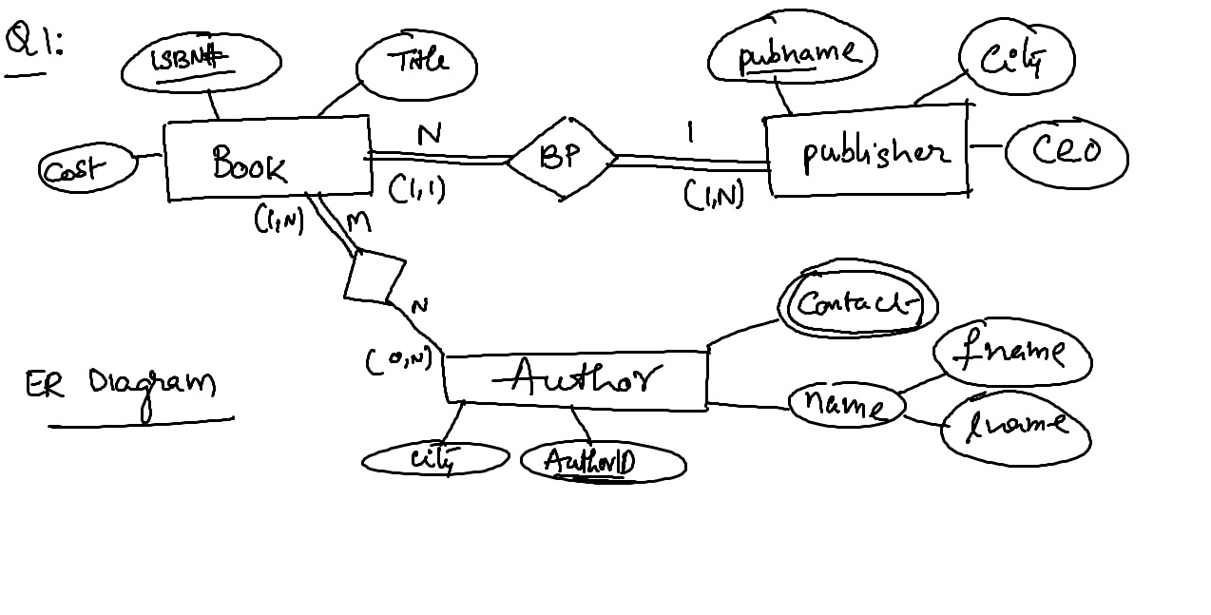
17 SSZG 518 Database Design & Applications

Slide 23
Exercise Problem-2
Q2. Assume that we need to capture the data about a Non-profit organization(NPO) with following details/requirements.
i) The NPO depends on a number of different types of persons for its successful operations.
ii) The NPO is interested in following attributes of a person- SSN (identifier), name, address (consists of house#/city/state/zip components), and telephone.
iii) Three types of persons are of great interest to the NPO- employees, volunteers, and donors.
iv) Employees have only a date_hired attribute, volunteers have skill attribute, and donors have donor category as specific attribute.
v) Donors have a specific relationship (called Donates) with an item entity type(assume suitable attributes for Item entity type including a key).
vi) A donor must have donated one or more items, and an item may have no donors, or one or more donors.
vii) There are persons other than employees, volunteers, and donors who are of interest to the NPO, so that a person need not belong to any of these three types/groups. On the other hand, at a given time a person may belong to two or more of the above groups.
18 SSZG 518 Database Design & Applications

Slide 24
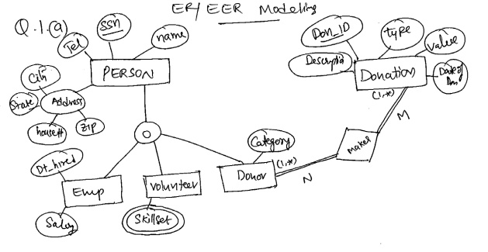
19 SSZG 518 Database Design & Applications

Slide 25
    Summary
    What are basics of relational model
    Relation instance
    Relational data constraints
    Referential integrity
    Relational scheme representation
    Operations on relations and constraints
20 SSZG 518 Database Design & Applications

