Slide 1
Database Design & Applications
(SS ZG 518)
Chennupati R Prasanna
CS&IS Dept.

Slide 2
E(E)R to Relational Mapping (Ch. 7)
    Content
    Mapping Regular Entity types
    Mapping Weak Entity types
    Mapping 1:1 Relationships
    Mapping 1:N Relationships
    Mapping N:M Relationships
    Mapping Multivalued and Complex attributes
    Mapping Class Hierarchies
1 Database Design & Applications

Slide 3
Mapping entity types
Mapping of Regular Entity Types.
  For each regular (strong) entity type E in the ER schema, create a relation R that includes all the simple attributes of E.
  Choose one of the key attributes of E as the primary key for R.
  If the chosen key of E is composite, the set of simple attributes that form it will together form the primary key of R.
2 SSZG 518 Database Design & Applications

Slide 5
2. Mapping of Weak Entity Types
  For each weak entity type W in the ER schema with owner entity type E, create a relation R & include all simple attributes (or simple components of composite attributes) of W as attributes of R.
  Also, include as foreign key attributes of R the primary key attribute(s) of the relation(s) that correspond to the owner entity type(s).
  The primary key of R is the combination of the primary key(s) of the owner(s) and the partial key of the weak entity type W, if any.
3 SSZG 518 Database Design & Applications

Slide 7
Mapping Relationship types
3. Mapping of Binary 1:1 Relation Types
  For each binary 1:1 relationship type R in the ER schema, identify the relations S and T that correspond to the entity types participating in R.
There are three possible approaches:
  Foreign Key approach: Choose one of the relations-say S-and include a foreign key in S that refers to the primary key of T. It is better to choose an entity type with total participation in R in the role of S.
  Merged relation option: An alternate mapping of a 1:1 relationship type is possible by merging the two entity types and the relationship into a single relation. This may be appropriate when both participations are total.
  Cross-reference or relationship relation option: The third alternative is to set up a third relation R for the purpose of cross-referencing the primary keys of the two relations S and T representing the entity types.
4 SSZG 518 Database Design & Applications

Slide 9
4. Mapping of Binary 1:N Relationship Types.
  For each regular binary 1:N relationship type R, identify the relation S that represent the participating entity type at the N-side of the relationship type.
  Include as foreign key in S the primary key of the relation T that represents the other entity type participating in R.
  Include any simple attributes of the 1:N relation type as attributes of S.
5 SSZG 518 Database Design & Applications

Slide 10
5. Mapping of Binary M:N Relationship Types.
  For each regular binary M:N relationship type R, create a new relation S to represent R.
  Include as foreign key attributes in S the primary keys of the relations that represent the participating entity types; their combination will form the primary key of S.
  Also include any simple attributes of the M:N relationship type (or simple components of composite attributes) as attributes of S.
6 SSZG 518 Database Design & Applications

Slide 12
Mapping Multivalued attributes
6. Mapping of Multivalued attributes.
  For each multivalued attribute A, create a new relation R.
  This relation R will include an attribute corresponding to A, plus the primary key attribute K-as a foreign key in R-of the relation that represents the entity type of relationship type that has A as an attribute.
  The primary key of R is the combination of A and K. If the multivalued attribute is composite, we include its simple components.
7 SSZG 518 Database Design & Applications

Slide 13
Mapping n-ary relationships
7. Mapping of N-ary Relationship Types.
  For each n-ary relationship type R, where n>2, create a new relationship S to represent R.
  Include as foreign key attributes in S the primary keys of the relations that represent the participating entity types.
  Also include any simple attributes of the n-ary relationship type (or simple components of composite attributes) as attributes of S.
8 SSZG 518 Database Design & Applications

Slide 14
Mapping n-ary relationships
Example: The relationship type SUPPY in the ER on the next slide.
  This can be mapped to the relation SUPPLY shown in the relational schema, whose primary key is the combination of the three foreign keys {SNAME, PARTNO, PROJNAME}
SSZG 518 Database Design & Applications

Slide 15

ER-Diagram for Company Database
9 SSZG 518 Database Design & Applications

Slide 16
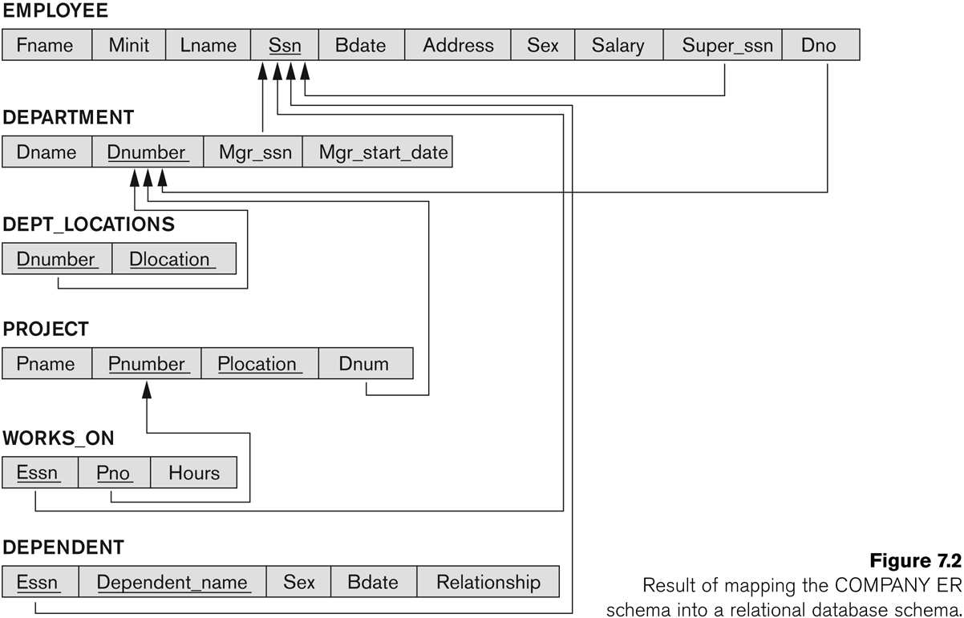
ER-Relational mapping for Company Database
10 SSZG 518 Database Design & Applications

Slide 17


Mapping ternary relationship
11 SSZG 518 Database Design & Applications

Slide 18


Mapping Class hierarchies
    Option 8A: Multiple
    relations-Superclass
    and subclasses
12 SSZG 518 Database Design & Applications

Slide 19
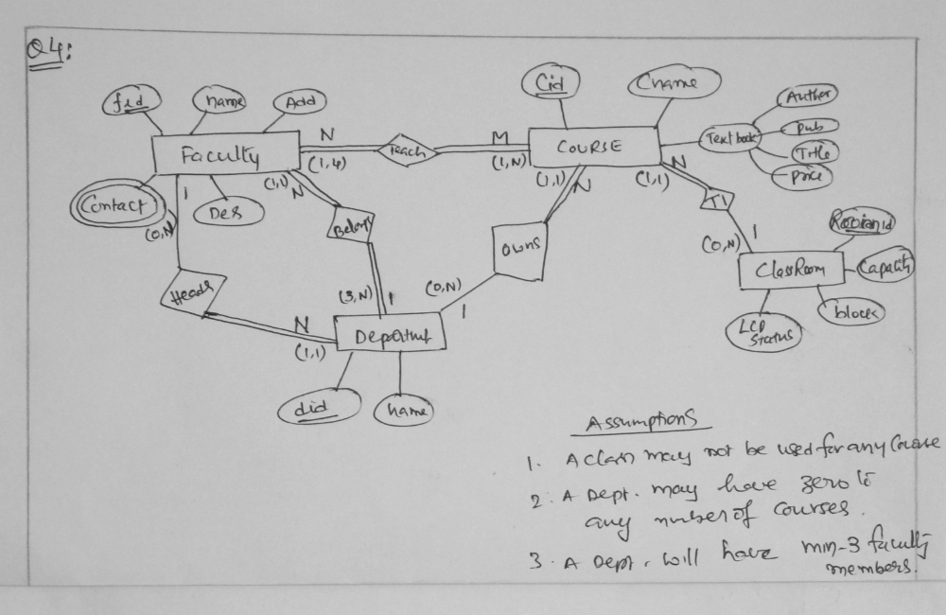
Exercise problem-1
13 SSZG 518 Database Design & Applications

Slide 20
Try this your self
SSZG 518 Database Design & Applications

Slide 21
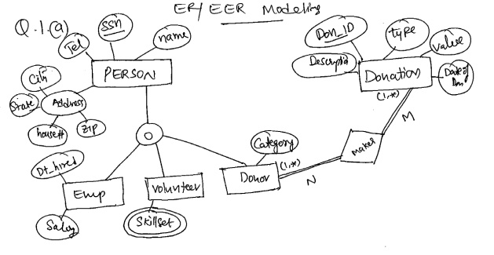
Exercise problem-2
14 SSZG 518 Database Design & Applications

Slide 22
SSZG 518 Database Design & Applications

Slide 23
    Summary
    We have learnt the rules and guidelines for mapping ER to Relational model.
    Rules for mapping Entity types
    Rules for mapping Relationships
    Rules for mapping Class hierarchies
15 SSZG 518 Database Design & Applications

