Slide 1
Database Design & Applications
(SS ZG 518)
Chennupati R Prasanna
CS&IS Dept.

Slide 2
Lecture Session-5
Relational Algebra & Relational Calculus (Ch. 6)
    Query languages & Formal query languages for Relational data model
    Introduction to Relational Algebra
    Relational operators
    Set operators
    Join operators
    Aggregate functions
    Grouping operator
    Relational Calculus concepts
1 SSZG 518 Database Design & Applications

Slide 3
Query Languages for Relational data model
Querying means extracting data from the database for the purpose of processing it.
Every data model has some formal query languages to support specification of data retrieval and manipulate requests.
Formal query languages
1. Relational Algebra
2. Relational Calculus
(a) Tuple Relational Calculus
(b) Domain Relational Calculus
Commercial query languages
1. Structured Query Language (SQL)
2. Query by Example (QBE)
2 SSZG 518 Database Design & Applications

Slide 4
Introduction to Relational Algebra
Relational Algebra is a formal query language for relational data model.
A basic set of relational model operations constitute the relational algebra.
These operations enable the user to specify basic data retrieval requests.
The result of a relational algebra query is also a new relation which may have been formed from one or more relations.
A sequence of relational algebraic operations forms a relational algebraic expression, whose result is also a relation.
3 SSZG 518 Database Design & Applications

Slide 5
Operations in Relational Algebra
Set Operations
Union,
Intersection,
Difference,
Cartesian product.
Relational Operations
Select,
Project,
join,
Division etc.
4 SSZG 518 Database Design & Applications

Slide 6

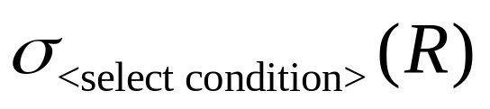

Select Operation: is to select subset of tuples that satisfy some selection condition.
Symbol used is σ (sigma)
Ex: (EMP)
The above expression selects all tuples from EMP table, where the value of the column ‘dno’ is 4.
The general form of ‘select’ clause is
Projection Operation:
Selects certain columns. Symbol is π( pi) (EMP)
Selects columns name, age, dno for all tuples from the table EMP
5 SSZG 518 Database Design & Applications

Slide 7



Note:
We can apply the expressions in sequence or we can nest them in single expression.
Ex.:
The above expression selects name and age of employees working with dno 5.
The above query can also be written as
R₁ & R₂ are the names given to intermediate results(relations).
6 SSZG 518 Database Design & Applications

Slide 8
Union:
If two relations R₁ & R₂ are compatible ( i.e., have same type of tuples) then we can merge them by union operation.
Duplicate tuples are eliminated. Ex: (R₁ ∪ R₂).
Intersection R₁ ∩ R₂
Only equivalent tuples from R₁ & R₂ are selected.
Difference R₁ – R₂
Only those tuples seen in R₁ and not seen in R₂ are selected.
Note: (R1-R2) is not same as (R2-R1)
7 SSZG 518 Database Design & Applications

Slide 9
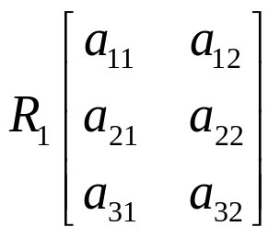
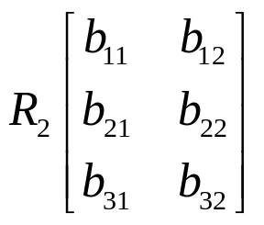
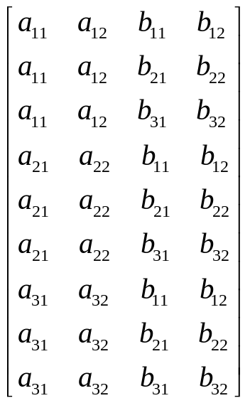
 | no rows = 3 no Columns -2 |  | Rows=3 Column=2
(R₁ × R₂) =
No of rows = 3 × 3 = 9 No Columns = 2 + 2 = 4
Cross product or Cartesian product
8 SSZG 518 Database Design & Applications

Slide 10
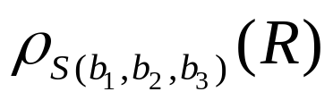
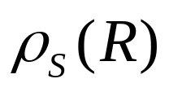
Rename operator
ρ(rho)
Ex:
Renames R to S and new names of attributes are b₁, b₂, b₃
Renames R to S with same attribute names
9 SSZG 518 Database Design & Applications

Slide 12

Division (÷)
Used when we want to check the meeting of all the criteria
Let R(A, B) and S(A) T ← R ÷ S
Selects all values for B column in R which contains all values under A in S.
Hence the no. column in T is only B.
Join: ( ) Used to join tuples from different tables based on same condition. Result is new tuple with different arity.
D ← DEPT _{Mgtssn = ssn} EMP
Joins tuples from DEPT & EMP where Mgrssn in DEPT is equal to ssn in EMP and stores the new tuples in relation D.
10 SSZG 518 Database Design & Applications

Slide 13
Division operator
A | B
a1 | b1
a1 | b2
a1 | b3
a2 | b2
a2 | b3
a3 | b1
a3 | b2
a3 | b3
a4 | b3
B
b1
b2
b3
A
a1
a4
SSZG 518 Database Design & Applications

Slide 15
Natural Join: is an join on attributes in R and S having the same label.
In the resulting relation only one column is listed.
Ex. D ← DEPT *EMP.
The joining is on common attribute with same name (Dept Name).
11 SSZG 518 Database Design & Applications

Slide 16



Inner Join (R S) An inner join only combines tuples from R and S if they meet the conditions. Tuples that do not meet the conditions are not showed in the final result. (This is the usual type of join).
Outer join: An outer join displays the tuples of one of the relations even if there is no match for the tuple in the other relation.
Left outer join: (R S) In the result relations, in addition to all the matching tuples from R and S, all the remaining tuples from left side relation (R) are also showed. For these tuple from R, columns under S will have null values(padding).
Right Outer Join: (R S) In the result relation, matching tuples will occur from R & S. In addition all the tuples form S will also appear with null values for the R attributes.
Full Outer join (R S) In the result, all tuples from R & S will appear with null values for the other relations attributes.
12 SSZG 518 Database Design & Applications

Slide 19
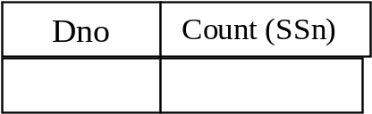
Additional Relational Operations
Aggregate functions: Sum Average Max Min Count
Grouping:
The tuples of a relation are first grouped by the value of some attribute and then aggregate functions are applied on individual groups.
Symbol used is – £
Ex. Dno £_{Count (ssn)} (EMP)
The above expression first group the tuples in EMP table based on Dno, and then applies count function on individual groups this will output no. of employees in each department.
Result relation →
13 SSZG 518 Database Design & Applications

Slide 20
14 24/01/2015 SSZG 518 Database Design & Applications Dr.R.Gururaj

Slide 21
Tuple Relational Calculus
Relational Calculus is a formal query language for relational model where we write one declarative expression to specify a retrieval request and hence there is no description of how to evaluate the query.
A calculus expression specifies what is to be retrieved rather than how to do it.
Hence, relational calculus is non–procedural language where as relational algebra discussed in the previous section is procedural, where we write sequence of operations to retrieve data.
Any expression for data retrieval written in relational algebra can also be written in relational calculus and vice-versa.
Hence expression power of relational algebra and relational calculus is same.
15 SSZG 518 Database Design & Applications

Slide 22
Tuple Rational Calculus(TRC) is based on specifying a number of tuple variables.
Each tuple variable usually ranges over a particular database relation. Variables can take values of individual tuples from the relation.
A simple relational calculus query is in the form-
{t | condition (t)}
t – tuple variable
condition (t) – is a conditional expression involving t.
Result is a set of all tuples that satisfy the conditions specified in condition (t).
16 SSZG 518 Database Design & Applications

Slide 23
Ex. Find all employees whose salary is above 50,000
{t | EMP (t) and t. salary > 50,000}
Selects all tuples from EMP such that for each tuple selected, the salary value is > 50,000.
The expression EMP(t) specifies from where the tuple t must be chosen.
Hence EMP relation in this case is known as a range relation.
Note: The above query retrieves all the attributes of relation EMP.
17 SSZG 518 Database Design & Applications

Slide 24
Relational Completeness:
This notion is used to compare high level query languages.
Any relational query language L is considered to be relationally complete if we can express in L any query that is expressed in relational algebra (RA) or relational calculus (RC).
18 SSZG 518 Database Design & Applications

Slide 25
Sample Database
EMP (eid, ename, esal, dno) //dno FK refers to dno of DEPT
DEPT(dno, dname , dloc)
PROJ(pno, pname, dno) //dno FK refers to dno of DEPT
EMP_PROJ(eid, pno, hrs) //eid FK refers to eid of EMP
and pno FK refers to pno of PROJ
19 SSZG 518 Database Design & Applications

Slide 26
Sample Data Retrieval requests
Get the list of employee IDs, names for those who have no projects.
Get the empIDs and salary for those working with HR dept.
Get the list of employee IDs, and names who have more than two projects.
Get the list of projectIDs, names controlled by department with name “ACCOUNTS”.
Get the list of employee IDs working on all projects.
Find the projectsIDs and names for those projects controlled by departments located in Mumbai.
20 SSZG 518 Database Design & Applications

Slide 27
21 SSZG 518 Database Design & Applications

Slide 28
    Summary
    What is a query language
    Formal query languages for Relational data model
    Basic concepts of Relational Algebra
    Operations in Relational Algebra
    Relational Calculus
    Examples
SSZG 518 Database Design & Applications

