Slide 1
Database Design & Applications
(SS ZG 518)
Chennupati R Prasanna
CS&IS Dept.

Slide 2
Relational Algebra & Relational Calculus (Ch. 6) {cont..}
    Sequence of operations and the rename operations
    Additional operators
      Set intersection
      Join
      Division
      Assignment
    Extended relation algebra
      Generalized projection
      Aggregation
      Outer join
    Relational Calculus
1 SSZG 518 Database Design & Applications

Slide 3
Introduction to Relational Algebra {revision}
Relational Algebra is a formal query language for relational data model.
A basic set of relational model operations constitute the relational algebra.
These operations enable the user to specify basic data retrieval requests.
The result of a relational algebra query is also a new relation which may have been formed from one or more relations.
A sequence of relational algebraic operations forms a relational algebraic expression, whose result is also a relation.
3 SSZG 518 Database Design & Applications

Slide 4

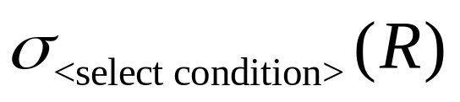

Selection and projection {revision}
Select Operation: is to select subset of tuples that satisfy some selection condition.
Symbol used is σ (sigma)
Ex: (EMP)
The above expression selects all tuples from EMP table, where the value of the column ‘dno’ is 4.
The general form of ‘select’ clause is
Projection Operation:
Selects certain columns. Symbol is π( pi) (EMP)
Selects columns name, age, dno for all tuples from the table EMP
5 SSZG 518 Database Design & Applications

Slide 5
Union and difference {revision}
Union:
If two relations R₁ & R₂ are compatible ( i.e., have same type of tuples) then we can merge them by union operation.
Duplicate tuples are eliminated. Ex: (R₁ ∪ R₂).
Difference R₁ – R₂
Only those tuples seen in R₁ and not seen in R₂ are selected.
Note: (R1-R2) is not same as (R2-R1)
7 24/01/2015 SSZG 518 Database Design & Applications Dr.R.Gururaj

Slide 6
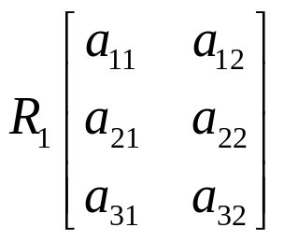
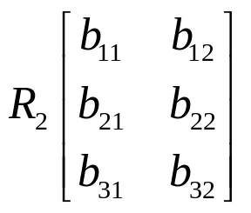
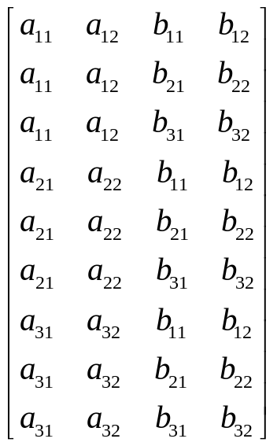
Cartesian product {revision}
 | no rows = 3 no Columns -2 |  | Rows=3 Column=2
(R₁ × R₂) =
No of rows = 3 × 3 = 9 No Columns = 2 + 2 = 4
Cross product or Cartesian product
8 24/01/2015 SSZG 518 Database Design & Applications Dr.R.Gururaj

Slide 7
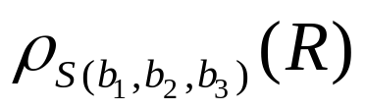
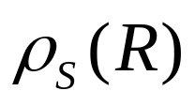
rename operators {revision}
Rename operator
ρ(rho)
Ex:
Renames R to S and new names of attributes are b₁, b₂, b₃
Renames R to S with same attribute names
9 24/01/2015 SSZG 518 Database Design & Applications Dr.R.Gururaj

Slide 8
Additional operators are
Set intersection
Join
Division
Assignment

Slide 9
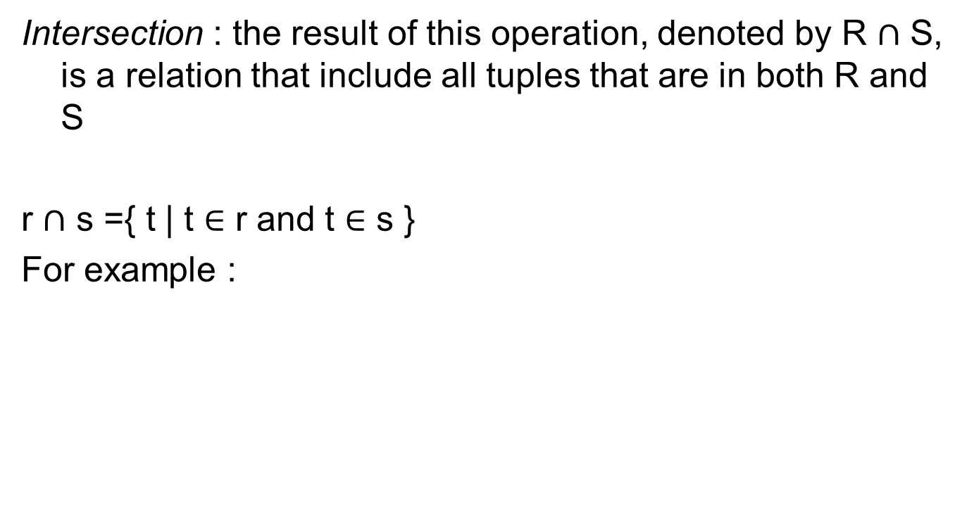
Set intersection

Slide 10

Join
Join: ( ) Used to join tuples from different tables based on same condition. Result is new tuple with different arity.
D ← DEPT _{Mgtssn = ssn} EMP
Joins tuples from DEPT & EMP where Mgrssn in DEPT is equal to ssn in EMP and stores the new tuples in relation D.
10 24/01/2015 SSZG 518 Database Design & Applications Dr.R.Gururaj

Slide 11
Example on joins (equijoin)

Slide 12
natural join
Denoted by *_ was created to get rid of the second (superfluous) attribute in equijoin condition.
The standard definition of natural join requires that the two join attributes(or each pair of join attributes have the same name in both relations)
If this is not the case, a renaming operation is applied first.

Slide 13
Example on natural join

Slide 14
Division (÷) operations
Division (÷)
The division operation, denoted by ÷, is useful for a special kind of query that sometimes occurs in database applications
Example
  Is retrieve the name of employees who work on all the projects that ‘john smith’ works on.

Slide 15
Division operator
A | B
a1 | b1
a1 | b2
a1 | b3
a2 | b2
a2 | b3
a3 | b1
a3 | b2
a3 | b3
a4 | b3
B
b1
b2
b3
A
a1
a4
28/01/2014 SSZG 518 Database Design & Applications Dr.R.Gururaj

Slide 16
Assignment

Slide 17
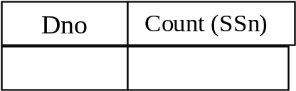
Additional Relational Operations
Aggregate functions: Sum Average Max Min Count
Grouping:
The tuples of a relation are first grouped by the value of some attribute and then aggregate functions are applied on individual groups.
Symbol used is – £
Ex. Dno £_{Count (ssn)} (EMP)
The above expression first group the tuples in EMP table based on Dno, and then applies count function on individual groups this will output no. of employees in each department.
Result relation →
13 24/01/2015 SSZG 518 Database Design & Applications Dr.R.Gururaj

Slide 18
14 24/01/2015 SSZG 518 Database Design & Applications Dr.R.Gururaj

Slide 19
Tuple Relational Calculus
Relational Calculus is a formal query language for relational model where we write one declarative expression to specify a retrieval request and hence there is no description of how to evaluate the query.
A calculus expression specifies what is to be retrieved rather than how to do it.
Hence, relational calculus is non–procedural language where as relational algebra discussed in the previous section is procedural, where we write sequence of operations to retrieve data.
Any expression for data retrieval written in relational algebra can also be written in relational calculus and vice-versa.
Hence expression power of relational algebra and relational calculus is same.
15 24/01/2015 SSZG 518 Database Design & Applications Dr.R.Gururaj

Slide 20
Tuple Rational Calculus(TRC) is based on specifying a number of tuple variables.
Each tuple variable usually ranges over a particular database relation. Variables can take values of individual tuples from the relation.
A simple relational calculus query is in the form-
{t | condition (t)}
t – tuple variable
condition (t) – is a conditional expression involving t.
Result is a set of all tuples that satisfy the conditions specified in condition (t).
16 24/01/2015 SSZG 518 Database Design & Applications Dr.R.Gururaj

Slide 21
Ex. Find all employees whose salary is above 50,000
{t | EMP (t) and t. salary > 50,000}
Selects all tuples from EMP such that for each tuple selected, the salary value is > 50,000.
The expression EMP(t) specifies from where the tuple t must be chosen.
Hence EMP relation in this case is known as a range relation.
Note: The above query retrieves all the attributes of relation EMP.
17 24/01/2015 SSZG 518 Database Design & Applications Dr.R.Gururaj

Slide 22
Relational Completeness:
This notion is used to compare high level query languages.
Any relational query language L is considered to be relationally complete if we can express in L any query that is expressed in relational algebra (RA) or relational calculus (RC).
18 24/01/2015 SSZG 518 Database Design & Applications Dr.R.Gururaj

Slide 23
Thanks

