Slide 1

A
Seminar
On
MEMRISTORS
Submitted By:
TULIKA SHARMA
Electronics Engg.- and VLSI Design and Tech.
(2317101)
DEPARTMENT OF PHYSICAL SCIENCE
BANASTHALI VIDYAPITH , RAJASTHAN
February, 2025

Slide 2
Outline
Introduction
Historical Perspective
Circuit Involved
VI Characteristics
Fabrication Techniques
Benefits
Challenges Involved
Applications
Future Scope
Conclusions
References and Sources

Slide 3
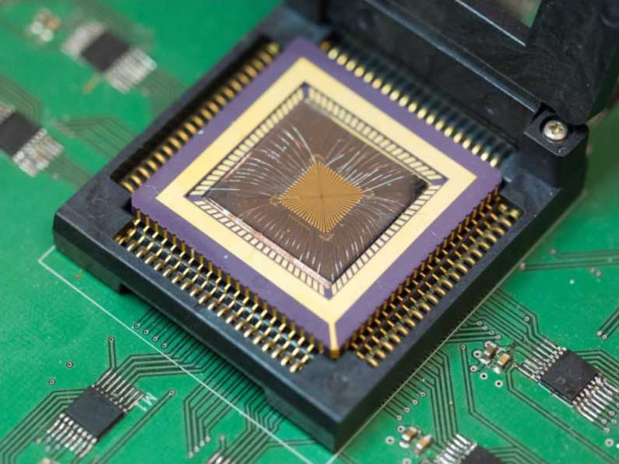
Introduction
Memristor - memory resistor
Memristors are non-volatile
Resistance switching memories are memristors

Slide 4

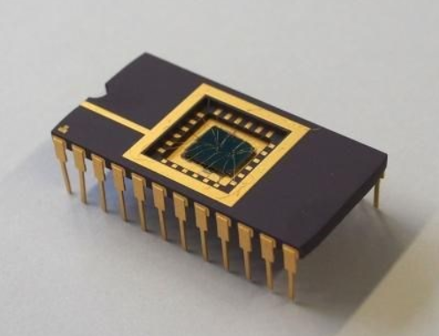
Historical Perspective
Theory was developed in 1971 by Professor Leon Chua.
The first memristor was fabricated in 2008 by Stanley Williams and his group at Hewlett Packard.

Slide 5
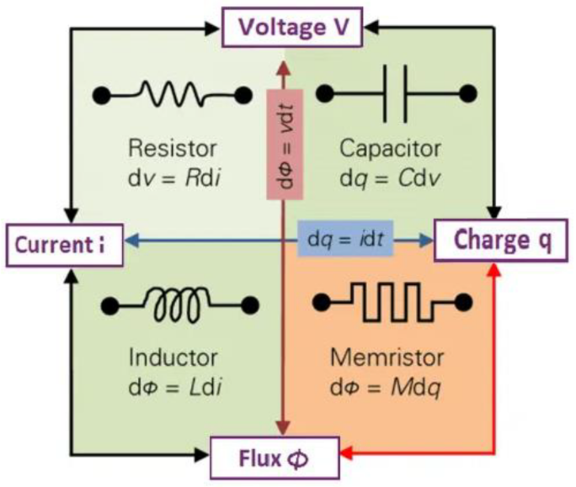
Circuit Involved

Slide 6
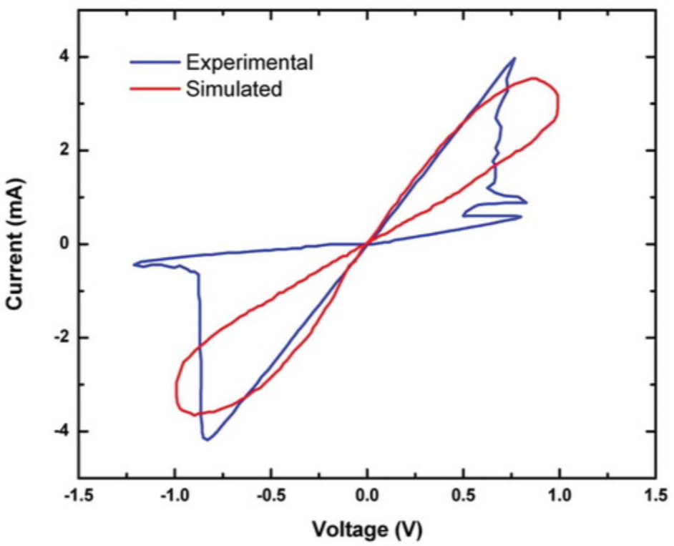
VI Characteristics

Slide 7
Fabrication Techniques
Sputtering:
Deposit the Bottom Electrode
Deposit the Switching Layer
Deposit the Top Electrode
Pattern the Device
3D Printing:
Design
Slicing
Printing
Post-Processing

Slide 8
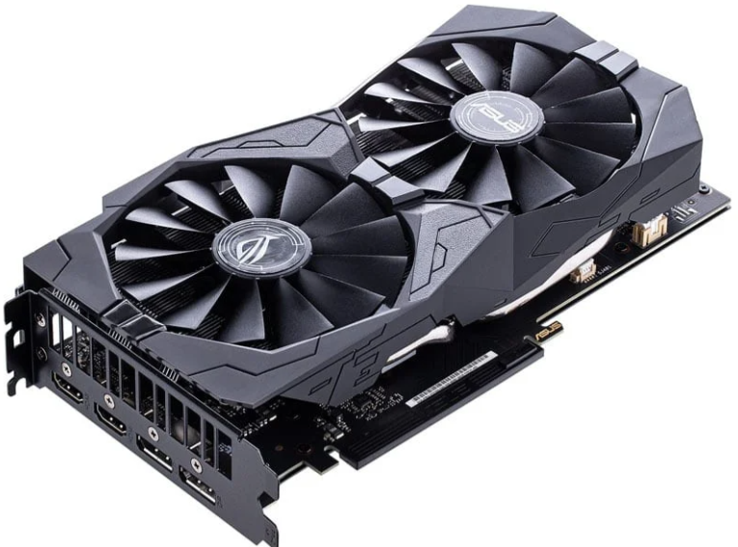
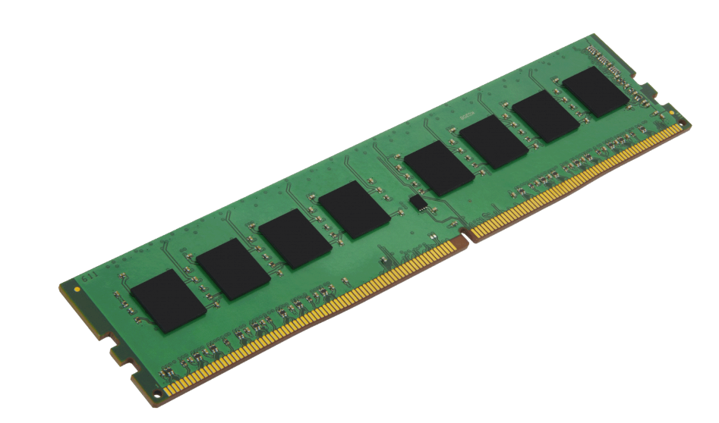
Benefits
GPU: not suitable for low power devices, less scalable
DRAM: volatile, expensive, require high power
Memristor: low power, cost effective, retains memory without power.

Slide 9
Challenges Involved
Cost
Memristor manufacturing costs exceed conventional memory.
Variability
Variability in devices and cycles causes inconsistent performance.
Miniaturization
Industry Standards
Noise
Scaling memristors increases quantum effects and interfacial defects.
No universal framework exists for memristor fabrication, testing, and characterization.
Analog computations in neuromorphic systems suffer from noise, reducing accuracy.
.

Slide 10
Applications
Security
Non-Volatile Memory
Neuromorphic Computing
Biological and Medical Applications
Flexible and wearable electronics

Slide 11
Future Scope
Wearable and Implanted Device
Sustainable Electronics
Human-Machine Interfaces
Energy-Efficient Systems
Next-Generation Computing

Slide 12
Conclusions
Non-volatile memory with resistance based on past usage.
Energy-efficient and high-density storage.
Used in AI, neuromorphic computing, and next-gen
memory.
Challenges: Fabrication complexity and integration issues.
Future potential in advanced computing and memory
technologies.

Slide 13
References & Sources
1. Ali, S., Khan, S., Khan, A., & Bermak, A. (2021). Memristor fabrication through printing technologies: a review. IEEE Access, 9, 95970-95985.
2. Marani, R., Gelao, G., & Perri, A. G. (2015). A review on memristor applications. arXiv preprint arXiv:1506.06899.
3. Strukov, D. B., Snider, G. S., Stewart, D. R., & Williams, R. S. (2008). The missing memristor found. nature, 453(7191), 80-83.

