Slide 1
Equivalence testing
Duncan Tulimieri
9/15/2021

Slide 2



What is it?
Frequentist statistics = falsification
Falsify the H₀
$H_{0}: μ_{1}=μ_{2}$
$H_{a}:μ_{1}≠μ_{2}$
But I want to support $H_{0}$
Go $H_{0}$ !!!

Slide 3


What does a p-value mean?
Can I support $H_{0}$ when p > 0.05?
Why not?
p < 0.05 means the data are surprising assuming the null hypothesis ($H_{0}: μ_{1}=μ_{2}$) is true.
Not that the data support $H_{0}$

Slide 4
Papers that used (p > 0.05) as similarity

Slide 5
Papers that used t-test (p > 0.05)

Slide 6
Papers that used t-test (p > 0.05)

Slide 7

How can we test for equivalence
Option 1: Bayesian statistics
Option 2: Flip the story
Falsify the H₀’s
$H_{01}:Δ≤−Δ_{L}$
$H_{02}:Δ≥Δ_{U}$
$H_{a1}:Δ>−Δ_{L}$
$H_{a2}:Δ<Δ_{U}$

Slide 8
TOST (Two one-sided t-tests)
Goal: Specify a lower and upper bound, such that results falling within this range are deemed equivalent to the absence of an effect that is worthwhile to examine.
Bounds
Symmetric around 0 (recommended)
Asymmetric around 0 (not recommended [e.g., bias])

Slide 9
TOST (Two one-sided t-tests)
Equivalence Tests for Difference Between Two Independent Means
1. Calculate t-statistics
2. Calculate degrees of freedom
Both t-tests need to be significant
to declare equivalence, but
common to only report one
(highest p-value)

Slide 10
TOST (Two one-sided t-tests)
Best to do power analysis apriori to determine sample size
Equivalence tests require slightly larger sample sizes than traditional null hypothesis tests.
Equivalence Tests for Difference Between Dependent Means
Equivalence Tests for One-Sample t Tests
Equivalence Tests for Correlations
Equivalence Tests for Meta-Analyses

Slide 11
TOST (Two one-sided t-tests)
Setting bounds
1. Apriori with theoretical backing
2. Practical bounds (inverse power-analysis)
3. Regulations (pharmacokinetics)

Slide 12
Lakens Excel Examples [Independent Samples (equivalence bounds based on raw scores)]
Mean group 1 | 5.25 | Mean group 2 | 5.22
SD group 1 | 0.95 | SD group 2 | 0.83
n group 1 | 95 | n group 2 | 89
low equivalence bound (raw scores) | -0.3836 | high equivalence bound (raw scores) | 0.3836

Slide 13
Lakens Excel Examples [Independent Samples (equivalence bounds based on raw scores)]
TOST Equivalence Test Equal Variances Not Assumed
One-Sided Test 1 |  | One-Sided Test 2
t | 3.150 | t | -2.693
df | 181.13 | df | 181.13
p | 0.001 | p | 0.004
TOST result
t | -2.693 | p | 0.004
The TOST procedure based on Welch's t-test indicated that the observed effect size (d = 0.03) was significantly within the equivalent bounds of -0.38 and 0.38 scale points, (or in Cohen's d: -0.43 and 0.43), t(181.13) = -2.69, p = 0.004

Slide 14
Lakens Excel Examples [Independent Samples (equivalence bounds based on raw scores)]
TOST Equivalence Test Equal Variances Not Assumed
One-Sided Test 1 |  | One-Sided Test 2
t | 3.150 | t | -2.693
df | 181.13 | df | 181.13
p | 0.001 | p | 0.004
TOST result
t | -2.693 | p | 0.004
The TOST procedure based on Welch's t-test indicated that the observed effect size (d = 0.03) was significantly within the equivalent bounds of -0.38 and 0.38 scale points, (or in Cohen's d: -0.43 and 0.43), t(181.13) = -2.69, p = 0.004
Can my GUI replicate?

Slide 15
KINmod
Demographics
Sometimes we want a significant difference between groups
Sometimes we want significant similarity between groups

Slide 16
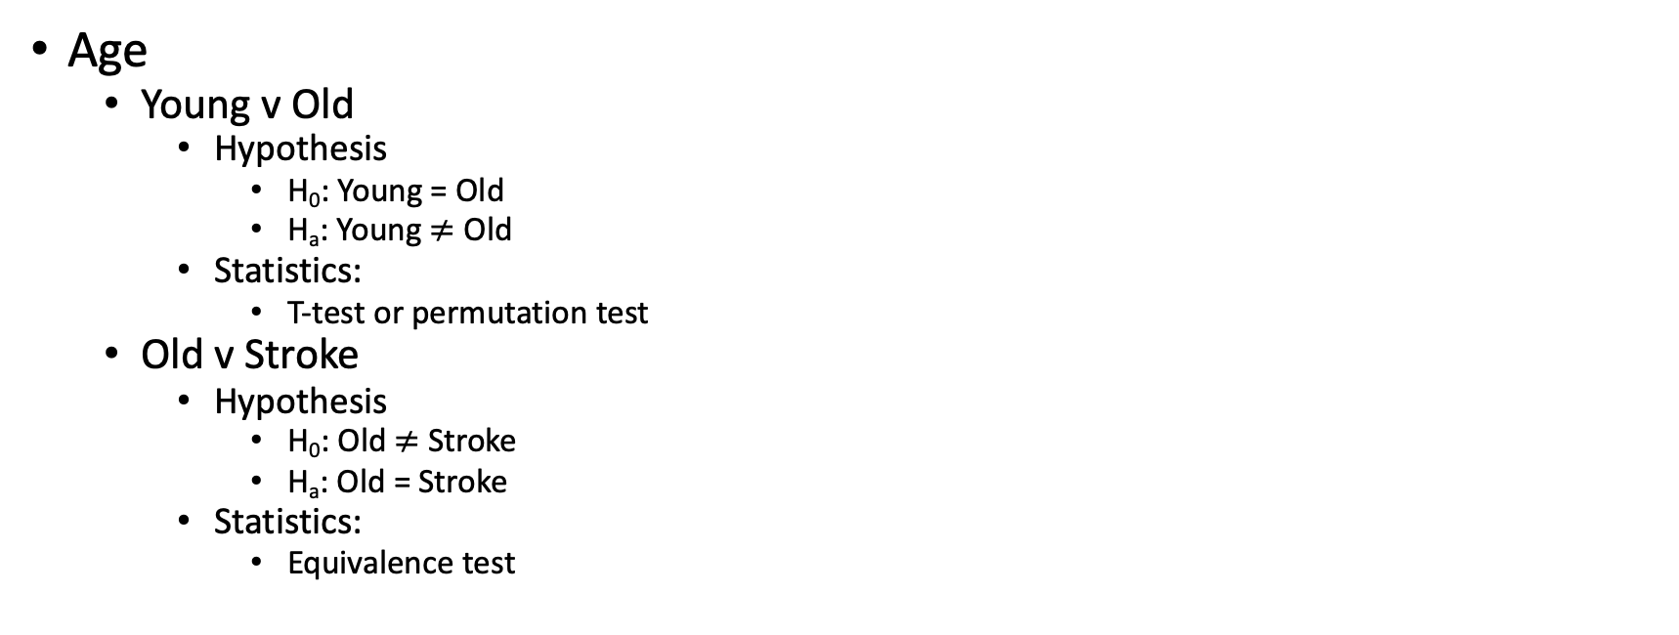
KINmod
Groups: Young, Old, Stroke
Age
Young v Old
Hypothesis
H₀: Young = Old
H_{a}: Young $≠$ Old
Statistics:
T-test or permutation test
Old v Stroke
Hypothesis
H₀: Old $≠$ Stroke
H_{a}: Old = Stroke
Statistics:
Equivalence test

