Slide 1
Experiment to psychometric function
Duncan Tulimieri
January 29, 2021

Slide 2
Components of a psychophysical task
Stimulus - what is being presented to the observer
Task - How stimulus is being presented (IFC/AFC or adjustment)
Method – How task is being implemented (constant, adaptive, adjustment)
Analysis – How psychometric function is being fit
Measure – Parameter(s) of interest
Question: Do young controls, old controls, and people with stroke differ in their visual acuity?

Slide 3




Stimulus
Landolt rings
Can be anything that activates sensory mechanism in question
Starting guidelines: stimulus exposure of 250 ms, interstimulus interval of 500 ms, intertrial interval of 1000 ms
Encouraged to explore as necessary

Slide 4
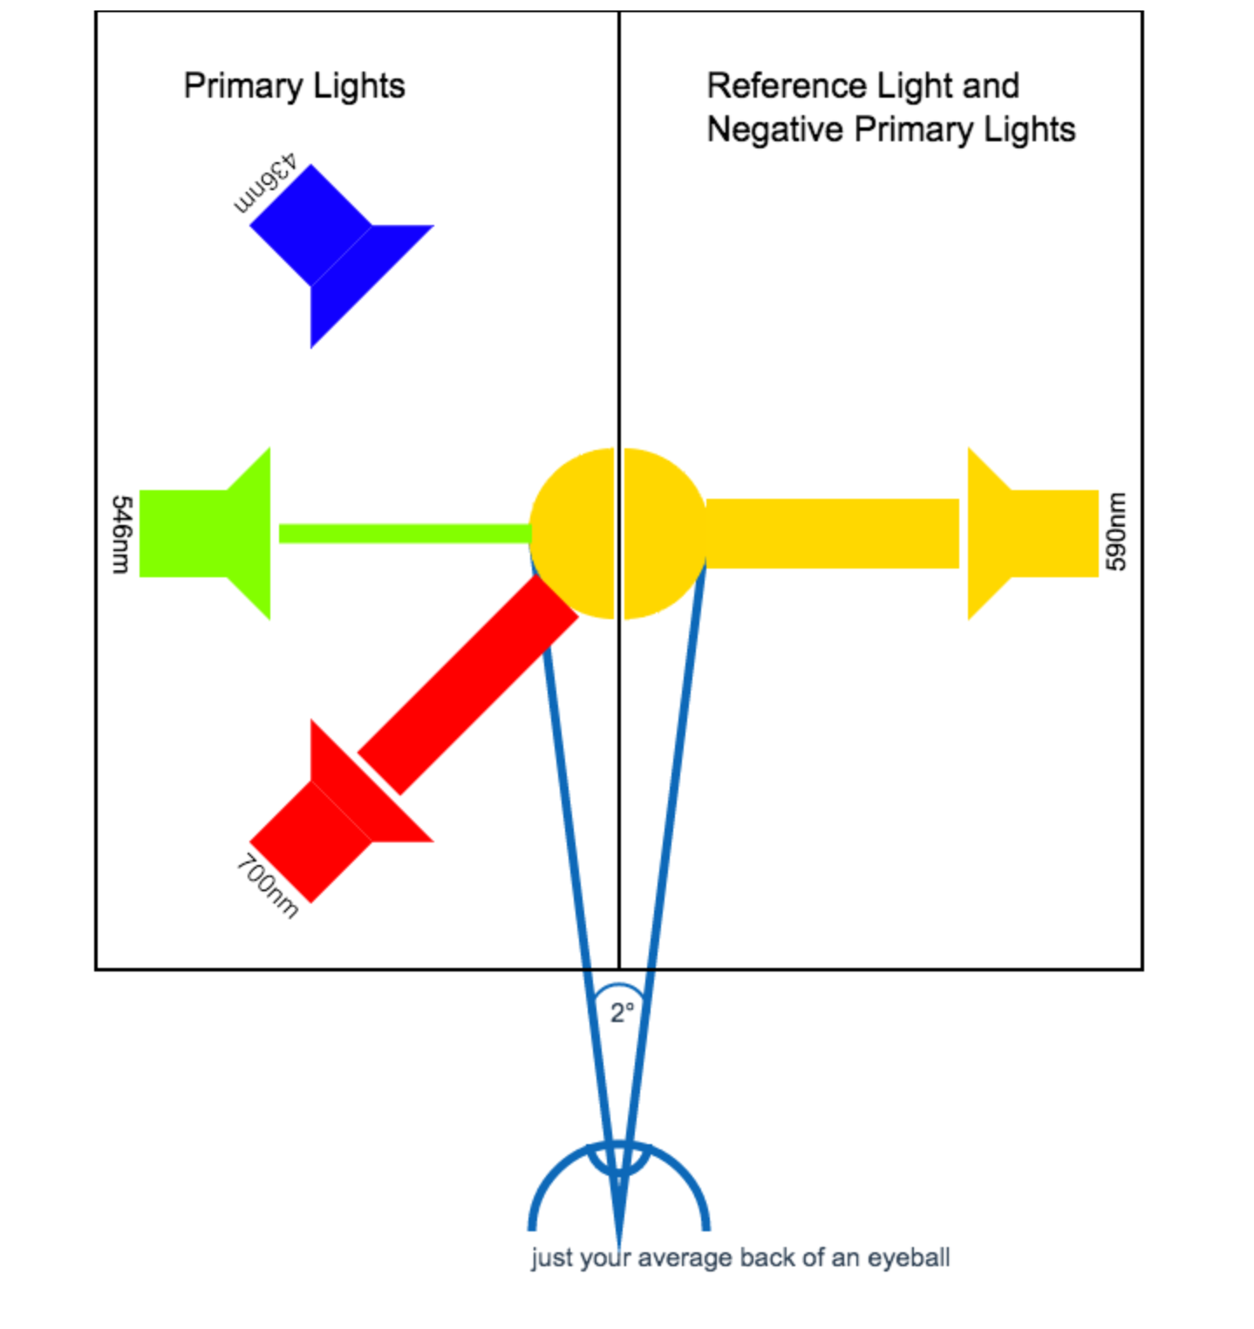
Task
Adjustment
Forced-choice task
N – number of stimuli presented
M – number of stimulus alternatives per trial
AFC – alternative forced choice
IFC – interval forced choice
MAFC
N = 1
M = 4
4AFC task
https://medium.com/hipster-color-science/a-beginners-guide-to-colorimetry-401f1830b65a

Slide 5
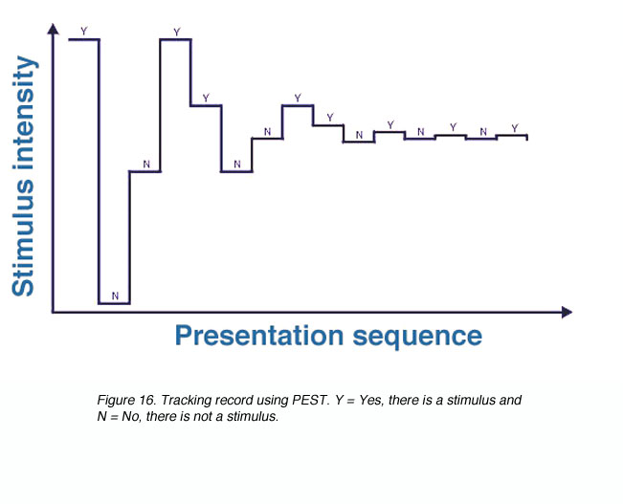
Method
Method of Constant
0.1cm:0.2cm:5cm
Method of Adjustment/Staircase
Set criteria
Ex. i.) minimum step of X, ii.) X consecutive trials at same level, iii.) maximum trials or time limit. (Rinderknecht et al., 2018)
https://webvision.med.utah.edu/imageswv/Kall06.jpeg

Slide 6
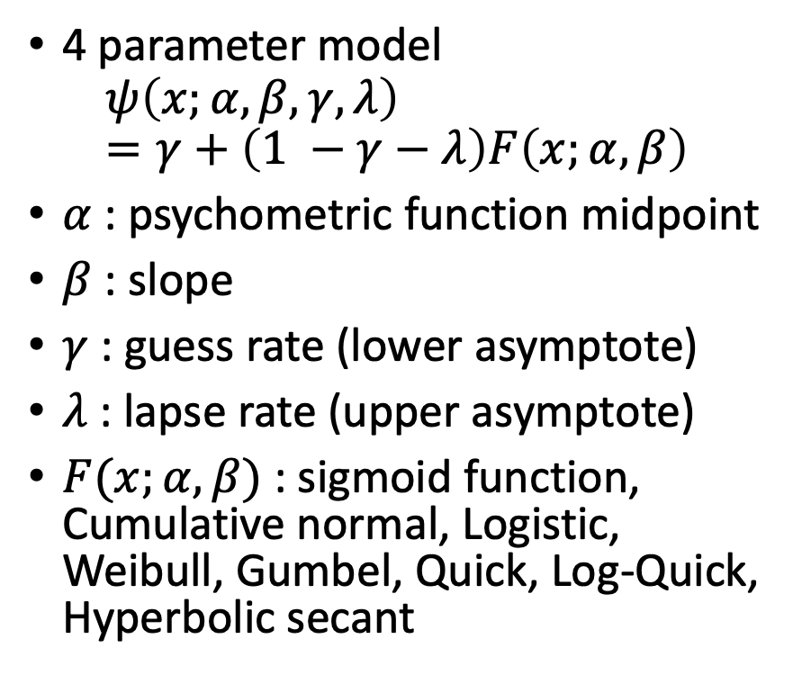
Analysis + Measure
4 parameter model
$$ψ\left(x;α, β, γ, λ\right)=γ+\left(1 −γ−λ\right)F\left(x;α,β\right)$$
$α$ : psychometric function midpoint
$β$ : slope
$γ$ : guess rate (lower asymptote)
$λ$ : lapse rate (upper asymptote)
$F(x;α, β)$ : sigmoid function, Cumulative normal, Logistic, Weibull, Gumbel, Quick, Log-Quick, Hyperbolic secant
Maximum Likelihood Criterion
Minimize the negative log likelihood
MathTools!
Bayesian Criterion
Allows one to add a prior
Previous literature/experiments
Pilot subjects
Minimize the negative log posterior?

Slide 7
Experimental design
Present stimulus (250 ms)
Force decision (left, right, up, down)
Intertrial interval 1000 ms
Repeat

Slide 8
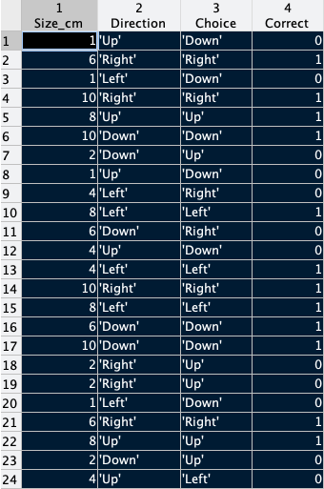
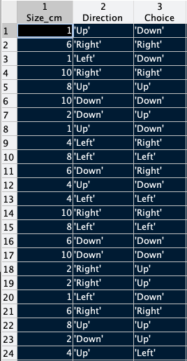
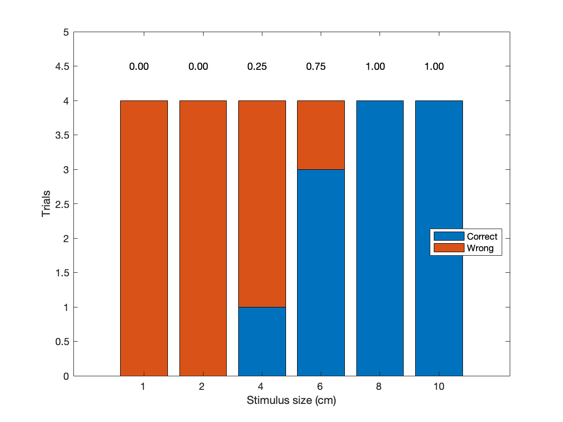
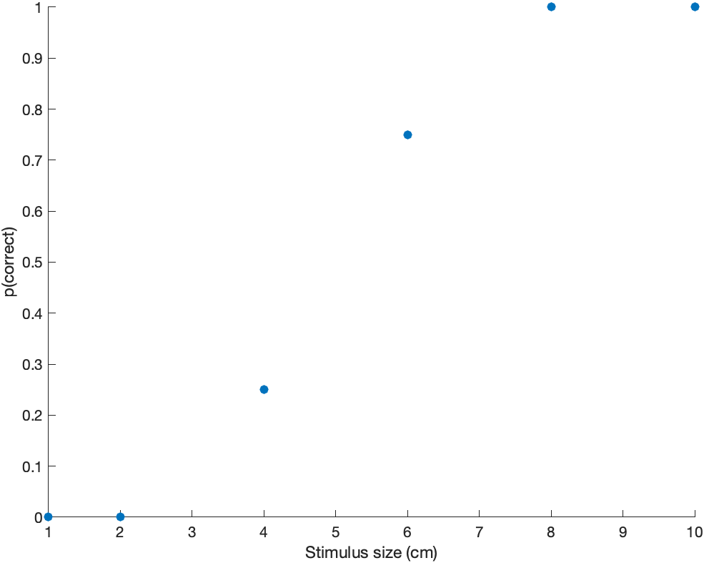
Data
4 trials x 6 sizes (randomly presented)
Determine correct/incorrect responses
Group data by stimulus size (x-axis) & Calculate p(correct) for each stimulus size

Slide 9
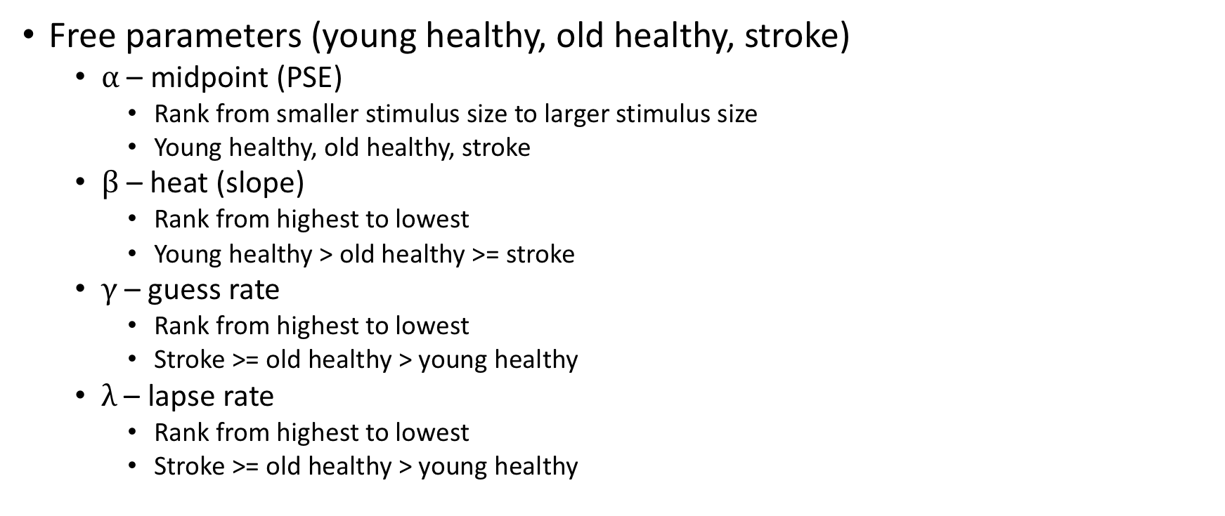
Hypothesis
Free parameters (young healthy, old healthy, stroke)
$α$ – midpoint (PSE)
Rank from smaller stimulus size to larger stimulus size
Young healthy, old healthy, stroke
$β$ – heat (slope)
Rank from highest to lowest
Young healthy > old healthy >= stroke
$γ$– guess rate
Rank from highest to lowest
Stroke >= old healthy > young healthy
$λ$ – lapse rate
Rank from highest to lowest
Stroke >= old healthy > young healthy

