Slide 1
Gifs and figures with transparent backgrounds
Duncan Tulimieri

Slide 2
MATLAB

Slide 3
MATLAB

Slide 4
MATLAB

Slide 5
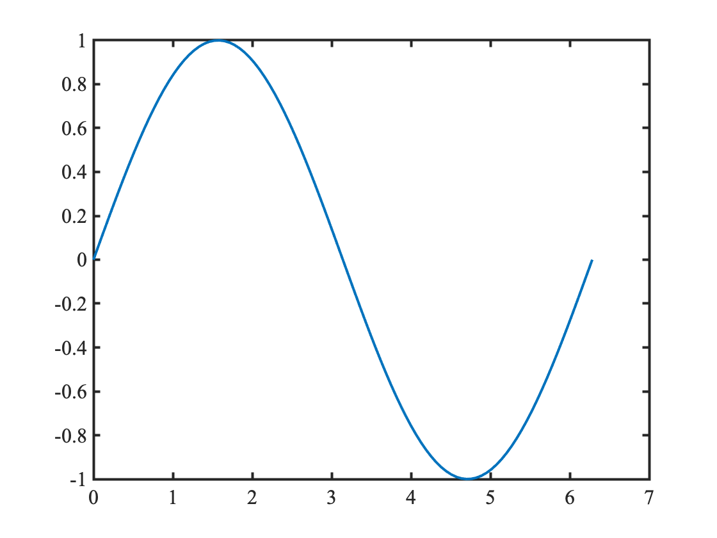
MATLAB

Slide 6
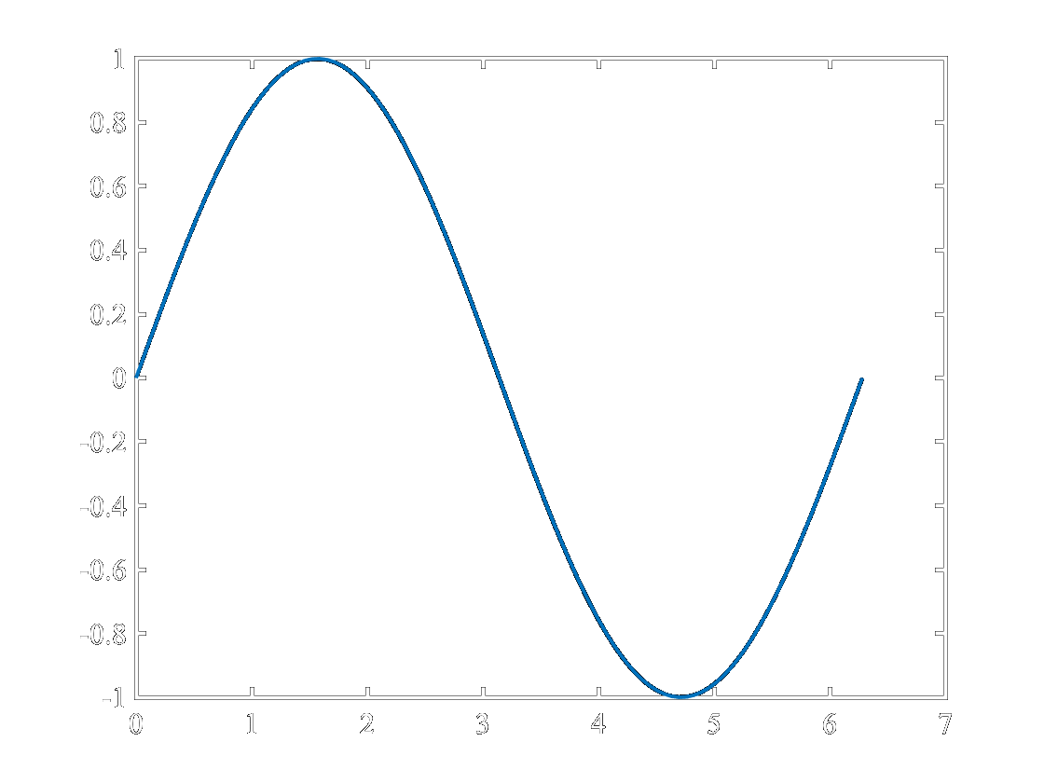
MATLAB

Slide 7
MATLAB

Slide 8
Python

Slide 9
Python

Slide 10
Python

Slide 11
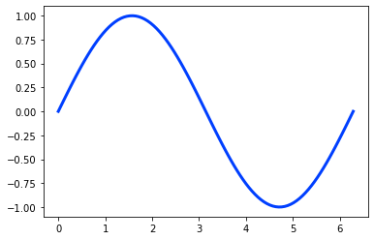
Python

Slide 12
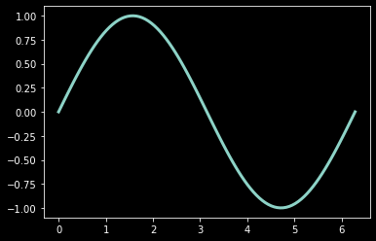
Python

Slide 13
Python

