Slide 1
MODEL-VIEW-CONTROLLER
TULIN DANIIL, 497, MIPT

Slide 2
DESCRIPTION
COMPONENTS
HISTORY
USE IN WEB APPS
CONTENT

Slide 3
MODEL–VIEW–CONTROLLER (MVC)
IS A SOFTWARE DESIGN PATTERN

Slide 4
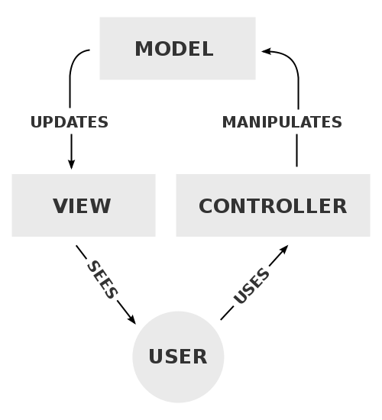
THE MODEL MANAGES THE DATA
A VIEW IS OUTPUT REPRESENTATION
THE CONTROLLER ACCEPTS INPUT

Slide 5
A MODEL STORES DATA THAT IS RETRIEVED ACCORDING TO COMMANDS FROM THE CONTROLLER AND DISPLAYED IN THE VIEW

Slide 6
A VIEW GENERATES NEW OUTPUT TO THE USER BASED ON CHANGES IN THE MODEL

Slide 7
A CONTROLLER CAN SEND COMMANDS TO THE MODEL TO UPDATE THE MODEL'S STATE

Slide 8
ARTICLE IN THE JOURNAL OF OBJECT TECHNOLOGY EXPRESS MVC AS A GENERAL CONCEPT IN 1988
THE MVC PATTERN HAS EVOLVED,^{[12]} GIVING RISE TO VARIANTS
SPRING (OCTOBER 2002, FOR JAVA)
RAILS (DECEMBER 2005, FOR RUBY)
DJANGO (JULY 2005, FOR PYTHON)
HISTORY

Slide 9
WEB MVC FRAMEWORKS TAKE A THIN CLIENT APPROACH

