Slide 1

covered
connected
confident

Slide 2
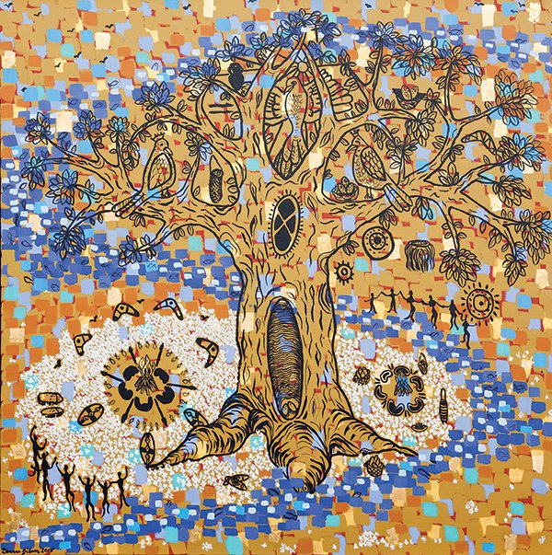
This artwork is titled ‘Cultural Tree of Knowledge’ by Deanne Gilson, a Wadawurrung Traditional Custodian and a PhD candidate at the Deakin NIKERI Institute

Slide 3
covered
connected
confident

Slide 4


Slide 5
.
.

Slide 7
Skill-based
Decision-based
Social engineering

Slide 9
covered
connected
confident

Slide 11
Methodological Overview:

Slide 12
)

Slide 13


Slide 19
covered
connected
confident

Slide 20
covered
connected
confident

