Slide 1
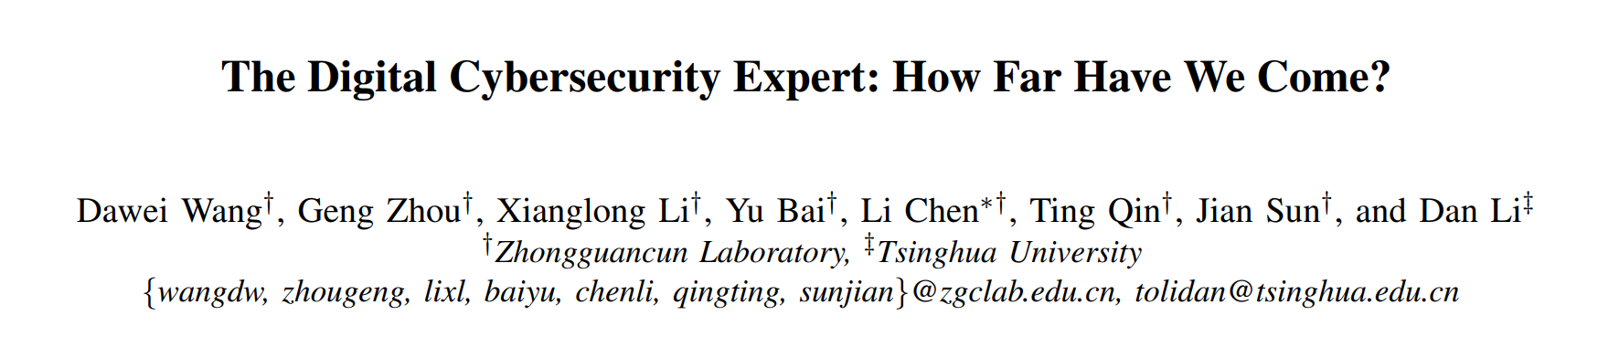
IEEE S&P 2025

Slide 2
Contents
1 Background
2 Motivation
3 Related Work
4 Contributions
5 Method
6 Experiments
7 Discussion
8 Conclusion

Slide 3
1 Background
With the rapid development of Large Language Models (LLMs), the concept of "digital cybersecurity experts" has gradually gained attention. Companies such as Microsoft and Google have launched related tools (e.g., Copilot for Security, Gemini in Security).
However, a key question remains: How far are current LLMs from becoming true digital cybersecurity experts? The answer to this question is crucial for understanding the capabilities and limitations of LLMs in this field and promoting their effective deployment.

Slide 4
1 Background
Existing studies mainly evaluate LLMs from two aspects: performance on specific security tasks and understanding of cybersecurity knowledge. However, they have the following limitations:
Lack of a comprehensive knowledge framework for cybersecurity experts.
Inability to identify specific knowledge gaps of LLMs
Mismatch between question design and knowledge mastery requirements
Notes:
现有研究主要从特定安全任务性能和网络安全知识理解两方面评估 LLMs，但存在以下不足：
L1：缺乏全面的网络安全专家知识框架：现有方法聚焦于特定技能或任务，未建立网络安全专家应具备的知识体系，导致评估问题缺乏深度，覆盖不全面。
L2：无法识别 LLMs 的具体知识缺口：现有评估较粗粒度，难以评估 LLMs 对特定知识点的理解，也无法明确其知识短板。即使发现任务性能不佳，也难以确定失败原因。
L3：问题设计与知识掌握要求不匹配：不同类型的知识点（如事实性、概念性、程序性知识）需要不同的评估方式，但现有评估常采用 “一刀切” 的设计，导致无法准确衡量 LLMs 对不同类型知识的掌握程度。

Slide 5
1 Background
To address the aforementioned limitations, the authors have developed CSEBenchmark, a fine-grained cybersecurity evaluation framework based on cognitive science. This framework aims to comprehensively assess LLMs' cybersecurity knowledge, clarify their strengths and weaknesses, and provide guidance for the effective application of LLMs in the cybersecurity domain.
Notes:
为解决上述局限，作者开发了基于认知科学的细粒度网络安全评估框架 CSEBenchmark，以全面评估 LLMs 的网络安全知识，明确其优势与不足，为 LLMs 在网络安全领域的有效应用提供指导。 翻译为英文

Slide 6
2 Motivation
To fill the gap in the existing evaluation of LLMs' cybersecurity capabilities, by constructing a systematic knowledge framework and evaluation tools, we aim to clarify the gap between LLMs and "digital cybersecurity experts" and promote their rational deployment and optimization in this field.
Notes:
为了填补现有 LLMs 网络安全能力评估的空白，通过构建系统的知识框架和评估工具，明确 LLMs 距离 “数字网络安全专家” 的差距，推动其在该领域的合理部署与优化

Slide 7
3 Related Work
Evaluations of Large Language Models (LLMs) generally fall into two categories:
Task-based assessments: These focus on models' performance in specific cybersecurity tasks.such as threat intelligence analysis , vulnerability management , and secure code generation. However, due to the lack of quantification of the knowledge required for tasks, such assessments struggle to clarify the reasons behind poor model performance, limiting targeted analysis.
Knowledge-based assessments:These evaluate models' understanding of knowledge in specific cybersecurity domains through formats like multiple-choice questions.such as SecQA, CyberMetric, SecEval, and CTIBench. Nevertheless, existing studies only assess based on fragmented knowledge and lack a comprehensive modeling of the knowledge and skills required of cybersecurity experts, failing to fully answer the core question: "How far are LLMs from becoming digital cybersecurity experts?"
Notes:
LLMs的评估通常分为任务型评估和知识型评估两类：
任务型评估：聚焦模型在特定网络安全任务中的表现，如威胁情报分析（评估实体识别、情报分类、摘要生成等能力）、漏洞管理（通过代码片段评估模型理解代码、调试、生成单元测试、识别漏洞和应用补丁的能力）、安全代码生成（评估生成代码的安全性）。但此类评估因缺乏对任务所需知识的量化，难以明确模型表现不佳的原因，限制了针对性分析。
知识型评估：通过选择题等形式评估模型对特定网络安全领域知识的理解，例如SecQA（基于《计算机系统安全》一书生成约200题评估安全原理知识）、CyberMetric（10,000题覆盖渗透测试、密码学等领域）、SecEval（2,126题来自教材和行业指南）、CTIBench（2,500题评估网络威胁情报知识）等。然而，现有研究仅基于碎片化知识进行评估，缺乏对网络安全专家所需知识与技能的全面建模，无法充分回答“LLMs距离成为数字网络安全专家还有多远”这一核心问题。

Slide 8
4 Contributions
New evaluation framework:This paper proposes CSEBenchmark, the first cognitive science-based cybersecurity knowledge assessment framework, which covers 345 knowledge points across 7 subdomains and includes 11,050 multiple-choice questions. It has been made publicly available for community use.
New findings：Evaluations of 12 mainstream LLMs reveal that the best-performing model achieves an accuracy of only 85.42% with existing knowledge gaps. After addressing these gaps, the correction rate for errors in relevant tasks is improved by up to 84%, and different models exhibit varying degrees of alignment with specific job roles.
Provide practical guidance:Different LLMs have unique knowledge gaps, and even larger models within the same series may underperform smaller models in certain knowledge points.
Notes:
新的评估框架：提出首个基于认知科学的网络安全知识评估框架 CSEBenchmark，涵盖 7 个子领域的 345 个知识点，含 11,050 道选择题，已公开供社区使用。
新发现：对 12 个主流 LLMs 评估发现，最佳模型准确率仅 85.42%，存在知识缺口，填补后相关任务错误修正率最高提升 84%，且不同模型与特定岗位匹配度不同。 提供实践指导：强调了根据不同网络安全角色的知识需求选择 LLMs 的重要性，为 LLMs 在网络安全领域的有效部署与优化提供了理论依据和实践参考。

Slide 9
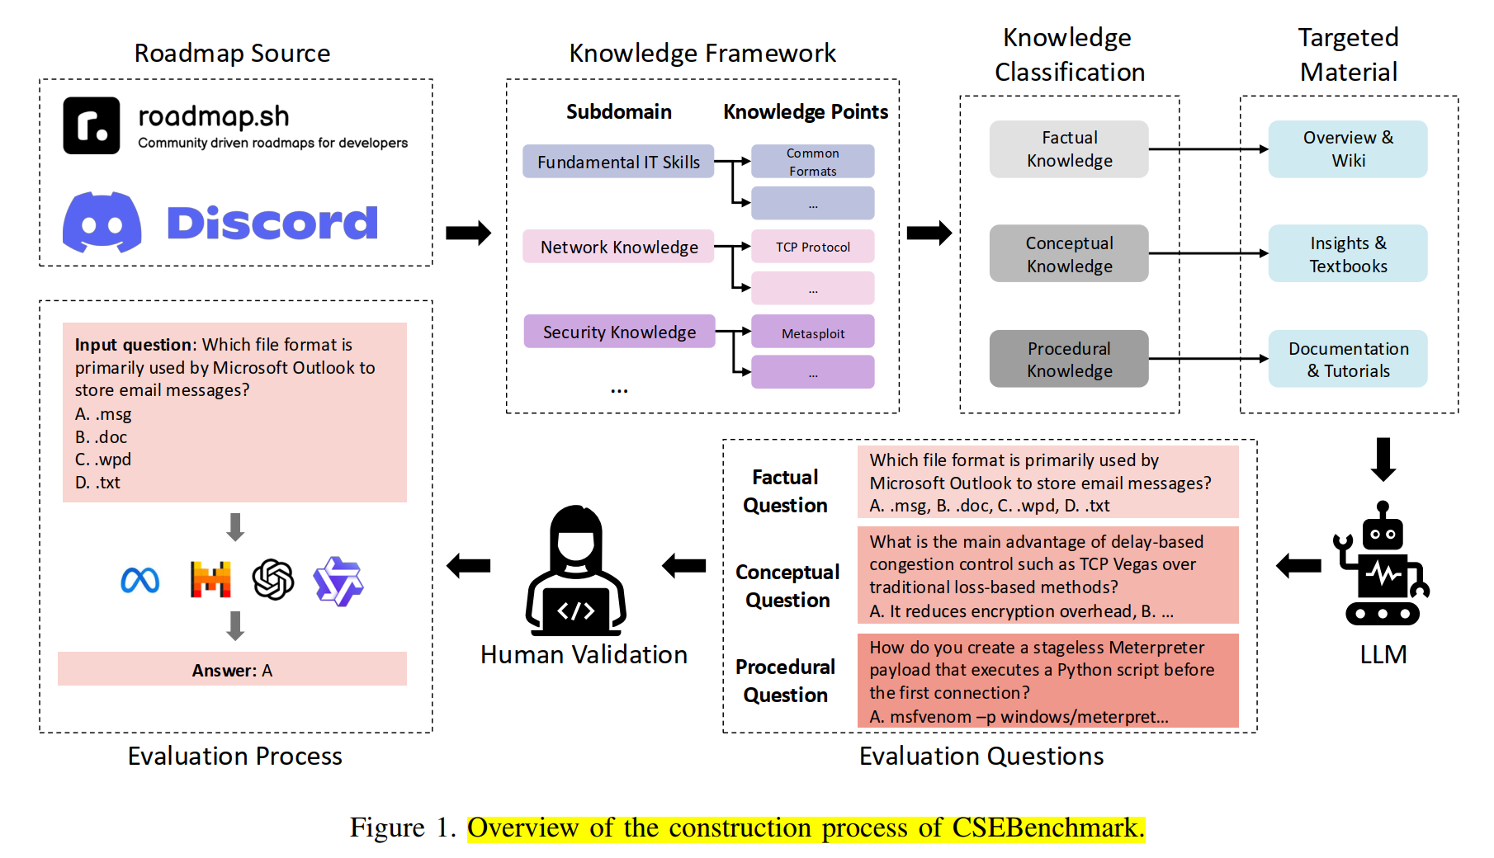
5 Method
Notes:
CSEBenchmark是基于认知科学的网络安全专家知识评估框架，是首个用于评估大型语言模型（LLMs）向数字网络安全专家演进能力的数据集，其构建过程分为四个步骤

Slide 10
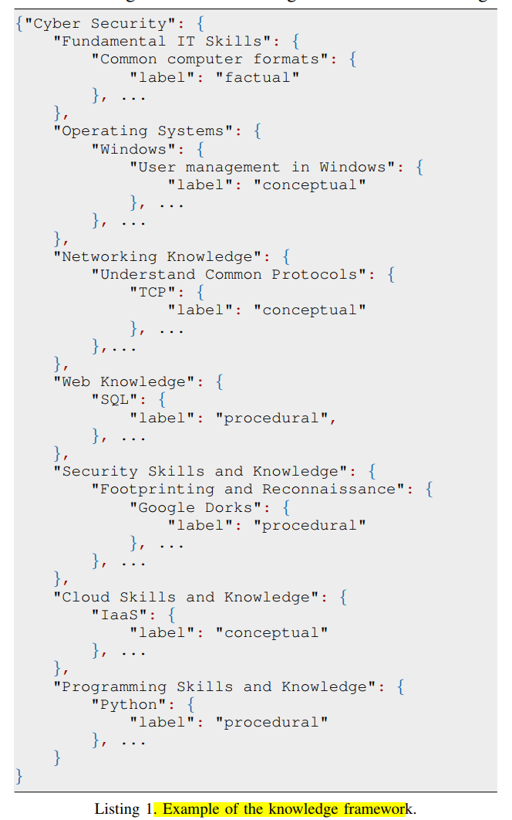
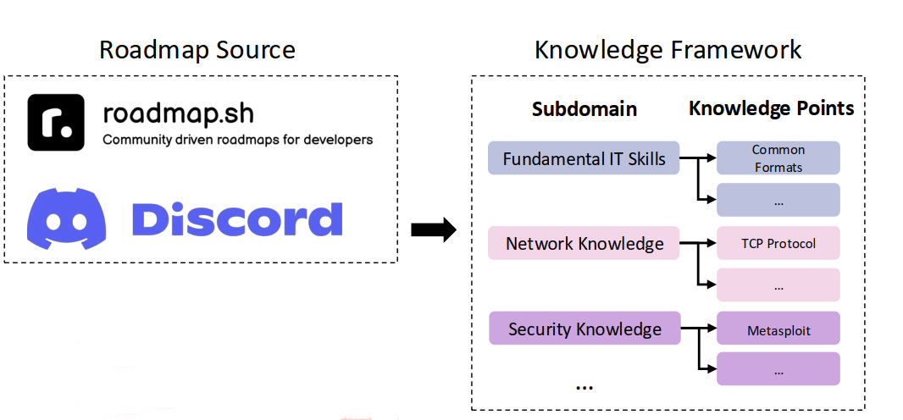
5 Method
5.1.Knowledge Framework
Three cybersecurity expert roadmaps as the basis: Cybersecurity Expert Roadmap and Ethical Hacker Roadmap from roadmap.sh,, and From Power Button to PWN: Computer Security Roadmap from the Hacking & Coding Discord community.
Seven subdomains：FIS、OS、NK、WK、SSK、CSK、PSK
This framework is organized in a hierarchical tree structure and finally forms 345 leaf nodes, representing the most specific knowledge points, enabling a fine - grained assessment of the knowledge of cybersecurity experts.
Notes:
为评估LLMs是否具备人类网络安全专家的知识，研究选取三个知名的网络安全专家路线图作为基础：GitHub上获得295k星标的roadmap.sh中的《网络安全专家路线图》《道德黑客路线图》，以及Hacking & Coding Discord社区的《从电源按钮到PWN：计算机安全路线图》。基于这些路线图，构建了涵盖7个子领域的知识框架，包括基础IT技能（FIS）、操作系统（OS）、网络知识（NK）、Web知识（WK）、安全技能与知识（SSK）、云技能与知识（CSK）、编程技能与知识（PSK）。该框架以层级树结构组织，最终形成345个叶子节点，代表最具体的知识点，实现对网络安全专家知识的细粒度评估。

Slide 11
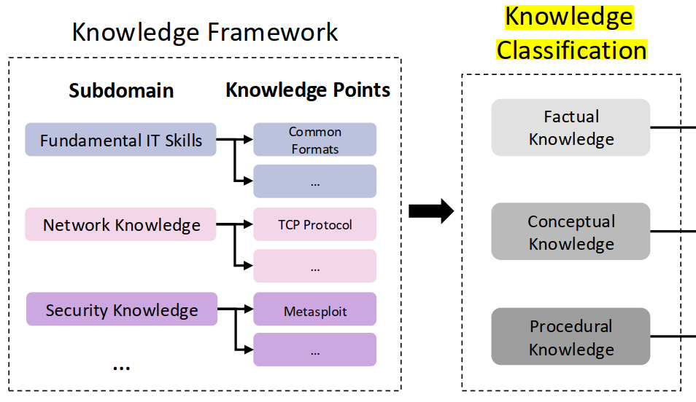
5 Method
5.2.Knowledge Classification
Based on the knowledge classification theory in cognitive science and combined with the characteristics of both theory and practice in the field of cybersecurity, the 345 knowledge points are divided into three categories:
Factual knowledge: Specific information that needs to be memorized, with a total of 121 knowledge points.
Conceptual knowledge: Theoretical knowledge that requires understanding of underlying principles, with a total of 136 knowledge points.
Procedural knowledge: Skills that need hands - on practice, with a total of 88 knowledge points.
The classification is completed by two cybersecurity practitioners. In case of disagreements, a senior expert makes the final decision to ensure alignment with actual application scenarios.
Notes:
依据认知科学的知识分类理论，结合网络安全领域兼具理论与实践的特点，将345个知识点分为三类：
事实性知识：需记忆的具体信息，共121个知识点；
概念性知识：需理解底层原理的理论知识，共136个知识点；
程序性知识：需动手实践的技能，共88个知识点。
分类由两名网络安全从业者完成，分歧时由资深专家裁决，确保与实际应用场景对齐。

Slide 12
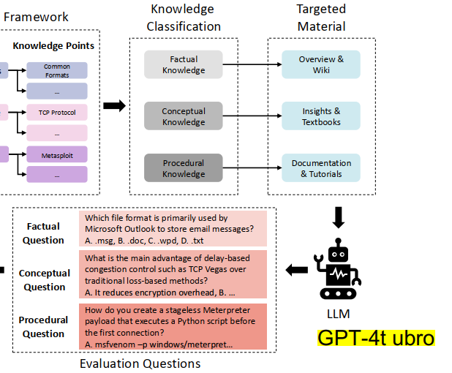
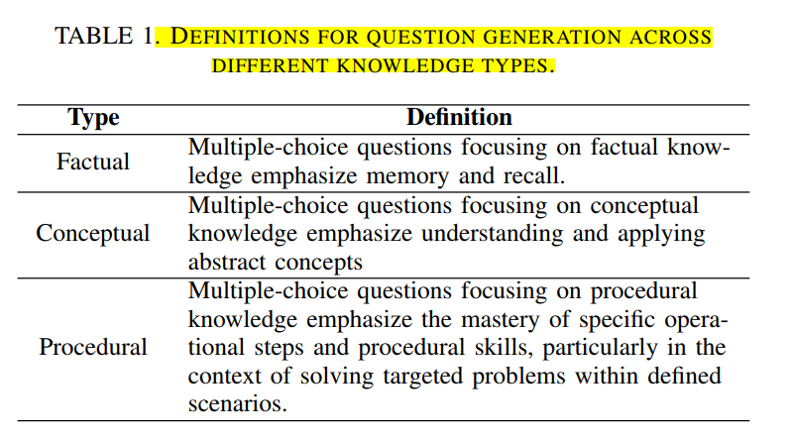
5 Method
5.3.Question Generation
The purpose of this table is to guide the GPT-4-Turbo model used for problem generation, enabling it to accurately generate problems that conform to various knowledge features
Material segmentation method: The study instead segments materials according to their chapter structure, ensuring that each section retains complete contextual integrity after segmentation.
Adaptive generation of question quantity: Materials of the same length may vary in information density. Materials with higher information density should generate more questions, while those with lower density should generate fewer; otherwise, it may result in redundant questions or insufficient coverage. Therefore, the study defines information density as the number of topics, and uses LLMs to first extract all topics from the materials, then generate 5 questions per topic. This achieves an adaptive match between the number of questions and the information density of the materials.
Notes:
该表的目的是指导用于生成问题的 GPT-4-Turbo 模型，使其能精准生成符合各类知识特征的问题 材料分割方式：
由于大语言模型（LLM）输入窗口有限，无法一次性处理全部材料，且过长材料可能导致模型忽略重要细节，因此需要分割材料。传统方法是设置令牌阈值切割材料，但这种方式可能破坏材料结构、丢失上下文信息。为此，研究改为按材料的章节结构分割，确保每个部分分割后仍保持完整的语境。
问题数量的自适应生成：
相同长度的材料信息密度可能不同（即包含的主题数量不同），信息密度高的材料应生成更多问题，反之则应生成更少问题，否则可能导致问题重复或覆盖不足。因此，研究将信息密度定义为主题数量，通过 LLM 先提取材料中的所有主题，再为每个主题生成 5 个问题，实现问题数量与材料信息密度的自适应匹配。

Slide 13
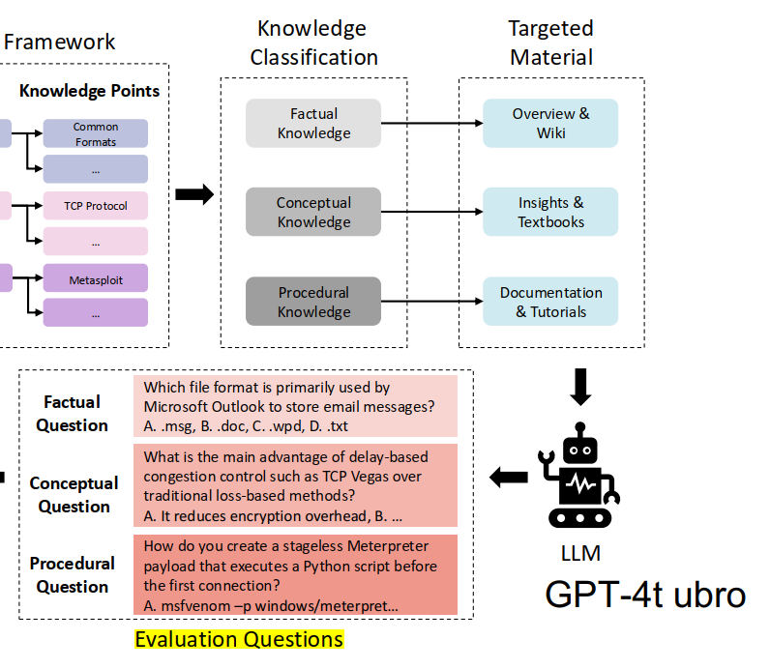
5 Method
5.3.Question Generation
Questions were generated using GPT-4-Turbo, with each question containing 1 correct answer and 3 distractors. In total, 11,743 questions were generated for 345 knowledge points. After removing duplicates based on semantic text similarity (with a threshold of 0.85), 11,468 unique questions were obtained, with a generation cost of $234.5.
Notes:
使用GPT-4-Turbo生成问题，每个问题包含1个正确答案和3个干扰项。最后345个知识点共生成11743个问题。经语义文本相似度去重（阈值0.85）后，得到11,468个独特问题，生成成本为234.5美元。 翻译为英文

Slide 14
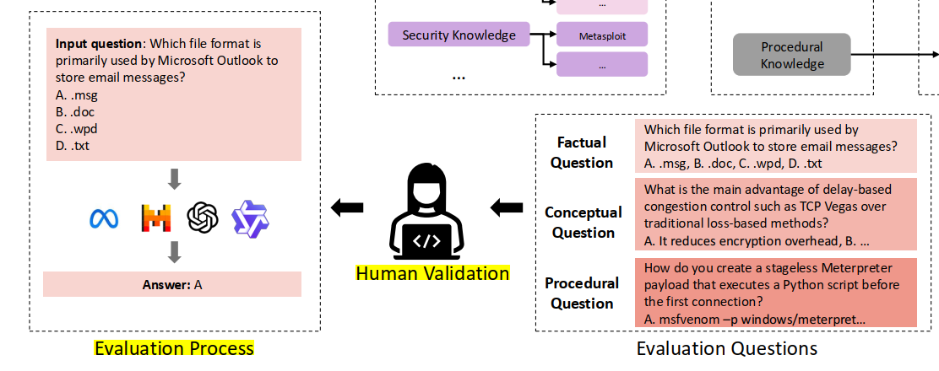
5 Method
5.4.Dataset Validation and Correction
Due to the hallucination issue in content generated by LLMs, a manual verification was conducted on the 11,468 questions (taking 672 person - hours). It was found that 1,726 questions had 8 types of problems, such as incorrect answers, multiple correct options, and missing context.
Notes:
由于LLM生成内容存在幻觉问题，对11,468个问题进行人工验证（耗时672人时），发现1,726个问题存在错误答案、多正确选项、上下文缺失等8类问题。

Slide 15
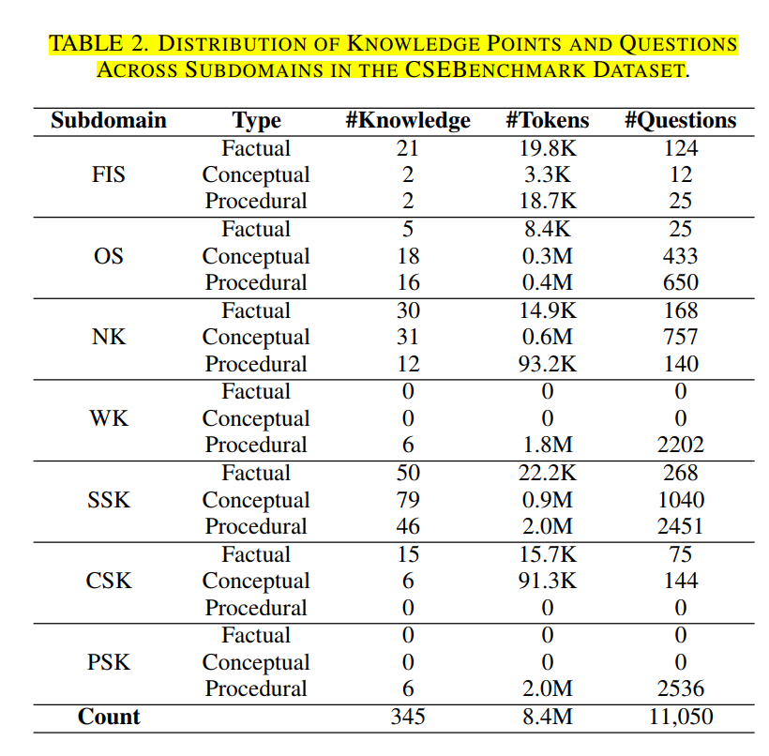
5 Method
5.4.Dataset Validation and Correction
Through manual correction (such as replacing incorrect answers and generating new distractors) and removing invalid questions, 11,050 high-quality multiple-choice questions were finally obtained.The dataset covers 7 subdomains. The distribution of questions is skewed due to differences in knowledge points designed by the roadmap and variations in corpus size. The specific distribution is as follows: 161 questions for Fundamental IT Skills (FIS), 1108 questions for Operating Systems (OS), 1065 questions for Network Knowledge (NK), 2202 questions for Web Knowledge (WK), 3759 questions for Security Skills and Knowledge (SSK), 219 questions for Cloud Skills and Knowledge (CSK), and 2536 questions for Programming Skills and Knowledge (PSK).
Notes:
通过人工修正（如替换错误答案、生成新干扰项）和移除无效问题，最终得到11,050个高质量选择题。
数据集涵盖7个子领域，问题分布因路线图设计的知识点差异及语料规模不同而有所倾斜，具体分布为：基础IT技能161题、操作系统1108题、网络知识1065题、Web知识2202题、安全技能与知识3759题、云技能与知识219题、编程技能与知识2536题。

Slide 16
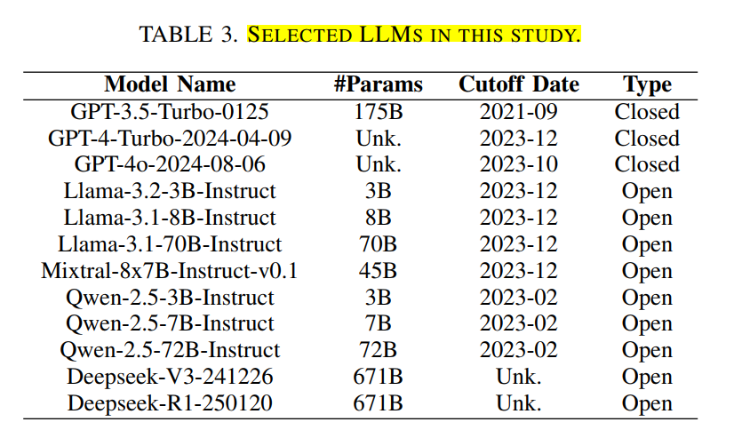
6 Experiments
6.1. Experiment Settings
LLM selection and configuration
Twelve mainstream LLMs were selected, with parameter scales ranging from 3B to 671B. They cover closed-source models (such as the GPT series) and open-source models (such as the Llama series and Deepseek series), including mixture-of-experts models (Mixtral 8×7B) and inference models (Deepseek-R1). These models were invoked through APIs or open-source frameworks, with the temperature parameter set to 0.2 to reduce the impact of random outputs.
Notes:
选取12个主流LLMs，参数规模从3B到671B，涵盖闭源（如GPT系列）和开源模型（如Llama系列、Deepseek系列），包括混合专家模型（Mixtral 8×7B）和推理模型（Deepseek-R1）。通过API或开源框架调用，设置温度参数为0.2以减少随机输出影响。

Slide 17
6 Experiments
6.1. Experiment Settings
Interaction methods: Three methods were adopted, namely Zero-shot, Few-shot (5-shot), and Chain-of-Thought (CoT). The best result was taken as the upper limit of the model's knowledge.
Measurement methods: Each question underwent 5 independent reasoning processes, and it was considered correct only when all reasoning results were correct. The system rotated the positions of options to ensure that the model relied on understanding rather than guessing. The xFinder tool was used to extract answers, with an accuracy rate of 92.47%.
Evaluation metrics: The accuracy rate of questions associated with knowledge points was used as the metric, which was divided into four levels (100%, [90%,100%), [80%,90%), <80%), representing complete mastery, near mastery, partial mastery, and weak links respectively.
Notes:
交互方法：采用Zero-shot、Few-shot（5-shot）和思维链（CoT）三种方法，取最佳结果作为模型知识上限。
测量方法：每个问题进行5次独立推理，仅当全部正确时视为正确；系统轮换选项位置，确保模型依赖理解而非猜测；使用xFinder工具提取答案，准确率达92.47%。
评估指标：以知识点关联问题的准确率为指标，分为四个等级（100%、[90%,100%)、[80%,90%)、<80%），分别代表完全掌握、接近掌握、部分掌握和薄弱环节。

Slide 18
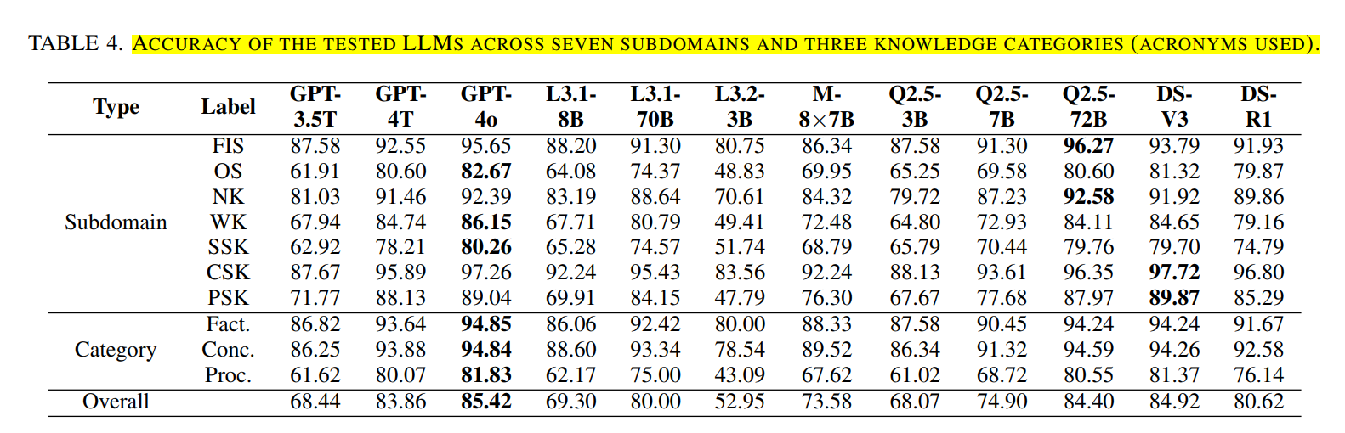
6 Experiments
6.2. LLM Cybersecurity Expertise Assessment
Overall performance: GPT-4o achieved the highest accuracy (85.42%), Deepseek-V3 took the lead among open-source models (84.92%), followed by Qwen-2.5-72B (84.40%); the worst-performing model, Llama-3.2-3B, had an accuracy of only 52.95%.
Notes:
整体表现：GPT-4o准确率最高（85.42%），Deepseek-V3在开源模型中领先（84.92%），Qwen-2.5-72B紧随其后（84.40%）；最差模型Llama-3.2-3B准确率仅52.95%。

Slide 19
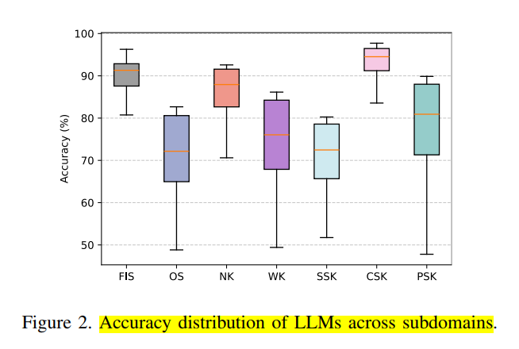
6 Experiments
6.2. LLM Cybersecurity Expertise Assessment
Subdomain differences: LLMs perform well in Fundamental IT Skills (FIS), Network Knowledge (NK), and Cloud Skills (CSK) with accuracy rates exceeding 90%, but show significant deficiencies in Operating Systems (OS), Web Knowledge (WK), Security Skills (SSK), and Programming Skills (PSK), with a median accuracy of approximately 72%.
Notes:
LLMs在基础IT技能（FIS）、网络知识（NK）、云技能（CSK）表现较好（准确率超90%），但在操作系统（OS）、Web知识（WK）、安全技能（SSK）、编程技能（PSK）存在明显不足（中位数约72%）

Slide 20
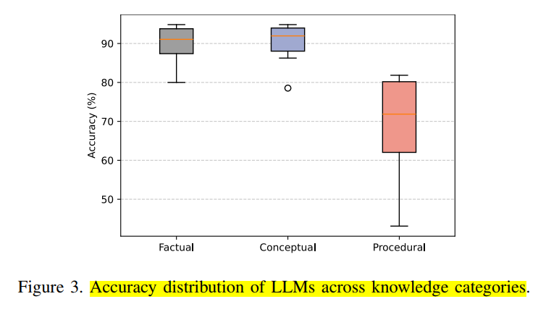
6 Experiments
6.2. LLM Cybersecurity Expertise Assessment
Differences in knowledge types: Factual knowledge (median accuracy 92%) and conceptual knowledge (92%) are well mastered, but there is a significant weakness in procedural knowledge (71.86%), especially in the use of professional tools and practical skills
Notes:
LLMs在基础IT技能（FIS）、网络知识（NK）、云技能（CSK）表现较好（准确率超90%），但在操作系统（OS）、Web知识（WK）、安全技能（SSK）、编程技能（PSK）存在明显不足（中位数约72%）

Slide 21
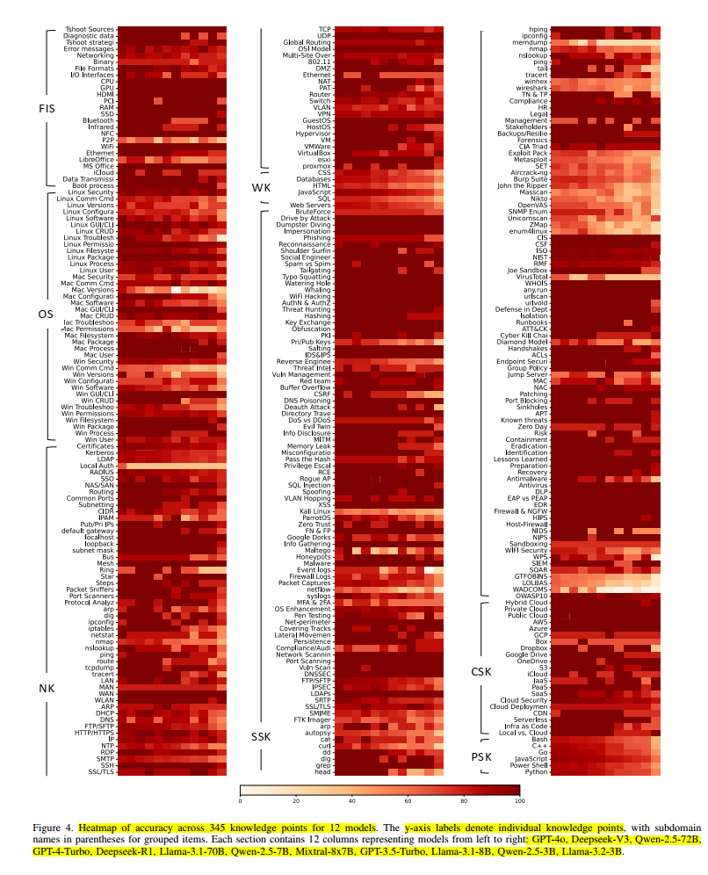
6 Experiments
6.2. LLM Cybersecurity Expertise Assessment
Knowledge point coverage: 241 knowledge points have reached the expert level (100% accuracy), and 35 are close to the expert level. These mainly include factual knowledge, conceptual knowledge, and high-frequency procedural knowledge, accounting for 80% of the total.
Notes:
知识点覆盖：241个知识点达到专家水平（100%准确率），35个接近专家水平，主要为事实性、概念性知识及高频程序性知识，占比80%。

Slide 22
6 Experiments
6.3. LLM Knowledge Gap Assessment
Overview of knowledge gaps: Although LLMs have reached or approached the level of cybersecurity experts in 276 knowledge points, there are still significant gaps in 69 knowledge points.
Partially mastered knowledge points (accuracy rate of 80% -90%):There are a total of 40 knowledge points that LLMs have partially mastered but still need to improve, including:
(1) 11 factual knowledge (such as basic coding, differences in operating system versions, threat intelligence, etc.);
(2) 11 conceptual knowledge (such as MacOS permission management, DNS, VPN, DDoS attacks, and other core concepts);
(3) 18 procedural knowledge (such as Linux/Windows system installation and configuration, use of nmap scanning tools, log analysis, introduction to reverse engineering, etc.).
Weak knowledge points (accuracy below 80%):There are a total of 29 knowledge points, and LLMs have significant room for improvement, including:
(1) 4 factual knowledge (such as P2P) and one conceptual knowledge (the difference between brute force cracking and password spraying), even if seemingly simple, the model understanding is still not solid (such as frequently answering incorrectly questions about security enhancement measures for local authentication);
(2) 24 procedural knowledge focused on the use of professional network security and forensic tools (such as Windows commands SQL).Due to their strong professionalism and insufficient representativeness in the pre training corpus, these tools are difficult for the model to effectively grasp..
Notes:
知识缺口概况：
尽管 LLMs 在 276 个知识点上达到或接近网络安全专家水平，但仍在 69 个知识点上存在明显缺口。
部分掌握的知识点（准确率 80%-90%）：
共 40 个知识点，LLMs 已部分掌握但仍需提升，包括：
11 个事实性知识（如基础编码、操作系统版本差异、威胁情报等）；
11 个概念性知识（如 MacOS 权限管理、DNS、VPN、DDoS 攻击等核心概念）；
18 个程序性知识（如 Linux/Windows 系统安装配置、nmap 扫描工具使用、日志分析、逆向工程入门等）。
薄弱知识点（准确率低于 80%）：
共 29 个知识点，LLMs 存在较大提升空间，包括：
4 个事实性知识（如 P2P、本地认证、VirusTotal、沙箱技术）和 1 个概念性知识（暴力破解与密码喷洒的区别），即使看似简单，模型理解仍不扎实（如本地认证的安全增强措施问题常答错）；
24 个程序性知识，集中在专业网络安全与取证工具的使用（如 Windows 命令、SQL、Kali Linux、Wireshark、Metasploit、Burp Suite 等），这些工具因专业性强、预训练语料中代表性不足，导致模型难以有效掌握。

Slide 23
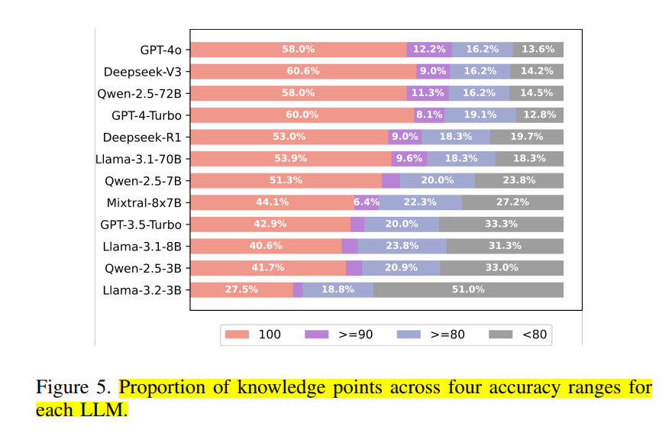
6 Experiments
6.3. LLM Knowledge Gap Assessment
Model-specific gaps:The gaps of different LLMs are distinctive. Even large models in the same series may be inferior to smaller models in terms of certain knowledge points (for example, Llama-3.1-70B performs worse than Llama-3.1-8B in the use of tcpdump).
Notes:
模型特异性缺口：不同LLM的缺口各具特点，即使同系列大模型也可能在某些知识点上不如小模型（如Llama-3.1-70B在tcpdump使用上不如Llama-3.1-8B）。

Slide 24
6 Experiments
6.4. Enhancing LLMs Through CSEBenchmark
Evaluate the dataset:VuldetectBench、SecLLMHolmes、CTI-RCM
Experimental model：Select the models with poor performance in the Llama series (Llama 3.1-8B, Llama 3.1-70B, Llama 3.2-3B) as the main enhancement objects; Add high-performance model GPT-4o to verify whether high-performance models can also benefit from enhancement
Enhancement method：The Retrieval-Augmented Generation (RAG) technique is adopted to directionally supplement knowledge based on the knowledge gaps identified by CSEBenchmark:
(1) Initial evaluation: First, test the performance of the original models on the 3 datasets and record all instances of incorrect predictions.
(2)Extraction of knowledge gaps: Screen out knowledge points with an accuracy rate below 90% for each model from CSEBenchmark (i.e., knowledge gaps).
(3)Construction of knowledge retrieval library: Build a vector database for each model using Milvus, storing question-answer pairs related to knowledge gaps from CSEBenchmark; use the BGE-M3 model for embedding processing.
(4)Directional enhanced reasoning: When re-evaluating the previous incorrect instances, first query the vector database using task instructions, retrieve the top 5 most relevant pieces of knowledge, and incorporate them into the original prompt (with the instruction "Please use the following retrieved context to answer the question") to help the models fill in the gaps.
Notes:
二、实验设计
评估数据集：选择 3 个主流的安全领域任务数据集，用于测试模型性能：
VuldetectBench：含 1000 个真实漏洞代码片段，聚焦漏洞检测；
SecLLMHolmes：含 15 组 CVE（漏洞编号）的补丁前后代码样本，结合 4 种提示策略共 120 个案例，同样用于漏洞检测；
CTI-RCM：含 2024 年的 1000 条 CVE 描述，通过评估模型将漏洞映射到对应 CWE（常见弱点枚举）分类的准确率，测试威胁情报分析能力。
实验模型：
选取 Llama 系列中表现较差的模型（Llama-3.1-8B、Llama-3.1-70B、Llama-3.2-3B）作为主要增强对象；
加入高性能模型 GPT-4o，验证高表现模型是否也能从增强中受益。
三、增强方法（核心步骤）
采用检索增强生成（RAG） 技术，基于 CSEBenchmark 识别的知识缺口定向补充知识：
初始评估：先测试原始模型在 3 个数据集上的表现，记录所有错误预测实例；
提取知识缺口：从 CSEBenchmark 中筛选出各模型准确率低于 90% 的知识点（即知识缺口）；
构建知识检索库：为每个模型用 Milvus 构建向量数据库，存入 CSEBenchmark 中与知识缺口相关的问答对；用 BGE-M3 模型进行嵌入处理；
定向增强推理：对之前的错误实例重新评估时，先用任务指令查询向量库，检索最相关的前 5 条知识，加入提示中（附指令 “请用以下检索到的上下文回答问题”），帮助模型填补缺口。

Slide 25
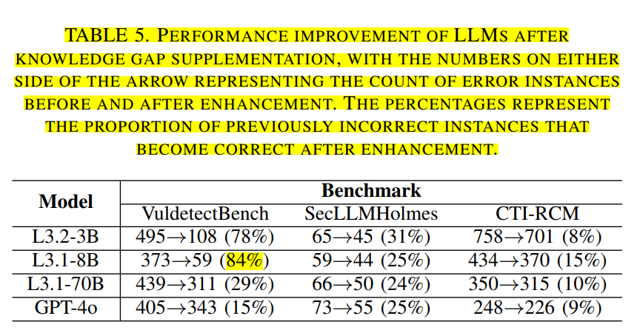
6 Experiments
6.4. Enhancing LLMs Through CSEBenchmark
Experimental result：In three network security benchmark tests (Vuldetectability Bench, SecLLMHolmes, Threat Intelligence Analysis CTI-RCM), after filling the gap, the error prediction correction rate of LLMs was as high as 84% (Llama-3.1-8B in Vuldetectability Bench), verifying the effectiveness of gap identification
Conclusion:The knowledge gaps identified by CSEBenchmark can be effectively used to improve the performance of LLMs in security tasks, and even if the retrieved knowledge does not fully match the task requirements, it can still be helpful; Optimizing RAG design in the future can further enhance its effectiveness.
Notes:
四、实验结果（表 5 数据）
所有模型在三个数据集上的性能均有提升，验证了 CSEBenchmark 识别的知识缺口的有效性：
提升幅度最高达 84%（Llama-3.1-8B 在 VuldetectBench 上，错误实例从 373 个降至 59 个）；
具体案例：Llama-3.2-3B 和 Llama-3.1-8B 在 “C++ 指针安全” 上存在知识缺口，补充相关问答对（如 “删除指针指向的内存后应设为 nullptr 避免悬垂指针”）后，模型能更准确识别代码中指针操作和内存释放相关的漏洞；
跨领域知识也有帮助：例如 Go 语言中 “空指针解引用” 的问答对，能辅助模型识别 C++ 中的同类漏洞；
高表现模型（如 GPT-4o）也有提升（15%-25%），但幅度低于低表现模型。
五、结论（Finding 7）
CSEBenchmark 识别的知识缺口可有效用于提升 LLMs 在安全任务中的性能，且即使检索到的知识不完全匹配任务需求，仍能带来帮助；未来优化 RAG 设计可进一步提升效果

Slide 26
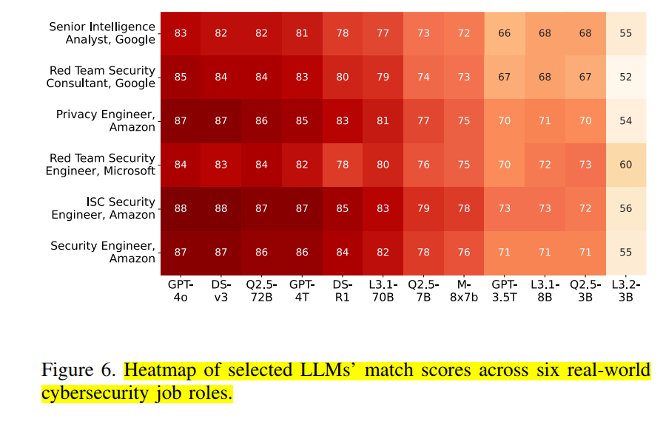
6 Experiments
6.5. LLM Job Role Assessment
Role selection：Six real-world cybersecurity roles (such as Google Senior Intelligence Analyst and Amazon Privacy Engineer) were evaluated. The role requirements were mapped to the knowledge points in CSEBenchmark, and matching scores were calculated.
Matching results:GPT-4o achieved the highest score in roles like Google Senior Intelligence Analyst, while Deepseek-V3 stood out in roles such as Amazon Privacy Engineer. However, the highest matching score of all models was below 90%, failing to fully meet professional requirements.
Notes:
角色选取：评估6个真实网络安全角色（如谷歌高级情报分析师、亚马逊隐私工程师），将角色要求映射到CSEBenchmark知识点，计算匹配得分。
匹配结果：GPT-4o在谷歌高级情报分析师等角色中得分最高，Deepseek-V3在亚马逊隐私工程师等角色中表现突出，但所有模型的最高匹配得分均低于90%，未完全满足职业需求。

Slide 27
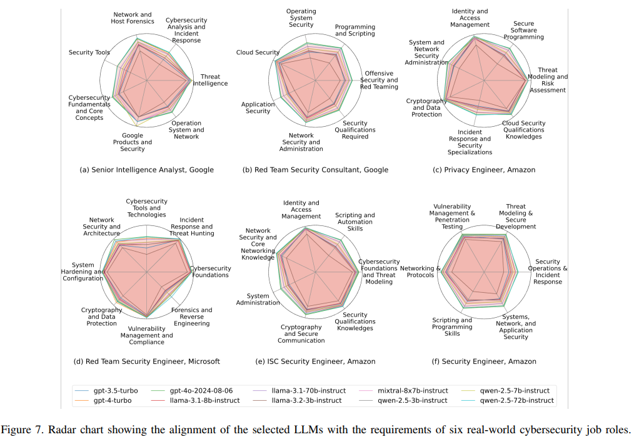
6 Experiments
6.5. LLM Job Role Assessment
Role specificity gap:Different roles have unique gaps, such as Google's senior intelligence analyst lacking in "network security analysis and incident response" and "security tool usage", and Microsoft's red team security engineers weak in "network security tool technology" and "forensics and reverse engineering".
Notes:
角色特异性缺口：不同角色存在独特缺口，如谷歌高级情报分析师在“网络安全分析与事件响应”“安全工具使用”上不足，微软红队安全工程师在“网络安全工具技术”“取证与逆向工程”上薄弱。

Slide 28
7 Discussion
Potential Cyclic Usage and Model Bias:Validated GPT-4-Turbo: Though it generated questions and gave answers, manual checks of 500 random questions showed questions were based on provided corpus (unaccessible during answering), ensuring no unfair cyclic use and credible results. Comparing topic extraction of models on specific knowledge points revealed consistent semantic - space topic distributions, with no topic - selection bias in GPT-4-Turbo’s question - generation.
Limitations and Future Work：Current knowledge framework, based on 3 public roadmaps, lacks coverage in areas like hardware security; future work includes expanding via expert interviews. Questions per knowledge point come from a single official source – more materials will be added. Only 3 prompting methods were used – advanced ones will be introduced. The xFinder tool has an 8% answer - extraction error rate – accuracy needs improvement. Due to varying model knowledge cutoffs, new materials may only be in some models’ training data. The study focuses on identifying LLMs’ current knowledge gaps. As LLMs evolve fast, conclusions may become outdated, requiring continuous evaluation.
Notes:
该部分主要围绕研究中潜在的周期性使用、模型偏差问题，以及CSEBenchmark的局限性和未来工作方向展开讨论。
5.1 潜在的周期性使用与模型偏差
周期性使用验证：GPT-4-Turbo既用于生成问题又参与回答，但通过人工检查500个随机问题，确认其生成的问题均基于提供的语料，且回答时无法访问该语料，因此不存在不公平的周期性使用，结果可信。
模型偏差评估：为验证GPT-4-Turbo生成问题时是否存在主题选择偏差，对比其与GPT-4o、Llama-3.1-70B、Qwen-2.5-72B在三个知识点（Kerberos、Packet Sniffer、Nikto）上的主题提取结果，发现语义空间中的主题分布一致，未观察到偏差。
5.2 局限性与未来工作
知识框架局限性：当前框架基于三个公开路线图，可能对硬件安全等专业领域覆盖不足，未来计划通过采访网络安全专家扩展知识点，以适应新兴需求。
单一来源限制：每个知识点的问题仅基于单一官方来源生成，可能无法全面覆盖知识范围，未来将补充更多相关材料。
提示技术优化：评估中仅使用Zero-shot、Few-shot和CoT三种提示方法，未来计划引入更先进的提示技术，更全面地评估LLM能力。
答案提取工具误差：依赖xFinder工具提取答案，存在8%的误差率，未来需提升其准确性以确保评估结果的公平性。

Slide 29
8 Conclusion
To assess large language models' (LLMs) knowledge gaps in acting as digital cybersecurity experts, this study built a cybersecurity knowledge model with 345 fine-grained knowledge points (based on cognitive science) and a benchmark dataset CSEBenchmark containing 11,050 questions.
Evaluation of 12 mainstream LLMs shows current models' highest overall accuracy is only 85.42%, with significant gaps in procedural knowledge like professional tool use and obscure commands. Knowledge gaps vary across LLMs; even large models in the same series may underperform smaller ones on certain points.
Filling these gaps improved error correction rates by up to 84% in two cybersecurity tasks (vulnerability detection, threat intelligence analysis) across three existing benchmarks, validating the findings.
In summary, this study identifies current LLMs' capabilities and limitations in cybersecurity, providing key evaluation basis for developing "digital cybersecurity experts."
Notes:
为评估大型语言模型（LLMs）在承担数字网络安全专家角色时的知识缺口，本研究基于认知科学构建了一个涵盖345个细粒度知识点的网络安全知识模型，并构建了包含11,050道题目的基准数据集CSEBenchmark。
对12个主流LLM的评估显示，当前模型的整体准确率最高仅为85.42%，在专业工具使用、冷门命令等程序性知识方面存在显著缺口。不同LLM的知识缺口各具特点，即便同系列的大型模型，在某些知识点上也可能不如小型模型表现出色。
通过填补这些知识缺口，在三个现有基准测试中，两个网络安全任务（漏洞检测、威胁情报分析）的错误预测修正率最高提升84%，验证了研究发现的有效性。
综上，本研究明确了当前LLMs在网络安全领域的能力与局限，为“数字网络安全专家”的发展提供了关键评估依据。

Slide 30
Thank you

