Slide 1
Hackathon Presentation Topic- Identify New Bikes
<BUG BUSTERS/>

Slide 2
Team Members
NAME | EMPLOYEE ID
SUBHAM HATI | 891151
TULIREKHA BANERJEE | 889821
SOHINI SENGUPTA | 891161
SUBHADEEP BASU | 891158
SUMAN MONDAL | 891105

Slide 3
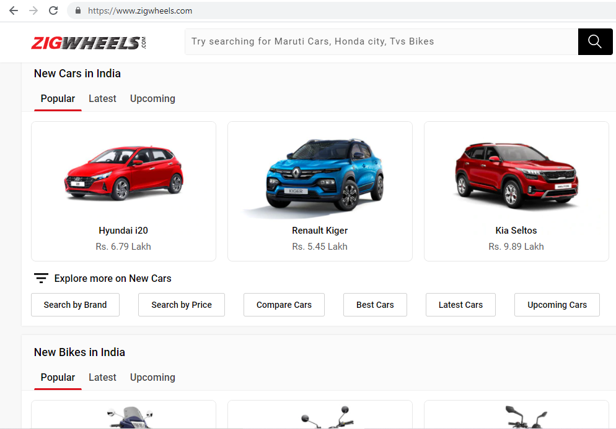
Website:
https://www.zigwheels.com/

Slide 4
TOOLS & TECHNOLOGY USED:
01. Selenium with Java in Eclipse
02. TestNG
Selenium is a portable framework for testing web applications. Selenium provides a playback tool for authoring functional tests.
TestNG is a testing framework for the Java programming language created by Cédric Beust and inspired by JUnit and NUnit.
03. Maven
04. POM with POI
05. Jenkins
Maven is a build automation tool used primarily for Java projects.
A Project Object Model or POM is the fundamental unit of work in Maven. It is an XML file that contains information about the project.
Jenkins – an open source automation server which enables developers around the world to reliably build, test, and deploy their software.

Slide 5
Work Done:
1. The Code is written in JAVA and is automated in different browsers with the help of Selenium. The project and dependencies are managed with the help of Maven.
3. Input data is obtained from properties file and from excel sheet with the help of Apache POI.
2. POM is used to create classes for each page therefore reducing usage of same code for various objects.
4. Jenkins is used for continuous integration of various versions of the code.

Slide 6
Requirements and Execution Steps:
Display "Upcoming" bikes details like bike name, price and expected launch date in India, for manufacturer 'Honda' & Bike price should be less than 4Lac.
For Used cars in Chennai, extract all the popular models in a List; Display the same
Try to 'Login' with google, give invalid account details & capture the error message
Display new bikes from Honda manufacturer
Search in search bar
Display upcoming bikes under 4lacs and also under 2 lacs by storing them in array and writing in excel sheet
Go to Used cars drop down and select the following cities: Chennai, Bangalore, Kolkata
Extract the displayed options and write them in excel sheet
Click on Login button in Homepage
Login to google with invalid credentials and capture screenshot
Login to facebook with invalid credentials and write the error message in extend report

Slide 7
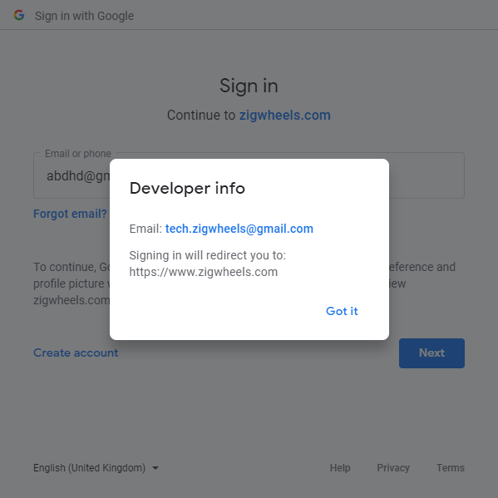
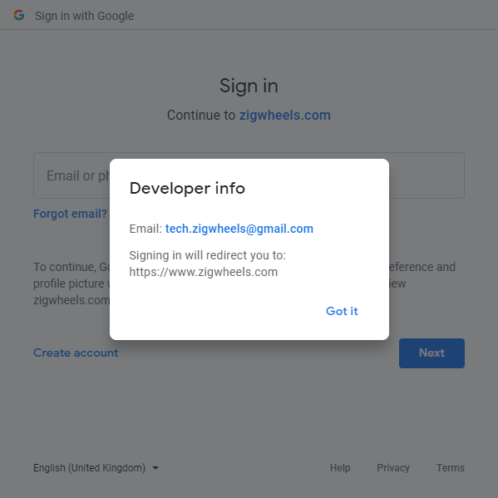
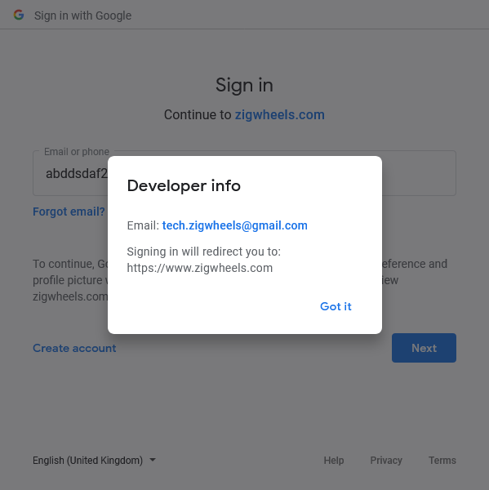
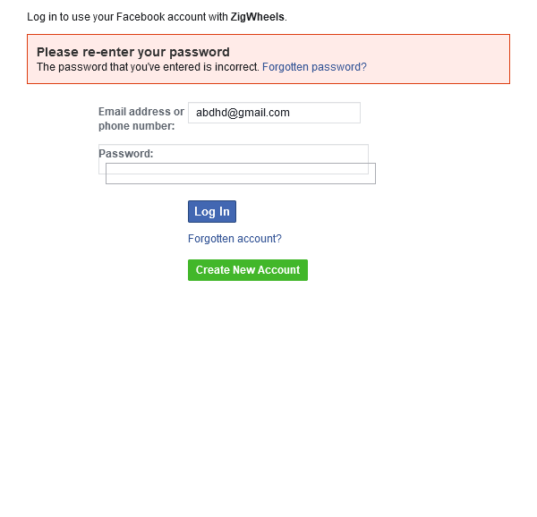
Screenshots:

Slide 8
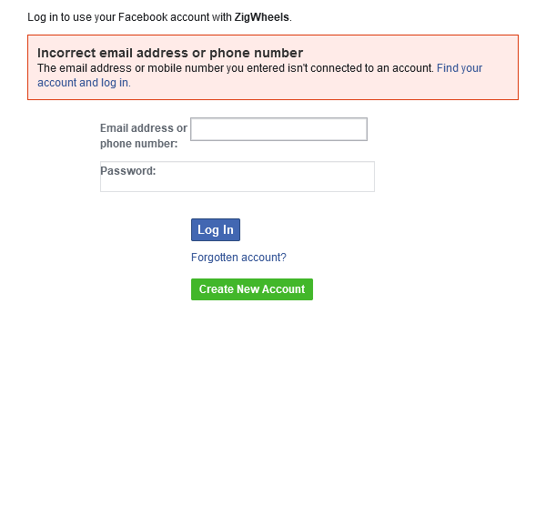
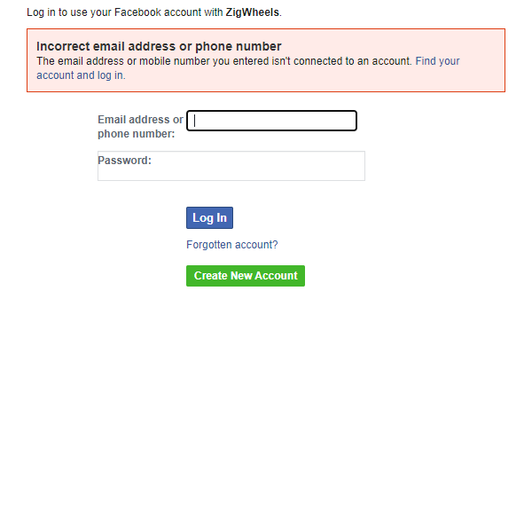
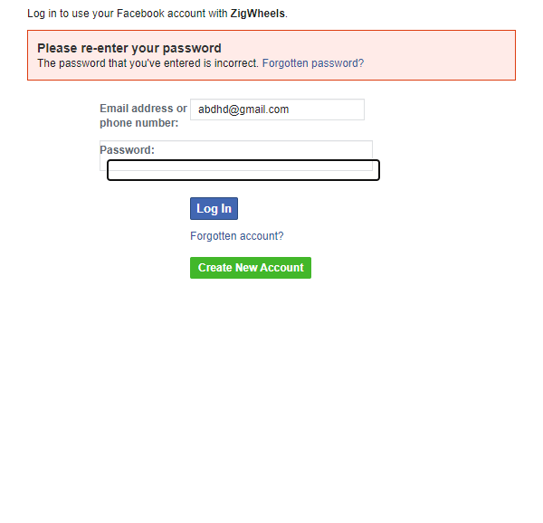
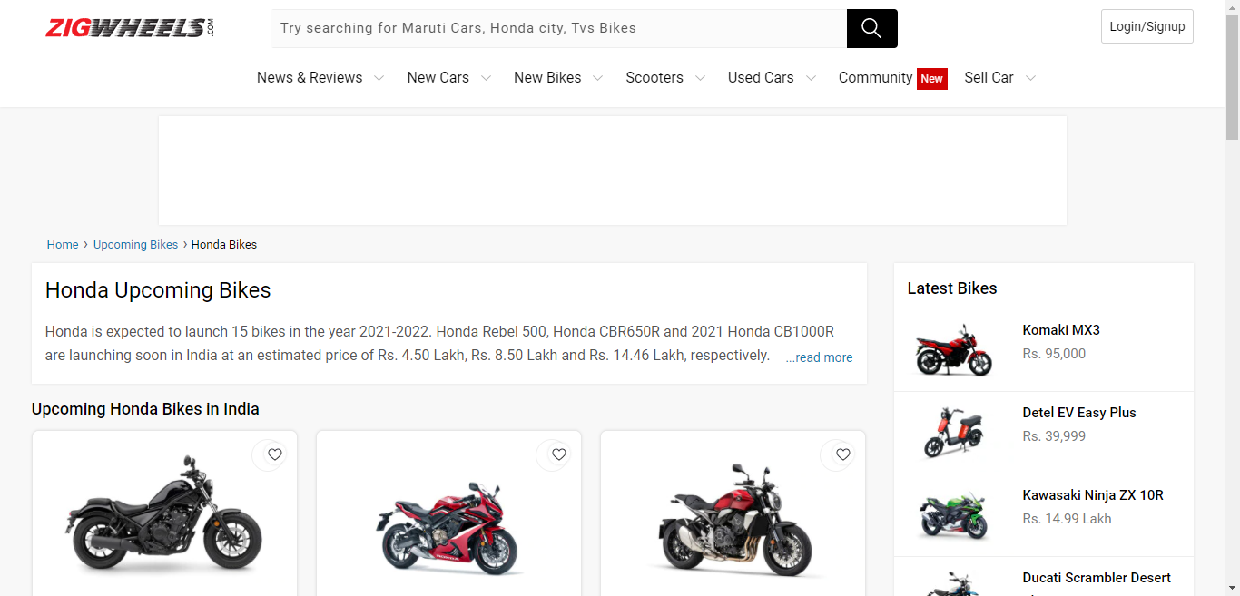
Screenshots:

Slide 9
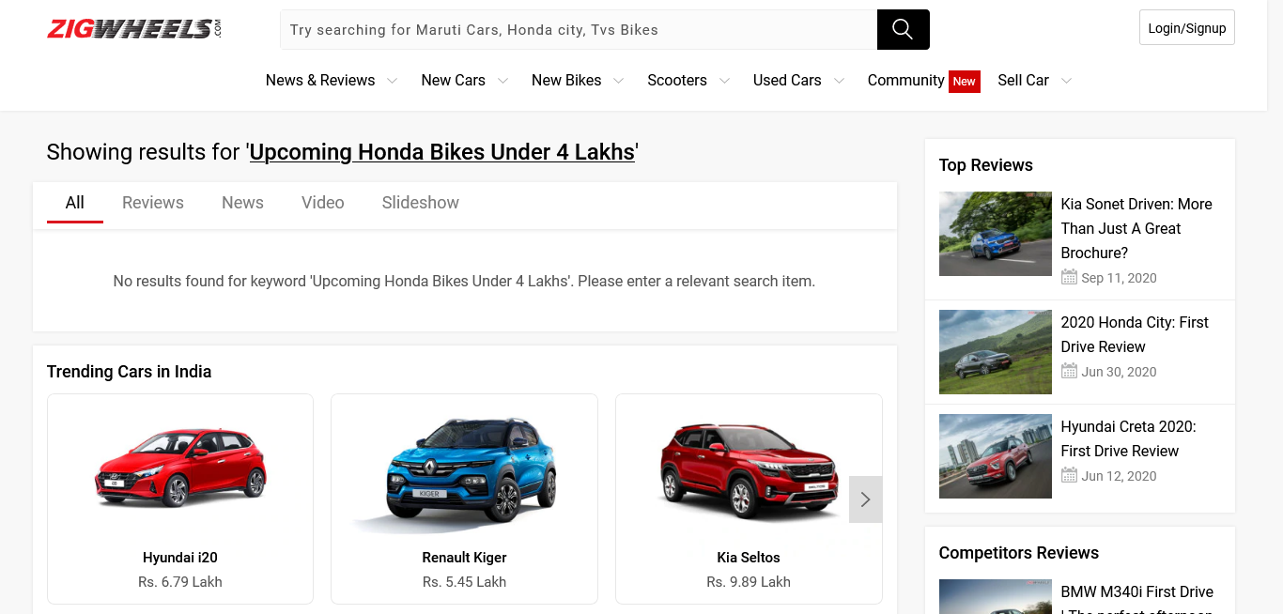
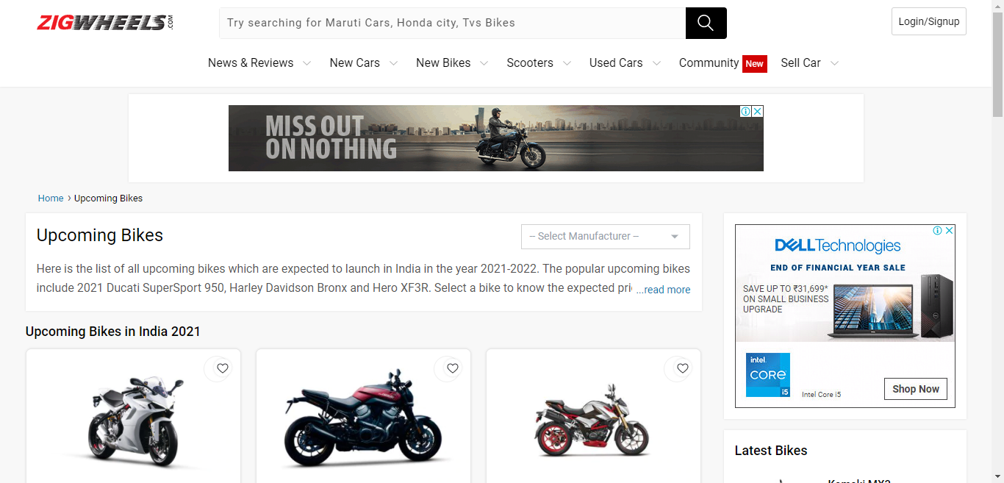
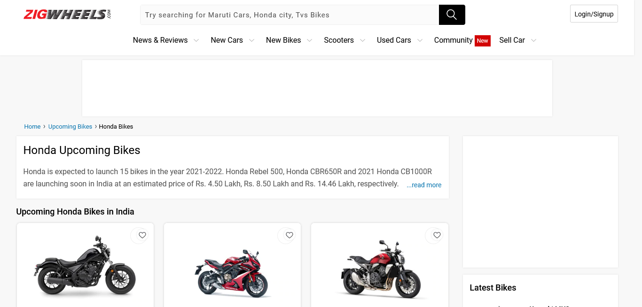
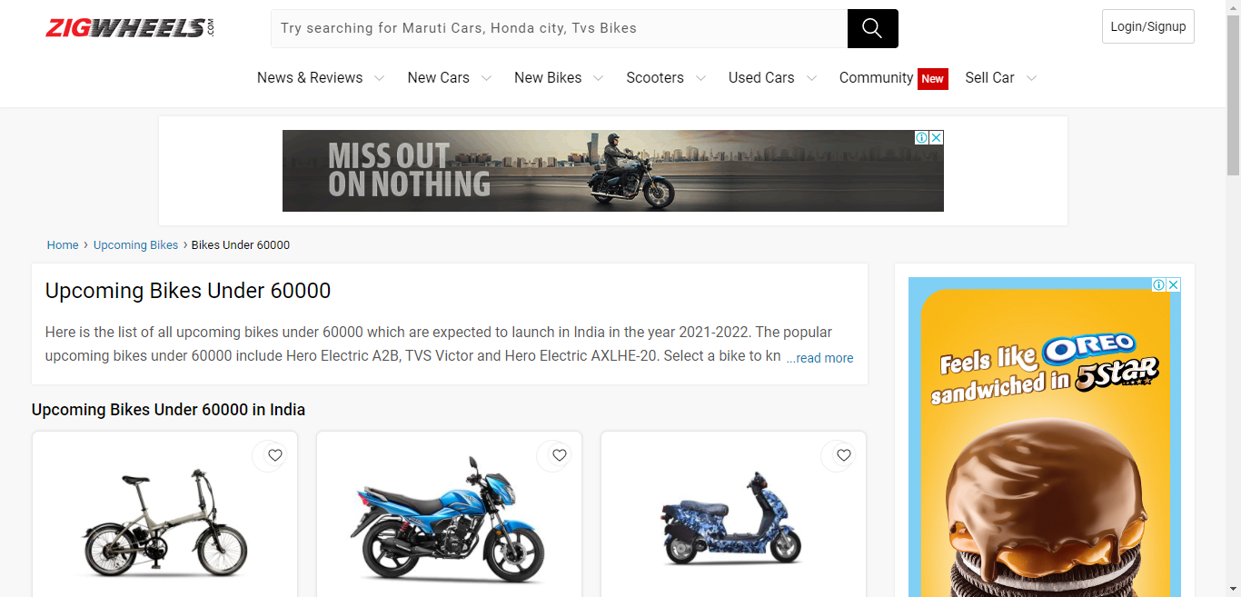
Screenshots:

Slide 10
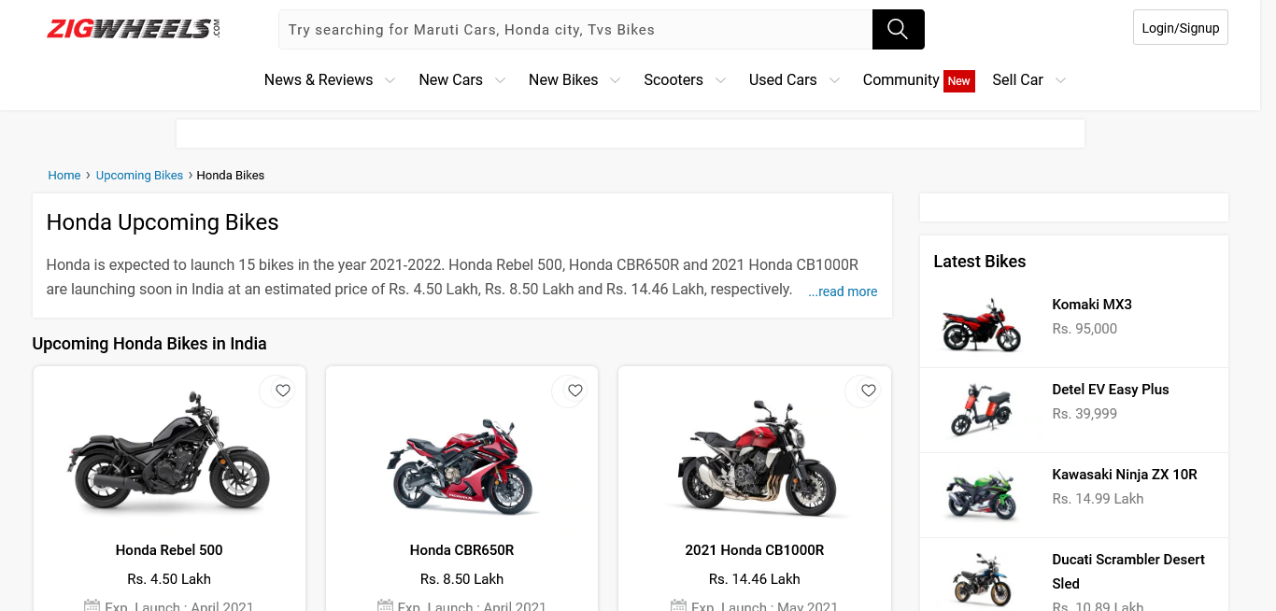
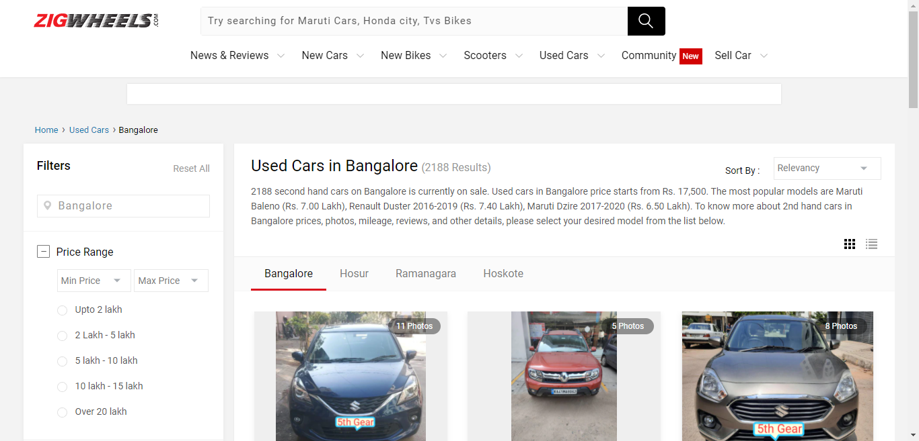
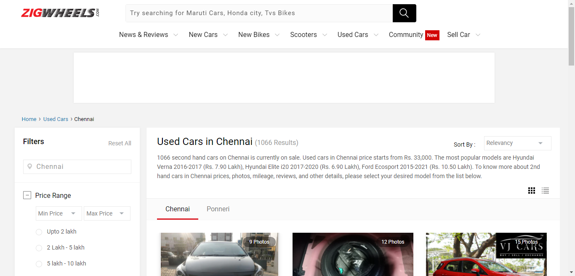
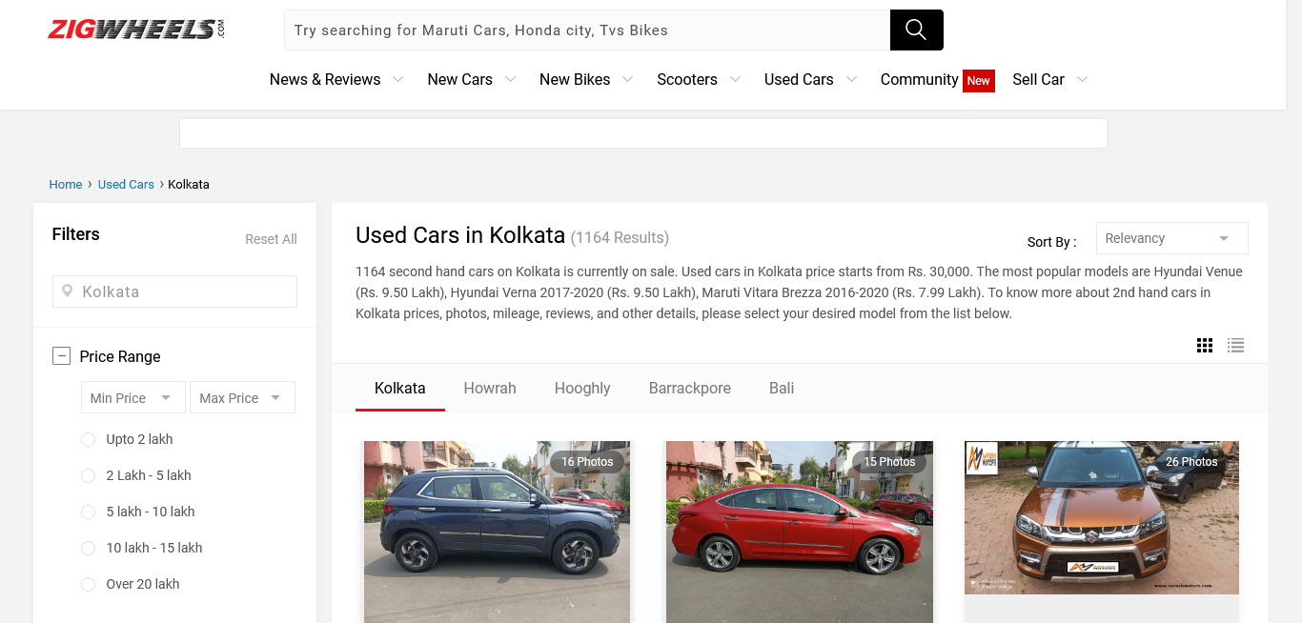
Screenshots:

Slide 11
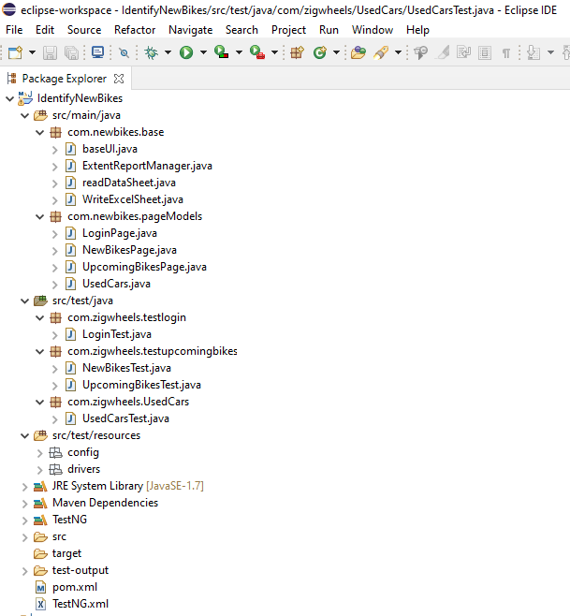
Project Structure

Slide 12
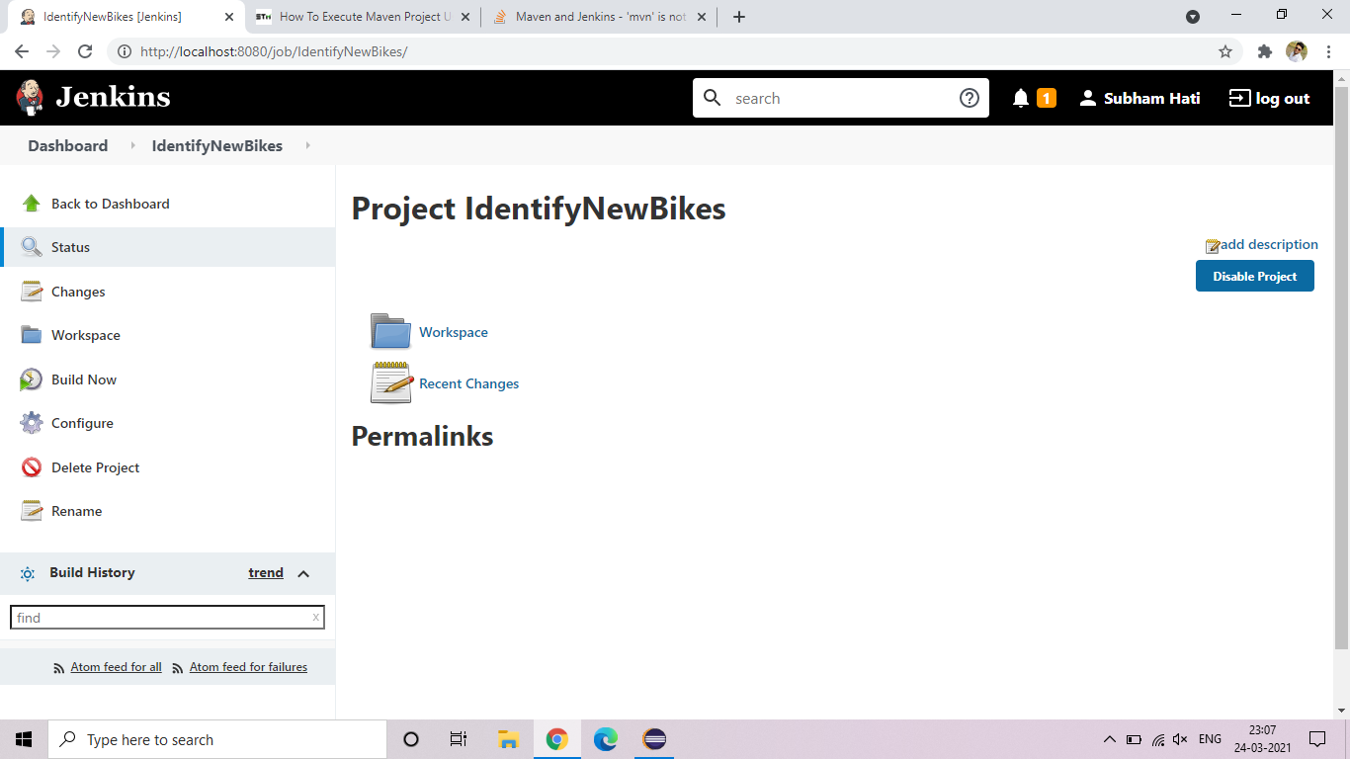
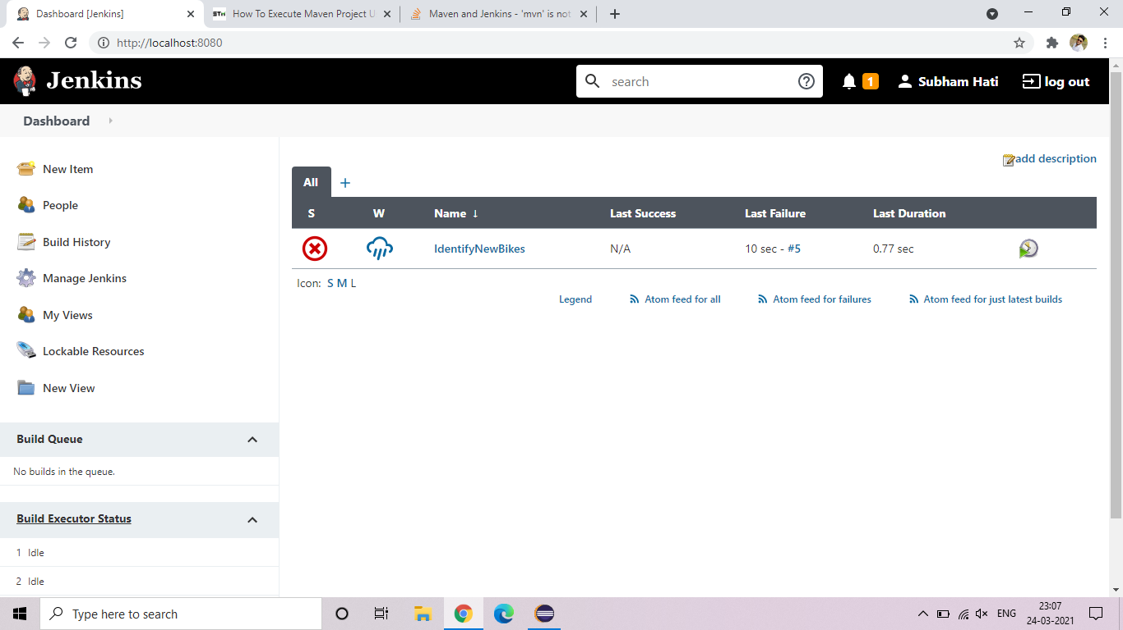
Jenkins Screenshots

Slide 13
Thank You
<Bug Busters/>

