Slide 2



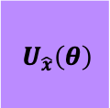











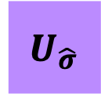

$$H$$
$$H$$
$$|0⟩$$
$$n$$
$U_{\hat{x}}\left(θ\right)$
$$|0⟩$$
Classical computer
$$\sqrt{P\left(q_{0}=0\right)−\left(q_{0}=1\right)}$$
$$⟨\hat{μ}|\hat{x}⟩$$
$$n$$
$$U_{\hat{μ}}$$
$$U_{\hat{σ}}$$
$$|0⟩$$
Achieve $E_{0}$?
$$θ$$
$$|ψ_{1}⟩$$
$$|ψ_{2}⟩$$
$$|ψ_{3}⟩$$
$$\left\langle H\right\rangle =⟨{0|U}_{\hat{x}}^{†}\left(θ\right)|\hat{H}|U_{\hat{x}}\left(θ\right)|0⟩$$
Update $θ$

Slide 3
