Slide 1
Pipeline: Introduction
Portions of these slides are derived from:
Dave Patterson © UCB

Slide 2
Pipelining Outline
Introduction 
  Defining Pipelining
  Pipelining Instructions
Hazards
  Structural hazards
  Data Hazards
  Control Hazards
Performance
Controller implementation

Slide 3
What is Pipelining?
A way of speeding up execution of instructions
Key idea:
overlap execution of multiple instructions

Slide 4
The Laundry Analogy
Ann, Brian, Cathy, Dave
each have one load of clothes
to wash, dry, and fold
Washer takes 30 minutes
Dryer takes 30 minutes
“Folder” takes 30 minutes
“Stasher” takes 30 minutes
to put clothes into drawers
A
B
C
D

Slide 5
If we do laundry sequentially...
6 PM
7
8
9
10
11
12
1
2 AM
30
30
30
30
30
30
30
30
30
30
30
30
30
30
30
30
T
a
s
k
O
r
d
e
r
Time
A
B
C
D
Time Required: 8 hours for 4 loads

Slide 6
To Pipeline, We Overlap Tasks
6 PM
7
8
9
10
11
12
1
2 AM
30
30
30
30
30
Time
30
30
T
a
s
k
O
r
d
e
r
A
B
C
D
Time Required: 3.5 Hours for 4 Loads

Slide 7
To Pipeline, We Overlap Tasks
6 PM
7
8
9
10
11
12
1
2 AM
30
30
30
30
30
Time
30
30
T
a
s
k
O
r
d
e
r
A
Pipelining doesn’t help latency of single task, it helps throughput of entire workload
Pipeline rate limited by slowest pipeline stage
Multiple tasks operating simultaneously
Potential speedup = Number pipe stages
Unbalanced lengths of pipe stages reduces speedup
Time to “fill” pipeline and time to “drain” it reduces speedup
B
C
D

Slide 8
Pipelining a Digital System
1 nanosecond = 10^-9 second
1 picosecond = 10^-12 second
Key idea: break big computation up into pieces
Separate each piece with a pipeline register
1ns
200ps
200ps
200ps
200ps
200ps
Pipeline
Register

Slide 9
Pipelining a Digital System
Why do this? Because it's faster for repeated computations
Non-pipelined:
1 operation finishes
every 1ns
1ns
Pipelined:
1 operation finishes
every 200ps
200ps
200ps
200ps
200ps
200ps

Slide 10
Comments about pipelining
Pipelining increases throughput, but not latency
  Answer available every 200ps, BUT
  A single computation still takes 1ns
Limitations:
  Computations must be divisible into stage size
  Pipeline registers add overhead

Slide 11
Pipelining a Processor
Recall the 5 steps in instruction execution:
  1. Instruction Fetch (IF)
  2. Instruction Decode and Register Read (ID)
  3. Execution operation or calculate address (EX)
  4. Memory access (MEM)
  Write result into register (WB)
Review: Single-Cycle Processor
  All 5 steps done in a single clock cycle
  Dedicated hardware required for each step

Slide 12
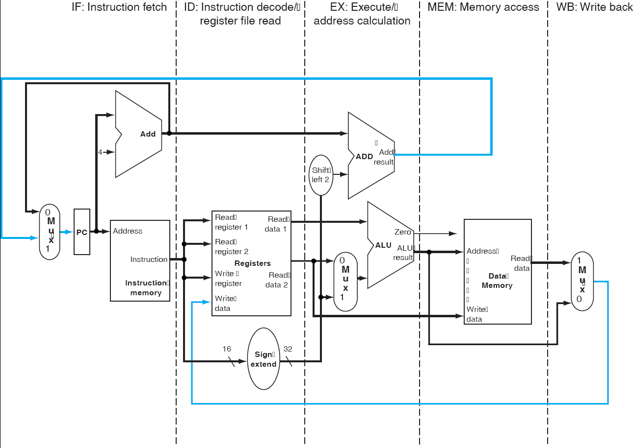
Review - Single-Cycle Processor
What do we need to add to actually split the datapath into stages?

Slide 13
The Basic Pipeline For MIPS
Cycle 1
Cycle 2
Cycle 3
Cycle 4
Cycle 5
Cycle 6
Cycle 7
I
n
s
t
r.
O
r
d
e
r
Ifetch
Reg
ALU
DMem
Reg
Ifetch
Reg
ALU
DMem
Reg
Ifetch
Reg
ALU
DMem
Reg
Ifetch
Reg
ALU
DMem
Reg
What do we need to add to actually split the datapath into stages?

Slide 14
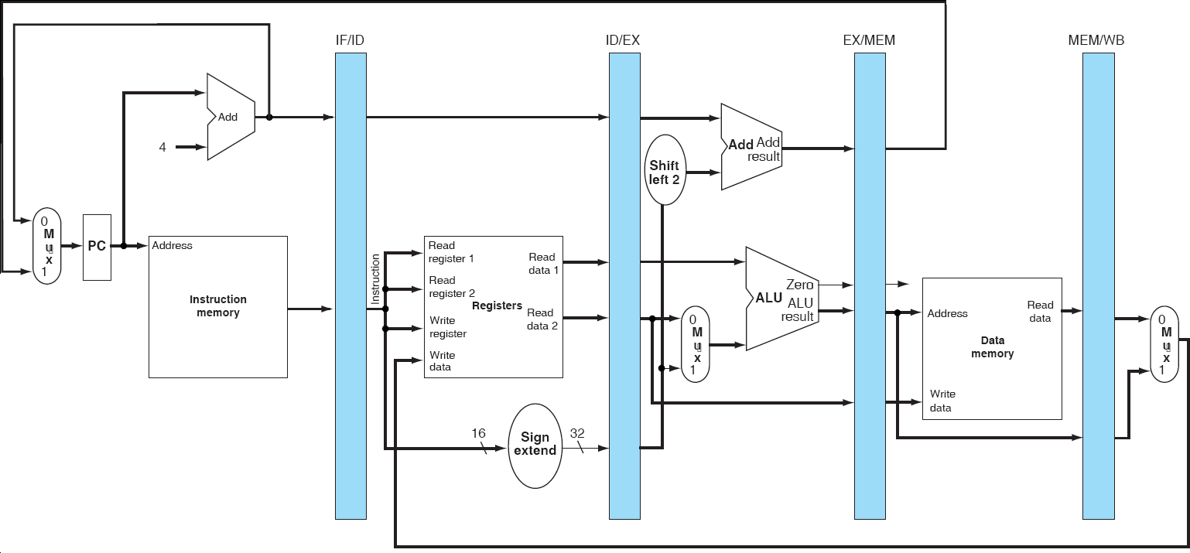
Basic Pipelined Processor

Slide 15
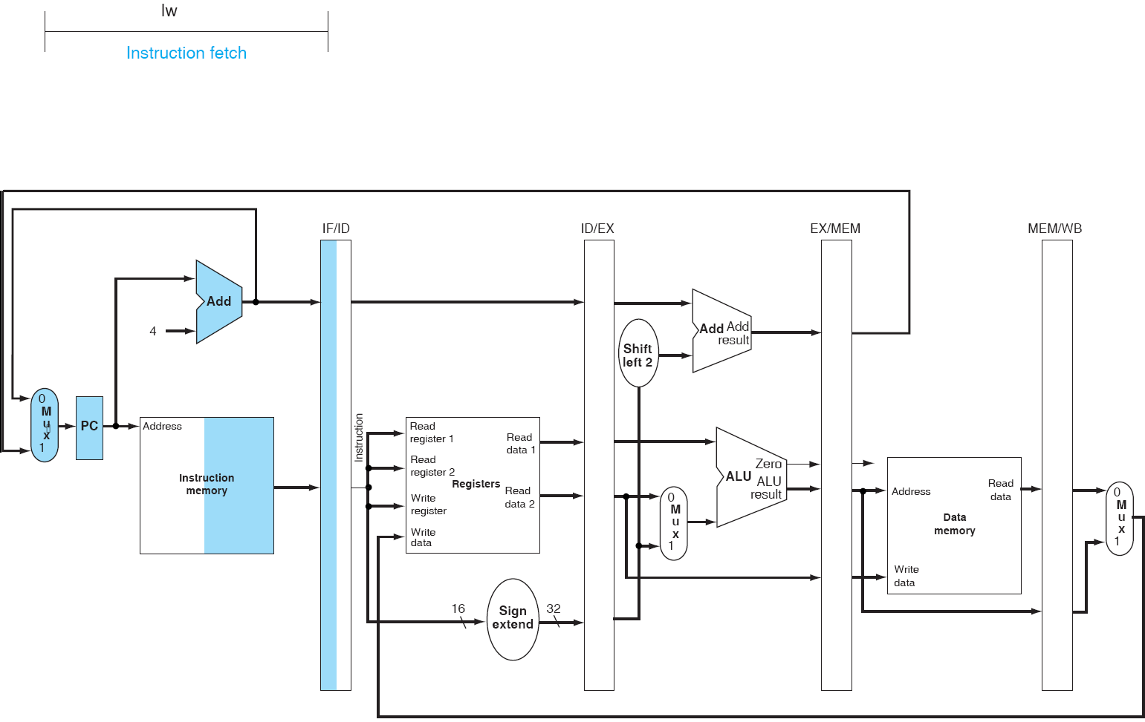
Pipeline example: lw
IF

Slide 16
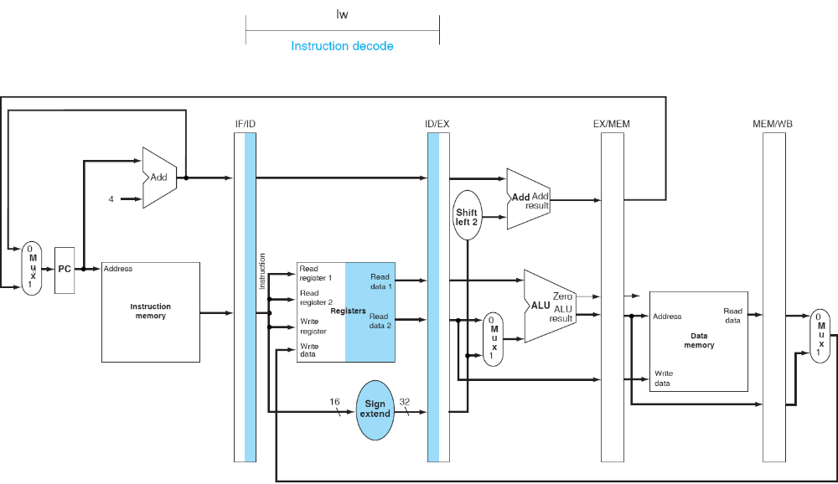
Pipeline example: lw
ID

Slide 17
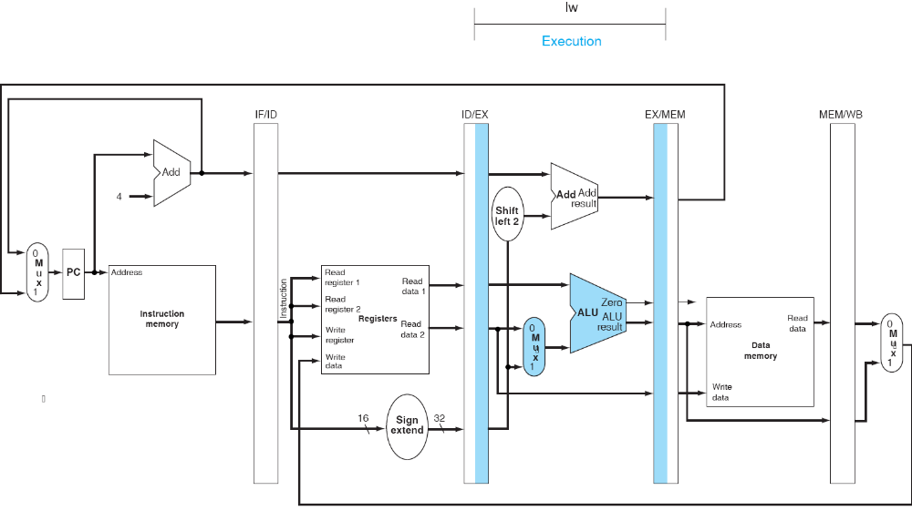
Pipeline example: lw
EX

Slide 18
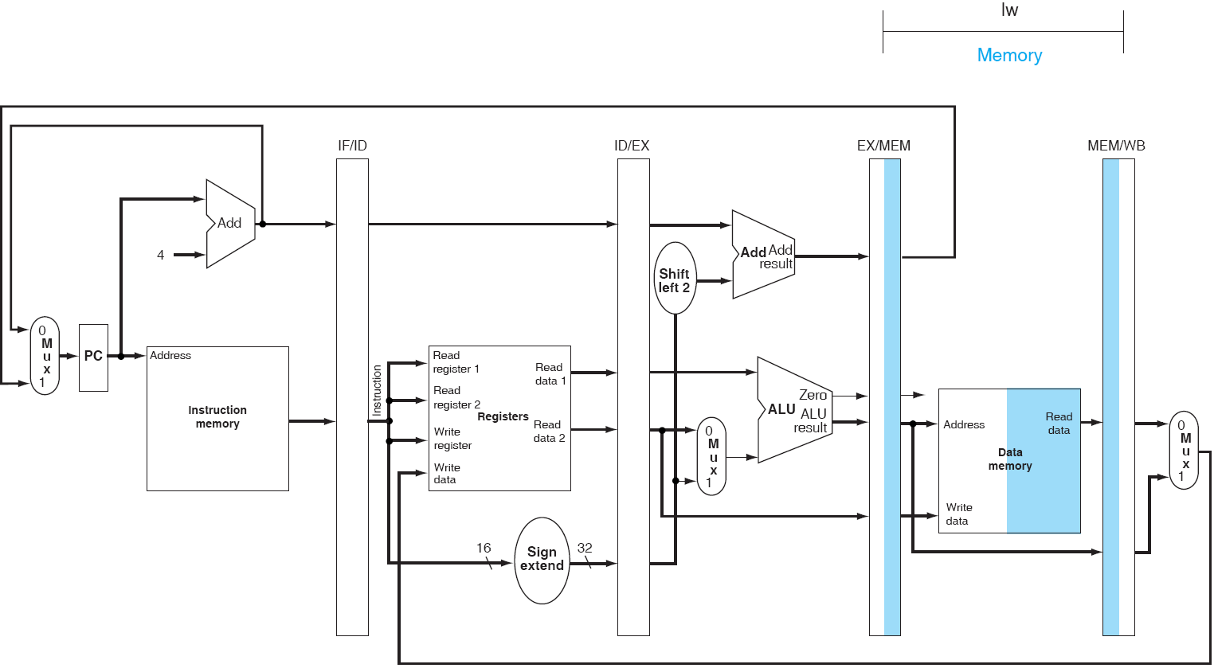
Pipeline example: lw
MEM

Slide 19
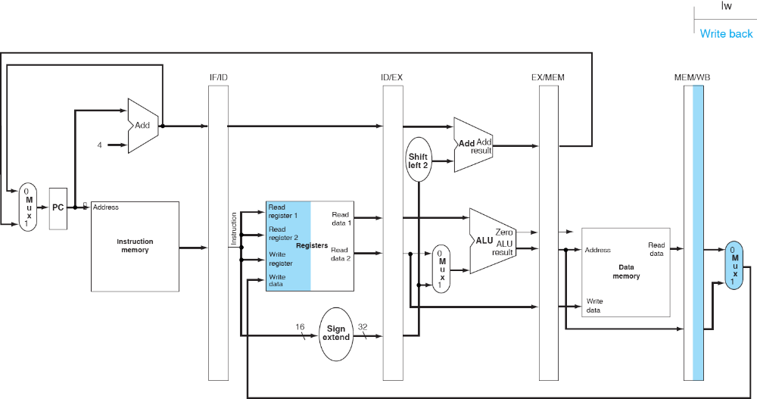
Pipeline example: lw
WB
Can you find a problem?

Slide 20
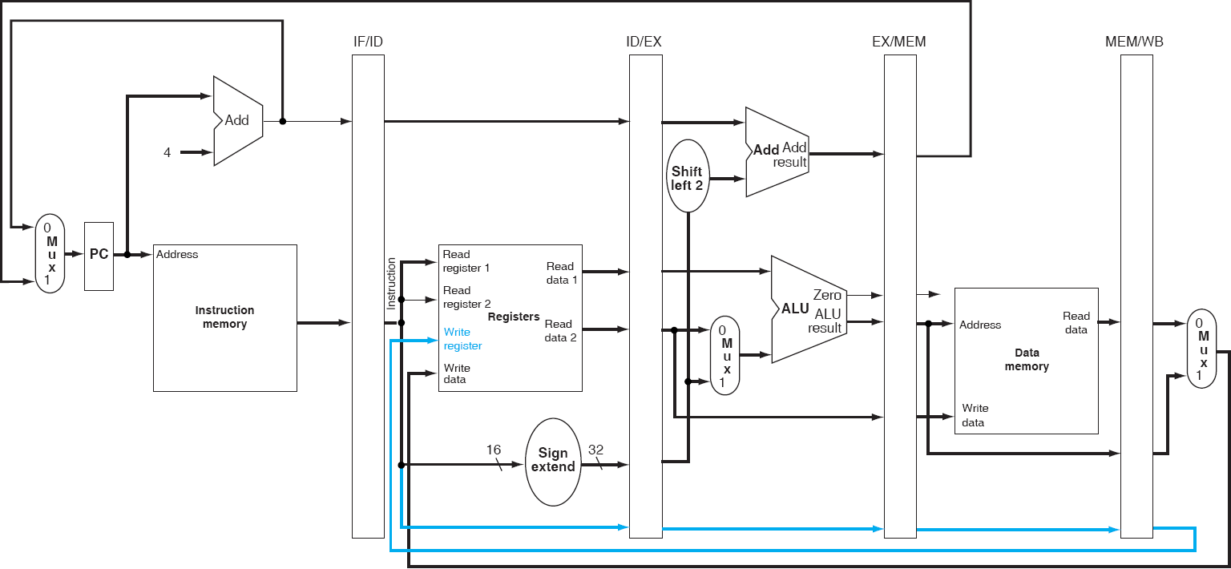
Basic Pipelined Processor (Corrected)

Slide 21
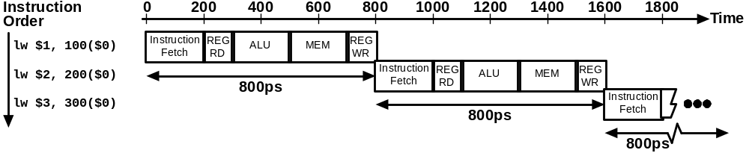
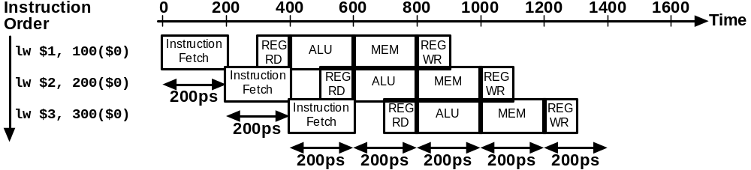
Single-Cycle vs. Pipelined Execution
Non-Pipelined
Pipelined

Slide 22
Speedup
Consider the unpipelined processor introduced previously. Assume that it has a 1 ns clock cycle and it uses 4 cycles for ALU operations and branches, and 5 cycles for memory operations, assume that the relative frequencies of these operations are 40%, 20%, and 40%, respectively. Suppose that due to clock skew and setup, pipelining the processor adds 0.2ns of overhead to the clock. Ignoring any latency impact, how much speedup in the instruction execution rate will we gain from a pipeline?
Average instruction execution time
= 1 ns * ((40% + 20%)*4 + 40%*5)
= 4.4ns
Speedup from pipeline
= Average instruction time unpiplined/Average instruction time pipelined
= 4.4ns/1.2ns = 3.7

Slide 23
Comments about Pipelining
The good news
  Multiple instructions are being processed at same time
  This works because stages are isolated by registers
  Best case speedup of N
The bad news
  Instructions interfere with each other - hazards
    Example: different instructions may need the same piece of hardware (e.g., memory) in same clock cycle
    Example: instruction may require a result produced by an earlier instruction that is not yet complete

Slide 24
Pipeline Hazards
Limits to pipelining: Hazards prevent next instruction from executing during its designated clock cycle
  Structural hazards: two different instructions use same h/w in same cycle
  Data hazards: Instruction depends on result of prior instruction still in the pipeline
  Control hazards: Pipelining of branches & other instructions that change the PC

Slide 25
Summary - Pipelining Overview
Pipelining increase throughput (but not latency)
Hazards limit performance
  Structural hazards
  Control hazards
  Data hazards

Slide 26
Pipelining Outline
Introduction
  Defining Pipelining
  Pipelining Instructions
Hazards
  Structural hazards 
  Data Hazards
  Control Hazards
Performance
Controller implementation

