Slide 1
Linear Programming

Slide 2
Introduction to Linear Programming
A Linear Programming model seeks to maximize or minimize a linear function, subject to a set of linear constraints.
The linear model consists of the following
components:
  A set of decision variables.
  An objective function.
  A set of constraints.

Slide 3
Problem
Giapetto’s Woodcarving, Inc., manufactures two types of wooden toys: soldiers and trains.
A soldier sells for $27 and uses $10 worth of raw materials. Each soldier that is manufactured increases Giapetto’s variable labor and overhead costs by $14.
A train sells for $20 and uses $9 worth of raw materials. Each train built increases Giapetto’s variable labor and overhead costs by 10$.
The manufacture of wooden solders and trains requires two types of skilled labor: carpentry and finishing .
A soldier requires 2 hours of finishing labor and 1 hour of carpentry labor.
A train requires 1 hours of finishing labor and 1 hours of carpentry labor.
Each week, Giapetto can obtain all the needed raw material but only 100 finishing hours and 80 carpentry hours. Demand for trains is unlimited, but at most 40 soldiers are bought each week.
Giapetto wants to maximize weekly profit (revenues – costs).
Formulate a mathematical model of Giapetto’s situation that can be used to maximize Giapetto’s weekly profit.

Slide 4
Decision Variable
Decision variables should completely describe the decisions to be made.
In this problem, it is required to know how many soldiers and trains should be manufactured each week.
  x₁ = number of soldiers produced each week
  x₂ = number of trains produced each week.

Slide 5
Objective Functions
Decision maker wants to maximize or minimize some function of the decision variables. This function is called objective function.
In this problem it’s required to maximize
  weekly revenues – (raw materials purchase cost) – (other variable costs)
  where,
    Weekly revenues
    = weekly_revenues_from_soldiers + weekly_revenues_from_trains
    =27x₁ +21x₂
    Weekly raw material cost = 10x₁+9x₂
    Other weekly variable costs = 14x₁ + 10x₂
  So maximize (27x₁ +21x₂)-(10x₁+9x₂)-(14x₁ + 10x₂)= 3x₁+2x₂
  So Objective function is
    Maximize z= 3x₁+2x₂

Slide 6
Constraints:
Each week, no more than 100 hours of finishing time may be used.
  2x₁+x₂≤100
Each week, no more than 80 hours of carpentry time may be used.
  x₁+x₂≤80
Because of limited demand, at most 40 soldiers should be produced each week.
  x₁≤40

Slide 7
Sign Restrictions
x₁≥0
x₂≥0

Slide 8
Optimized Model:
Maximize z= 3x₁+2x₂
Subject to
  2x₁+x₂≤100
  x₁+x₂≤80
  x₁≤40
  x₁≥0
  x₂≥0

Slide 9
Introduction to Linear Programming
The Importance of Linear Programming
  Many real world problems lend themselves to linear programming modeling.
  Many real world problems can be approximated by linear models.
  There are well-known successful applications in:
    Manufacturing
    Marketing
    Finance (investment)
    Advertising
    Agriculture

Slide 10
Introduction to Linear Programming
Assumptions of the linear programming model
  The parameter values are known with certainty.
  There are no interactions between the decision variables (the additivity assumption).
  The Continuity assumption: Variables can take on any value within a given feasible range.

Slide 11
Definitions
Decision Variable
Objective Function
Sign Restrictions
  Can the decision variable only assume nonnegative values or allowed to assume both positive and negative values.

Slide 12
Definitions
Linear Function:
  A function f(x₁,x₂..x_{n}) of x₁,x₂…x_{n} is a linear function if and only if for some constants c₁, c₂…c_{n}, f(x₁,x₂..x_{n}) = c₁x₁+c₂x₂+..+c_{n}x_{n}
  Example: f(x₁,x₂) = 2x₁+x₂ is a linear function
Feasible Region:
  set of all points satisfying all the LP’s constraints and all the LP’s sign restrictions.

Slide 13
Types of Mathematical Programming
Linear Programs (LP): the objective and constraint functions are linear and the decision variables are continuous.
Integer Linear Programs (ILP): one or more of the decision variables are restricted to integer values only and the functions are linear.
  Pure IP: all decision variables are integer.
  Mixed IP (MIP): some decision variables are integer, others are continuous.
  1/0 MIP: some or all decision variables are further restricted to be valued either “1” or “0”.
Nonlinear Programs: one or more of the functions is not linear.

Slide 14
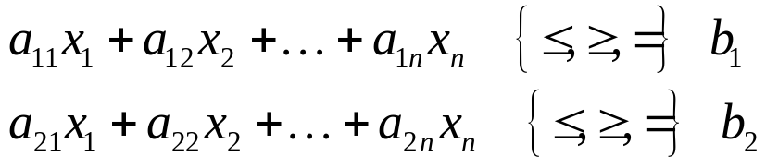
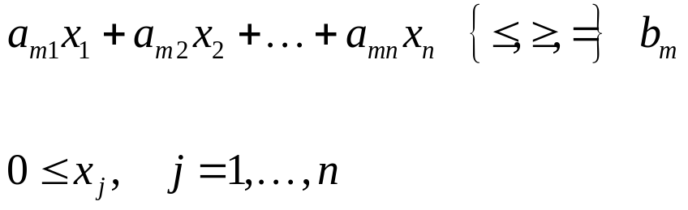
Linear Programming
General symbolic form
Maximize:
c
x
+
c
x
+
…
c
x
Objective
1
1
2
2
n
n
Subject to:
Constraints
…
Bounds
…where a_{ij}, b_{i}, and c_{i} are the model parameters.

Slide 15
Solving Mathematical Programming Problems
Graphical method
  Only useful for 2 decision variables (maybe 3 if you can handle 3-D chart)
Simplex method
  Efficient algorithm to solve LP problems by performing matrix operations on the LP Tableau
  Developed by George Dantzig (1947)
  Can be used to solve small LP problems by hand
Software packages
  MS Excel
  Lindo, LPSolve
  AMPL/CPLEX: modeling language and “solver” for large and complex LP/IP problems
Sub-Optimal Algorithms (Heuristics)
  Simulated annealing
  Genetic algorithms
  Tabu search

Slide 16
The Galaxy Industries Production Problem –
A Prototype Example
Galaxy manufactures two toy doll models:
  Space Ray.
  Zapper.
Resources are limited to
  1000 pounds of special plastic.
  40 hours of production time per week.

Slide 17
The Galaxy Industries Production Problem –
A Prototype Example
Marketing requirement
  Total production cannot exceed 700 dozens.
  Number of dozens of Space Rays cannot exceed number of dozens of Zappers by more than 350.
Technological input
  Space Rays requires 2 pounds of plastic and
  3 minutes of labor per dozen.
  Zappers requires 1 pound of plastic and
  4 minutes of labor per dozen.

Slide 18
The Galaxy Industries Production Problem –
A Prototype Example
The current production plan calls for:
  Producing as much as possible of the more profitable product, Space Ray ($8 profit per dozen).
  Use resources left over to produce Zappers ($5 profit
  per dozen), while remaining within the marketing guidelines.
The current production plan consists of:
Space Rays = 450 dozen
Zapper = 100 dozen
Profit = $4100 per week
8(450) + 5(100)

Slide 19
Management is seeking a production schedule that will increase the company’s profit.

Slide 20
A linear programming model
can provide an insight and an
intelligent solution to this problem.

Slide 21
The Galaxy Linear Programming Model
Decisions variables:
  X₁ = Weekly production level of Space Rays (in dozens)
  X₂ = Weekly production level of Zappers (in dozens).
Objective Function:
  Weekly profit, to be maximized

Slide 22
The Galaxy Linear Programming Model
Max 8X₁ + 5X₂ (Weekly profit)
subject to
2X₁ + 1X₂ ≤ 1000 (Plastic)
3X₁ + 4X₂ ≤ 2400 (Production Time)
X₁ + X₂ ≤ 700 (Total production)
X₁ - X₂ ≤ 350 (Mix)
X_{j}> = 0, j = 1,2 (Nonnegativity)

Slide 23
2.3 The Graphical Analysis of Linear Programming
The set of all points that satisfy all the constraints of the model is called
a
FEASIBLE REGION

Slide 24
Using a graphical presentation
we can represent all the constraints, the objective function, and the three types of feasible points.

Slide 25
Graphical Analysis – the Feasible Region
The non-negativity constraints
X₂
X₁

Slide 26
Graphical Analysis – the Feasible Region
X₂
1000
The Plastic constraint
2X₁+X₂ ≤ 1000
700
Total production constraint:
X₁+X₂ ≤ 700 (redundant)
500
Infeasible
Production
Time
3X₁+4X₂ ≤ 2400
Feasible
X₁
500
700

Slide 27
Graphical Analysis – the Feasible Region
X₂
1000
The Plastic constraint
2X₁+X₂ ≤ 1000
700
Total production constraint:
X₁+X₂ ≤ 700 (redundant)
500
Infeasible
Production mix
constraint:
X₁-X2 ≤ 350
Production
Time
3X₁+4X2≤ 2400
Feasible
500
700
X₁
  Interior points.
  Boundary points.
Extreme points.
There are three types of feasible points

Slide 28
The search for an optimal solution
X₂
Start at some arbitrary profit, say profit = $2,000...
1000
Then increase the profit, if possible...
...and continue until it becomes infeasible
700
Profit =$4360
500
X₁
500

Slide 29
Summary of the optimal solution
  Space Rays = 320 dozen
  Zappers = 360 dozen
  Profit = $4360
  This solution utilizes all the plastic and all the production hours.
  Total production is only 680 (not 700).
  Space Rays production exceeds Zappers production by only 40 dozens.

Slide 30
Another Simple Example
Example
  A steel company must decide how to allocate production time on a rolling mill. The mill takes unfinished slabs of steel as input and can produce either of two products: bands and coils. The products come off the mill at different rates and have different profitability:
  The weekly production that can be justified based on current and forecast orders are:
Tons/ Profit/
hour ton
Bands 200 $25
Coils 140 $30
Maximum tons: Bands 6,000
Coils 4,000

Slide 31
Another Simple Example – Solution
The question facing the company:
  If 40 hours of production time are available, how many tons of bands and coils should be produced to bring the greatest profit?
Constructing the Verbal model
  Put the objective and constraints into words.
  For constraints, use the form:
    {a verbal description of the LHS} {a relationship} {an RHS constant}
Maximize: total profit
Subject to: total number of production hours ≤ 40
tons of bands produced ≤ 6,000
tons of coils produced ≤ 4,000

Slide 32
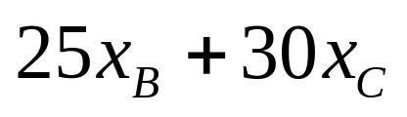
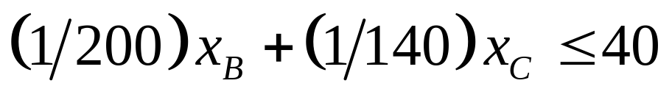
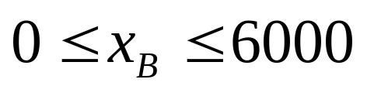
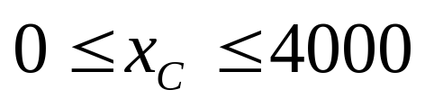
Another Simple Example – Solution (2)
Define the decision variables:
  x_{B} number of tons of bands produced.
  x_{C} number of tons of coils produced.
Construct the symbolic model
Maximize:
Subject to:

Slide 33
Another Simple Example – Solution (3)
Coils
Coils
Constraints
220K
Profit
6000
Hours
6000
192K
4000
4000
Optimal solution
2000
Feasible region
2000
120K
0
Bands
0
Bands
0
2000
4000
6000
8000
0
2000
4000
6000
8000

Slide 34
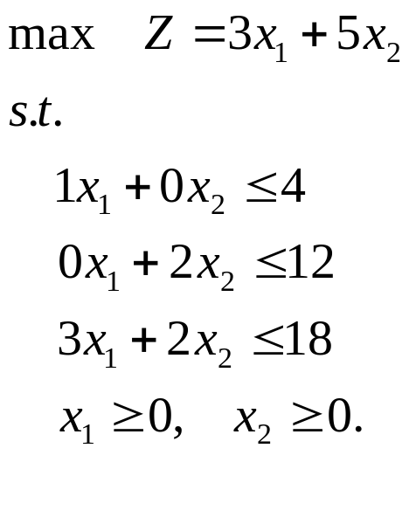
Graphical Solution – Wyndor Glass Problem
x₂
6
1
x₁
x₁
1
4
What is the feasible region?
Is the feasible region convex?

Slide 35
Graphical Solution Method – cont.
Minimization Problem – objective function moves in a direction that reduces the objective value.

Slide 36
Graphical Solution Method – cont.
Multiple Optimal Solutions - the objective function is parallel to a constraint as it leaves the feasible region.
x₂
60
max 3x₁ + 2x₂
s.t. x₁/40 + x₂/60 < 1
x₁/50 + x₂/50 < 1
x₁ ,x₂ > 0
10
Can you have exactly two optimal solutions?
x₁
x₁
10
50

Slide 37
Graphical Solution Method – cont.
Infeasible LP – the feasible region is empty
x₂
60
max 3x₁ + 2x₂
s.t. x₁/40 + x₂/60 < 1
x₁/50 + x₂/50 < 1
x₁ > 30
x₂ > 20
x₁ , x₂ > 0
10
x₁
x₁
10
50

Slide 38
Graphical Solution Method – cont.
Unbounded LP – the feasible region is unbounded, goes to infinity
x₂
6
max 2x₁ - x₂
s.t. x₁ - x₂ < 1
2x₁ + x₂ > 6
x₁ , x₂ > 0
1
x₁
x₁
1
5

Slide 39
Solving LP Problems Graphically – Outcomes
4 possible outcomes:
Unique Optimal Solution
Alternate Optimal Solutions
No Feasible Solution
Unbounded Optimal Solution

Slide 40
In-Class Problem #1
A diet is being prepared for the UoA’s Lister Hall. You need to feed the students at the least cost, but the diet must have between 1800 and 3600 calories. No more than 1400 calories can be from starch, no fewer than 400 can be protein, and no more than 150 can be fat. The diet is to be made of two foods: A and B. Food A costs $1.75 per pound and contains 600 cal/lb, 400 of which is from protein and 200 from starch. No more than 2 pounds of food A can be used per resident. Food B costs $2.50 per pound and contains 900 cal/lb, 700 from starch, 100 from protein, and 100 from fat.
How much of each food should be in the diet?

Slide 41
In-Class Problem #2
You want to mix two fuels, A and B, to run your truck fleet at minimum cost. Your fleet requires at least 3000 litres per month, you have storage capacity for 4000 litres of mixed fuel, and your supplier currently has 2000 litres of fuel type A and 4000 litres of fuel type B available. Fuel A costs $1.20 per litre and has an octane of 90, while fuel B costs $0.90 per litre and has an octane of 75. Your trucks need an octane of at least 80, and the octane level of the mixture is a simple weighted average (by volume) of the input fuels.
How much of each type of fuel should you buy for your truck fleet mixture?

Slide 42
In-Class Problem #3
Your facility can complete jobs on your own assembly machine, A, or another machine, B, in the fabrication shop across the street. Each of your jobs can be finished on either machine, but it costs $2 per job on machine A and $4 per job on machine B. You’re already committed to at least 10 jobs per week on the machine across the street, and need to find work for at least 3 personnel you have on extended contracts (40 hours per week each). It takes 4 hours to do each job on machine A and 6 hours to do it on machine B (you provide the personnel for machine B as well).
How many jobs should you assign to each machine?
  Don’t worry about integrality… the solution comes out integer anyway. ☺

Slide 43






In-Class Problem #4
Solve the following linear programming problem graphically.
  Objective Function:
  Subject to:

Slide 44
Preview of the Simplex Method
The graphical method can be used to solve a 2-dimensional LP problem (i.e., one with 2 variables).
An n-dimensional problem where n > 2, however, is impossible to solve graphically (well, maybe n > 3).
We can use the simplex method to find solutions to these larger problems.
  The simplex method finds the best solution by a neighbourhood search technique, essentially moving between adjacent corner points within the feasible region (corner points are adjacent if they have one binding constraint in common).
Adapted from: James Orlin, MIT, 2003

Slide 45
Preview of the Simplex Method (2)
p
14
The simplex method starts at some feasible extreme point.
It then moves to an adjacent corner point with better objective value.
It continue until no adjacent corner point has a better objective value.
12
10
8
6
4
The process is the same no matter how many dimensions (variables) the problem has.
2
w
2
4
6
8
10
12
14
Adapted from: James Orlin, MIT, 2003

Slide 46
Simplex Method

Slide 47
Standard Form of an LP
An LP is in standard form if the following are true:
  All variables have non-negativity constraints.
  All other constraints are strict equality constraints.
  The right hand side of all constraints are non-negative.
  The objective function must be a maximization.
The following LP is not in standard form:
maximize: z = 3x₁ + 2x₂ - x₃ + x₄
subject to: x₁ + 2x₂ + x₃ - x₄ ≤ 5
-2x₁ - 4x₂ + x₃ + x₄ ≤ -1
x₁ ≥ 0, x₂ ≥ 0
How do we convert it to standard form?

Slide 48
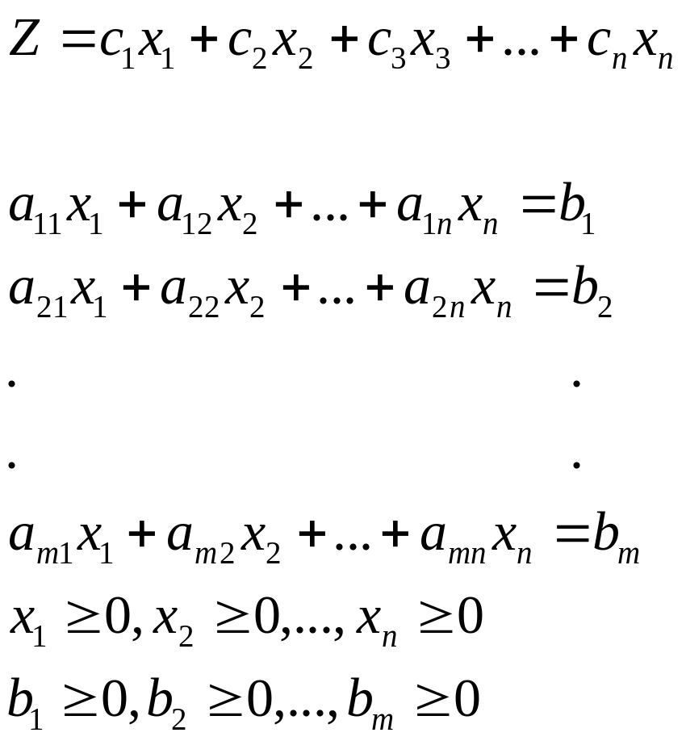
Linear Programming - Standard Form
Maximize (Minimize):
Subject to:

Slide 49
Linear Programming - Standard Form
Objective
Function
Maximize (Minimize):
Subject to:
Constraint Set
Non-negative
Right-hand side
Constants
Non-negative
Variables
Constraint

Slide 50
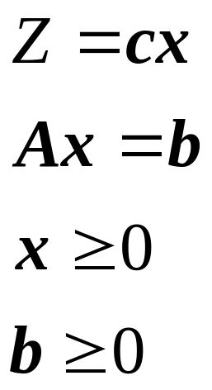
Linear Programming - Standard Form
Maximize (Minimize):
Subject to:

Slide 51
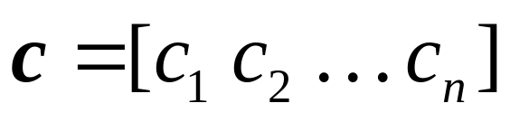
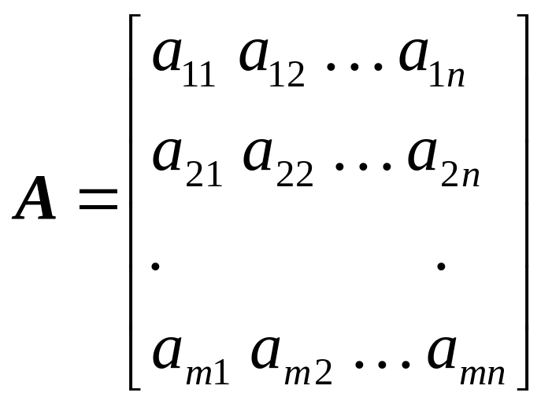
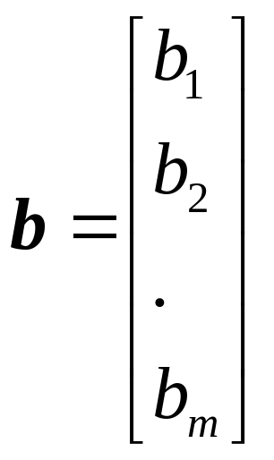
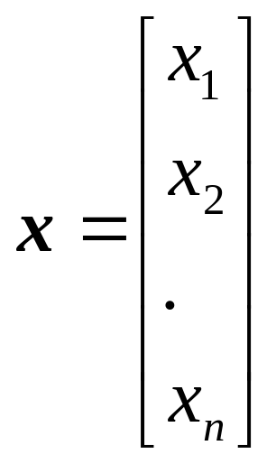
Linear Programming - Standard Form
Maximize (Minimize):
Subject to:
where,

Slide 52
Dealing with Non-Positive Variables
How do you deal with a non-positive (e.g., x ≤ 0) variable?
  Replace it by a new non-negative variable that is its negative.
  For example, the following LP:
    max - x₁ - 2x₂ - x₃ + x₄
    x₁ + 3x₂ + 4x₃ - x₄ ≤ 5
    x₁ ≥ 0, x₂ ≤ 0, x₃ ≤ 0, x₄ ≥ 0
  becomes the following new LP:
    max - x₁ + 2y₂ + y₃ + x₄
    x₁ - 3y₂ - 4y₃ - x₄ ≤ 5
    x₁ ≥ 0, y₂ ≥ 0, y₃ ≥ 0, x₄ ≥ 0
We recover the original variable by inspection after solution of the new LP.

Slide 53
Converting Inequalities to Equalities
How do you convert ≤ to an equality?
  Add a non-negative slack variable to the LHS.
  For example, the following inequality:
    x₁ + 2x₂ + x₃ - x₄ ≤ 5
  becomes the following equality:
    x₁ + 2x₂ + x₃ - x₄ + s₁ = 5 (note we also have s₁ ≥ 0)
The slack variable measures the amount of unused resource.
  So we can also say that:
    s₁ = - x₁ - 2x₂ - x₃ + x₄ + 5

Slide 54
Converting Inequalities to Equalities (2)
How do you convert ≥ to an equality?
  Subtract a non-negative surplus (excess) variable to the LHS.
  For example, the following inequality:
    x₁ + 2x₂ + x₃ - x₄ ≥ 5
  becomes the following equality:
    x₁ + 2x₂ + x₃ - x₄ - e₁ = 5 (note we also have e₁ ≥ 0)
The surplus variable measures the amount by which we over-satisfy a requirement.
  So we can also say that:
    e₁ = - x₁ - 2x₂ - x₃ + x₄ + 5

Slide 55
Converting Minimization to Maximization
How do you convert a minimization problem to a maximization problem?
  Simply recognize that to minimize z, you could alternatively maximize the negative of z.
  For example, the following minimization objective function:
    min x₁ + 2x₂ + x₃ - x₄
  becomes the following maximization objective function:
    max - x₁ - 2x₂ - x₃ + x₄

Slide 56
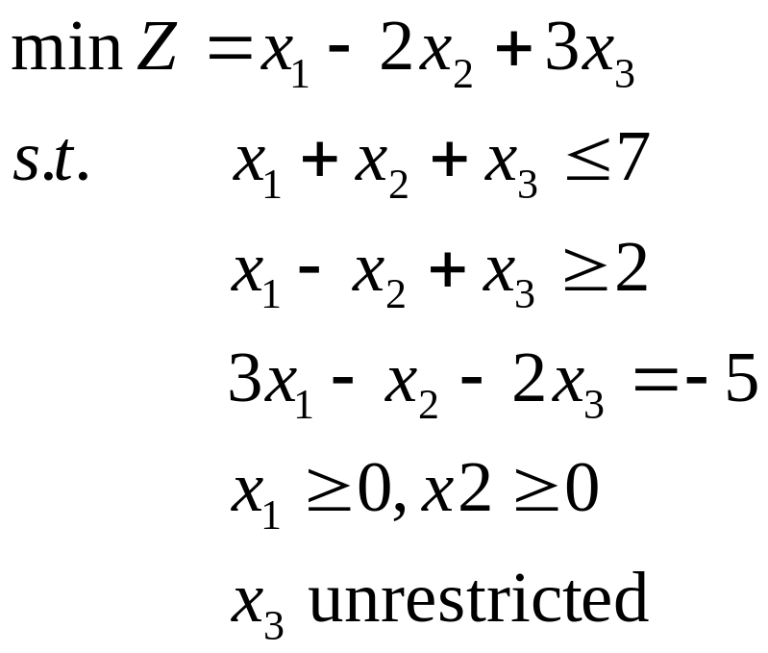
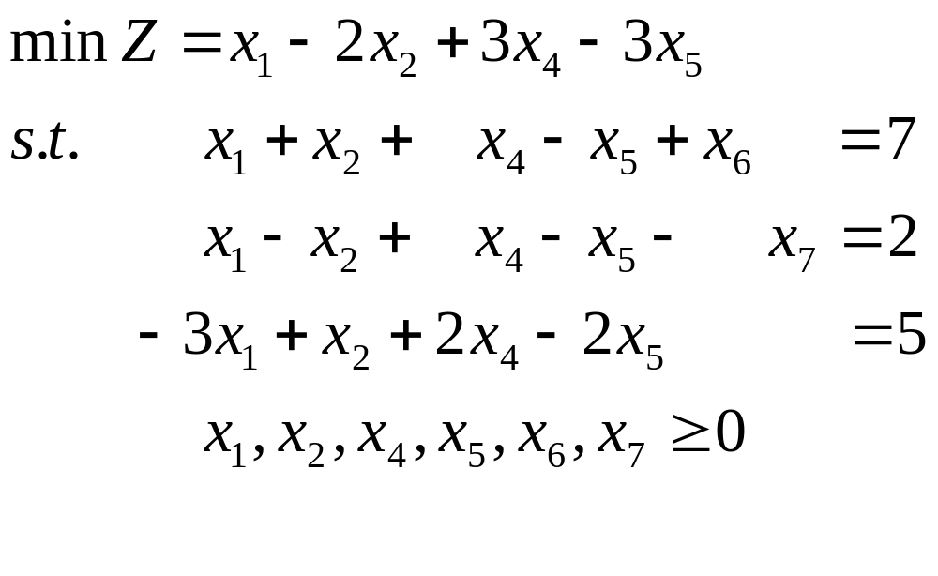
Linear Programming – Conversion to Standard Form
Standard Form
Example:

Slide 57
In-Class Problem – Standard Form Conversion
Transform the following LP to standard form:
  Minimize z = x₁ - x₂ + 2x₃ – x₄
  Subject to: 2x₁ – 3x₂ + x₃ ≥ 8
  2x₁ + 2x₂ + 3x₃ – x₄ ≤ 2
  4x₁ + 4x₂ + 2x₃ – x₄ ≥ 6
  x₁ – 2x₂ + 3x₃ – x₄ ≤ 2
  x₁ ≥ 0, x₂ ≤ 0, x₄ ≥ 0

Slide 58
Linear Programming – Conversion to Standard Form
Example:

Slide 59
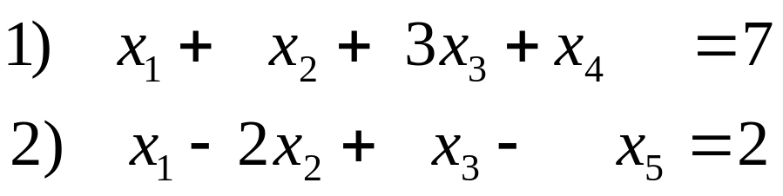
Solving Systems of Linear Equations
Use the Gauss-Jordan elimination procedure to solve this series of linear equations.
Multiply row 1 by 2 and add to row 2.

Slide 60
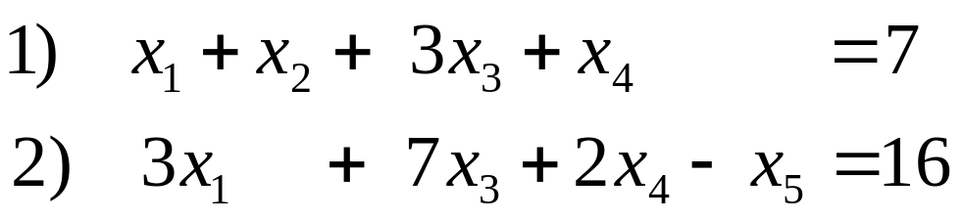
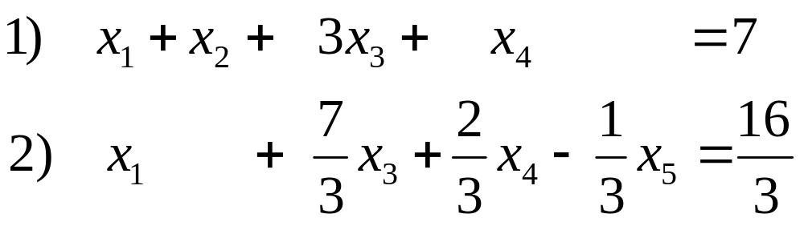
Solving Systems of Linear Equations
Divide row 2 by 3.
Multiply row 2 by –1 and add to row 1.

Slide 61
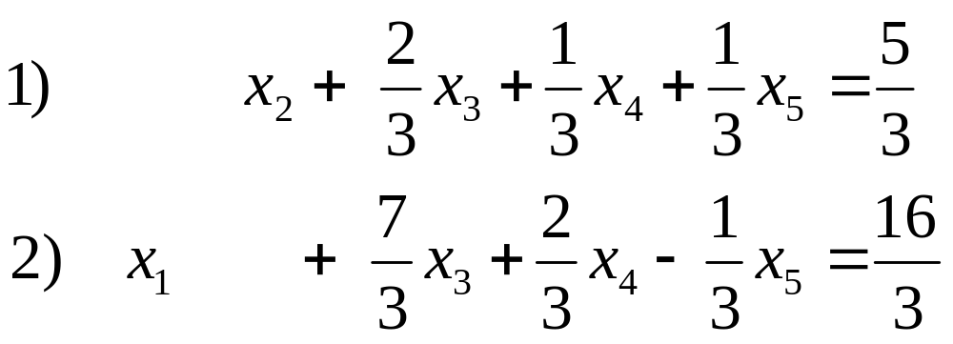
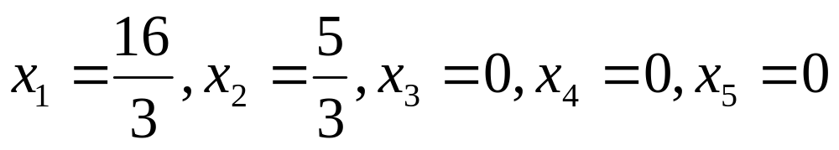
Solving Systems of Linear Equations
Solution:
x₁ and x₂ are basic variables; x₃ , x₄ and x₅ are non-basic variables

Slide 62
Solving Systems of Linear Equations
Solution:
is referred to as a basic solution since all non-basic variables
have been set to 0.
This solution is also referred to as a basic feasible solution
since all basic variables are non-negative.
Every corner point of the feasible region corresponds to a basic
Feasible solution – fundamental building block for the
simplex method.

Slide 63
In-Class Simplex Method Problem #1
Solve the following LP using the Simplex method:
  Maximize z = 3x₁ + 5x₂
  Subject to: x₁ ≤ 4
  2x₂ ≤ 12
  3x₁ + 2x₂ ≤ 18
  x₁ , x₂ ≥ 0

Slide 64
In-Class Simplex Method Problem #2
Solve the following LP using the Simplex method:
  Maximize z = 4x₁ + 3x₂ + 6x₃
  Subject to: 3x₁ + x₂ + 3x₃ ≤ 30
  2x₁ + 2x₂ + 3x₃ ≤ 40
  x₁, x₂, x₃ ≥ 0

