Slide 1
Linear Programming
Simplex Method

Slide 2

Already covered
Introduction to linear programming
Formulate to linear programming from the given problem.
Solve linear programming problem using geometrical technique
Convert LP problem to standard form
Solve LP
using simplex method.

Slide 3
Algebraic Solution of LPPs - Simplex Method
To solve an LPP algebraically, we first put it in the standard form.
  This means all decision variables are nonnegative
  all constraints (other than the nonnegativity restrictions) are equations with nonnegative RHS.

Slide 4
Tasks to convert standard form
Converting inequalities into equations
  Use slack/excess variable to do this
  Make sure that right side doesn’t contain negative sign.
  Convert unrestricted variables to restricted variables.

Slide 5
Basic variables, Basic feasible Solutions
Consider an LPP (in standard form) with m constraints and n decision variables.
  We assume m ≤ n.
  We choose n –m variables and set them equal to zero.
  Thus we will be left with a system of m equations in m variables.
  If this m×m square system has a unique solution, this solution is called a basic solution.
  If further if it is feasible, it is called a Basic Feasible Solution (BFS).

Slide 6
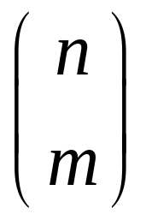
Basic variables, Nonbasic Variables
The n-m variables set to zero are called nonbasic and the m variables which we are solving for are known as basic variables.
Thus a basic solution is of the form
x = (x1, x2, …, xn)
where n-m “components” are zero and the remaining m components form the unique solution of the square system (formed by the m constraint equations).
Note that we may have a maximum of
basic solutions.

Slide 7
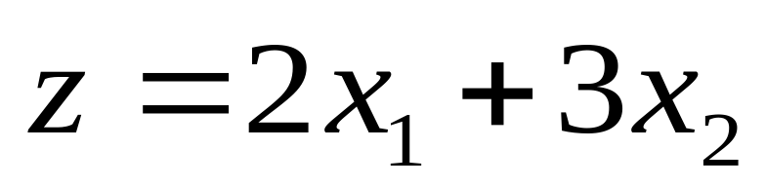
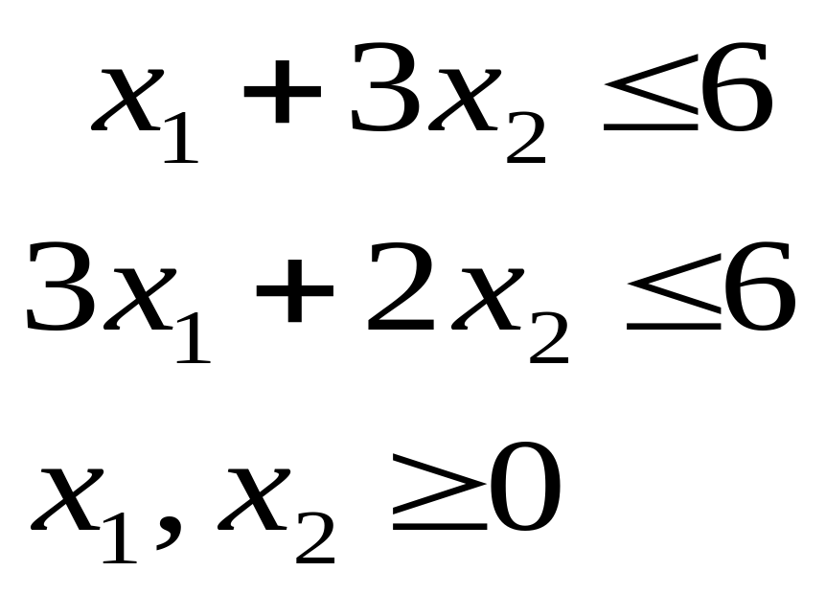
Consider the LPP:
Maximize
Subject to

Slide 8
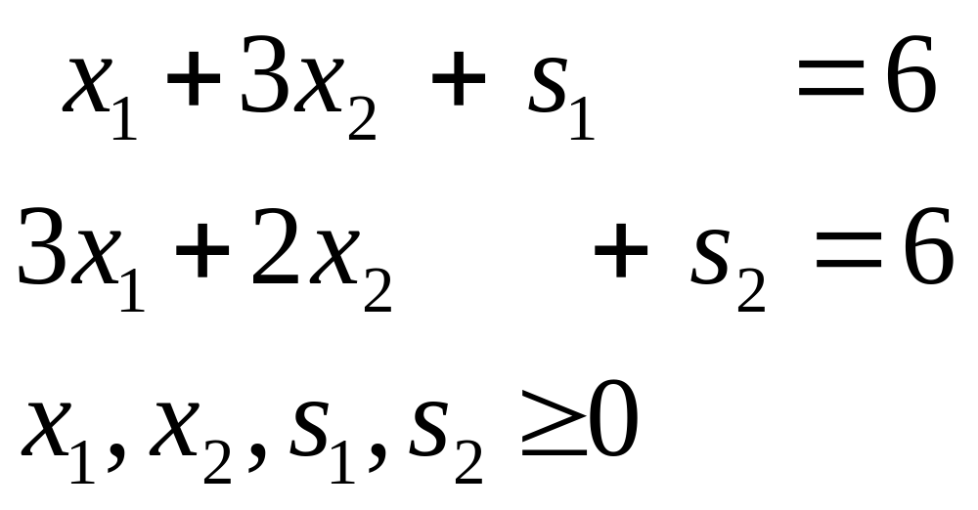
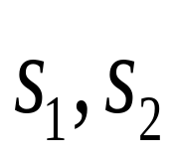
This is equivalent to the LPP (in standard form)
Maximize
Subject to
are slack variables.

Slide 9
Graphical solution of the above LPP
x2
Thus every Basic Feasible Solution corresponds to a corner(=vertex) of the set S_{F} of all feasible solutions.
Optimal point
E
(6/7, 12/7)
(0,3)
C
B
(0,2)
S_{F}
O
A
D
x1
(0,0)
(2,0)
(6,0)

Slide 10
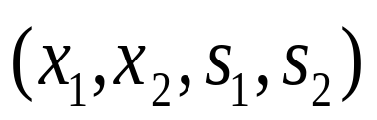
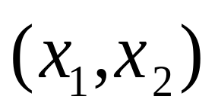
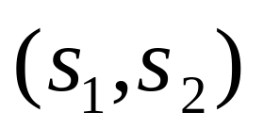
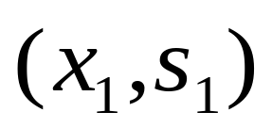
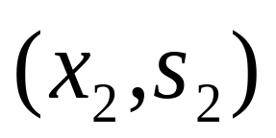
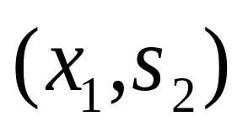
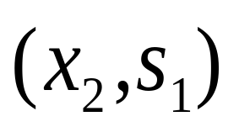
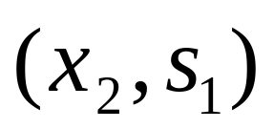
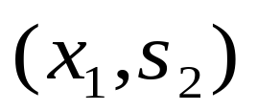
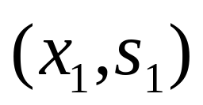
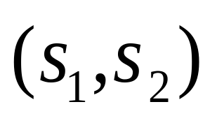
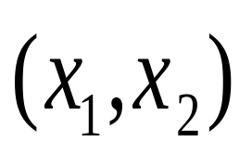
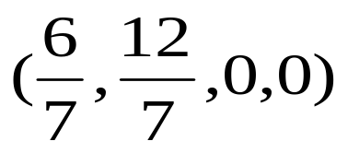
Nonbasic (zero) variables | Basic variables | Basic solution | Assoc-iated corner point | Feasible? | Object-ive value, z
 |  | (0,0,6,6) | O | Yes | 0
 |  | (0,2,0,2) | B | Yes | 6
 |  | (0,3,-3,0) | E | No | -
 |  | (6,0,0, -12) | D | No | -
 |  | (2,0,4,0) | A | Yes | 4
 |  |  | C | Yes | 48/7 Optimal

Slide 11
The Simplex algorithm

Slide 12
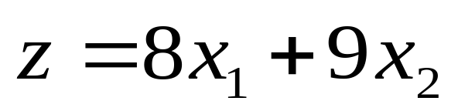
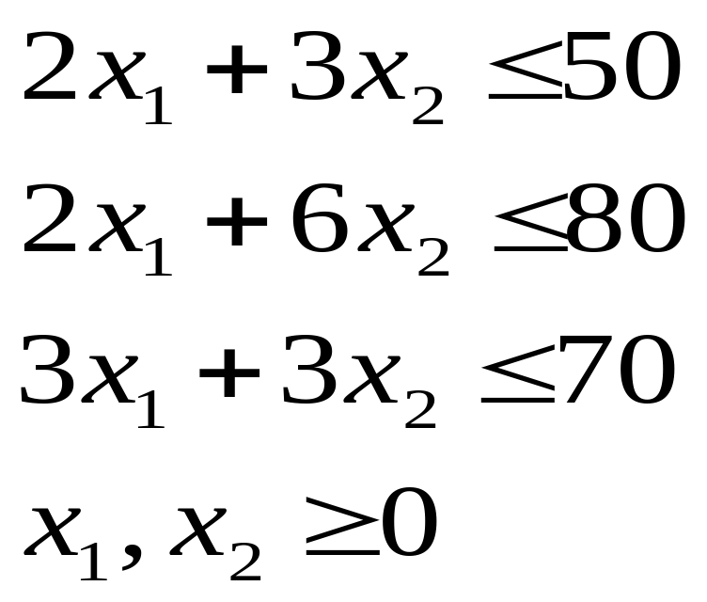
Example Consider the LPP
Maximize
Subject to the constraints

Slide 13
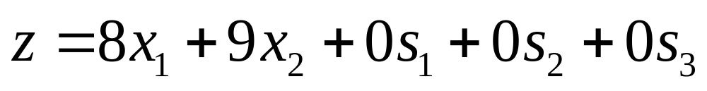
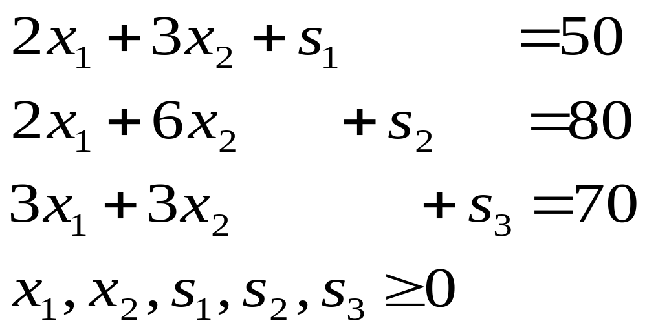
Introducing slack variables, the LPP is same as
Maximize
subject to the constraints
(*)

Slide 14

Basic Feasible Solution
Let
  x1, x2 as nonbasic variables
  Then BFS can be got immediately as
    (0,0, 50,80,70).
This is possible because in the LHS of the constraint equations (*) the coefficients of the basic variables s1, s2, s3 form an Identity matrix (of size 3 x 3).

Slide 15
Simplex tableau (Starting tableau)
Basic | z | x₁ | x₂ | s₁ | s₂ | s₃ | Solution
z | 1 | -8 | -9 | 0 | 0 | 0 | 0
s₁ | 0 | 2 | 3 | 1 | 0 | 0 | 50
s₂ | 0 | 2 | 6 | 0 | 1 | 0 | 80
s₃ | 0 | 3 | 3 | 0 | 0 | 1 | 70

Slide 16
Closer Look (1)
We note that the z-row is the objective function row.
The remaining 3 rows are the basic variable rows.
Each row corresponds to a basic variable;
  the leftmost variable denotes the basic variable corresponding to that row.

Slide 17
Closer Look (2)
In the objective function row,
  the coefficients of the basic variables are zero.
In each column corresponding to a basic variable,
  basic variable has a non-zero coefficient, namely 1,
  all the other basic variables have zero coefficients.

Slide 18
Closer Look (3)
We see at present, the objective function, z, has value zero.
We now seek to make
  one of the nonbasic variables as basic (and so) one of the basic variables will become nonbasic (that is will drop down to zero)
  the nonbasic variable that will become basic is chosen such that the objective function will “improve”:
    in a maximization problem it will increase
    in a minimization problem it will decrease.
The nonbasic variable that will become basic is referred to as “entering” variable and the basic variable that will become nonbasic is referred to as “leaving” variable.

Slide 19
Criterion for “entering” variable: (Optimality Condition)
Choose that variable as the “entering” variable which has
the most –ve coefficient in the z-row in case it is a maximization problem
(as the variable which has the most +ve coefficient in the z-row in case it is a minimization problem).
(Break the ties arbitrarily.)

Slide 20
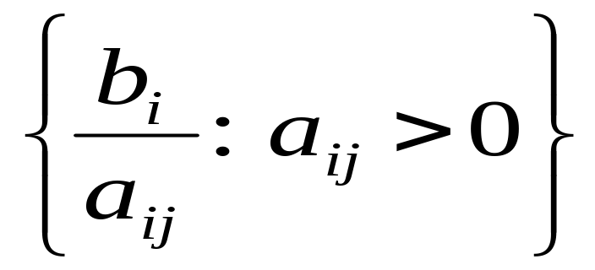
Criterion for “leaving” variable (Feasibilty Condition)
Let b_{i} be the RHS of the ith row. Let a_{ij} be the coefficient of the entering variable x_{j} in the ith row. The following “minimum ratio test” decides the leaving variable:
Choose x_{k} as the leaving variable where k is given as that row index i for which the ratio
is least.
(Break the ties arbitrarily.)

Slide 21
Pivot element
The entering variable column is called the pivot column.
The leaving variable row is called the pivot row.
The coefficient in the intersection of the two is referred to as the pivot element.

Slide 22
Operations
We apply elementary row operations to modify the simplex tableau so that the pivot column has 1 at the pivot element and zero in all other places.

Slide 23
The elementary Row operations are as follows:
♦ New pivot row = old pivot row ÷ pivot element
♦ New z row = old z row – (coefficient of the entering variable in old z row * New pivot row)
♦ Any other new row = corresponding old row – (old coefficient of the entering variable in that row * New pivot row)
♦ We shall also change the legend of the new pivot row only as the entering variable.

Slide 24
Simplex tableau (Starting tableau)
↓Enters
Basic | z | x₁ | x₂ | s₁ | s₂ | s₃ | Solution
z | 1 | -8 | -9 | 0 | 0 | 0 | 0
s₁ | 0 | 2 | 3 | 1 | 0 | 0 | 50
s₂ | 0 | 2 | 6 | 0 | 1 | 0 | 80
s₃ | 0 | 3 | 3 | 0 | 0 | 1 | 70
Leaves
Pivot element

Slide 25
Performing the elementary Row operations, we get the new Simplex tableau below
↓ Enters
Basic | z | x₁ | x₂ | s₁ | s₂ | s₃ | Solution
z | 1 | -5 | 0 | 0 | 3/2 | 0 | 120
s₁ | 0 | 1 | 0 | 1 | -1/2 | 0 | 10
x₂ | 0 | 1/3 | 1 | 0 | 1/6 | 0 | 40/3
s₃ | 0 | 2 | 0 | 0 | -1/2 | 1 | 30
Pivot element
Leaves

Slide 26
Performing the elementary Row operations, we get the new Simplex tableau below
↓ Enters
Basic | z | x₁ | x₂ | s₁ | s₂ | s₃ | Solution
z | 1 | 0 | 0 | 5 | -1 | 0 | 170
x₁ | 0 | 1 | 0 | 1 | -1/2 | 0 | 10
x₂ | 0 | 0 | 1 | -1/3 | 1/3 | 0 | 10
s₃ | 0 | 0 | 0 | -2 | 1/2 | 1 | 10
Pivot element
Leaves

Slide 27
Performing the elementary Row operations, we get the new Simplex tableau below.
This is optimal as all entries in z row are ≥ 0.
Basic | z | x₁ | x₂ | s₁ | s₂ | s₃ | Solution
z | 1 | 0 | 0 | 5 | 0 | 0 | 190
x₁ | 0 | 1 | 0 | -1 | 0 | 0 | 20
x₂ | 0 | 0 | 1 | 1 | 0 | 0 | 10/3
s₂ | 0 | 0 | 0 | -4 | 1 | 2 | 20
Optimum value = 190 at x₁=20, x₂=10/3

Slide 28
Graphical Solution of the problem
(0,40/3)
(10,10)
Optimal at
Direction of increasing z
(20,10/3)
(0,0)
(70/3,0)

Slide 29
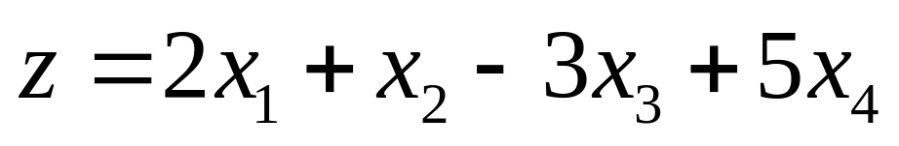
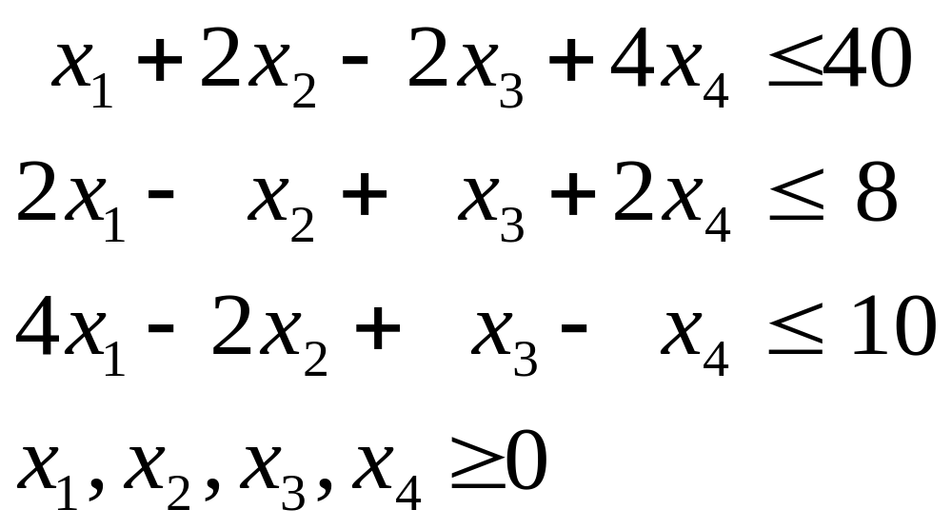
Example Consider the LPP
Maximize
Subject to the constraints

Slide 30
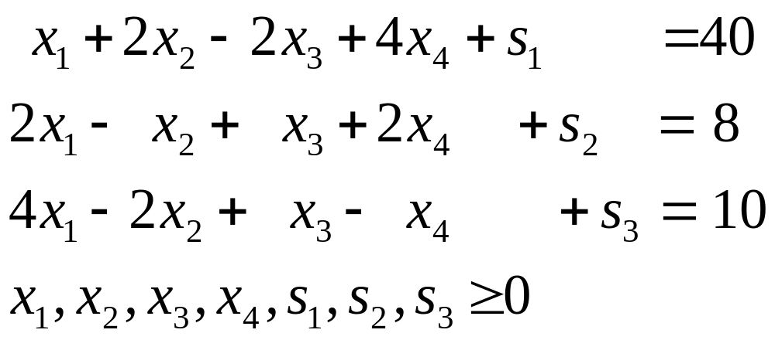
Introducing slack variables, the LPP becomes
Maximize
Subject to the constraints

Slide 31
Basic z x1 x2 x3 x4 s1 s2 s3 Sol.
z 1 -2 -1 3 -5 0 0 0 0
s1 0 1 2 -2 4 1 0 0 40
s2 0 2 -1 1 2 0 1 0 8
s3 0 4 -2 1 -1 0 0 1 10
2
z 1 3 -7/2 11/2 0 0 5/2 0 20
s1 0 -3 4 -4 0 1 -2 0 24
4
x4 0 1 -1/2 1/2 1 0 1/2 0 4
s3 0 5 -5/2 3/2 0 0 1/2 1 14
z 1 3/8 0 2 0 7/8 3/4 0 41
x2 0 -3/4 1 -1 0 1/4 -1/2 0 6
x4 0 5/8 0 0 1 1/8 1/4 0 7
s3 0 25/8 0 -1 0 5/8 -3/4 1 29

Slide 32
The last tableau is the optimal tableau as all entries in the objective function row are ≥ 0 and the LPP is a maximization problem.
Optimal Solution is
x₁ = 0, x₂ = 6, x₃ = 0, x₄ = 7
And the Optimal z (= Maximum z)
= 41

Slide 33
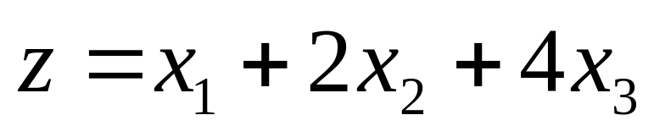
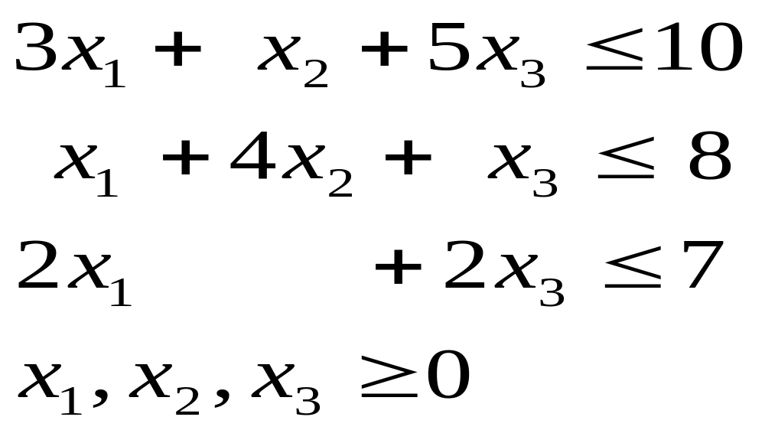
Solve the following LPP:
Maximize
Subject to the constraints

Slide 34
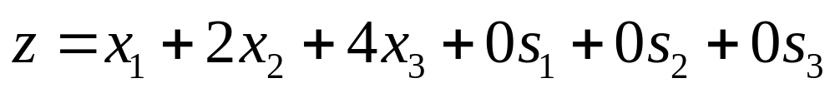
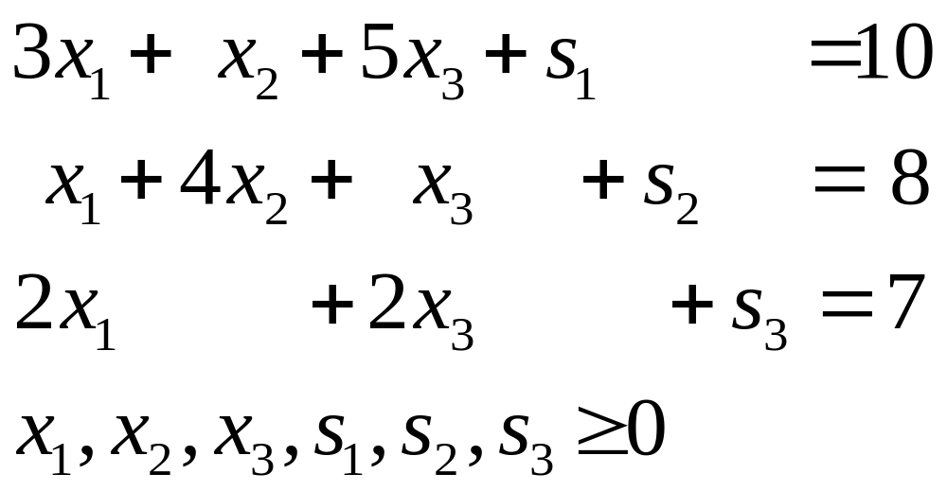
Introducing slack variables, the LPP becomes
Maximize
Subject to the constraints

Slide 35
Basic z x1 x2 x3 s1 s2 s3 Sol.
z 1 -1 -2 -4 0 0 0 0
s1 0 3 1 5 1 0 0 10
s2 0 1 4 1 0 1 0 8
s3 0 2 0 2 0 0 1 7
z 1 7/5 -6/5 0 4/5 0 0 8
x3 0 3/5 1/5 1 1/5 0 0 2
s2 0 2/5 19/5 0 -1/5 1 0 6
s3 0 4/5 -2/5 0 -2/5 0 1 3
z 1 29/19 0 0 14/19 6/19 0 188/19
x3 0 11/19 0 1 4/19 -1/19 0 32/19
x2 0 2/19 1 0 -1/19 5/19 0 30/19
s3 0 16/19 0 0 -8/19 2/19 1 69/19

Slide 36
The last tableau is the optimal tableau as all entries in the objective function row are ≥ 0 and the LPP is a maximization problem.
Optimal Solution is
x₁ = 0, x₂ = 30/19, x₃ = 32/19
And the Optimal z (= Maximum z)
= 188/19

Slide 37
Artificial Variable Techniques –
Big M-method

Slide 38
M method – basic idea
If in a starting simplex tableau,
  we don’t have an identity submatrix (i.e. an obvious starting BFS),
    then we introduce artificial variables to have a starting BFS.
    There are two methods to find the starting BFS and solve the problem –
      the Big M method
      two-phase method

Slide 39
M method – when required
Suppose a constraint equation i does not have a slack variable
  there is no ith unit vector column in the LHS of the constraint equations. (This happens for example when the ith constraint in the original LPP is either ≥ or = .)
Then we augment the equation with an artificial variable R_{i} to form the ith unit vector column.

Slide 40
Artificial Variable
As the artificial variable is extraneous to the given LPP,
  we use a feedback mechanism in which the optimization process automatically attempts to force these variables to zero level.
  This is achieved by giving a large penalty to the coefficient of the artificial variable in the objective function as follows:
  Artificial variable objective coefficient
  = - M in a maximization problem,
  = M in a minimization problem
  where M is a very large positive number.

Slide 41
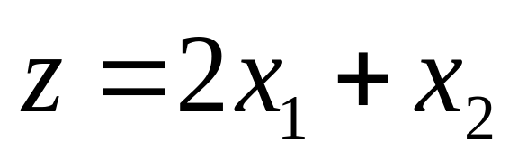
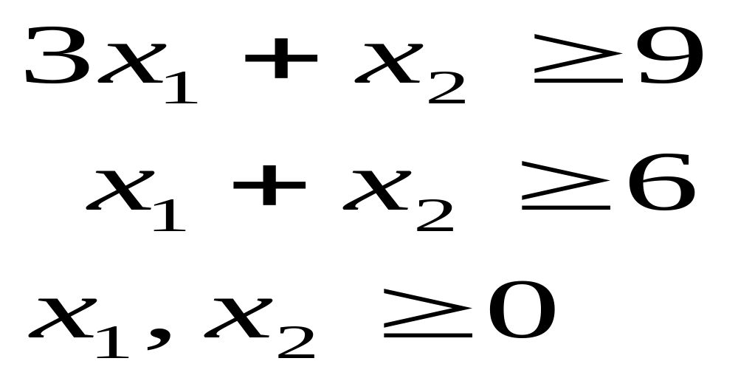
Consider the LPP:
Minimize
Subject to the constraints

Slide 42
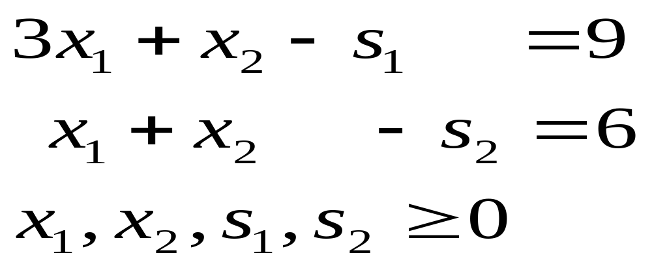
Putting this in the standard form, the LPP is:
Minimize
Subject to the constraints
Here s₁, s₂ are surplus variables.
Note that we do NOT have a 2x2 identity submatrix in the LHS.

Slide 43
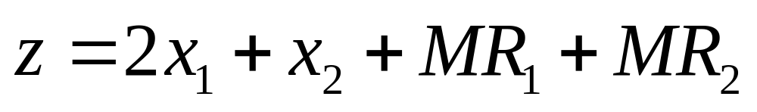
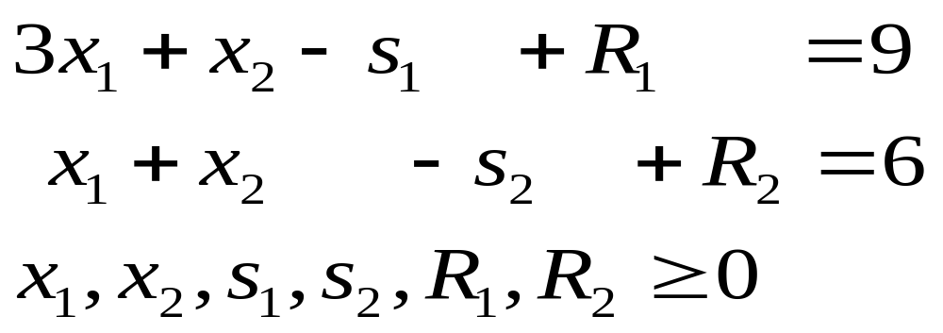
Introducing the artificial variables, R₁, R₂, the LPP is modified as follows:
Minimize
Subject to the constraints
Note that we now have a 2x2 identity submatrix in the coefficient matrix of the constraint equations.

Slide 44
Now we solve the above LPP by the Simplex method.

Slide 45
Basic z x1 x2 s1 s2 R1 R2 Sol.
-2+4M -1+2M -M -M 0 0 15M
z 1 -2 -1 0 0 -M -M 0
R1 0 3 1 -1 0 1 0 9
R2 0 1 1 0 -1 0 1 6
z 1 0 -1/3+ -2/3+ -M 2/3- 0 6+3M 2M/3 M/3 4M/3
x1 0 1 1/3 -1/3 0 1/3 0 3
R2 0 0 2/3 1/3 -1 -1/3 1 3
z 1 0 0 -1/2 -1/2 1/2–M 1/2-M 15/2
x1 0 1 0 -1/2 1/2 1/2 -1/2 3/2
x2 0 0 1 1/2 -3/2 -1/2 3/2 9/2

Slide 46
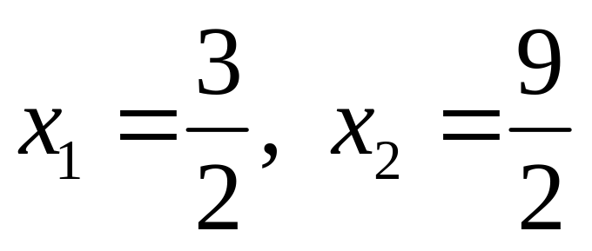
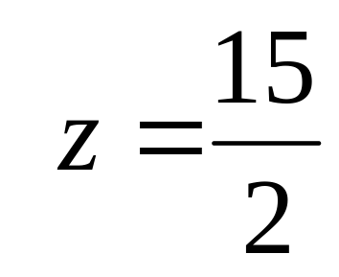
Note that we have got the optimal solution to the given problem as
Optimal z = Minimum
It is illuminating to look at the graphical solution also.

Slide 47
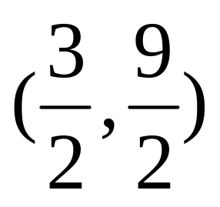
(0.9)
S_{F}
(0,6)
(0,0)
(3,0)
(6,0)
z minimum at

Slide 48
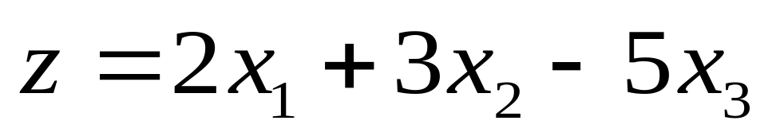
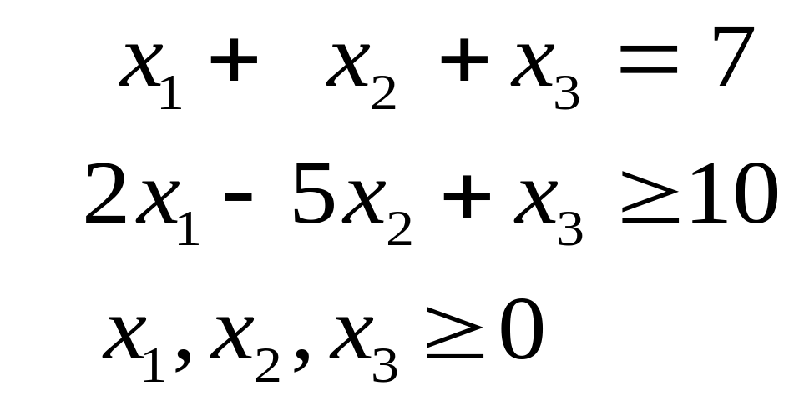
Maximize
Subject to the constraints

Slide 49
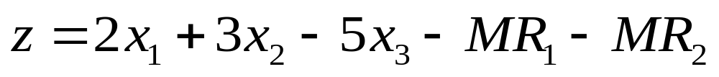
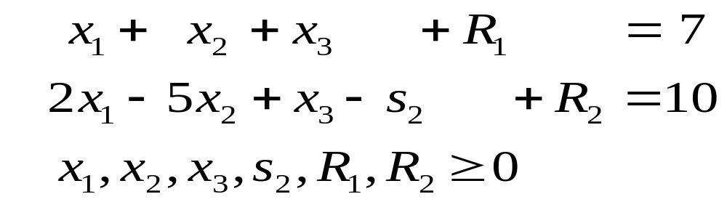
Introducing surplus and artificial variables, s₂, R₁and R₂, the LPP is modified as follows:
Maximize
Subject to the constraints
Now we solve the above LPP by the Simplex method.

Slide 50
Basic z x1 x2 x3 s2 R1 R2 Sol.
-2-3M -3+4M 5-2M M 0 0 -17M
z 1 -2 -3 5 0 M M 0
R1 0 1 1 1 0 1 0 7
R2 0 2 -5 1 -1 0 1 10
z 1 0 -8 - 6 - -1 - 0 1 + 10 - 7M/2 M/2 M/2 3M/2 2M
R1 0 0 7/2 1/2 1/2 1 -1/2 2
x1 0 1 -5/2 1/2 -1/2 0 1/2 5
z 1 0 0 50/7 1/7 16/7 + -1/7 102/7
M +M
x2 0 0 1 1/7 1/7 2/7 -1/7 4/7
x1 0 1 0 6/7 -1/7 5/7 1/7 45/7

Slide 51
The optimum (Maximum) value of
z = 102/7
and it occurs at
x₁ = 45/7, x₂ = 4/7, x₃ = 0

Slide 52
Remarks
If in any iteration, there is a tie for entering variable between an artificial variable and other variable (decision, surplus or slack), we must prefer the non-artificial variable to enter the basis.
If in any iteration, there is a tie for leaving variable between an artificial variable and other variable (decision, surplus or slack), we must prefer the artificial variable to leave the basis.

Slide 53
If in the final optimal tableau, an artificial variable is present in the basis at a non-zero level, this means our original problem has no feasible solution.

Slide 54
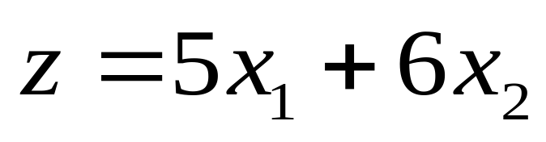
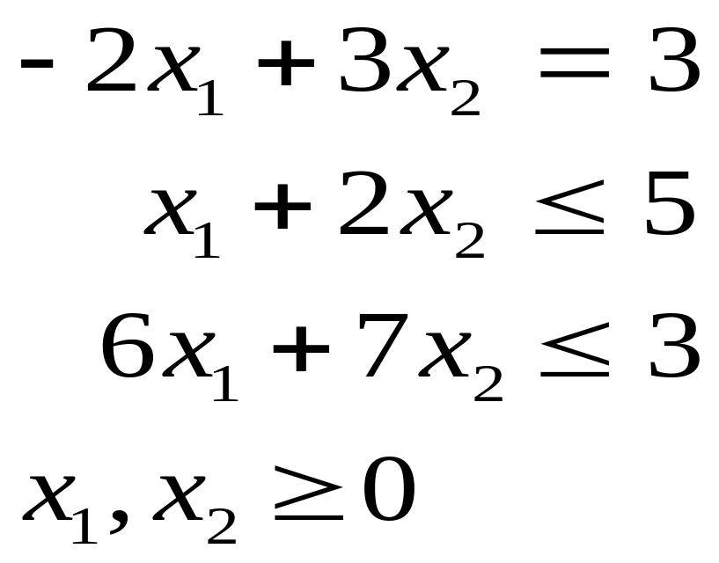
Maximize
Subject to the constraints

Slide 55
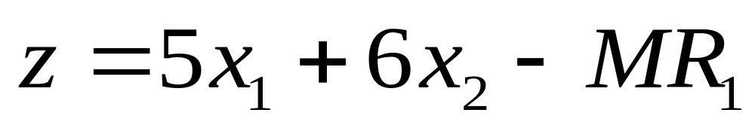
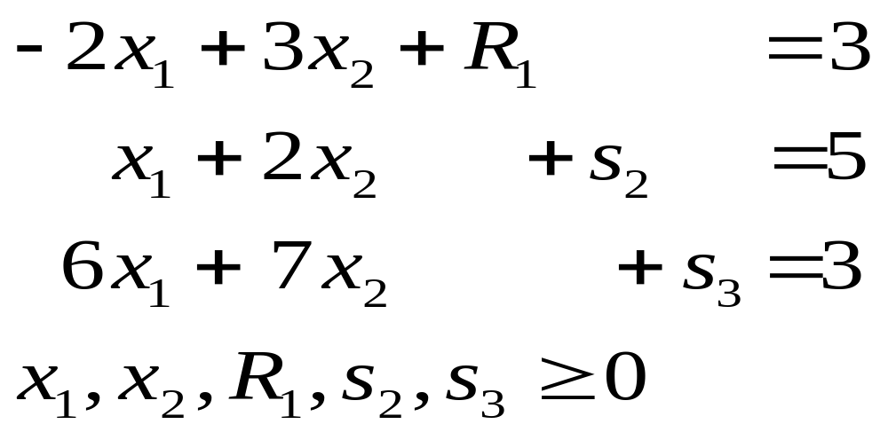
Introducing slack and artificial variables, s₂, s₃, and R₁, the LPP is modified as follows:
Maximize
Subject to the constraints

Slide 56
Basic z x1 x2 R1 s2 s3 Sol
-5+2M -6-3M 0 0 0 -3M
z 1 -5 -6 M 0 0 0
R1 0 -2 3 1 0 0 3
s2 0 1 2 0 1 0 5
s3 0 6 7 0 0 1 3
z 1 1/7+ 0 0 0 6/7+ 18/7- 32M/7 3M/7 12M/7
R1 0 -32/7 0 1 0 -3/7 12/7
s2 0 -12/7 0 0 1 -2/7 29/7
x2 0 6/7 1 0 0 1/7 3/7
This is the optimal tableau. As R₁ is not zero, there is NO feasible solution.

Slide 57
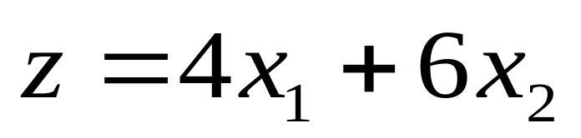
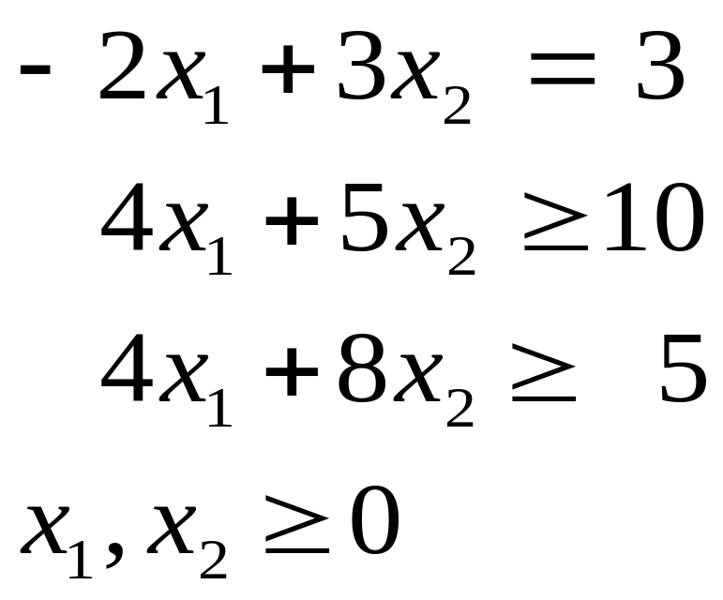
Minimize
Subject to the constraints

Slide 58
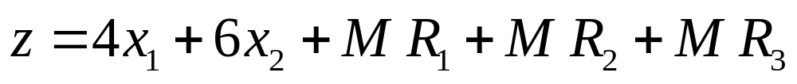
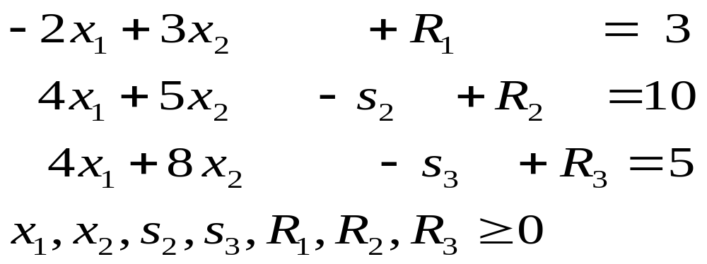
Introducing the surplus and artificial variables, R₁, R₂, the LPP is modified as follows:
Minimize
Subject to the constraints

Slide 59
Basic z x1 x2 s2 s3 R1 R2 R3 Sol.
-4+6M -6+16M -M -M 0 0 0 18M
z 1 -4 -6 0 0 -M -M -M 0
R1 0 -2 3 0 0 1 0 0 3
R2 0 4 5 -1 0 0 1 0 10
R3 0 4 8 0 -1 0 0 1 5
z 0 -1-2M 0 -M -3/4 0 0 3/4 15/4 +M -2M +8M
R1 0 -7/2 0 0 3/8 1 0 -3/8 9/8
R2 0 3/2 0 -1 5/8 0 1 -5/8 55/8
x2 0 1/2 1 0 -1/8 0 0 1/8 5/8

Slide 60
Basic z x1 x2 s2 s3 R1 R2 R3 Sol.
z 1 -1-2M 0 -M -3/4 0 0 3/4 15/4 +M -2M +8M
R1 0 -7/2 0 0 3/8 1 0 -3/8 9/8
R2 0 3/2 0 -1 5/8 0 1 -5/8 55/8
x2 0 1/2 1 0 -1/8 0 0 1/8 5/8
z 1 -8 + 0 -M 0 2 0 -M 6 22M/3 -8M/3 +5M
s3 0 -28/3 0 0 1 8/3 0 -1 3
R2 0 22/3 0 -1 0 -5/3 1 0 5
x2 0 -2/3 1 0 0 1/3 0 0 1

Slide 61




Basic z x1 x2 s2 s3 R1 R2 R3 Sol.
z 1 -8 + 0 -M 0 2 0 -M 6 22M/3 -8M/3 +5M
s3 0 -28/3 0 0 1 8/3 0 -1 3
R2 0 22/3 0 -1 0 -5/3 1 0 5
x2 0 -2/3 1 0 0 1/3 0 0 1
z 1 0 0 -6/11 0 2/11 12/11 -M - M -M
s3 0 0 0 -14/11 1 6/11 14/11 -1
x1 0 1 0 -3/22 0 -5/22 3/22 0
x2 0 0 1 -1/11 0 2/11 1/11 0

Slide 62

This is the optimal tableau.
The Optimal solution is:
And Optimal z = Min z =

Slide 63


Minimize
Subject to the constraints
Ans: x₁=12, x₂=6 Soln(= Min z) = 102

Slide 64


Introducing the surplus and artificial variables, R₁, R₂, the LPP is modified as follows:
Minimize
Subject to the constraints

Slide 65
Basic z x1 x2 s1 s2 s3 R1 R2 R3 Sol
-5+6M -7+8M -M -M -M 0 0 0 120M
z 1 -5 -7 0 0 0 -M -M -M 0
R1 0 2 3 -1 0 0 1 0 0 42
R2 0 3 4 0 -1 0 0 1 0 60
R3 0 1 1 0 0 -1 0 0 1 18
z 1 0 -M -M 0 0 98+8M
x2 0 2/3 1 -1/3 0 0 1/3 0 0 14
R2 0 1/3 0 4/3 -1 0 -4/3 1 0 4
R3 0 1/3 0 1/3 0 -1 -1/3 0 1 4

Slide 66
Basic z x1 x2 s1 s2 s3 R1 R2 R3 Sol
z 1 0 -M -M 0 0 98+8M
x2 0 2/3 1 -1/3 0 0 1/3 0 0 14
R2 0 1/3 0 4/3 -1 0 -4/3 1 0 4
R3 0 1/3 0 1/3 0 -1 -1/3 0 1 4
z 1 0 0 -M - M 0 105+3M
x2 0 3/4 1 0 -1/4 0 0 1/4 0 15
s1 0 1/4 0 1 -3/4 0 -1 3/4 0 3
R3 0 1/4 0 0 1/4 -1 0 -1/4 1 3

Slide 67
Basic z x1 x2 s1 s2 s3 R1 R2 R3 Sol
z 1 0 0 -M -M 0 105+3M
x2 0 3/4 1 0 -1/4 0 0 1/4 0 15
s1 0 1/4 0 1 -3/4 0 -1 3/4 0 3
R3 0 1/4 0 0 1/4 -1 0 -1/4 1 3
z 1 0 0 0 -2 1 -M 2-M -1-M 102
x2 0 0 1 0 -1 3 0 1 -3 6
s1 0 0 0 1 -1 1 -1 1 -1 0
x1 0 1 0 0 1 -4 0 -1 4 12

Slide 68
Basic z x1 x2 s1 s2 s3 R1 R2 R3 Sol
z 1 0 0 0 -2 1 -M 2-M -1-M 102
x2 0 0 1 0 -1 3 0 1 -3 6
s1 0 0 0 1 -1 1 -1 1 -1 0
x1 0 1 0 0 1 -4 0 -1 4 12
z 1 0 0 -1 -1 0 1-M 1-M 2-M 102
x2 0 0 1 -3 2 0 3 -2 0 6
s3 0 0 0 1 -1 1 -1 1 -1 0
x1 0 1 0 4 -3 0 -4 3 0 12

Slide 69
Basic z x1 x2 s1 s2 s3 R1 R2 R3 Sol
z 1 0 0 -1 -1 0 1-M 1-M 2-M 102
x2 0 0 1 -3 2 0 3 -2 0 6
s3 0 0 0 1 -1 1 -1 1 -1 0
x1 0 1 0 4 -3 0 -4 3 0 12
This is the optimal tableau.
Optimal solution: x₁=12, x₂=6
Optimal z = Minimum z = 102

