Slide 1
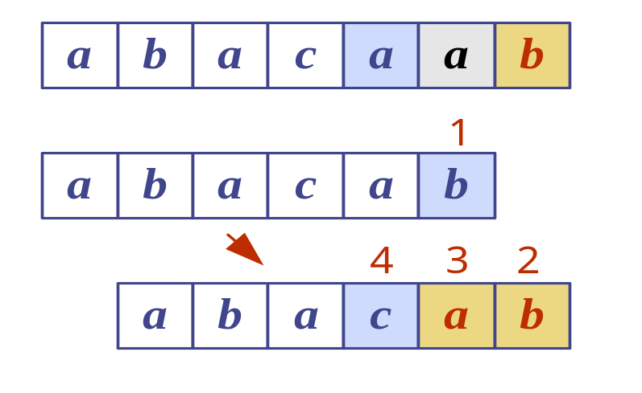
Pattern Matching

Slide 2
Introduction
What is string matching?
  Finding all occurrences of a pattern in a given text (or body of text)
Many applications
  While using editor/word processor/browser
  Login name & password checking
  Virus detection
  Header analysis in data communications
  DNA sequence analysis

Slide 3
String-Matching Problem
The text is in an array T [1..n] of length n
The pattern is in an array P [1..m] of length m
Elements of T and P are characters from a finite alphabet ∑
  E.g., ∑ = {0,1} or ∑ = {a, b, …, z}
Usually T and P are called strings of characters

Slide 4
String-Matching Problem …contd
We say that pattern P occurs with shift s in text T if:
  0 ≤ s ≤ n-m and
  T [(s+1)..(s+m)] = P [1..m]
If P occurs with shift s in T, then s is a valid shift, otherwise s is an invalid shift
String-matching problem: finding all valid shifts for a given T and P

Slide 5
Example 1
1
2
3
4
5
6
7
8
9
10
11
12
13
text T
a | b | c | a | b | a | a | b | c | a | b | a | c
s = 3
pattern P
a | b | a | a
1
2
3
4
shift s = 3 is a valid shift
(n=13, m=4 and 0 ≤ s ≤ n-m holds)

Slide 6
Example 2
1
2
3
4
pattern P
a
b
a
a
1
2
3
4
5
6
7
8
9
10
11
12
13
text T
a | b | c | a | b | a | a | b | c | a | b | a | a
s = 3
a | b | a | a
s = 9
a
b
a
a

Slide 7
Terminology
Concatenation of 2 strings x and y is xy
  E.g., x=“sri”, y=“lanka” ⇒ xy = “srilanka”
A string w is a prefix of a string x, if x=wy for some string y
  E.g., “srilan” is a prefix of “srilanka”
A string w is a suffix of a string x, if x=yw for some string y
  E.g., “anka” is a suffix of “srilanka”

Slide 8
Naïve String-Matching Algorithm
Input: Text strings T [1..n] and P[1..m]
Result: All valid shifts displayed
NAÏVE-STRING-MATCHER (T, P)
n ← length[T]
m ← length[P]
for s ← 0 to n-m
if P[1..m] = T [(s+1)..(s+m)]
print “pattern occurs with shift” s

Slide 9
Analysis: Worst-case Example
1
2
3
4
pattern P
a
a
a
b
1
2
3
4
5
6
7
8
9
10
11
12
13
text T
a | a | a | a | a | a | a | a | a | a | a | a | a
a
a
a
b
a
a
a
b

Slide 10
Worst-case Analysis
There are m comparisons for each shift in the worst case
There are n-m+1 shifts
So, the worst-case running time is Θ((n-m+1)m)
Naïve method is inefficient because information from a shift is not used again

Slide 11
Other Approaches
Naïve view is that it is always necessary to examine every character in T in order to locate a pattern P as a substring.
This is not always the case…

Slide 12
The KMP Algorithm
Knuth-Morris-Pratt’s algorithm compares the pattern to the text in left-to-right, but shifts the pattern more intelligently.
When a mismatch occurs, what is the most we can shift the pattern so as to avoid redundant comparisons?
Answer: the largest prefix of P[1..j] that is a suffix of P[2..j]
.
.
a
b
a
a
b
x
.
.
.
.
.
a
b
a
a
b
a
j
a
b
a
a
b
a
No need to
repeat these
comparisons
Resume
comparing
here

Slide 13
KMP Failure Function
Knuth-Morris-Pratt’s algorithm preprocesses the pattern to find matches of prefixes of the pattern with the pattern itself
The failure function F(j) is defined as the size of the largest prefix of P[1..j] that is also a suffix of P[2..j]
Knuth-Morris-Pratt’s algorithm modifies the brute-force algorithm so that if a mismatch occurs at P[j+1] ≠ T[i] we set j ← F(j)
j | 1 | 2 | 3 | 4 | 5 | 6
P[j] | a | b | a | a | b | a
F(j) | 0 | 0 | 1 | 1 | 2 | 3
.
.
a
b
a
a
b
x
.
.
.
.
.
a
b
a
a
b
a
j+1
a
b
a
a
b
a
F
(
j
)

Slide 14
Computing the Failure Function
The failure function can be represented by an array and can be computed in O(m) time
The construction is similar to the KMP algorithm itself
Algorithm failureFunction(P)
F[1] ← 0
k ← 0
for q ←2 to m
  while k>0 and P[k+1] ≠ P[q]
  k ← F[k]
  if P[k+1] = P[q]
  k ← k+1
  F[q] ← k

Slide 15
Example Problem
We want to match the pattern “abacab” to the text “abacaabaccabacabaabb”
  We start by computing the fail function.
  Then we run the search using the fail function.

Slide 16
Example – Computing the Fail Function
Algorithm failureFunction(P)
F[1] ← 0
k ← 0
for q ←2 to m
while k>0 and P[k+1] ≠ P[q]
  k ← F[k]
  if P[k+1] = P[q]
  k ← k+1
  F[q] ← k
q | 1 | 2 | 3 | 4 | 5 | 6
P[q] | a | b | a | c | a | b
F(q)
0
0
1
0
1
2
q
k
F(q)
P[2…q] = P[2…2] = “b”
2
3
4
5
6
0
1
0
1
2
P[2…q] = P[2…3] = “ba”
0
1
0
1
2
P[2…q] = P[2…4] = “bac”
P[2…q] = P[2…5] = “baca”
P[2…q] = P[2…6] = “bacab”

Slide 17
The KMP Algorithm
The failure function can be represented by an array and can be computed in O(m) time
Algorithm KMPMatch(T, P)
F ← failureFunction(P)
q ← 0
for i=1 to n
  while q>0 and P[q+1]!=T[i]
  q=F [ q ];
  if T[i] = P[q+1]
  q ← q+1;
  if q = m
  print “Match at i-m”;
  q=F[q];

Slide 18
Example – Doing the search
a
b
a
c
a
a
b
a
c
c
a
b
a
c
a
b
a
a
b
b
1
2
3
4
5
6
q = 0, i is incremented, not q
q = 5, so set q = f(5) = 1
q = 1, so set q = f(1) = 0
a
b
a
c
a
b
q = 4, so set q = f(4) = 0
Algorithm KMPMatch(T, P)
F ← failureFunction(P)
q ← 0
for i=1 to n
  while q>0 and P[q+1]!=T[i]
  q=F [ q ];
  if T[i] = P[q+1]
  q ← q+1;
  if q = m
  print “Match at i-m”;
  q=F[q];
7
a
b
a
c
a
b
8
9
10
11
12
a
b
a
c
a
b
13
a
b
a
c
a
b
j | 1 | 2 | 3 | 4 | 5 | 6
P[j] | a | b | a | c | a | b
F(j) | 0 | 0 | 1 | 0 | 1 | 2
14
15
16
17
18
19
a
b
a
c
a
b

Slide 19
Complexity
Using Potential method of amortized analysis
Failure Function’s Complexity O(m).
KMP’s String matching alg’s complexity: O(n)

